Slide 1
TRANSLATIONS
OF
THE ECSTASY OF
ST. TERESA OF AVILA
Diane Evans

Slide 2
Translation: To conduct through, pass beyond, to the other side of a division or difference.
Translation can be viewed as liberation, transformation, renewal or as a supplementation that produces the original rather than being subservient to it. (Farago 2003,6)

Slide 3
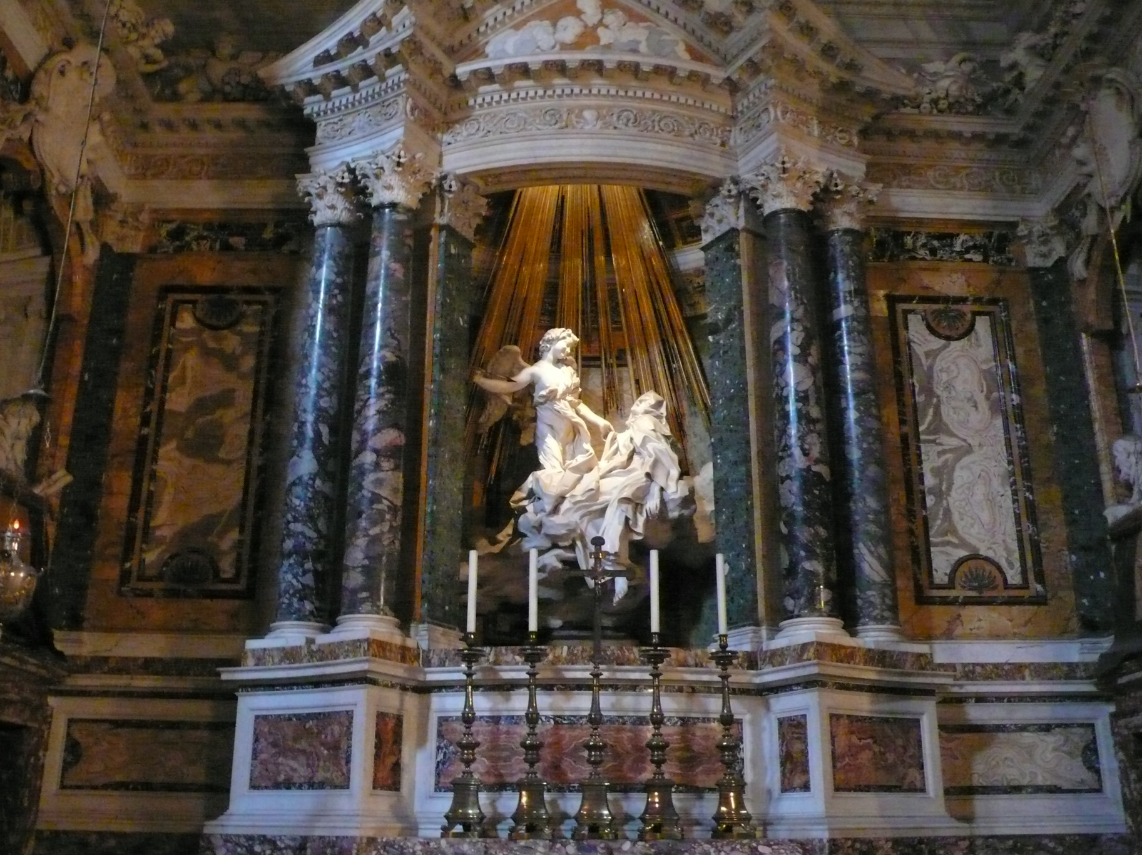
Cornaro Chapel, 1647
Santa Maria Della Vittoria, Rome
http://commons.wikimedia.org/wiki/File:Teresa_von_Avila_Bernini3.JPG

Slide 4
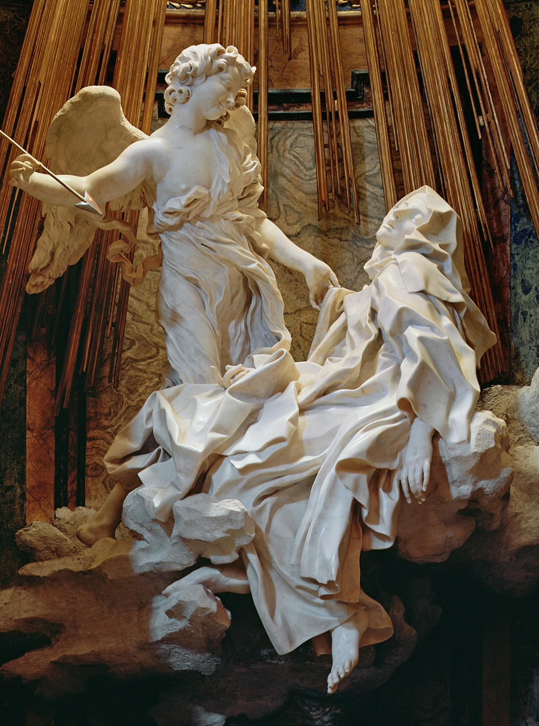
While content and language form a certain unity in the original like a fruit and its skin, the language of the translation enveloped its content like a royal robe with ample folds.
Walter Benjamin
http://www.magnificat.com/lifeteen/images/hd/11.jpg

Slide 5
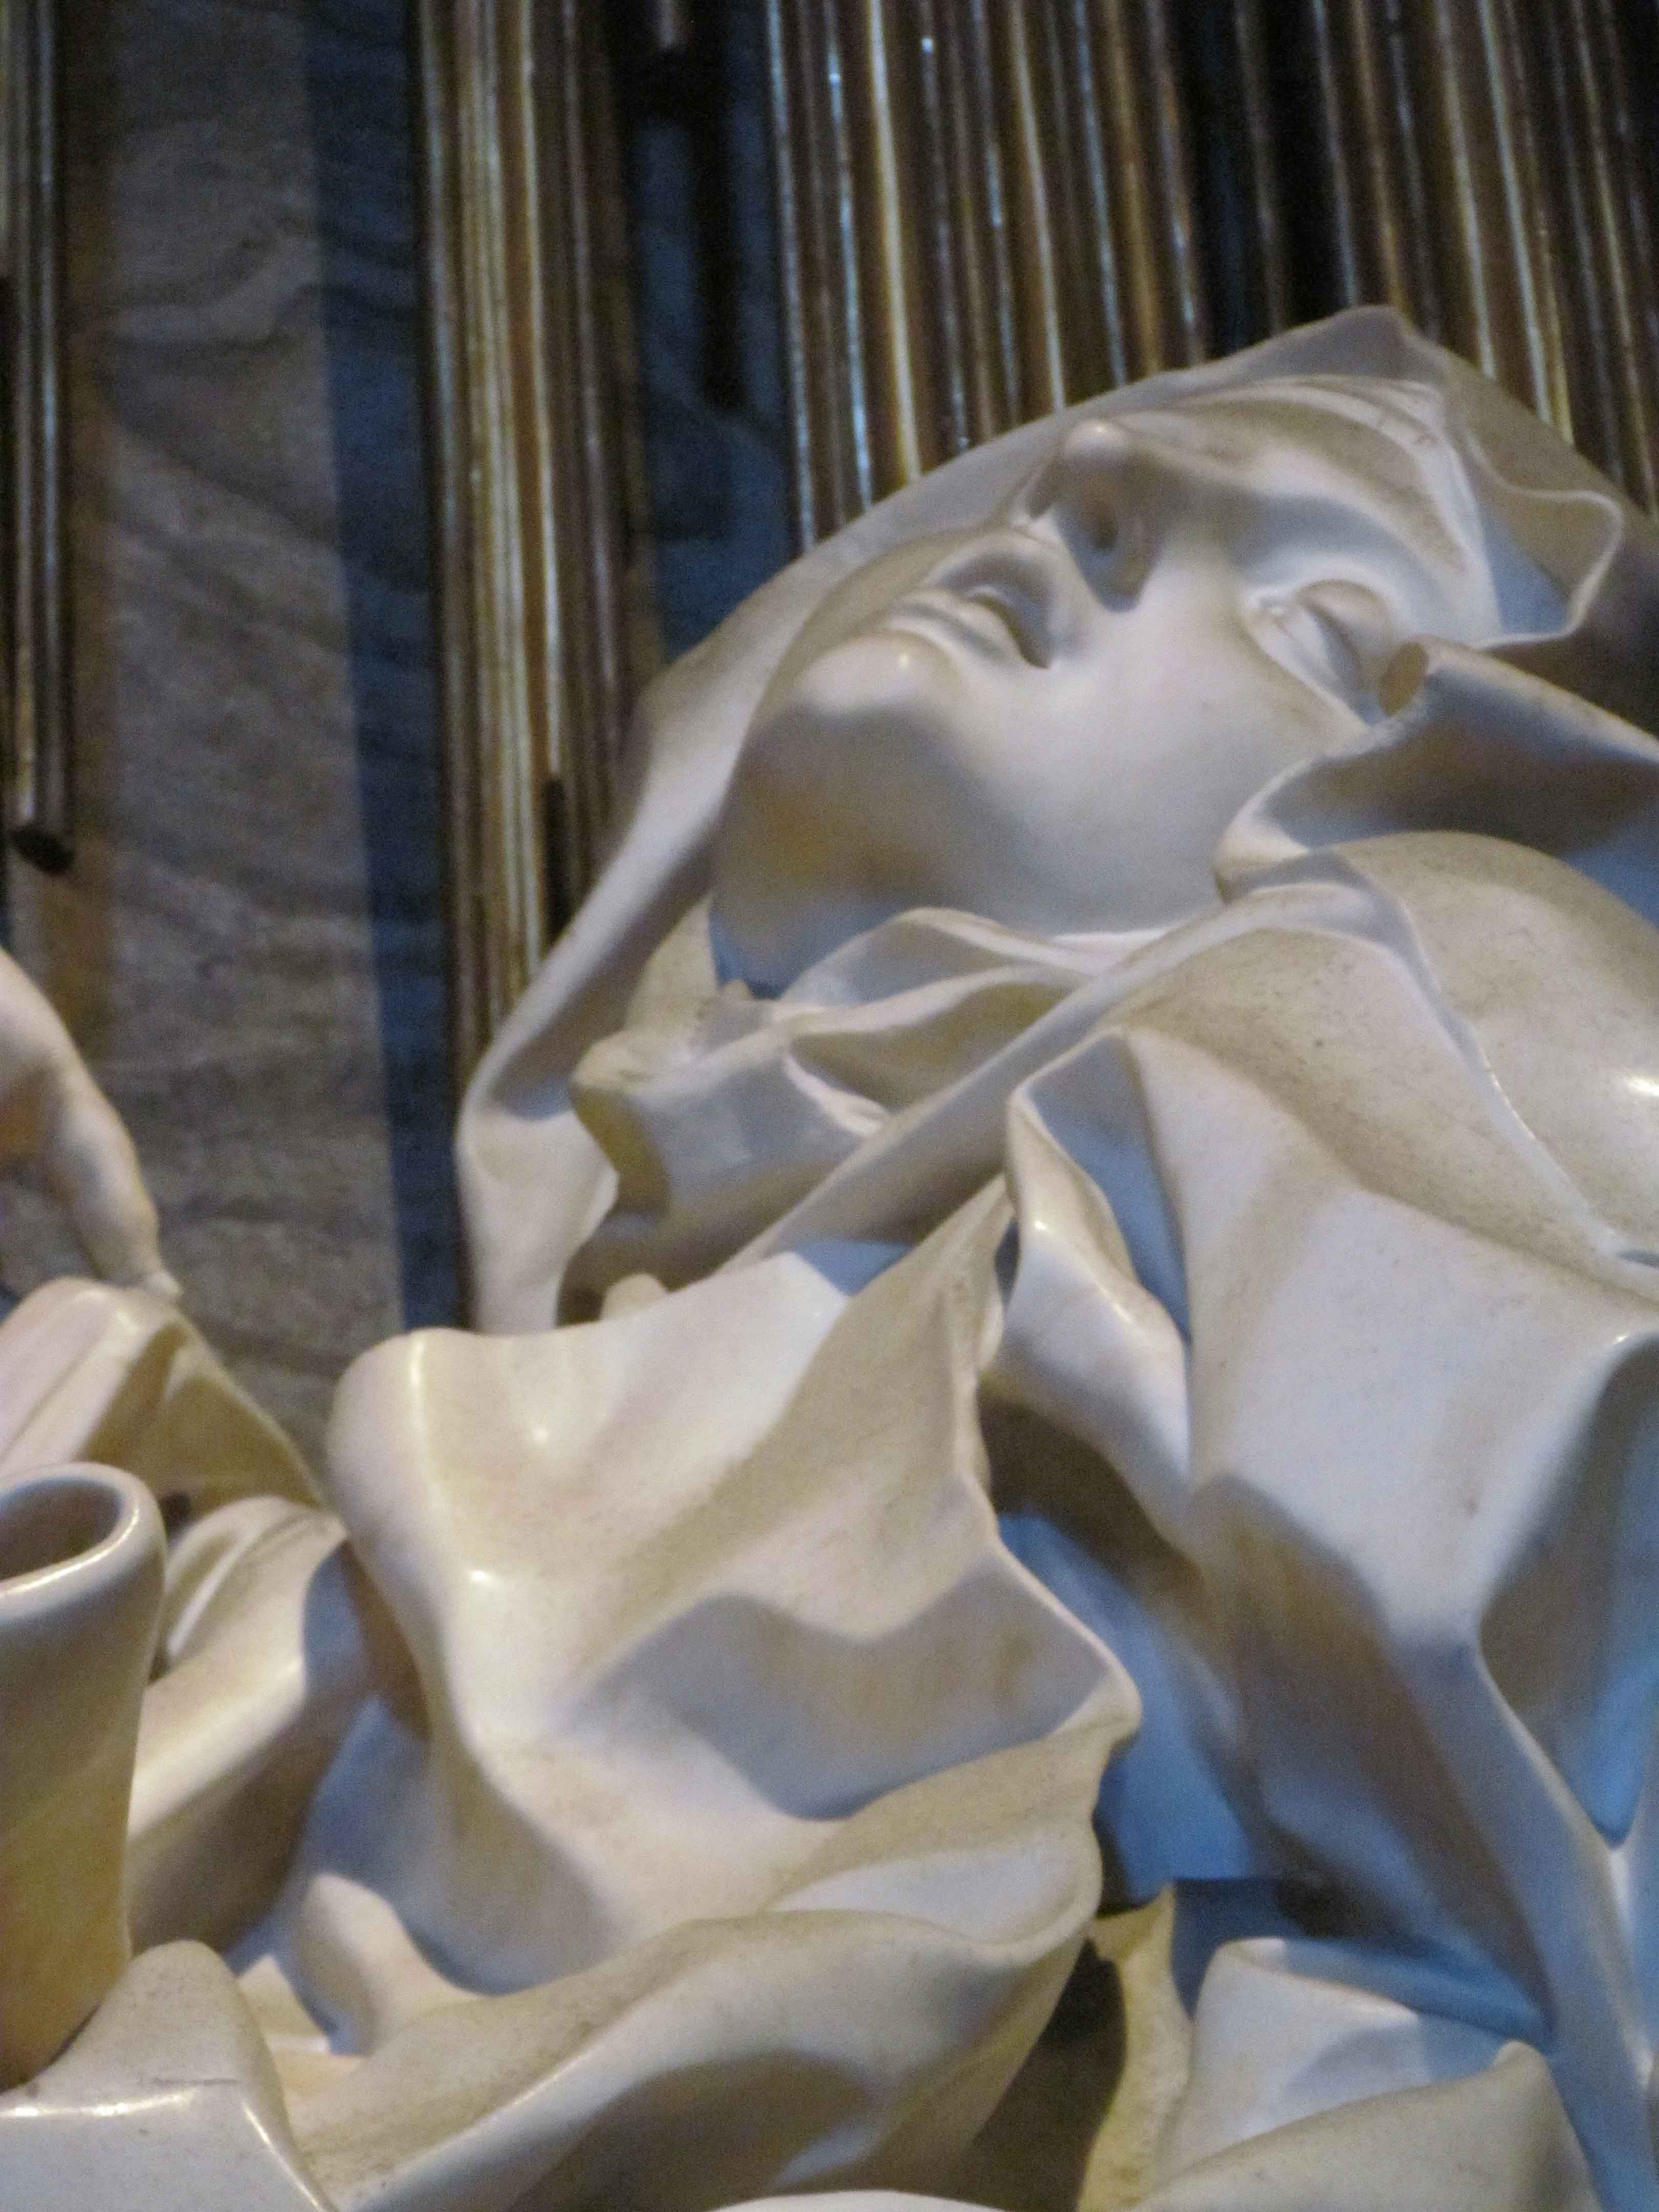
https://alottogelato.wordpress.com/2011/10/05/arividerchi/

Slide 6
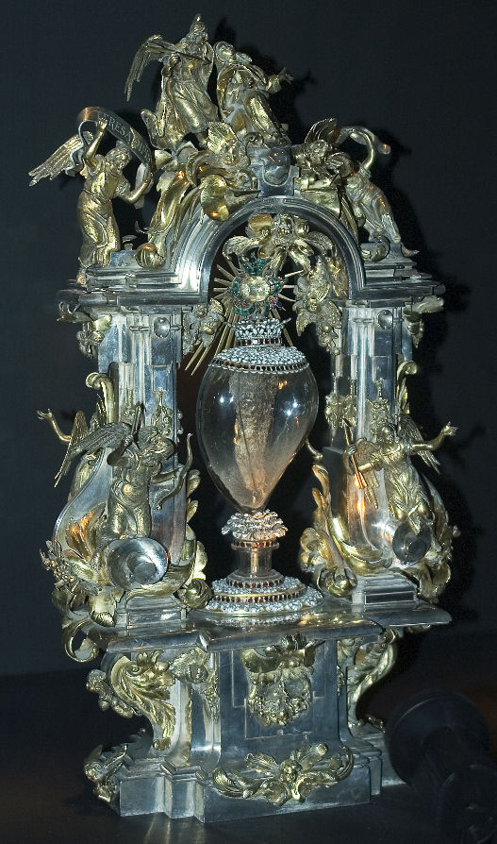
Heart incorrupt and transverberato of St. Teresa of Avila,
Chiesa del Convento de la Anunciación de Madres Carmelitas, Alba de Tormes
http://www.microsofttranslator.com/bv.aspx?from=&to=en&a=http%3A%2F%2Fwww.scuolaecclesiamater.org%2F2014%2F08%2Ffesta-della-transverberazione-di-s.html

Slide 7
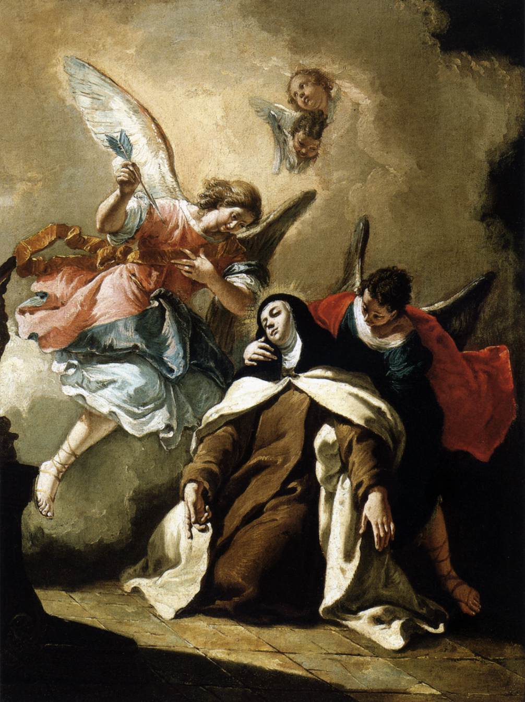
http://blogs.nd.edu/oblation/files/2013/10/The-Ecstasy-of-St.-Teresa-Fontebasso.jpg

Slide 8
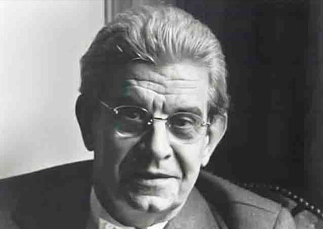
Jacques Lacan 1901 - 1981
http://www.famouspsychologists.org/jacques-lacan/

Slide 9
‘What I call jouissance- in the sense in which the body experiences itself- is always in the nature of tension, in the nature of forcing, of a spending, even of an exploit. Unquestionably, there is jouissance at the level at which pain begins to appear, and we know that it is only at this level of pain that whole dimension of the organism, which would otherwise remain veiled, can be experienced.’
and P Jacques Lacan 1966 Pscychoanalysis and Medicine Lecture
http://www.english.upenn.edu/~cavitch/pdf-library/Braunstein_Desire.pdf
‘ Psychoanalysis

Slide 10
There is no such a thing as The woman, where the definite article stands for the universal.
There is no such thing as The woman since of here essence…she is not all…. There is woman only as excluded by the nature of things which is the nature of words…It none the less remains that if she is excluded by the nature of things, it is precisely that in being not all, she has, in relation to what the phallic function designates of jouissance, a supplementary jouissance.
Jacques Lacan, God and the Jouissance of T/he Woman’ in Rose and Mitchel(eds), Feminine Sexuality:Jacques Lacan and the École Freudiennce, pp. 137- 48.

Slide 11
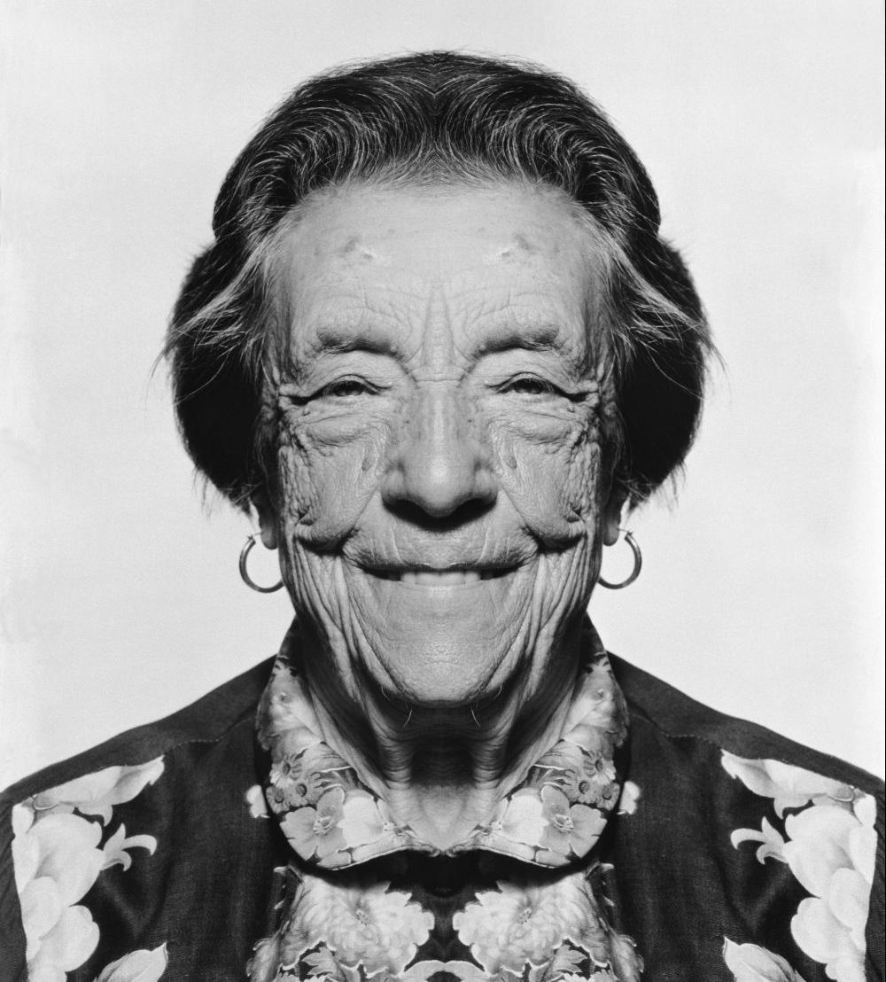
Louise Bourgeois 1911 - 2010
http://www.igndes.com/v2/louise-borgeois/

Slide 12
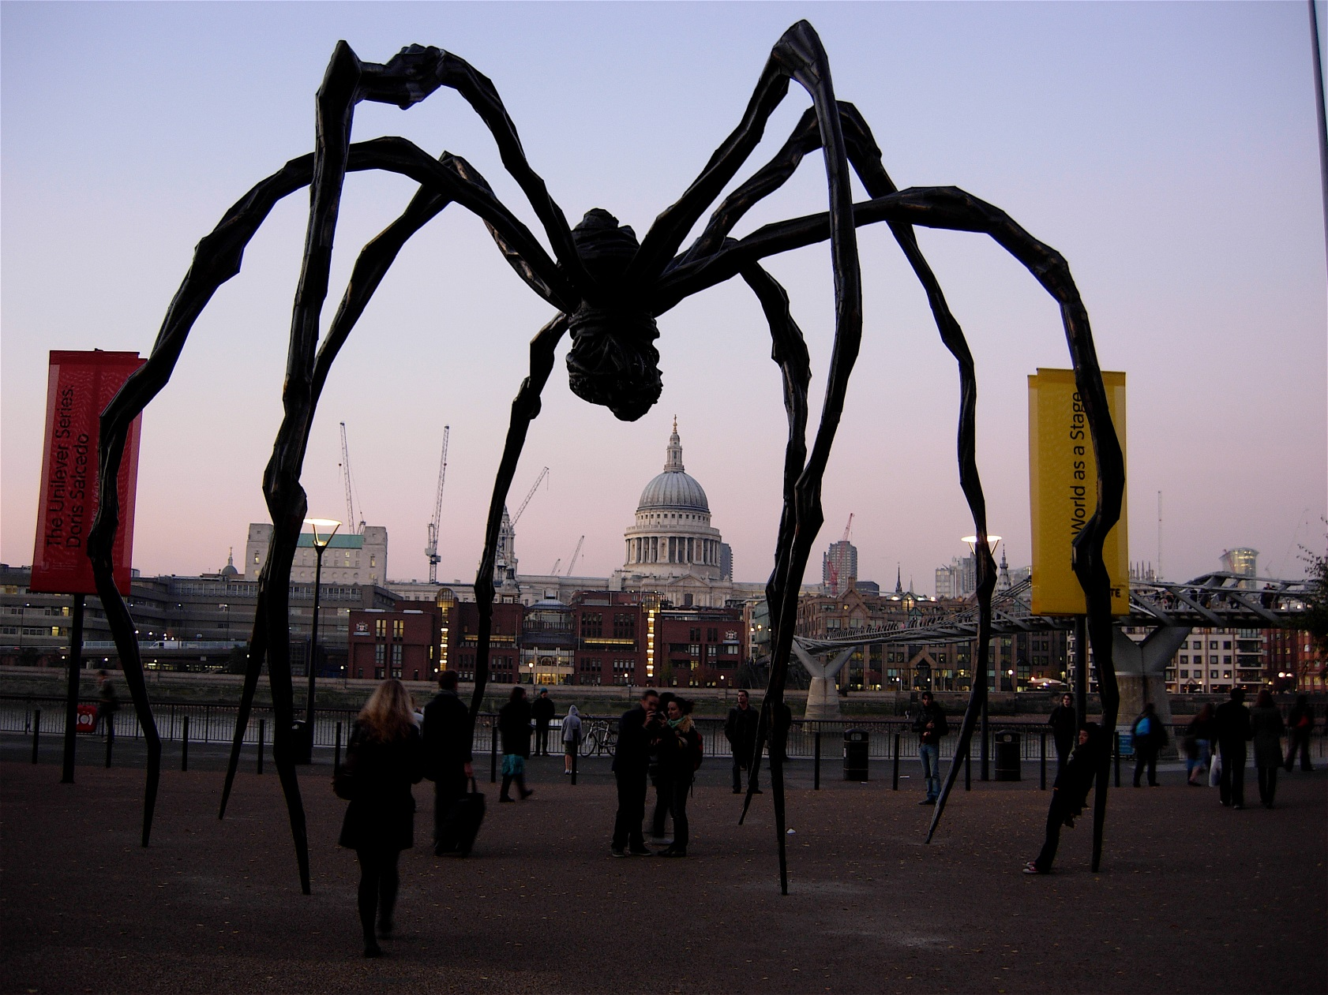
MAMAN created for the opening of Tate Modern 2000
https://www.flickr.com/photos/dullhunk/5449462934

Slide 13
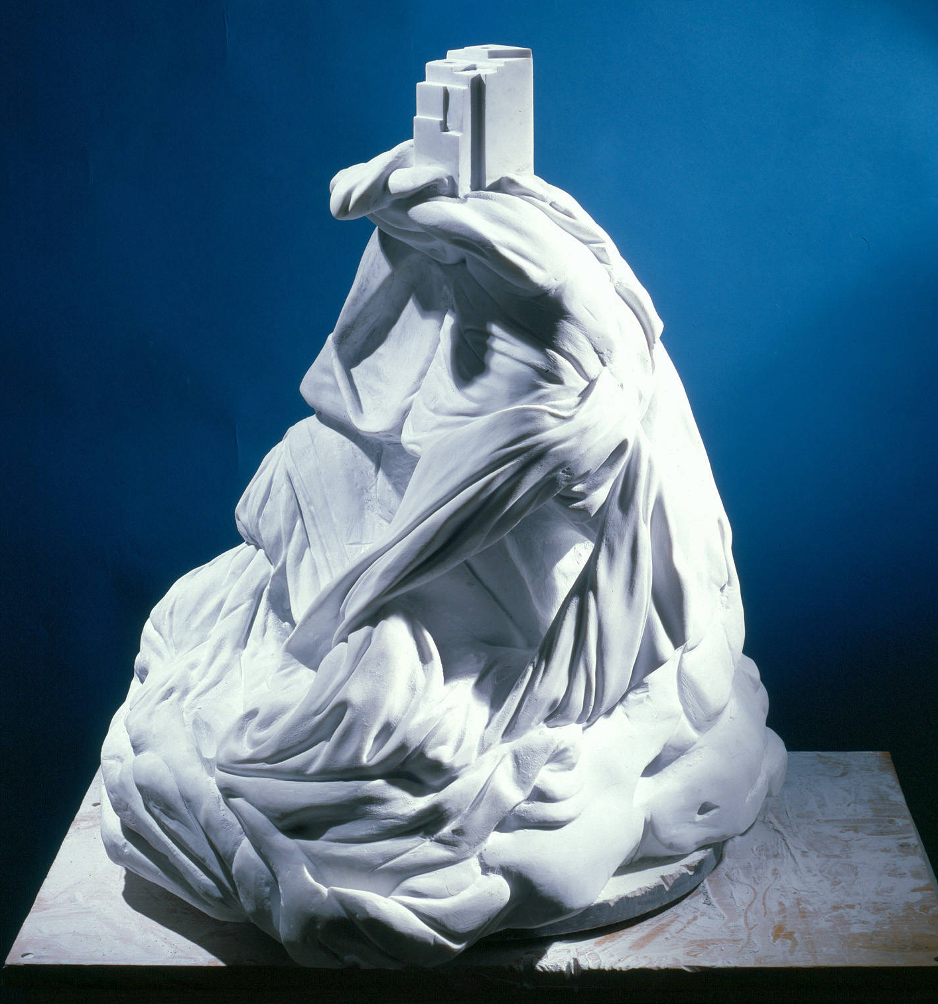
The past can be seized only as an image which flashes up at the instant when it can be recognised and is never to be seen again. For every image of the past that is not recognized by the present as one of its own concerns threatens to disappear irretrievably. Walter Benjamin, ‘Theses on the Philosophy of History’
(Bal, 2003,5)
Femme Maison, Louise Bourgeois 1983
http://newsoftheartworld.com/wp-content/uploads/2014/10/1bis-Femme-maison-1983-news.pcc_.edu_.jpg

Slide 14
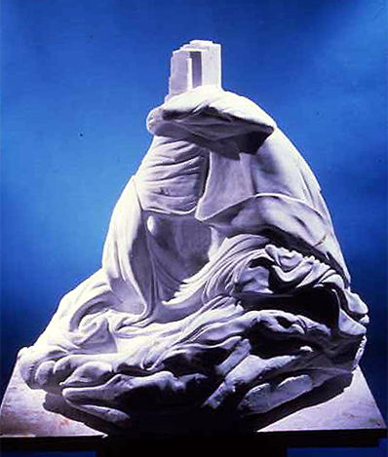
Femme Maison
htthttp://www2.fiu.edu/~ereserve/av/damian/ARH4871/part4/0023.jpgp://www2.fiu.edu/~

Slide 15
Polymorphism is a feature of Louise Bourgeois’s work, which recycles forms through processes of alteration, accumulation or combination, utilizing metamorphosis by applying the topology of Henri Poincaré, a subject dear to the Surrealists (the continuous transformation of organic forms), or by the use of other materials (from the noblest to the most ordinary), setting objects in a different context, or by the physical and psychological inversion of ideas attached to these formal elements (eg. landscape-body, human-animal).
http://newsoftheartworld.com/louise-bourgeois-art-making-as-means-of-survival/?lang=en

Slide 16
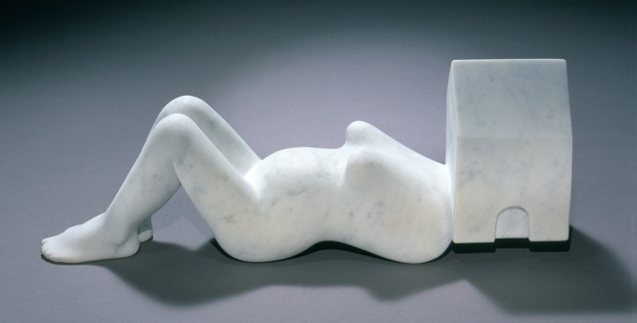
Femme Maison 1994
http://newsoftheartworld.com/louise-bourgeois-art-making-as-means-of-survival/?lang=en

Slide 17
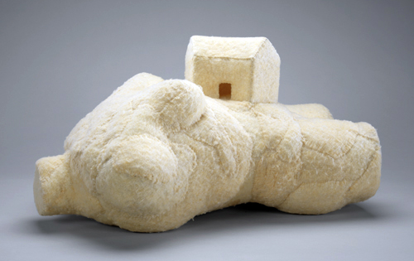
Femme Maison 2001
http://artblart.com/tag/construction-of-identity/

Slide 18
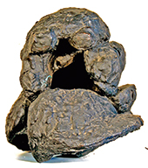
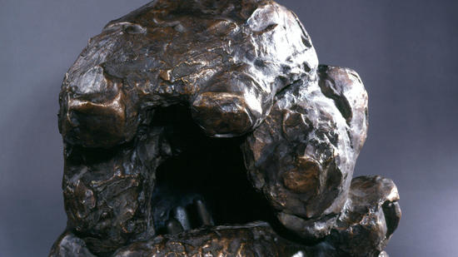
Hommage to Bernini
Louise Bourgeois 1967
http://www.telegraphindia.com/1120110/jsp/calcutta/story_14984412.jsp#.VYBb-dRwbGg

Slide 19
https://www.youtube.com/watch?v=RKcJvjP9zgYhttps://www.youtube.com/watch?v=RKcJvjP9zgY
https://www.youtube.com/watch?v=RKcJvjP9zgY
https://

Slide 20
https://www.youtube.com/watch?v=2Hua7m6wQuw

