Slide 1
Briefing on New Programme Approvals process
Dr Iain Cross
Associate Dean, Learning and Teaching

Slide 2
Programme Approvals Process
New approach to new programme approvals being introduced from 1 May 2021
Approved by Academic Board on 10 June 2020
Programme Approvals replaces ‘Validation’
Switch from 5 year to 6 year gap (maximum) between approval and first periodic review
‘Revalidation’ will be replaced by Periodic Review for 21/22 AY
Revalidations planned for September 2021 will be subject to new PR process
This will be developed and approved by QAEC - ADC during 20/21 AY
Emphasis on critically reflective analysis of programme, developing enhancements and alignment to programme KPIs

Slide 3
Programme Approvals Process

Slide 4
What’s changing and why?
Proposals and development process managed using SITS e:Vision Curriculum Management Tool
Easier flow of approvals; reduced administrative details
Communication among professional services
Setting up of key SITS data fields automatically
Initial Proposal Workshops & Programme Design Intensives
Supportive processes to enhance curriculum design
IPW: integrating professional services into discussions prior to proposal submission
PDI: facilitated curriculum design session; alignment to institutional priorities & embedding best practice: after approval of proposal

Slide 5
What’s changing and why?
Introduction of a one-year recruitment window
Improved recruitment opportunity through marketing without ‘subject to validation’
Extends programme development window: AB approval in the July of the academic year prior to delivery (e.g. July 2021 for a September 2022 start)
New Fast-Track process facilitates rapid / compressed development phase subject to QAEC approval
Revised documents for programme approval
Accessibility compliant designs for module outlines and programme specifications
New Student Handbook
Significantly briefer Programme Approval Document replaces Validation Document

Slide 6
What’s changing and why?
Enhancements to financial modelling & marketing information
Improved finance template improves estimates of financial performance
More dialogue between marketing consultant and programme team
Extension of ‘cycle’ length to six years
Introduction Periodic Review means no more ‘out of validation’
Newly approved programmes will be due Periodic Review after maximum of six years
PR will reoccur on intervals no longer than six years

Slide 7
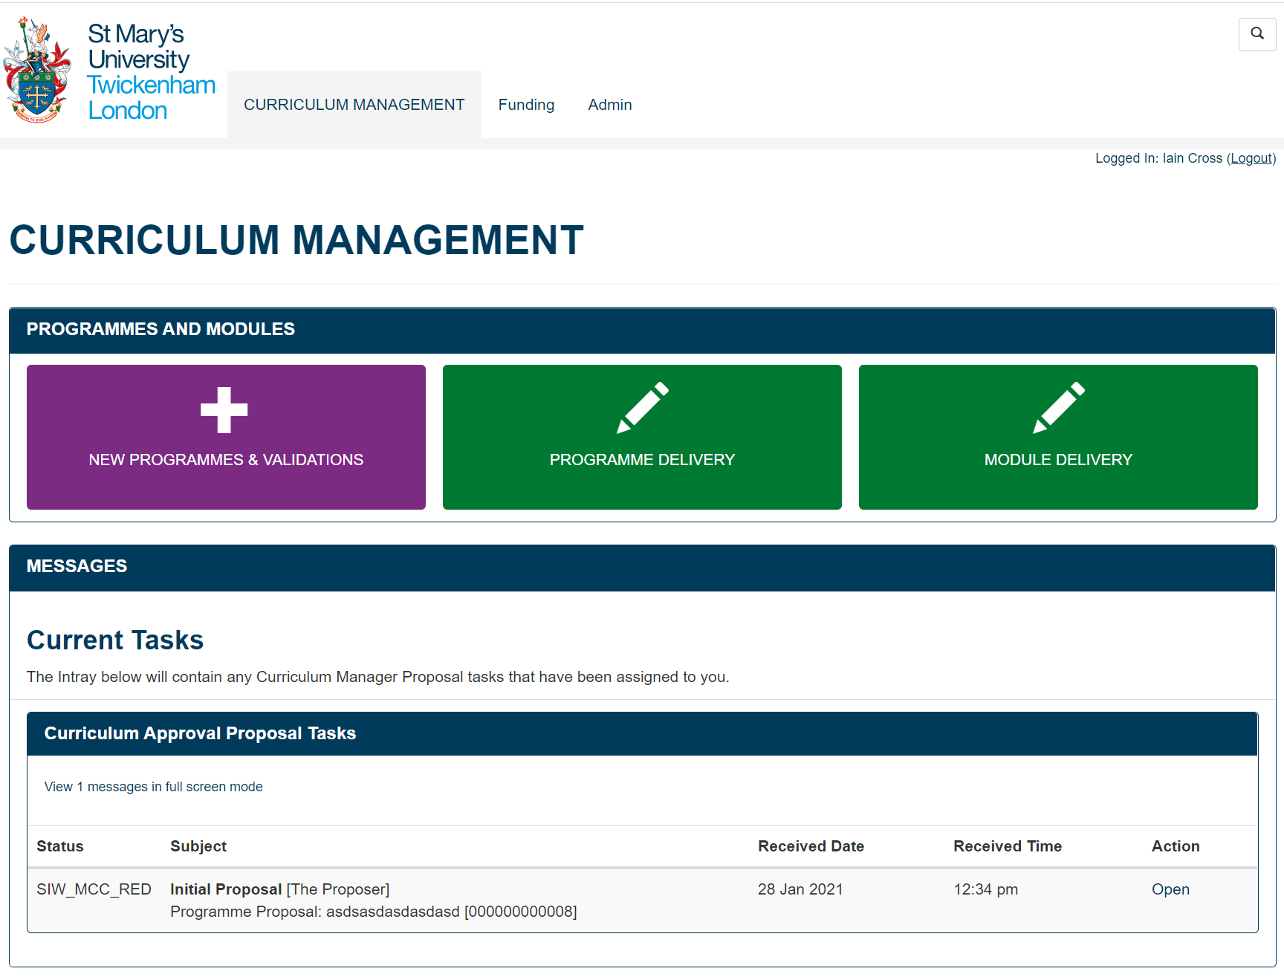
Curriculum Management Tool (SITS e:Vision)

Slide 8
Curriculum Management Tool (SITS e:Vision)

Slide 9
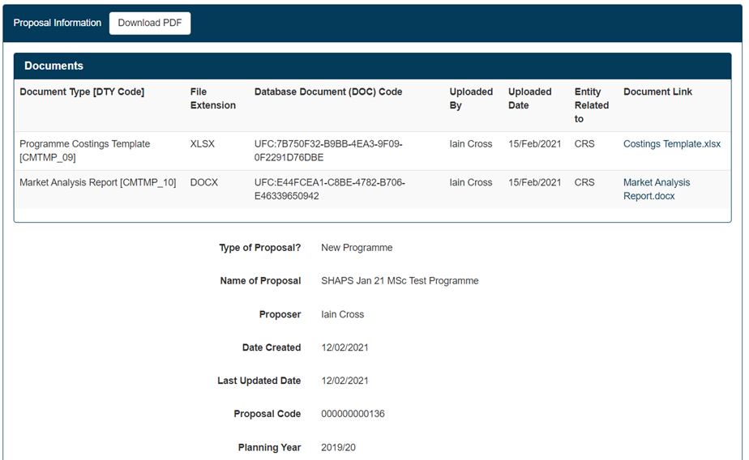
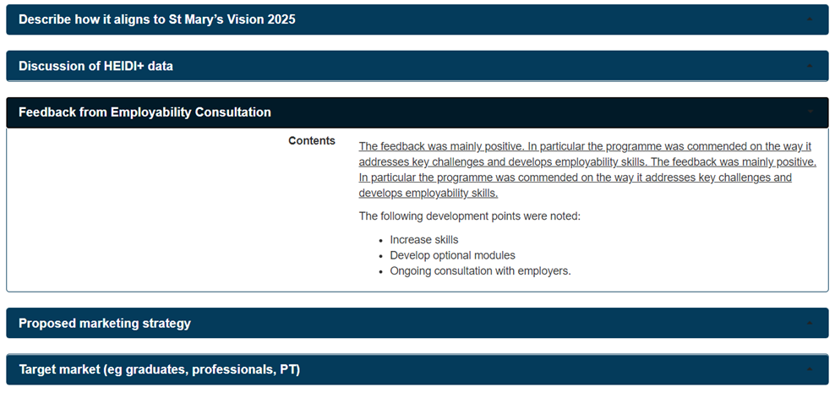
Curriculum Management Tool (SITS e:Vision)

Slide 10
Timelines for programme development
New Approval Process – typical timeline
Month | Indicative Schedule (latest dates)
Mar-21
Apr-21 | Faculty / Institute Exec Approval
May-21 | Initial Proposal Design Workshop
Jun-21 | CTESS Approval of Proposal
Jul-21 | I/FADC Approval of Proposal
Aug-21
Sep-21 | Programme Design Intensive
Oct-21 | Programme Development Phase
Nov-21
Dec-21
Jan-22
Feb-22
Mar-22 | I/FADC Approval of Final Programme Documentation
Apr-22
May-22 | Programme Approval Event
Jun-22 | Report to QAEC
Jul-22 | Approval by ADC & notification to Academic Board
Aug-22
Sep-22- Aug 23 | Recruitment window
Sep-23 | Programme Delivery commences
New Approval Process – Fast-Track
Month | Indicative Schedule
Sep-22 | Faculty / Institute Exec Approval
Oct-22 | Initial Proposal Design Workshop
Nov-22 | CTESS / F/IADC Approval
Dec-22 | Programme Design Intensive & Programme Development Phase
Jan-23
Feb-23
Mar-23 | Programme Development Phase
Apr-23
May-23 | Approval Event
Jun-23 | Report to QAEC, Approval by ADC
Jul-23 | Notification to Academic Board
Aug-23
Sep-23 | Programme Delivery commences

Slide 11
How do stakeholders interact with the proposal and programme design process?
Initial Proposal Workshop (Proposal Stage)
Programme Proposers and Professional Services
Reviewing key requirements for programmes e.g. technology, estates, library
Developing marketing / financial plans
Programme Design Intensives
Led by CTESS colleagues
Full programme team plus professional services e.g. TEL, widening participation
Designing key programme strategies e.g. retention, assessment, alignment with CF
Embedding good practice; sector issues; integrating PSRB requirements

Slide 12
How do stakeholders interact with the proposal and programme design process?
Approval, comments and notifications via e:Vision tool
Programme approval process modelled as a series of stages
Proposer (academic) initiates proposal
Information about the proposal available to stakeholders – including feedback from others
One or more members of stakeholder teams approves – allows proposal to move on to the next stage
No more requirement for emailing at each stage
Does not replace off-line discussion!
A demonstration programme will progress through the approvals process in early March

Slide 13
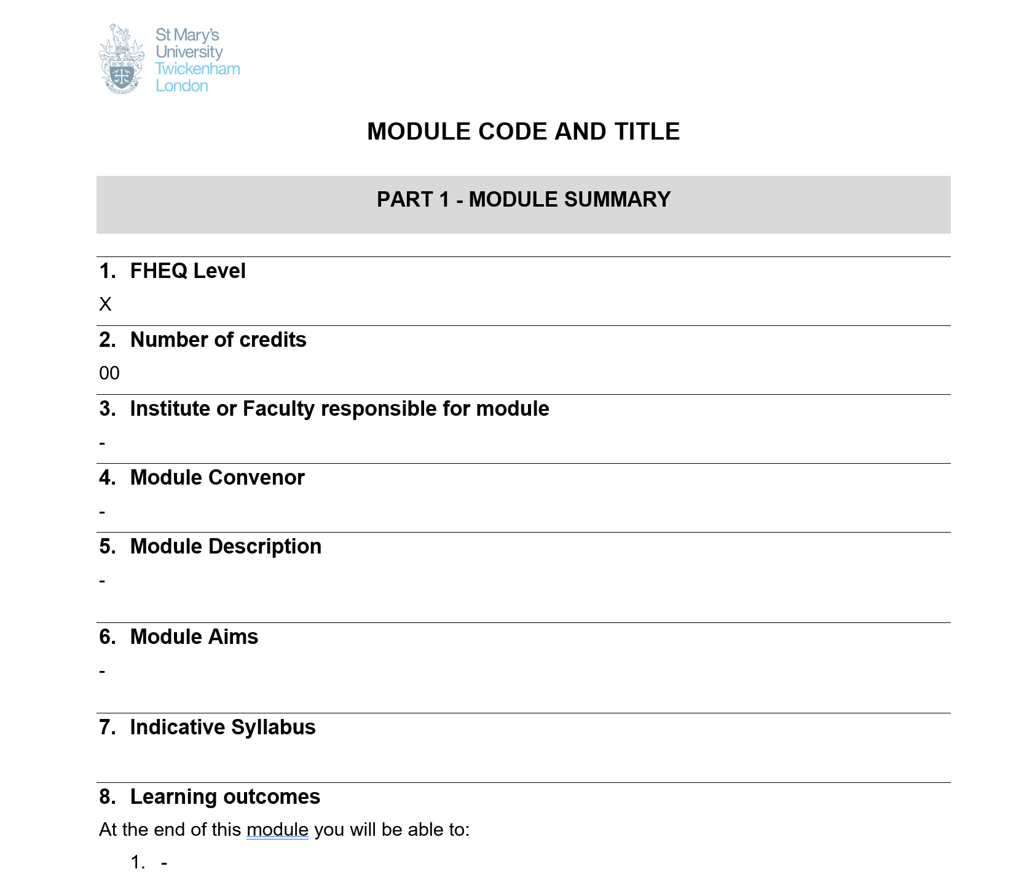
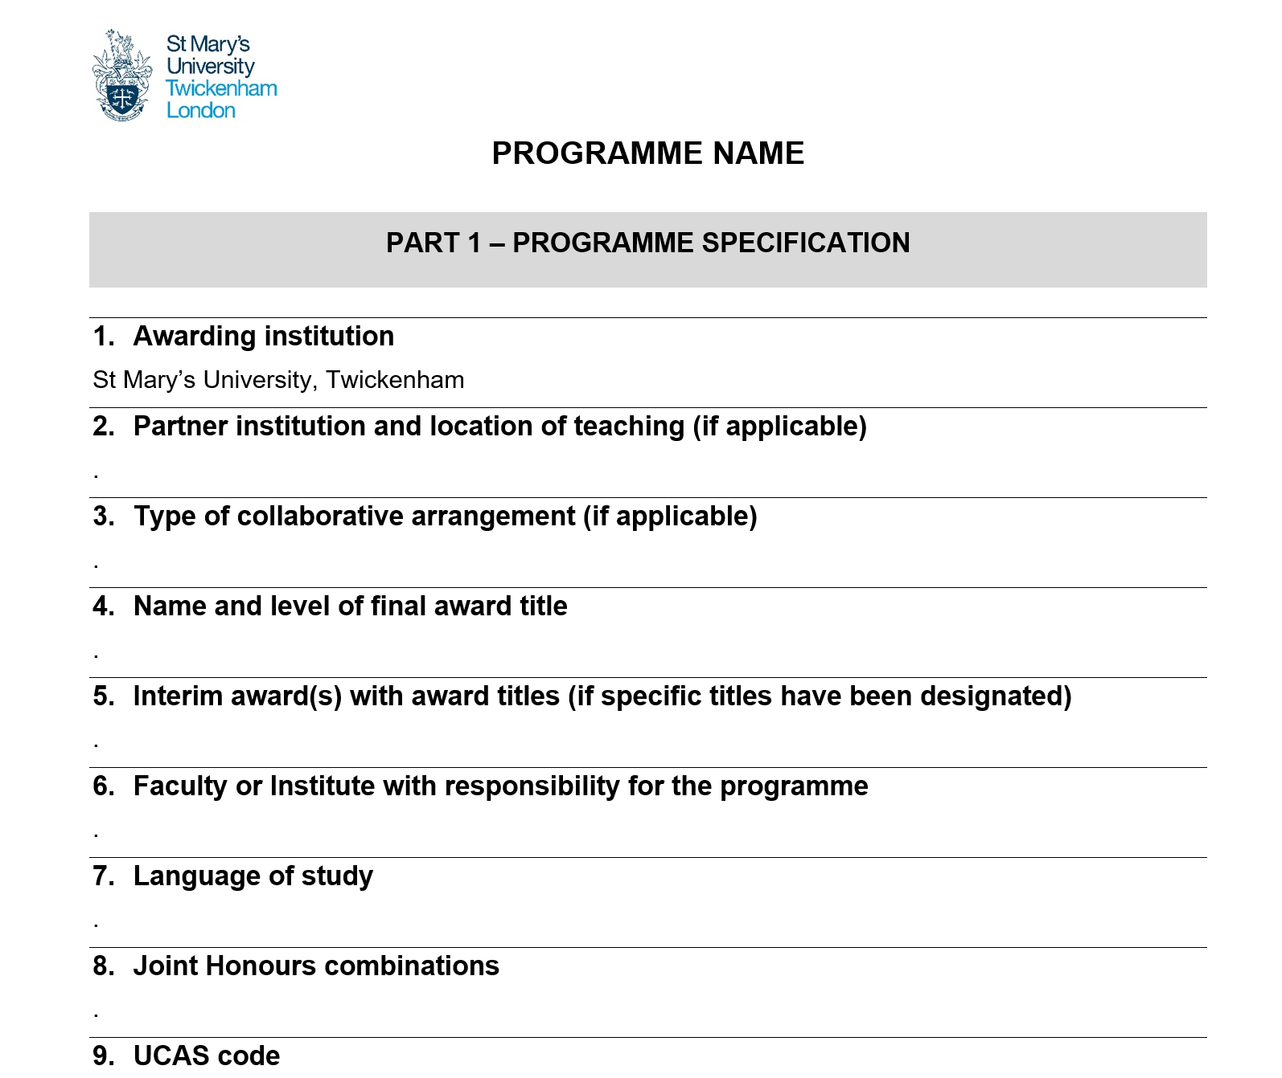
Programme Approval Documents
Programme specification and module outlines have been updated
Additional information; accessible format

Slide 14
Programme Approval events
Approval events with external / internal advisors and students continue to be part of the process
Approval events have worked well in online format during lockdown
Likely to continue to use this approach for the majority of approval events
Periodic Review will also utilise external and student advisors

Slide 15
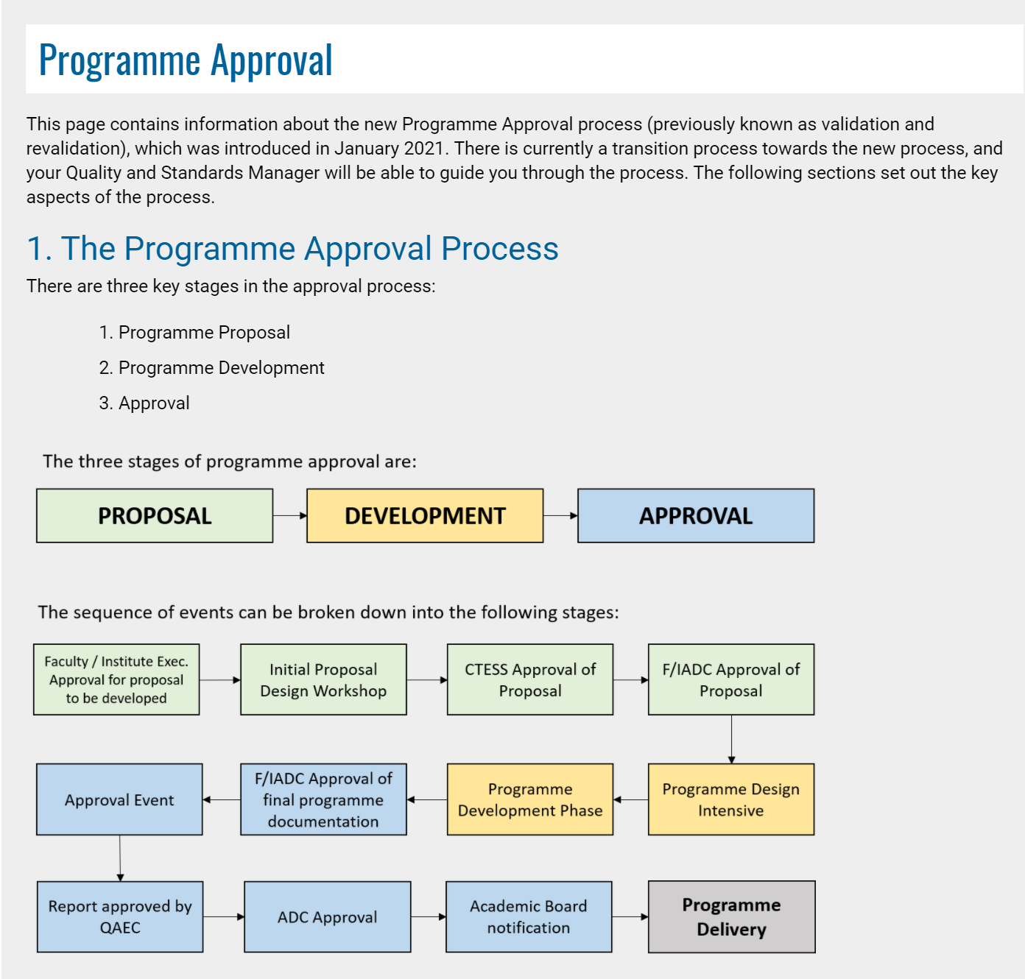
Support for new approvals process
Programme Approval
StaffNet pages (live)
e:Vision tool
Training Guide (in preparation)
Video walk-throughs (March 2021)
Trial programme approval for approvers (March 2021)
e:Vision training for academics / programme proposers (April 2021)
Template documents
Programme Specification & Module Outline (live)
Student Handbook: in production – contributions from PS teams (in preparation)
Programme Approval Document (in preparation)

