Slide 1
St Mary’s University
Melissa Blissett | 25 May 2016
Your journey to retirement

Slide 2
Regulatory information
The information in this presentation is based on our understanding of current taxation law, proposed legislation and HM Revenue & Customs practice, which may be subject to future variation.
This presentation is not intended to provide and must not be construed as regulated investment advice. Returns are not guaranteed and the value of investments may go down as well as up.
Barnett Waddingham LLP is a limited liability partnership registered in England and Wales.
Registered Number OC307678.
Registered Office: Cheapside House, 138 Cheapside, London, EC2V 6BW
Barnett Waddingham LLP is authorised and regulated by the Financial Conduct Authority and is licensed by the Institute and Faculty of Actuaries for a range of investment business activities.
2

Slide 3
Agenda
who are Barnett Waddingham LLP?
overview and reasons for proposed improvements
freedom and choice
review of the default investment arrangement
reminder of contribution structure
changes to tax on death benefits
pension scams
what you need to do
further information
questions
3

Slide 4
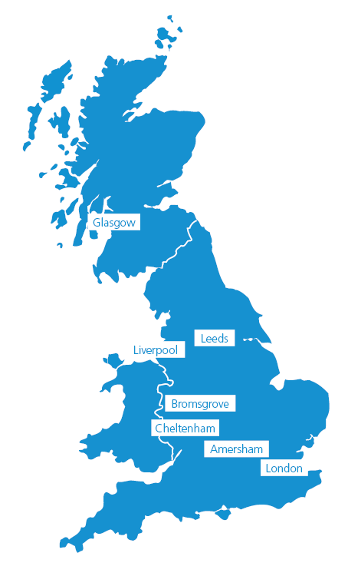
Barnett Waddingham LLP
independent UK firm committed to pensions
founded in 1989 (history dates back to 1960s)
64 partners
750+ employees and partners
42 Investment specialists
40 DC experts
7 UK offices
we advise over 700 pension scheme clients (DB and DC)

Slide 5
Proposed improvement
New default investment arrangement:
‘My Future’ 15 year lifetime investment programme

Slide 6
Reasons for change
to reflect new pension flexibilities legislation
for future Plan governance and costs to be proportionate relative to size of the membership
the University has taken advice from Barnett Waddingham

Slide 7
Freedom and choice

Slide 8
Your options around accessing
your pot
GUARANTEED INCOME FOR LIFE
Annuity?
FLEXIBLE WITHDRAWALS
LUMP SUM
Cash?
Drawdown?
8

Slide 9
Shaping the future (an example)
I need to top up my Basic State Pension at 67 from £8,000 to £12,000
I want to pay
the mortgage
off early
I need some rainy day funds
50
55
67
90
Access age

Slide 10
Do Friends Life offer these
new flexibilities?
Option | Available
Cash sums | ✓ (partial or full encashment)
New (flexi-access) drawdown | ✓ (via transfer to separate product)
Annuity purchase | ✓
10

Slide 11
Review of the default investment
arrangement

Slide 12
Friends Life current default only targets annuity
Friends Life BlackRock 50:50 Global Equity Fund (passive - index tracker)
lifestyle switching from 10 years to your selected retirement age
targets annuity purchase and 25% tax-free cash
12

Slide 13
My Future - new default to
address freedoms
my future growth (passive - index tracker)
lifestyle switching from 15 years to your selected retirement age - targets a broad mix of options at retirement
no change in the Annual Management Charge (AMC)
medium risk profile – no change - (see fund factsheets for definition of medium risk)
13

Slide 14
De-risking options
Default de-risking = consolidation fund
Targets a broad mix of options at retirement
Or you can choose a targeted strategy:
‘My Future Drawdown’
‘My Future Cash’
‘My Future Annuity’
14

Slide 15
Can I invest in more than one fund?
 | Friends Life BlackRock 50:50 Global Equity Fund | Friends Life ‘My Future’ Growth
De-risking approach | Lifestyle arrangement | Lifetime arrangement
 | you can invest some of your monies in other funds if you wish | all of your existing monies and future contributions would need to be invested in this approach you cannot combine this with any other fund choices
15

Slide 16
Risk warning
retirement benefits are not guaranteed and the value of investment may go down as well as up
past performance should not be regarded as a guide to future performance
you should review your investment choices regularly to ensure continued suitability
you may get back less than you put in
16

Slide 17
Friends Life governance
new legislation came into force from 1 April 2015
requires all providers to establish Independent Governance Committees (IGCs)
responsible for monitoring investment options with an emphasis on the default investment arrangement
tasked with ensuring pension schemes provide value to members
Friends Life’s My Future Strategy, being the core default approach will receive more focused IGC governance
IGC
Scheme governance
Scheme charges
Scheme administration
Design and execution of default
Employee engagement
17

Slide 18
Reminder of contribution
structure

Slide 19
Where are you on the journey?
Key messages:
How and when to take this benefit
50 – SRD and beyond
Stay In
Age 22 - 30
How much?
30 – 50
Growth
Shape
Access

Slide 20
Are you maximising your contributions?
You pay | The University pays | Total paid
1%* | 2%* | 3%*
3% | 6% | 9%
4% | 8% | 12%
5% | 10% | 15%
6% or more | 12% | 18% or more
*automatic-enrolment contribution rates
contributions are based on your contractual regular basic salary
you may wish to pay more to boost your retirement benefits
all pension contributions are subject to relevant allowances as set by HMRC
20

Slide 21
Know your limits
Annual Allowance (AA)
Lifetime Allowance (LTA)
a limit to the total amount of contributions that can be paid to your pension savings each year and still receive tax relief
a limit on the amount of pension benefit that can be drawn from your pension savings (e.g. lump-sums or retirement income) and can be paid without triggering an extra tax charge
£40,000 for the 2016/17 tax year
£1 million for the 2016/17 tax year
21

Slide 22
How good is the scheme?
the pre automatic-enrolment section qualifies for the ‘Pension Quality Mark Plus’ - an independent standard of a good scheme
this is an industry recognised qualification, which acknowledges a pension plan’s quality in terms of contributions, on-going governance and literature provided to members
since its launch in September 2009 only 188 pension schemes achieved either PQM or PQM PLUS standard
22

Slide 23
Changes to tax on death benefits

Slide 24
Death benefits – post April 2015
Before age 75
Lump sum
Tax-free
Income
Tax-free
After age 75
Lump sum
Income
Recipients rate of income tax
Recipients rate of income tax
24

Slide 25
What if I die before taking my benefits?
full fund value will be paid
free of IHT liability provided you die before age 75
Friends Life will pay the benefits as per instruction on expression of wish form
KEEP YOUR EXPRESSION OF WISH FORM UP TO DATE!
25

Slide 26
Pension scams

Slide 27
Pension scams
unfortunately, once you’ve moved your money into a scam, it’s too late
you could end up losing all of your money and in some cases face a huge tax bill of up to 55%
pension scam aliases:
pension loans
early pension release
pension selling
cashing in your pension
pension liberation
When people are tricked into transferring their pension savings into an arrangement where you can gain access to the money before age 55
If it sounds too good to be true, it probably is!
Source: http://www.thepensionsregulator.gov.uk/individuals/dangers-of-pension-scams.aspx
27
27

Slide 28
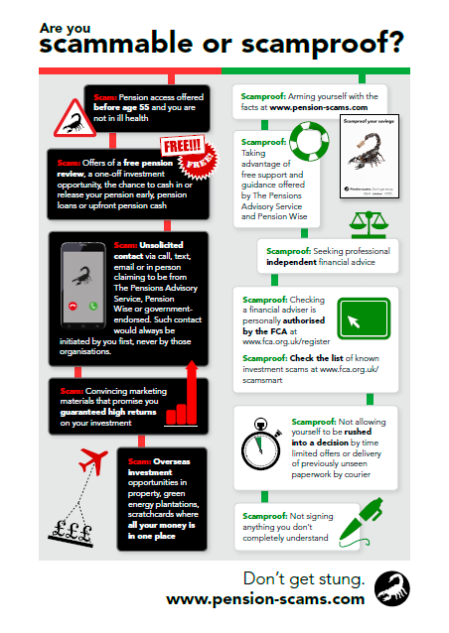
scammers claim that you can access your pension before age 55
you are called out of the blue via phone, text or sometimes on your doorstep
they lure you with the offer of cash upfront
sometimes you are offered a free ‘pension review’ or they entice you with ‘one-off’ investment opportunities
paperwork may be delivered to your door which requires an immediate signature
If you think you’re being targeted by a pension scam, contact Action Fraud on:
0300 132 2040
Source: http://www.thepensionsregulator.gov.uk/individuals/dangers-of-pension-scams.aspx
28
28

Slide 29
What you need to do

Slide 30
Empowered decisions
Cash figures p.a.
£12,000
£10,000
£8,000
65
£10,000 p.a.
50
when reviewing your pension projection, you may want to think ask yourself:
do I put more in?
do I take more risk?
do I push back retirement?
do I accept less?
30

Slide 31
What you need to do
1. Remain as you are
continue to be invested in your current fund choice(s)
2. Switch to ‘My Future’ - the new default
invest all accrued funds and future contributions into the new default
no action required
please note, these will not benefit from the same level of ongoing governance as the ‘My Future’ programme
fund switch online
complete a fund switch form and send to Friends Life
email or telephone Friends Life with your instructions
‘My Future’ will be available as an investment option from 20 June 2016
31

Slide 32
Existing members already within your lifestyling period
1. Remain as you are
continue to be invested in your current fund choice(s)
2. Switch to ‘My Future’ - the new default
invest all accrued funds and future contributions into ‘My Future’ and choose your de-risking strategy
no action required
please note, these will not benefit from the same level of ongoing governance as the ‘My Future’ programme
same action points as before
please note that this could result in a significant change to your investments – at your selected retirement age (SRA) up to 30% of your funds could continue to be invested in world stock markets - there would be no stock market exposure at your SRA with the old default.
32

Slide 33
Further information

Slide 34
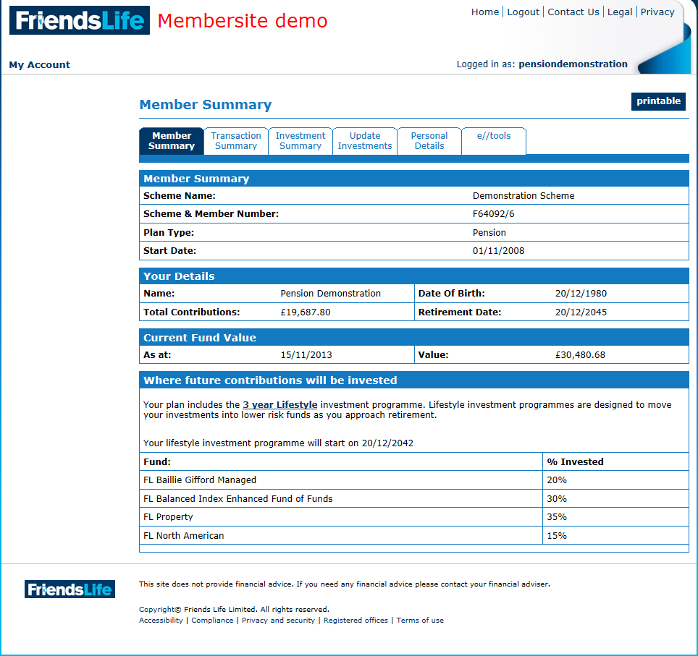
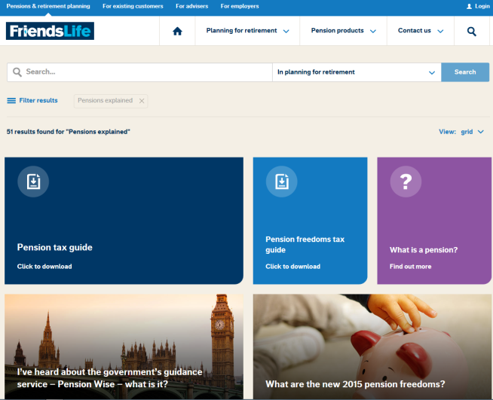
Online tools and services
Pensions calculator
View pension plan details
Alter investment choice
Change personal details
Register on the Friends Life website and an activation code will be sent to you:
Membersite home page (pre-login)
Membersite landing page (post-login)
34

Slide 35
If you want more information…
your Plan booklet
Friends Life
Log in: www.friendslife.co.uk/membersite
Telephone: 0345 602 9221
Email: ngp.questions@friendslife.co.uk
the University’s pension advisers: Barnett Waddingham LLP
Telephone: 01494 788 830
Email: StMarysEB@barnett-waddingham.co.uk
find an independent financial adviser near you
www.unbiased.co.uk or www.findanadviser.org
35

Slide 36
Other sources of pensions and financial planning information
www.pensionwise.gov.uk
Free impartial guidance
www.pensionsadvisoryservice.org.uk
Information about pensions
www.moneyadviceservice.org.uk
Information on financial issues
36

Slide 37
6 steps help you understand how to turn your pension pot into income for your retirement:
1
2
what you can do with your pension pot
3
plan how long your money needs to last
4
6
5
work out how much money you'll have in retirement
watch out for tax
shop around for the best deal
check how much is in your pension pot
www.pensionwise.gov.uk
37

Slide 38
Questions?
38

Slide 39
Reference slides

Slide 40
Flexible withdrawals
Greater flexibility, better value?
Pros
Cons
flexibility to vary withdrawals
control over investment strategy
ability to switch to an annuity in later life
better death benefits – residual pot available to members
tax-free before age 75
marginal rate of tax after
administrative/advice costs can erode value
complicated for the average member
investment risk
tax implications
longevity risk
reduced money purchase annual allowance (MPAA) of £10,000
money may run out
40
40

Slide 41
Cash lump sum
Pros
Cons
value to member/immediate gratification
use to pay off existing debts e.g. mortgage
pursue alternative investments; buy-to-let, ISAs, etc.
limited value of alternatives
taxed at marginal rate
in estate for inheritance tax (IHT) purposes
reduce income provision
future provision?
potential effect on state benefits
41
41

Slide 42
Examples of cash lump sum
Retirement savings | £40,000
Tax-free | £10,000
Taxable | £30,000
Tax paid @ 20% | £6,000
Amount after tax | £24,000
You get | £34,000
Retirement savings | £100,000
Tax-free | £25,000
Taxable | £75,000
Tax paid @ 40% | £30,000
Amount after tax | £45,000
You get | £70,000
Retirement savings | £250,000
Tax-free | £62,500
Taxable | £187,500
Tax paid @ 45% | £84,375
Amount after tax | £103,125
You get | £165,625
assuming you have no tax-free allowance
42

Slide 43
Guaranteed income (annuities)
Sometimes perceived to provide poor value
Pros
Cons
risk to the insurer and not the member
guaranteed income for life
use of enhanced/impaired rates can increase value for money
provide better value in later life
government will support innovation in the annuity space
annuity value eroded by;
increasing life expectancy
solvency 2 – additional capital requirements
budget 2014
falling gilt yields
limited death benefits
currently provide little flexibility once purchased
43
43

Slide 44
Asset allocation comparison
 | Friends Life BlackRock 50:50 Global Equity Fund | Friends Life ‘My Future’ Growth
UK equity | 49.9% | 28%
World (ex UK) equity | 50.1% | 37%
Overseas bonds | 0% | 0%
Corporate bonds | 0% | 6%
UK gilts | 0% | 22%
UK index-linked gilts | 0% | 7%
‘My Future’ targets volatility of 12% p.a. over the long-term and the split of index tracking funds are periodically reviewed to keep the performance of the Fund in line with its target
44

Slide 45
Salary exchange - the default
contribution method
Employee pension contribution
National Insurance (NI) deducted at 12% on whole amount
Salary between £8,060 p.a. and £43,000 p.a.
(Based on 2016/17 tax year)
Employer pension contribution
45

Slide 46
Pay less National Insurance (NI)
NI deducted at 12% on lower basic salary
you save 12% of your personal contribution
i.e. if you contribute £100 a month your take home pay increases by £12
Salary between £8,060 p.a. and £43,000 p.a.
(Based on 2016/17 tax year)
employer contribution increases by equal amount
Employer pension contribution
Some state related benefits can be affected by lower NI contributions
46

Slide 47
Salary exchange considerations
possible impact on earnings-related assessments;
mortgage applications
student loans
other income-linked employee benefits – not affected
this may increase your working tax credit
your entitlement to a State Second pension may be slightly reduced – however once the new flat rate pension is introduced, this is unlikely to have much impact
maternity leave – this could reduce your statutory maternity pay (SMP)
if you do not wish to contribute via this method you will need to opt out of salary exchange
47

