Slide 1






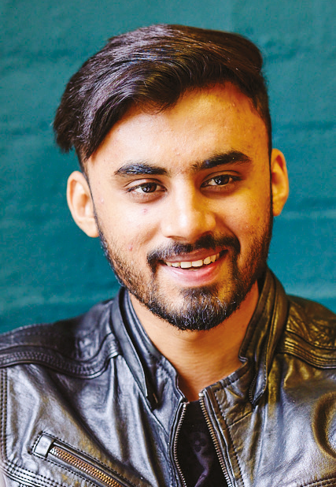

Planning your arrival
International Office

Slide 2
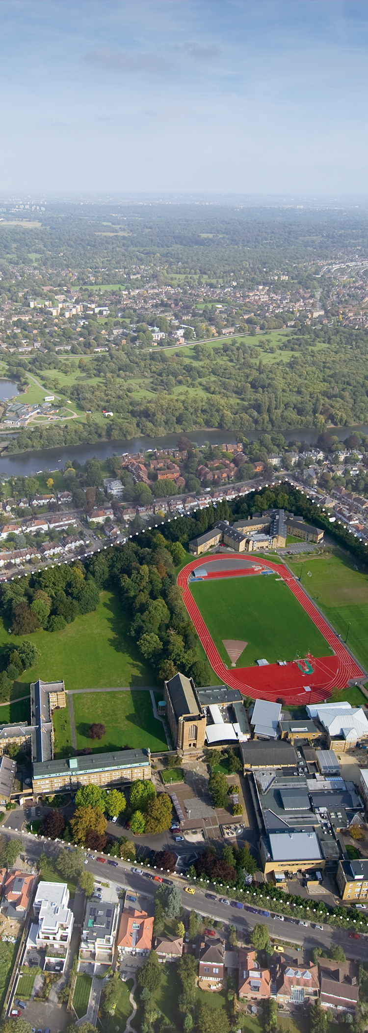

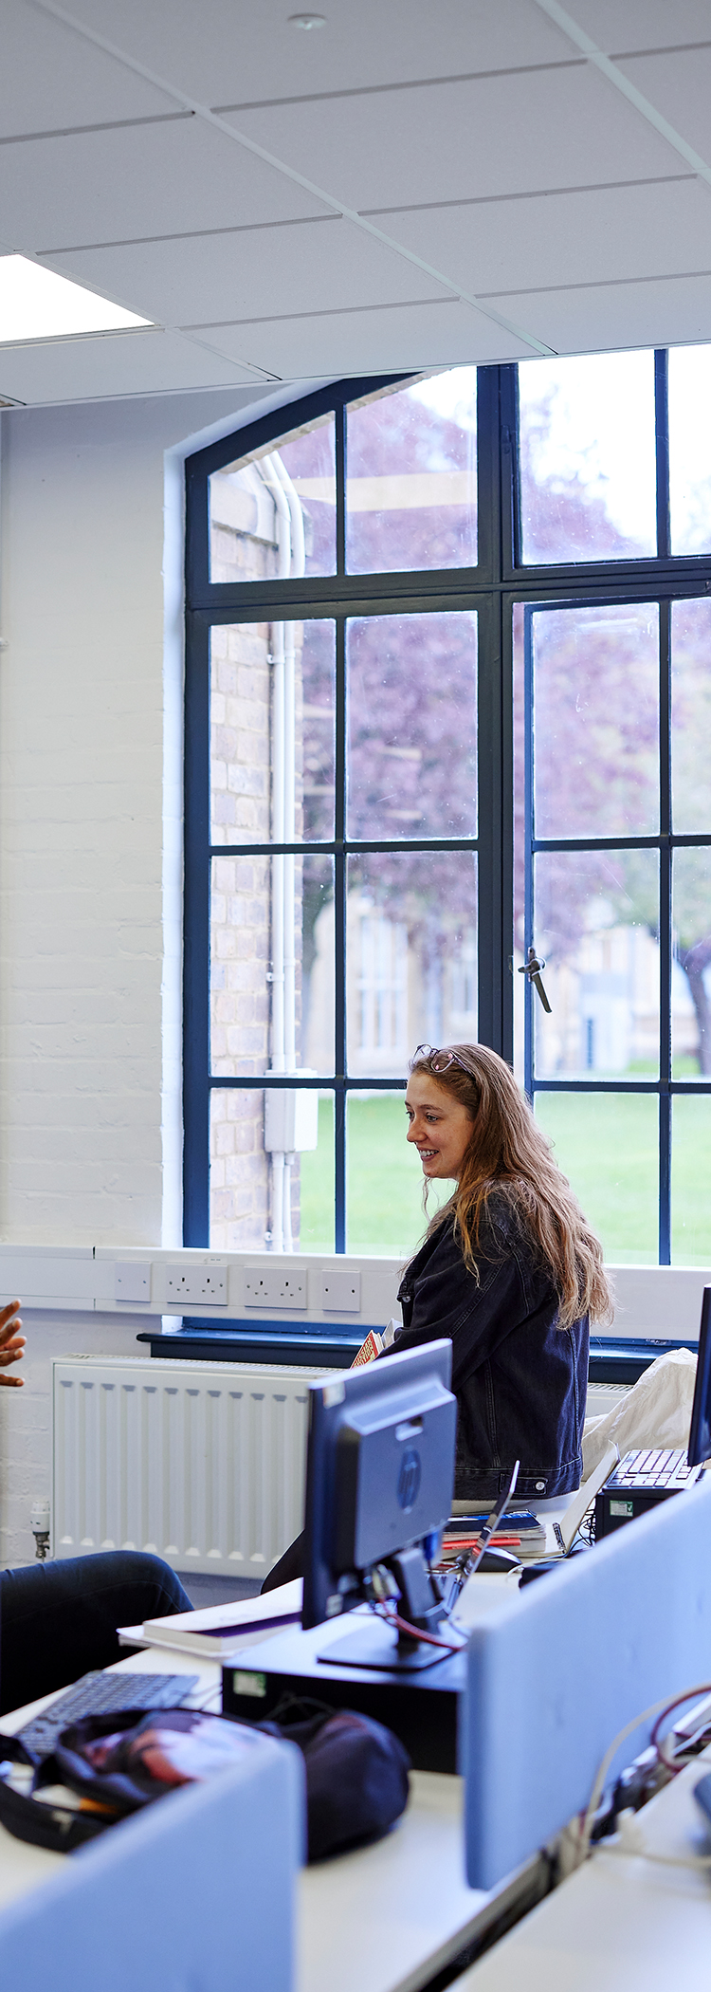
Steps to St. Mary's...
Admissions, CAS and course start dates
Accommodation
Visa and immigration
Travel and arrival
Online Enrolment
Course Induction and welcome
Any questions
Notes:
Agenda – 3 photos

Slide 3
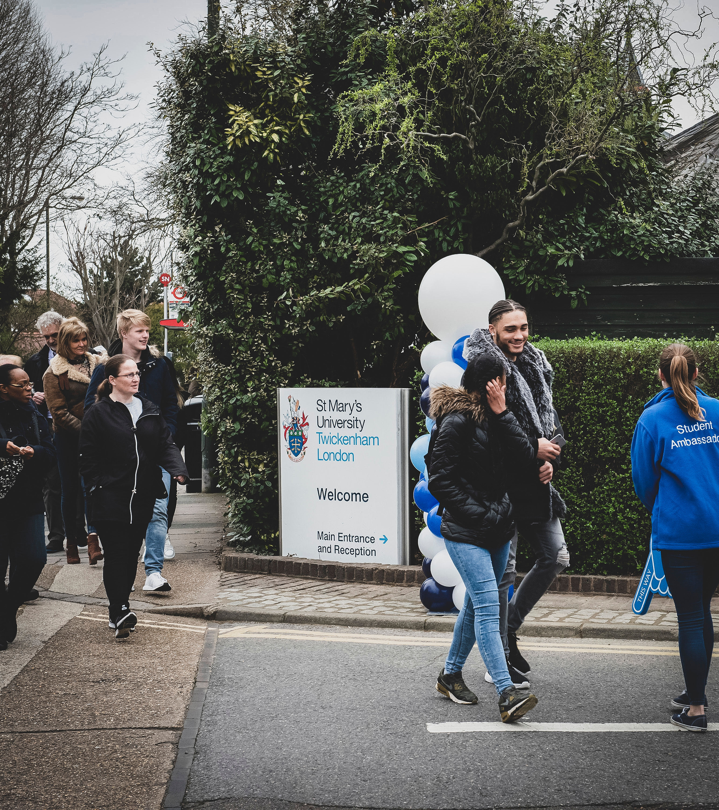
International
Admissions
Notes:
Delete and add your own video (insert > video > online film > enter URL link from YouTube)

Slide 4
Are you CAS Ready?
    Submit your documents
      Email Internationaladmissions@stmarys.ac.uk or upload via the St Mary's Applicant Portal
    Accept your Offer
      Log into the applicant portal → “My Application” → “Respond to offer”
    Attend your SMU Credibility Interview
      Be prepared to discuss Your History, Universities and the UK, Your Course, Finances, Student Visa Responsibilities
    Complete your deposit payment
      £8,000 deposit via applicant portal or Full Deposit if required (Unconditional Offer holders)
Notes:
Delete and add your own video (insert > video > online film > enter URL link from YouTube)

Slide 5
How to Request your CAS Statement
    Access CAS Shield
    An email from International Admissions titled "Your CAS Request"
    A second email from stmarys@cas-shield.com titled "Welcome to CAS Shield" - Click the invitation link and set your password
    Complete all fields to request your CAS Statement!
    Check your spam folder – if you haven't received an invitation within 24 hours, please email internationaladmissions@stmarys.ac.uk
CAS Shield Checklist
Valid Passport
Previous UK Visa information
Academic Documents
English Language Evidence
TB Test
Financial Evidence
Notes:
Delete and add your own video (insert > video > online film > enter URL link from YouTube)

Slide 6
Financial Evidence and TB Tests
    TB Tests - https://www.gov.uk/tb-test-visa
    Only required if UKVI regulations apply based on your country
    Financial Evidence - https://www.gov.uk/guidance/financial-evidence-for-student-and-child-student-route-applicants
Funds must be held for 28 consecutive days
    Financial evidence must be no more than 31 days old
    Bank Statements/documents must show an additional £500 for currency fluctuations
    Evidence must be in your name, parent’s, or legal guardian’s name
    All documents must be officially stamped and uploaded as clear copies
Notes:
Delete and add your own video (insert > video > online film > enter URL link from YouTube)

Slide 7
Submit your Visa application
Confirm your CAS Statement
  Check all details carefully and reply to your Draft CAS Email to receive your Final CAS Statement
Submit your Visa application
  Use your CAS Number to apply for your Student Route visa
Update CAS Shield
  → Visa Decision
  → Arrival Date
  → Visa copy (Share code)
Do not book any non-refundable flights: Wait to receive a decision on your visa.
Do not enter the UK before your visa start date If you enter the UK too soon, you may need to leave again!
Remember your latest arrival date: This is the latest date that you must be in the UK attending classes.
Contact us if you have any questions!
  internationaladmissions@stmarys.ac.uk
Notes:
Delete and add your own video (insert > video > online film > enter URL link from YouTube)

Slide 8
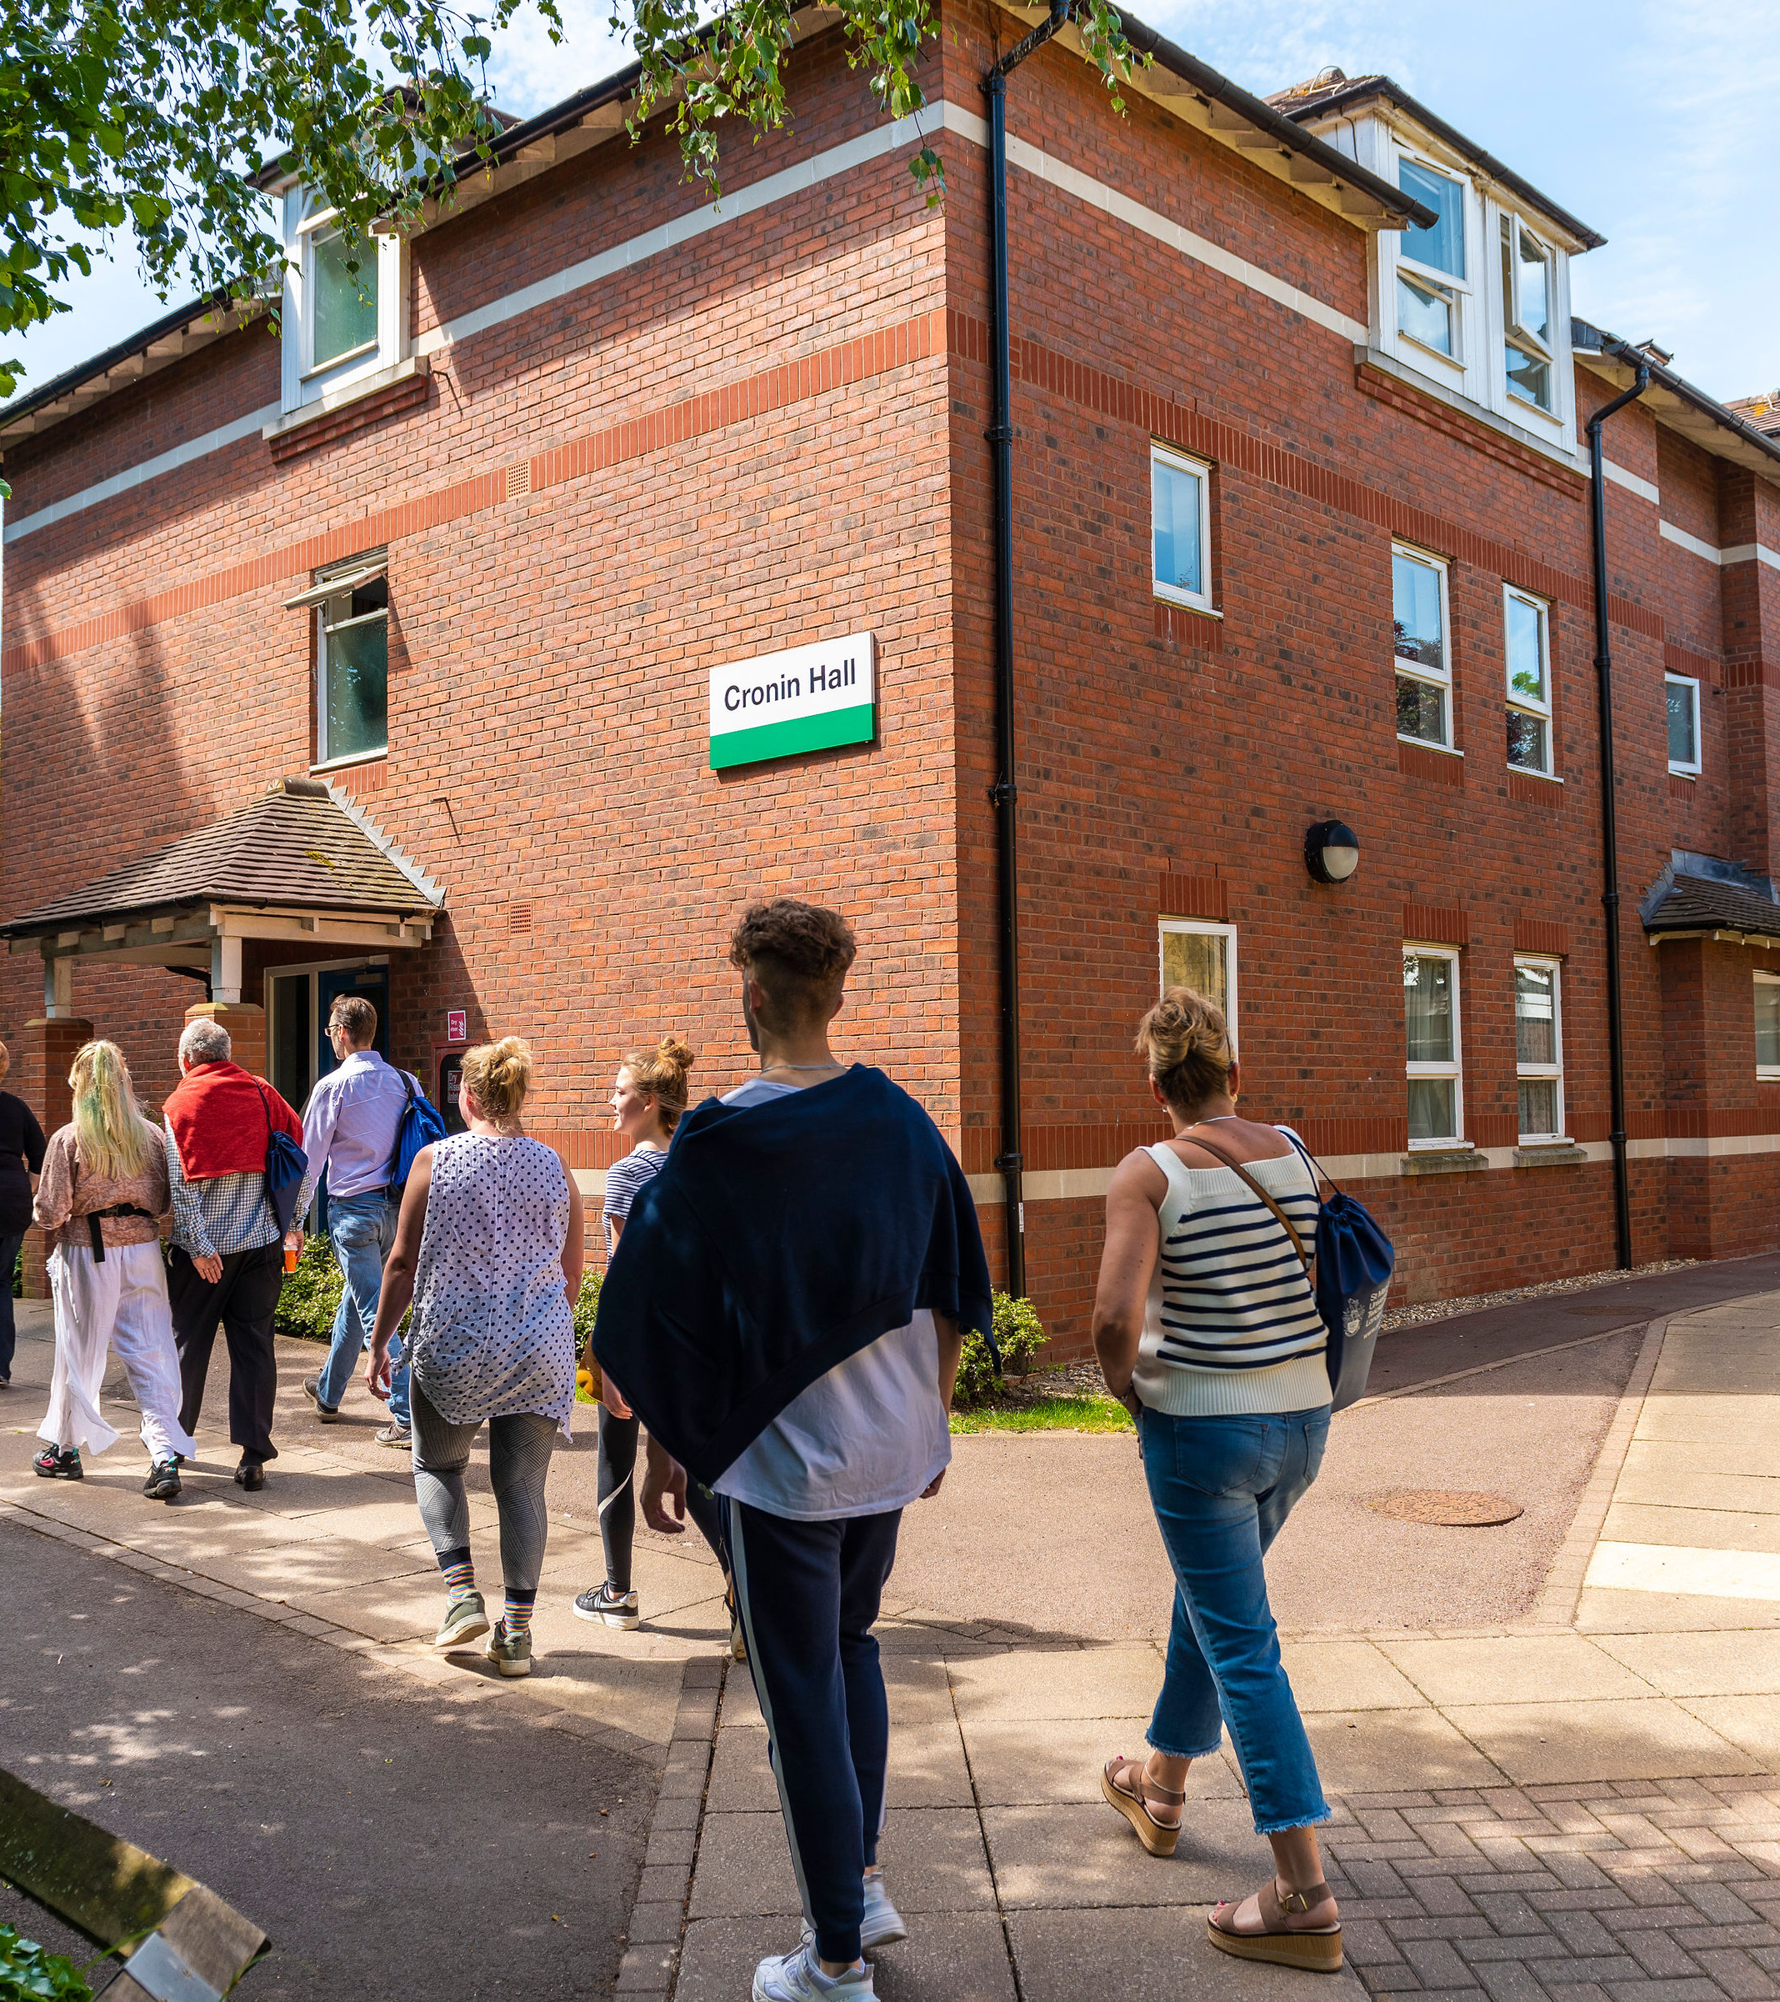
Accommodation
Notes:
Delete and add your own video (insert > video > online film > enter URL link from YouTube)

Slide 9
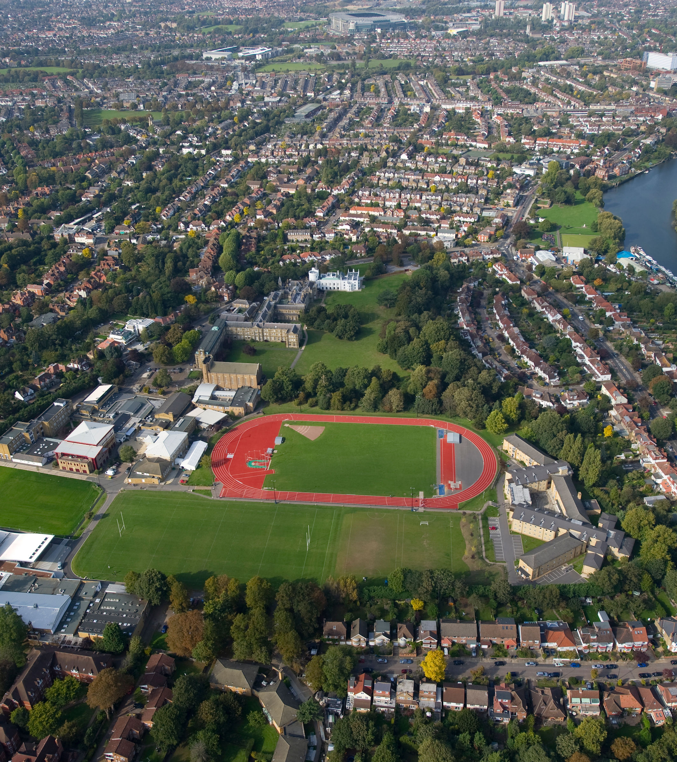
Campus Accommodation
E-induction – Email invitation to complete and select your arrival time slot.
Move In Sunday is the 13th September.
Check in Desk will be in the DV Lounge
Collect your key and ID card.
Resident Mentors and Senior Residents will be on hand to help you move in with trollies.
There will be a free BBQ for residents and their family and friends assisting with the move.
Mandatory hall meeting on Monday 14th September.

Slide 10
Items to bring | Items to purchase after arrival | Items that are in your room
Coat and jackets Shoes (Smart and Trainers) Flip Flops for shower use Phone charger with UK adaptor plug Electronics Toiletries Backpack Reusable water bottle Small gifts from home Comfort items – favorite book, photos | Bedding – Duvet, Pillows, Duvet Cover, Pillowcases, Towels Kitchen Equipment - Crockery, Cutlery, Microwavable dish, Washing up liquid, Kitchen roll and a Tea towel Room Decorations – Free standing picture frames, Posters for the notice board, Fake Plants, Storage boxes, Calander, Rug and Blanket Basic room essentials – Coat hangers, Fan, Extension plug | Desk and chair Bed and mattress Wardrobe Drawers/bedside table Waste bin Shelving Desk lamp Notice board

Slide 11
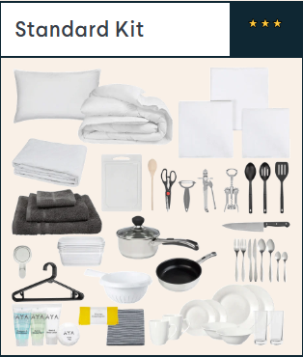
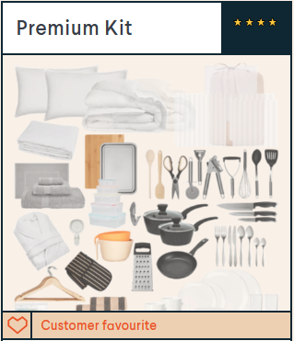
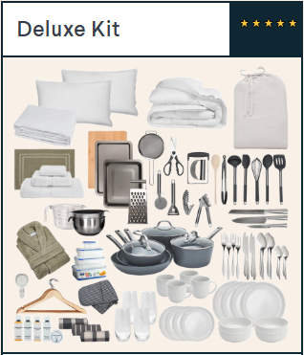

UniKitOut
You can order bedding kits as well as kitchen and bathroom kits ahead of time from our partners at UniKitOut and have everything delivered before you arrive at your accommodation.
Shop now and save 10% on your order with the discount code STMARYS10.
https://www.unikitout.com/?partner=St%20Marys%20University%20Twickenham

Slide 12

It's not too late to find Accommodation!
We have limited availability in campus accommodation
We can support you with finding accommodation in the private sector
Accommodation@stmarys.ac.uk
020 8240 4034

Slide 13
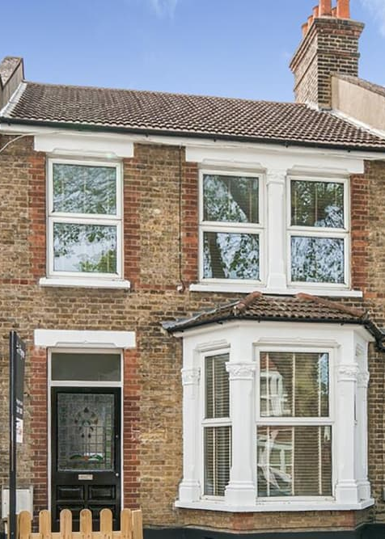
External / Private Sector Accommodation Options
St Mary's Student Pad - (Online platform for local landlords to advertise their properties and spare rooms) https://www.stmarysstudentpad.co.uk/Accommodation
St Mary's Find a Flatmate Facebook Group – Chat to other students who may have a space available in their student house and buddy up with other students to find accommodation https://www.facebook.com/groups/stmarysflatmate
Spare Room - Online letting agents, where people advertise properties and spare rooms. https://www.spareroom.co.uk/

Slide 14
Contact the Accommodation Office
accommodation@stmarys.ac.uk
020 8240 4034

Slide 15
Visa and Immigration
Notes:
Delete and add your own video (insert > video > online film > enter URL link from YouTube)

Slide 16
Travel and Arrival
Notes:
Delete and add your own video (insert > video > online film > enter URL link from YouTube)

Slide 17
Important dates to remember!
Course Name | Induction date | Teaching Start Date | Latest Arrival date
Physiotherapy Sports Rehabilitation MBBS | Check with admissions | Check CAS | Check CAS
All other courses | 14th September 2026 | 21st September 2026 | 2nd October 2026

Slide 18
Before you travel:
  Read our pre-departure advice at https://www.stmarys.ac.uk/international/prepare/get-ready.aspx
  Plan how to access money until you can open a bank account. Have a credit card and/or a prepaid debit card for emergencies (Visa or Mastercard).
  Fill any necessary prescriptions and take care of healthcare appointments
  Confirm your accommodation and plan how to get there when you arrive (contact international@stmarys.ac.uk if you need support)
Notes:
Pathway – programme photo on right

Slide 19
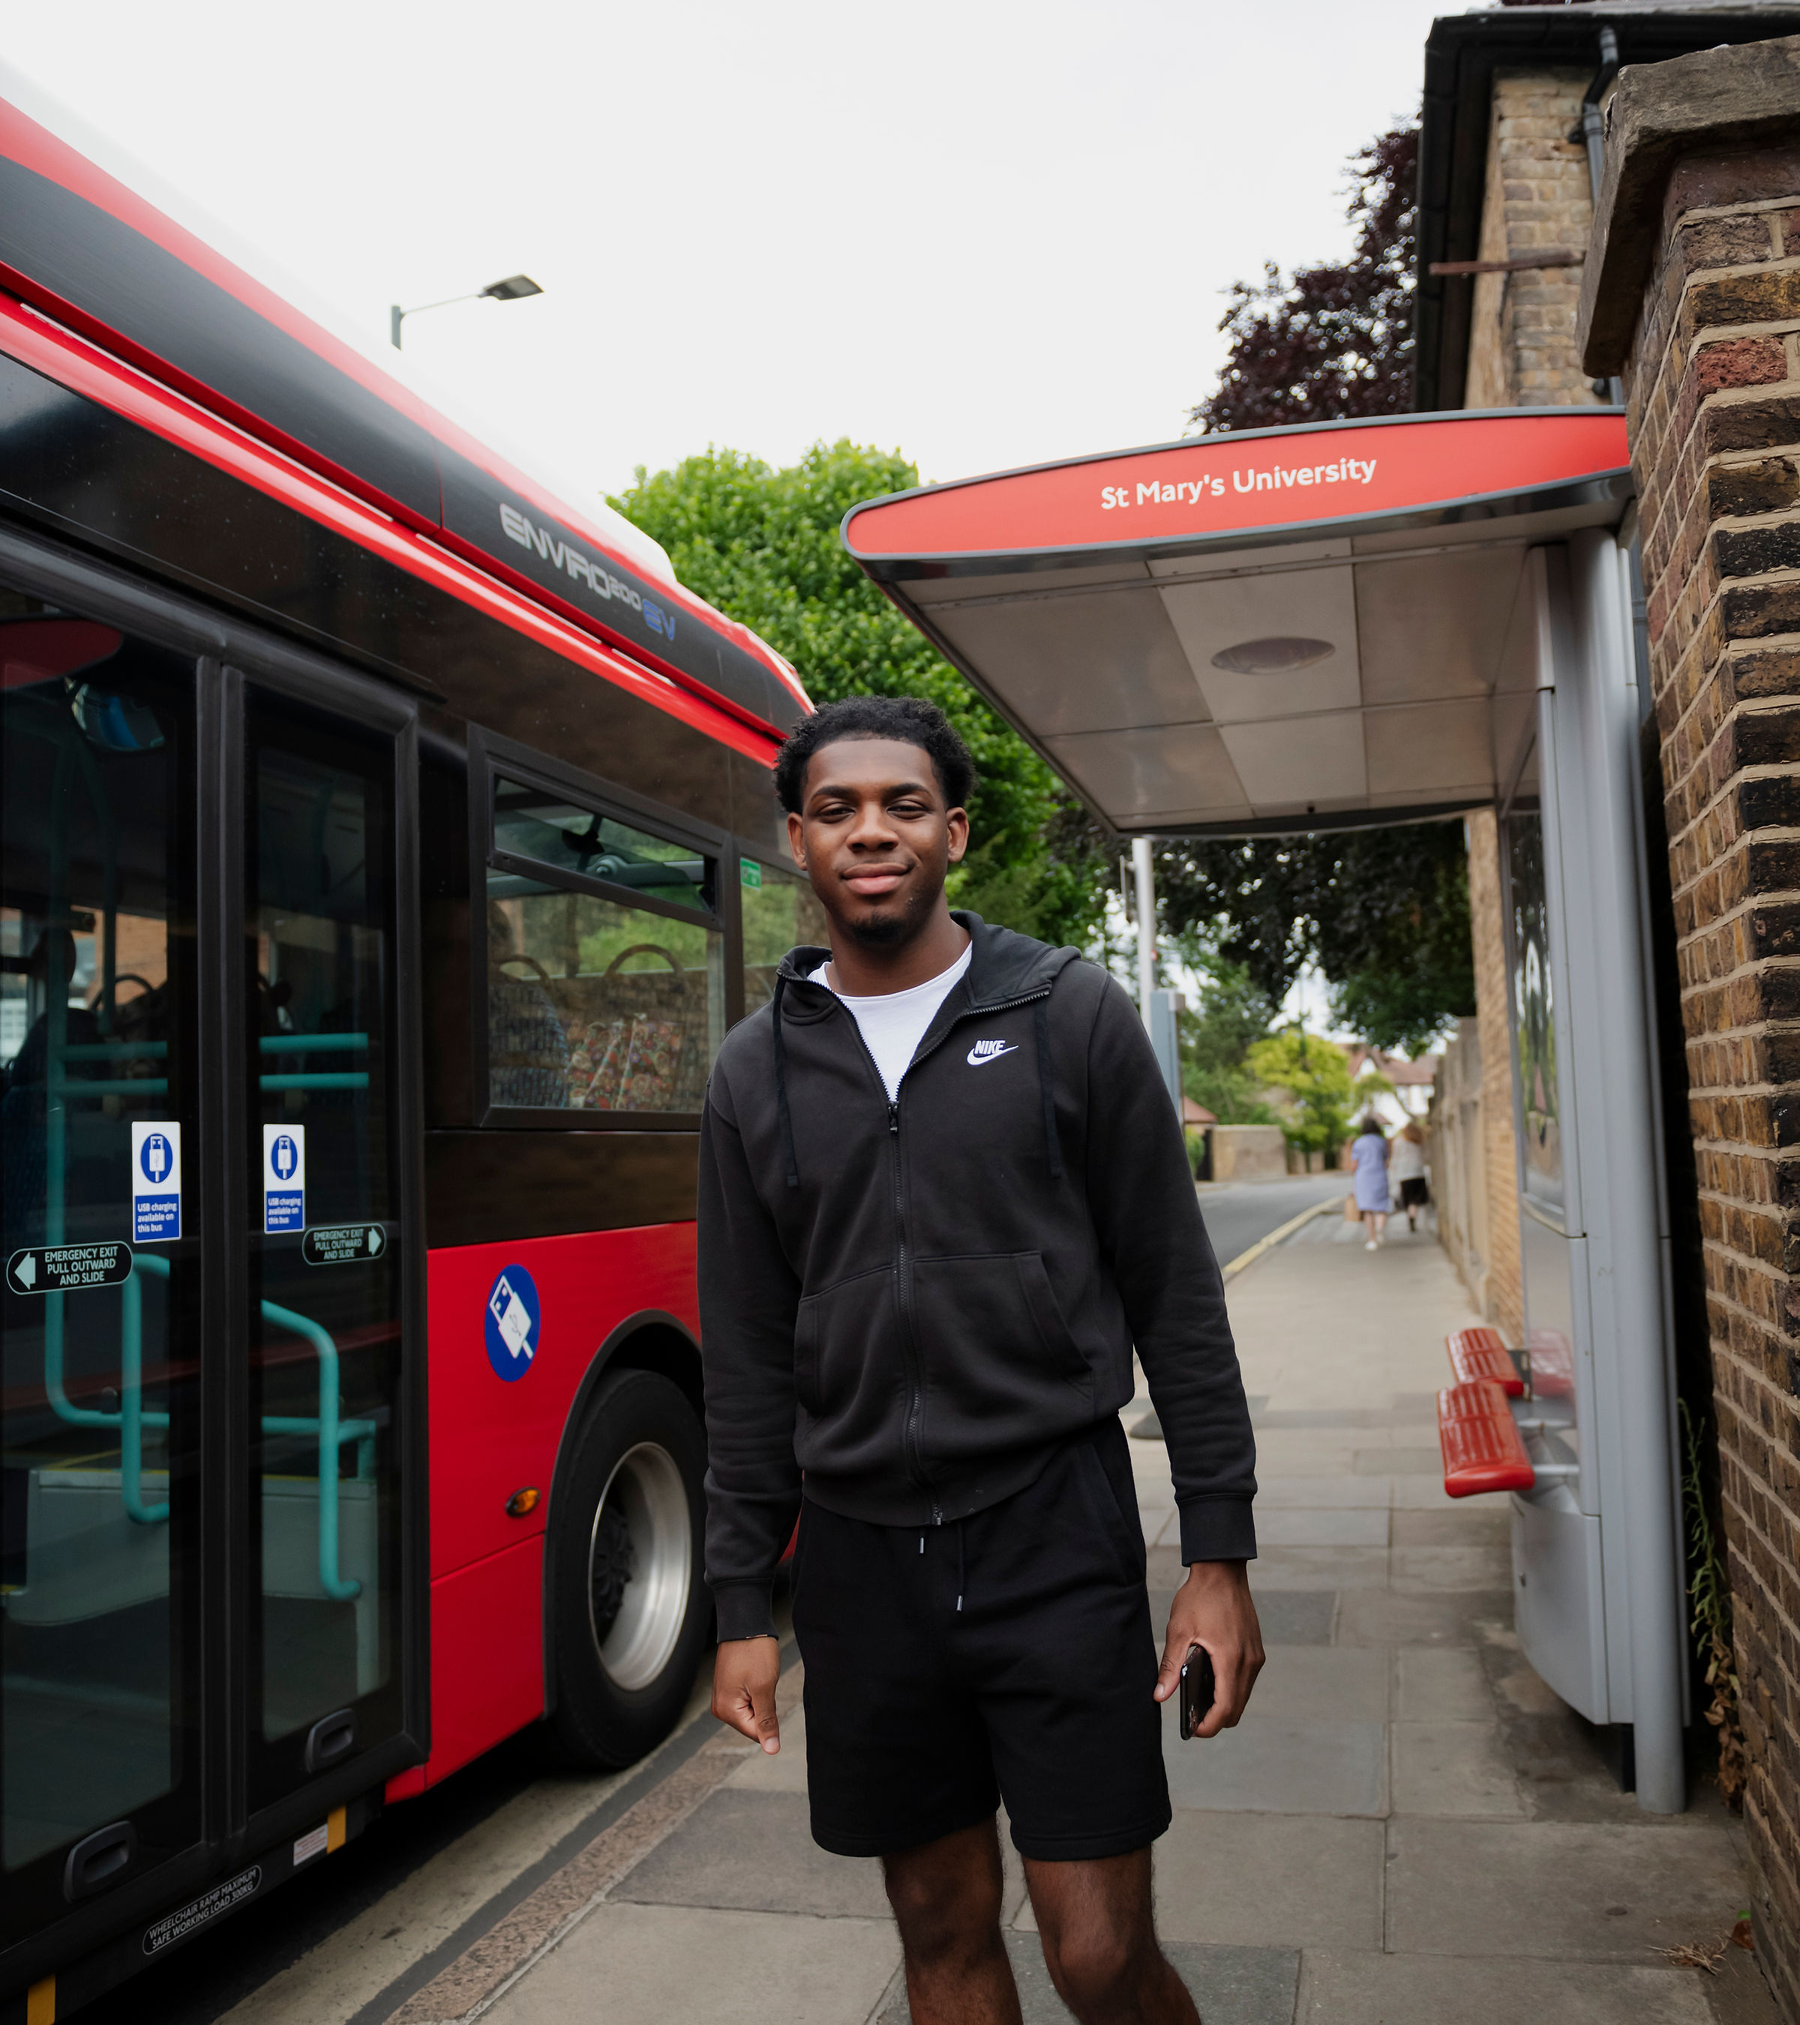
Before you book Air ticket:
Have your visa, if necessary. Make sure to arrive after your entry clearance starts.
Have a confirmed place to live
Check your start date: https://www.stmarys.ac.uk/about/term-dates.aspx
Notes:
Studying – programme photo on right

Slide 20
Entering the UK
  E-mail international@stmarys.ac.uk if you need advice about travel arrangements
  Carry paper copies of your St Mary’s offer letter, proof of finances and accommodation in your hand luggage
  See a Border Force Officer to check if you need a passport stamp and keep your boarding pass to show when you arrived
Your ID check: The St Mary’s University visa team must meet with you face-to-face during the enrolment period for your ID check. You must present yourself with your passport and your share code.
  Further guidance at ukcisa.org.uk/Information--Advice/Visas-and-Immigration/Immigration-on-arrival
  Directions to campus: www.stmarys.ac.uk/contact/directions.aspx

Slide 21
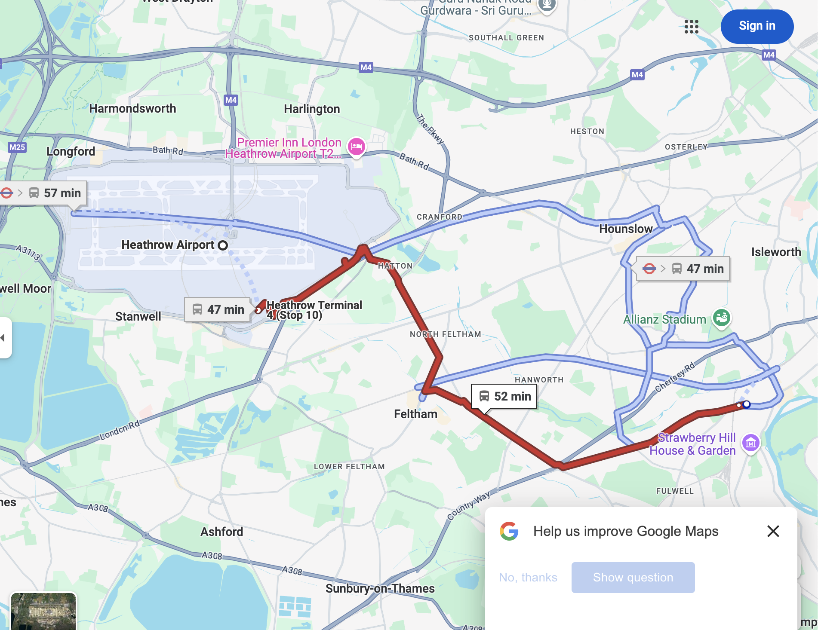
Closest Airport:
Easy commute by Bus, Train and Taxi
Heathrow Airport
Gatwick Airport
Students are recommended to be within 1hr 30mins commute time to campus at the most.

Slide 22
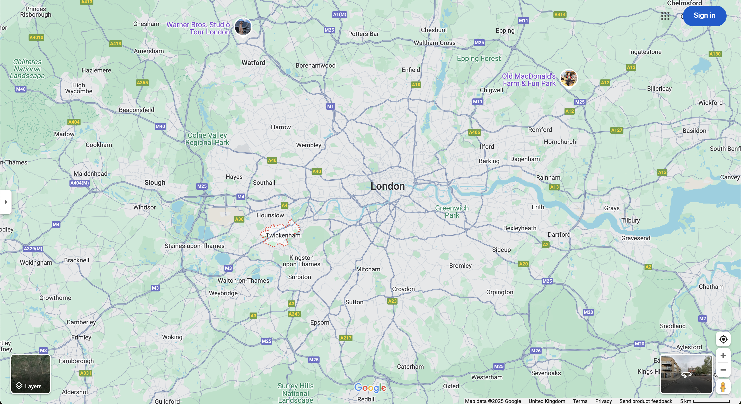


















Slide 23
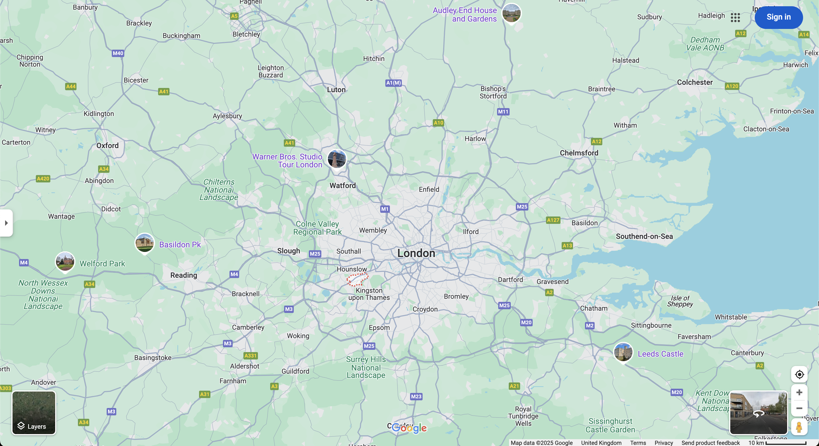





Slide 24
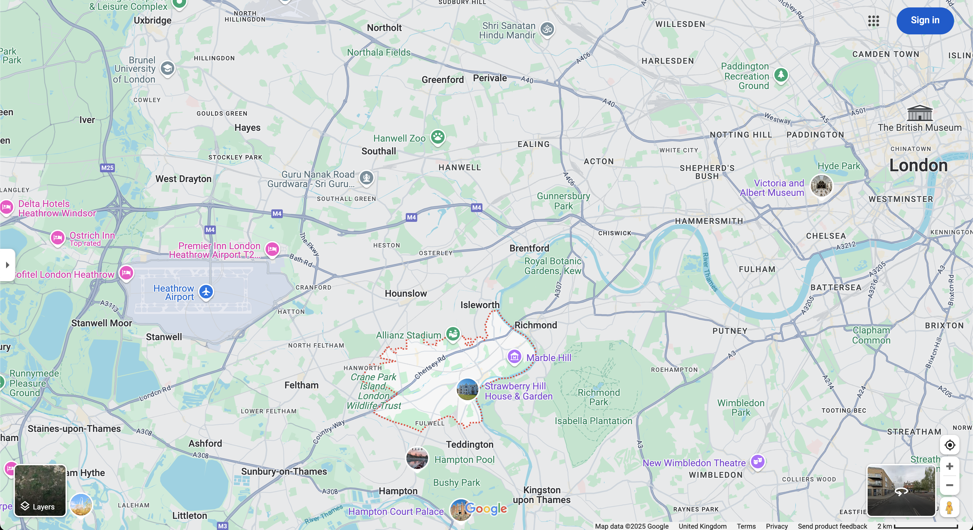




Slide 25
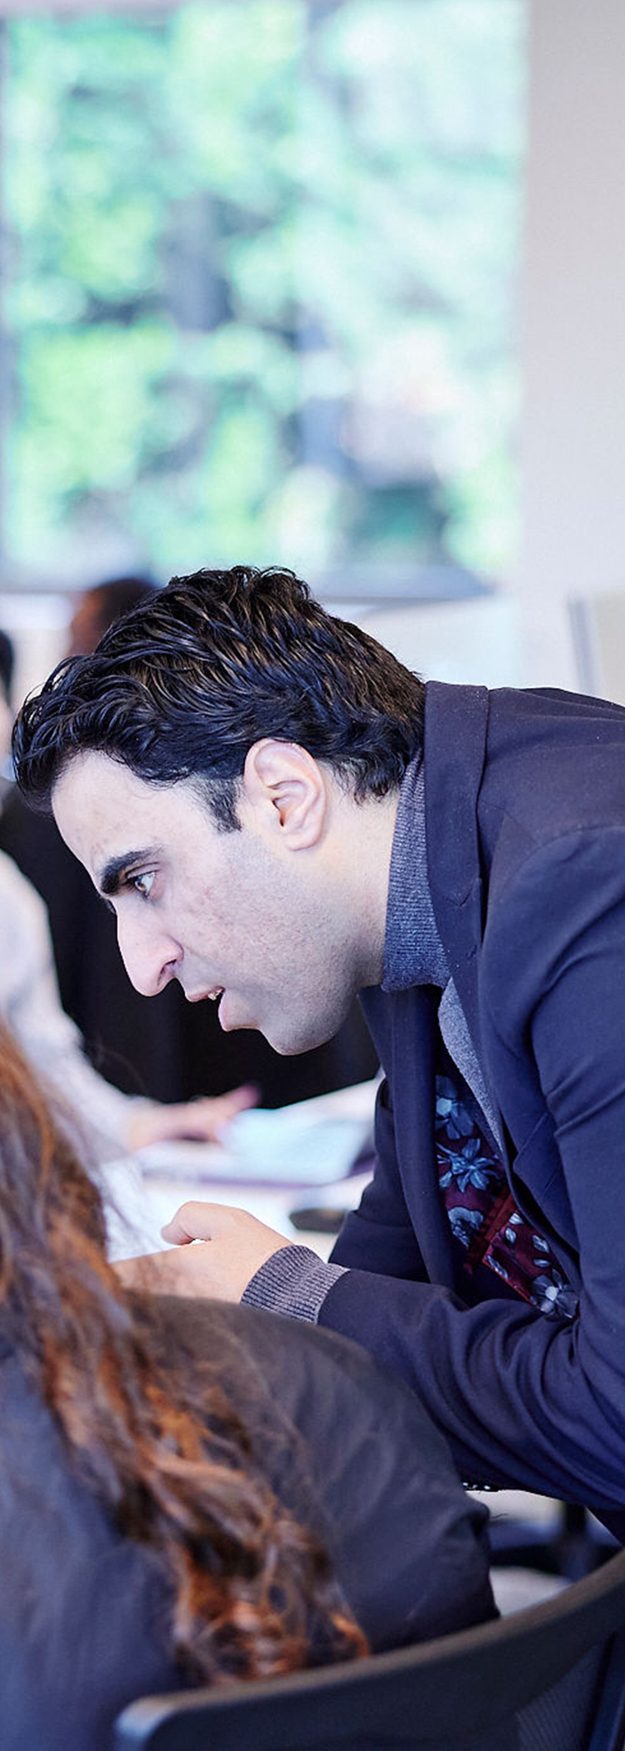
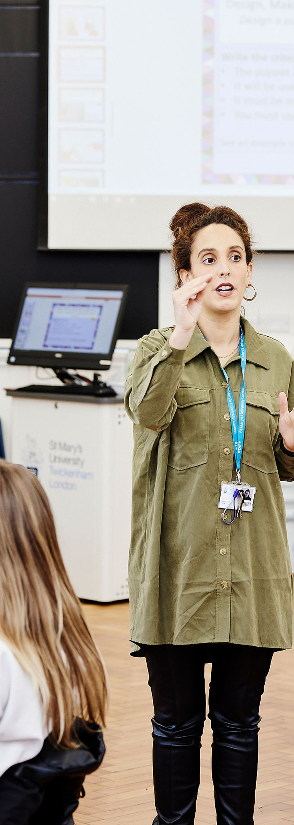
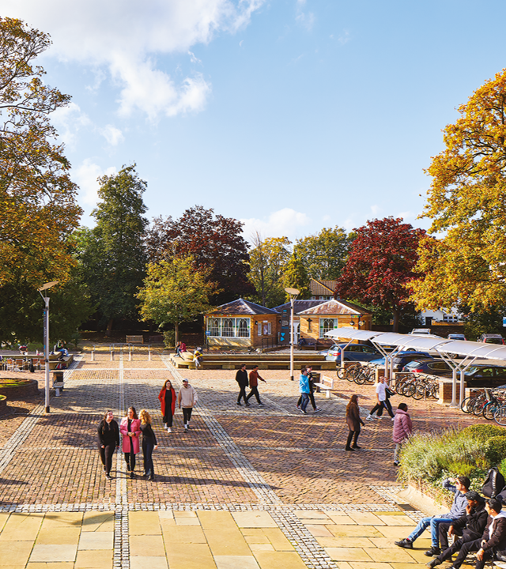
Getting Settled
Notes:
Delete and add your own video (insert > video > online film > enter URL link from YouTube)

Slide 26
After you arrive
Download MySMU app: required for attendance, time-table and regular updates.
    Open a bank account: After you enrol online, you can request a banking letter through your e:Vision student portal. See https://www.stmarys.ac.uk/international/student-life/%E2%80%8Bopening-a-bank-account.aspx for details.
    Register with a GP (doctor): This will also give you access to the COVID vaccination programme. For details, see www.stmarys.ac.uk/international/student-life/%E2%80%8Baccessing-health-services.aspx
    Get a National Insurance Number (if you have permission to work): You need to apply for this before you start work. Full instructions here: https://www.gov.uk/apply-national-insurance-number
Notes:
Delete and add your own video (insert > video > online film > enter URL link from YouTube)

Slide 27
Induction
Mandatory course induction schedule: https://www.stmarys.ac.uk/welcome/course-information.aspx
Choose which Student Life and Student Essentials talks to attend
Online international induction week commencing 16th September: https://www.stmarys.ac.uk/welcome/international.aspx and emails from the team for further details
Welcome Week is a great way to meet people: https://www.stmaryssu.co.uk/your-opportunities
Notes:
Delete and add your own video (insert > video > online film > enter URL link from YouTube)

Slide 28
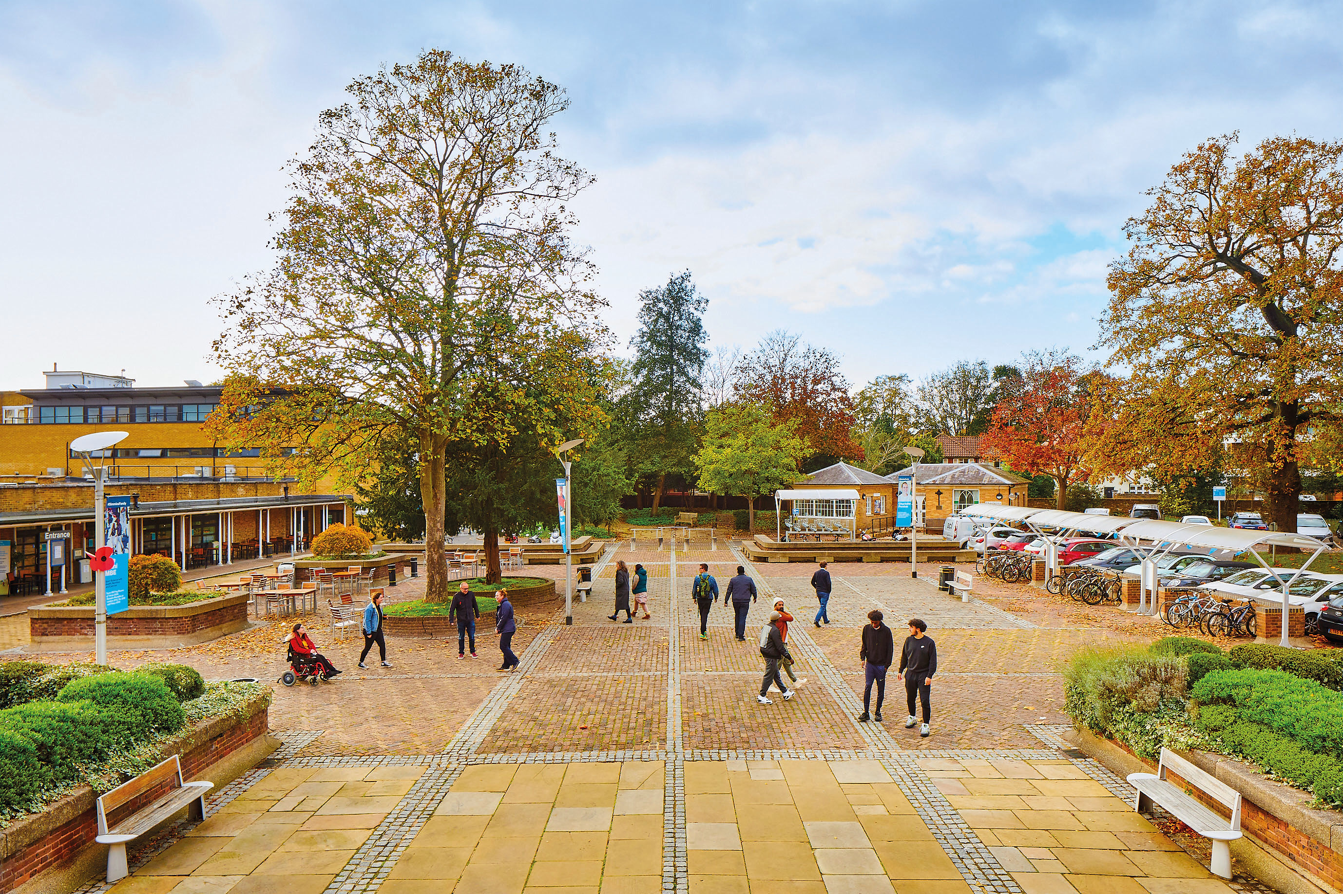
Starting on the Campus
Follow your teaching timetable
Get the MySMU app to check in for lectures
Collect your ID card from our Security team when you arrive
Personalised online campus tour at https://www.stmarys.ac.uk/virtual-tour/explore.aspx
Notes:
Careers

Slide 29
Succeeding at St. Mary's – our top tips
Join a sports club and/or student society: www.stmaryssu.co.uk/
    Register with a doctor (GP) right away: www.stmarys.ac.uk/international/student-life/%E2%80%8Baccessing-health-services.aspx
    Use study support early and often: www.stmarys.ac.uk/student-support/learning-development/study-support.aspx
    Protect yourself by knowing our academic integrity rules (plagiarism, etc.): stmarys.libguides.com/c.php?g=291307&p=1940644 and www.stmarys.ac.uk/policies/academic-regulations.aspx
    Explore London and the UK: www.visitlondon.com and www.visitbritain.com
Notes:
Careers

Slide 30
Key contacts
CAS and Admissions queries: internationaladmissions@stmarys.ac.uk
Arrival support: international@stmarys.ac.uk
Academic questions: Your Course Lead
Visa queries after you arrive, including BRP: studentvisas@stmarys.ac.uk
Queries about University and private housing: accommodation@stmarys.ac.uk
Problems logging into online resources: helpdesk@stmarys.ac.uk
Wellbeing or disability support: studentservices@stmarys.ac.uk
Tuition fee queries: feesoffice@stmarys.ac.uk
Registration queries: registryservices@stmarys.ac.uk
Notes:
Layout with 3 photos

Slide 31
Key contacts
South Asia team: southasia@stmarys.ac.uk
Pakistan and Southeast Asia: undaleeb.qazi@stmarys.ac.uk
Africa and Middle East: gregory.barron@stmarys.ac.uk
The Americas: bill.richards@stmarys.ac.uk
Notes:
Layout with 3 photos

Slide 32
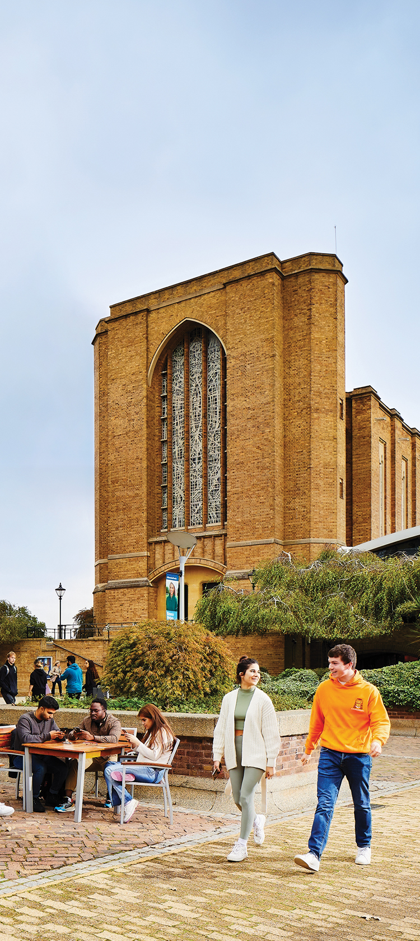
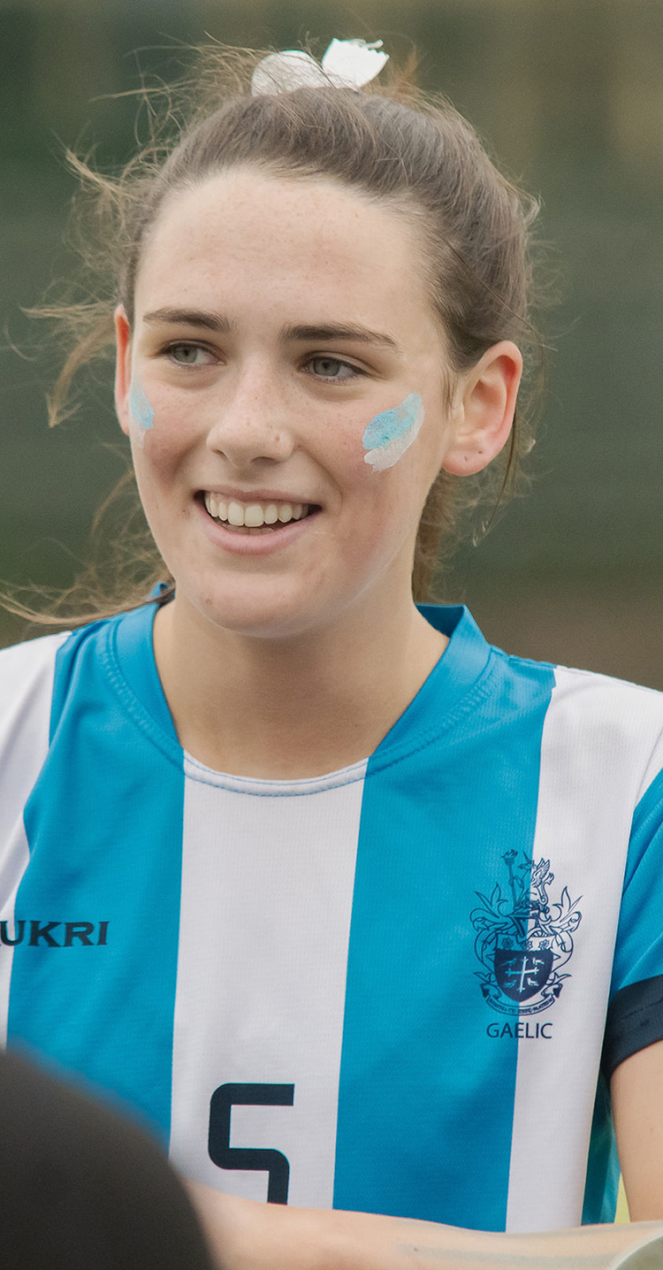
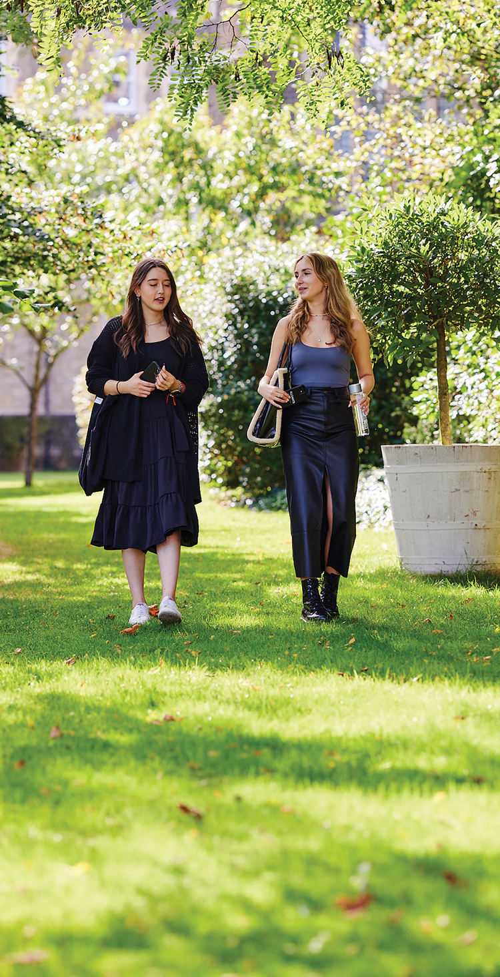
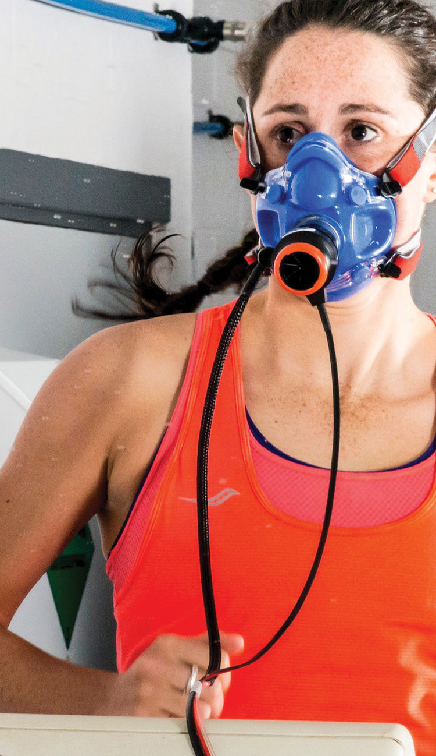
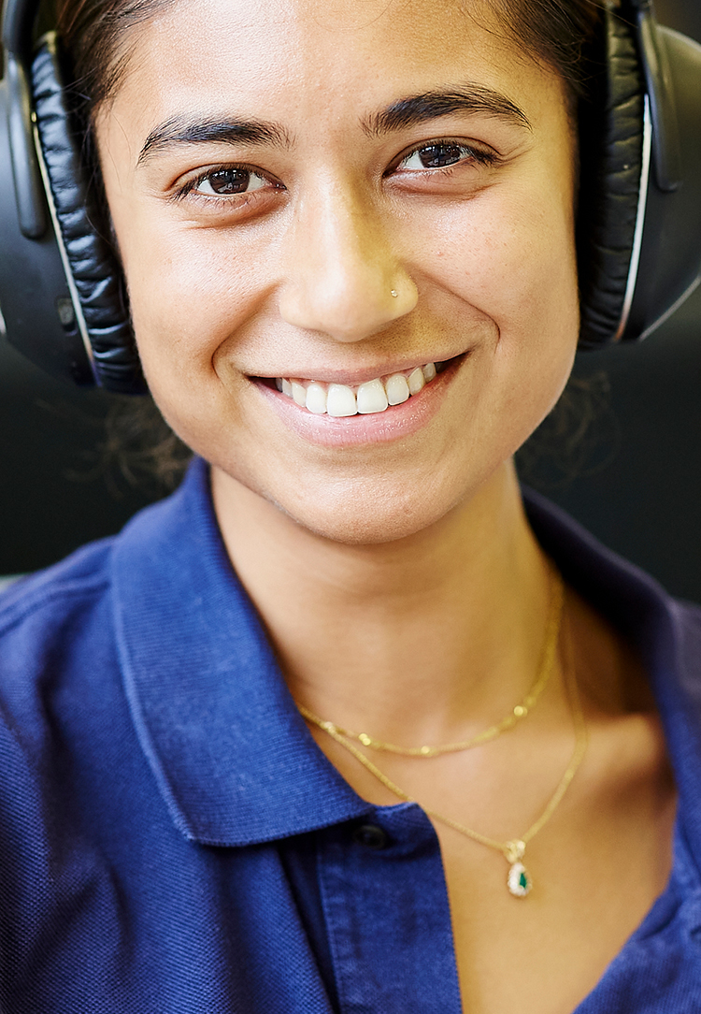

See you soon!
Notes:
Please follow design close to the cover of the prospectus – perhaps with ‘welcome’ rather than 2025 across images? Please include St Mary’s branding here.
Note: this should featured a diverse mix of students – and can be the same for each school

Slide 33
Back up slides – if needed
Notes:
Layout with 3 photos

Slide 34
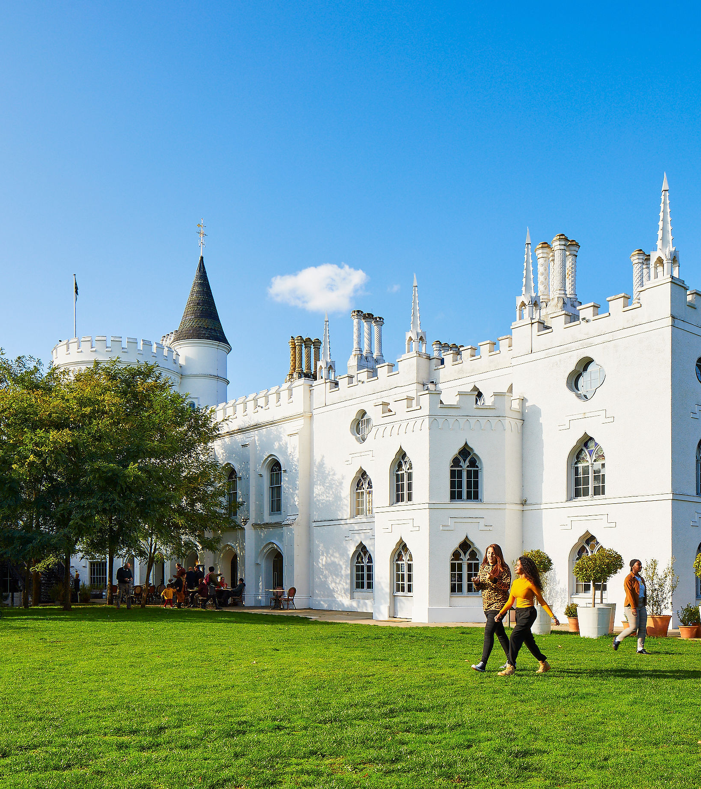
Visas
Notes:
Delete and add your own video (insert > video > online film > enter URL link from YouTube)

Slide 35
Student Visas
Process outlined on our website: www.stmarys.ac.uk/international/visas
Applications may be delayed due to backlogs
Follow all instructions from UKVI for e-visas
Don’t make travel arrangements before passport is returned
EU students with settled status don’t need a visa
Students here for less than six months may come as Standard Visitors, depending on circumstances
Notes:
Key fact – photo on right

Slide 36
Course start dates
Extremely important that you arrive by course start date
Check your CAS for the official course start date and the latest date you are allowed to arrive.
Please check with your Regional Manager if you are unsure.
Inform internationaladmissions@stmarys.ac.uk if you are experiencing any delays.
Most courses have an induction week prior to the start of teaching.
Notes:
Key fact – 3 picture

Slide 37
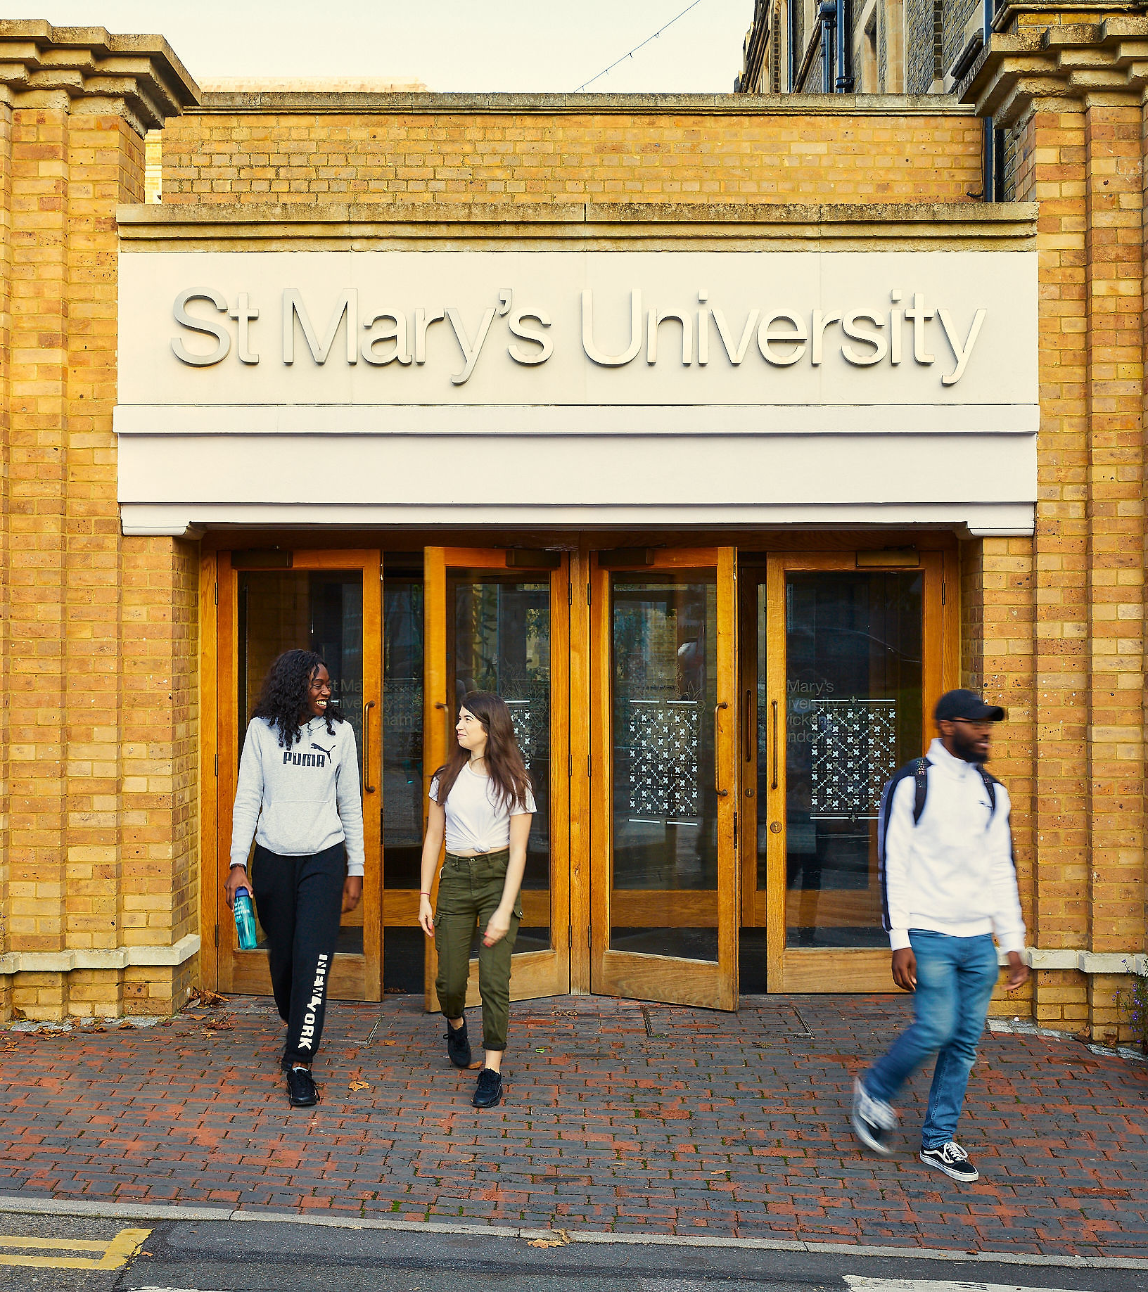
Online Enrolment
Notes:
Delete and add your own video (insert > video > online film > enter URL link from YouTube)

Slide 38
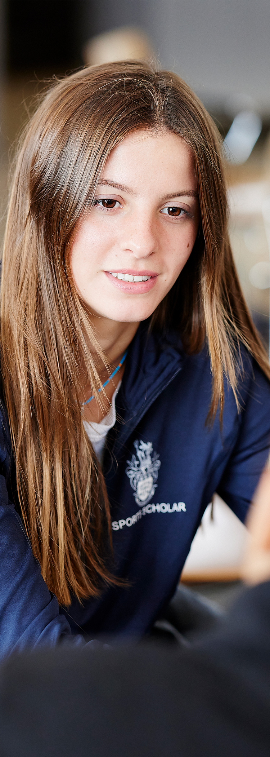
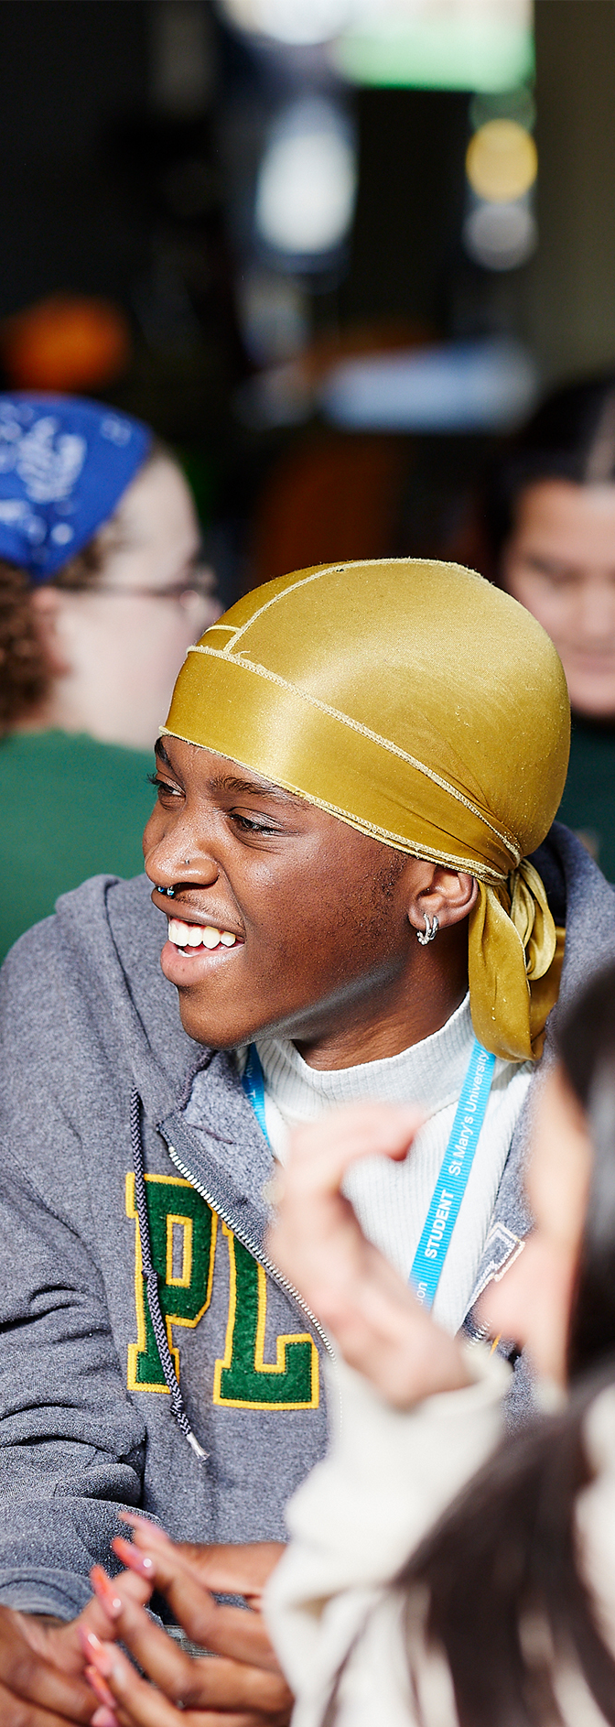
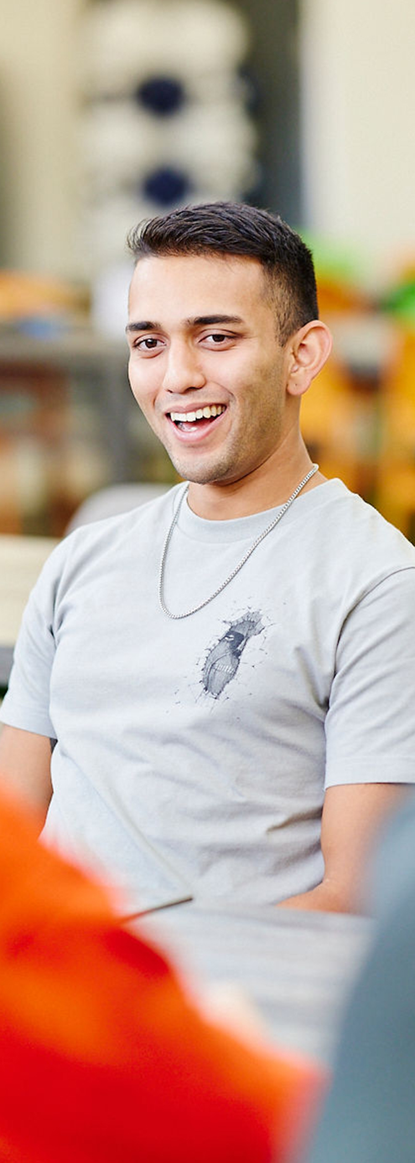
Online Enrolment
You will receive an invitation to enroll shortly
Log into the e:Vision portal
Confirm modules, visa status, fee payment, contact details and personal information
Full access to online resources after enrolment
Managed by Registry, registryservices@stmarys.ac.uk
Notes:
Layout with 3 photos

