Slide 1




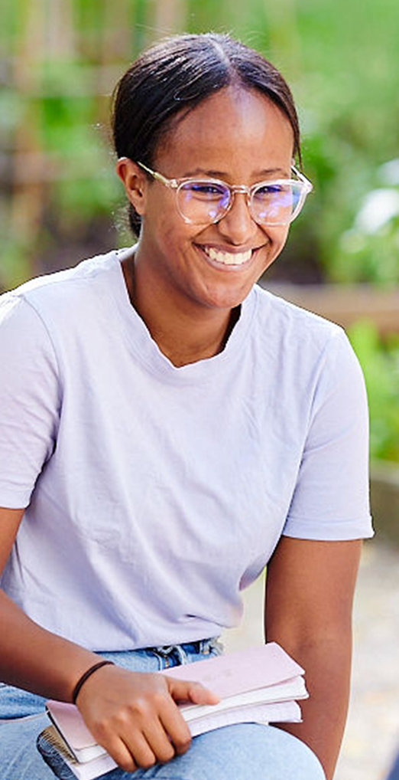
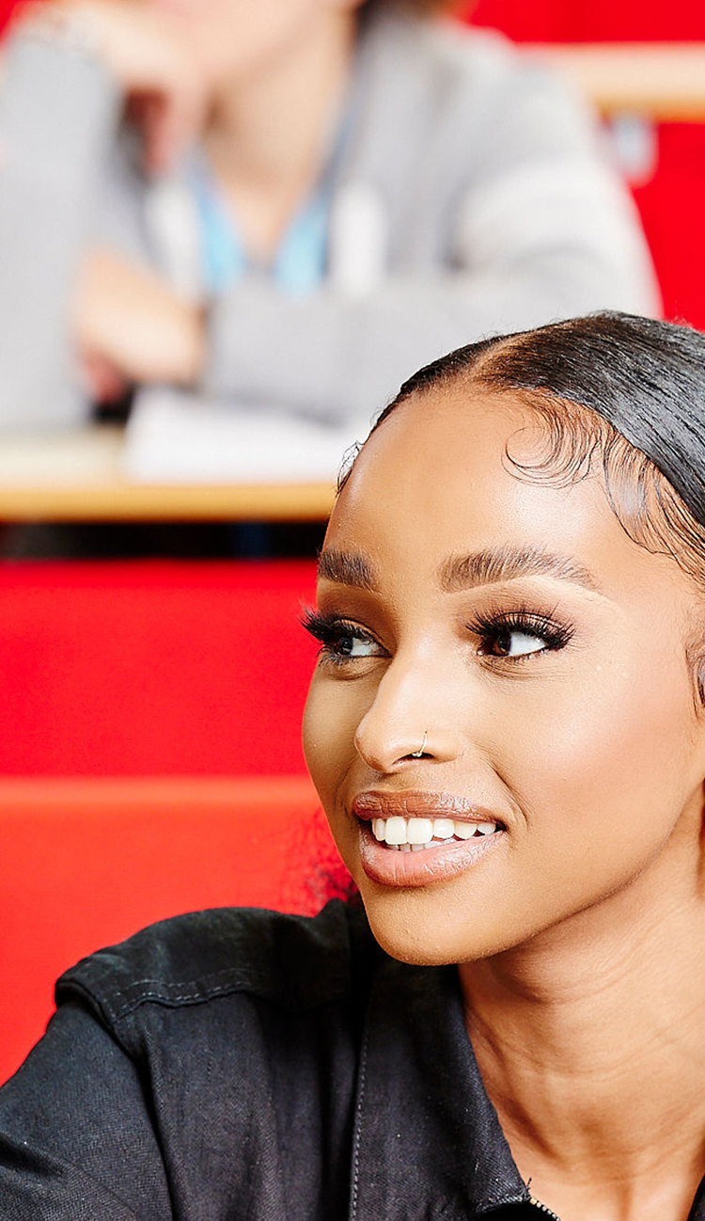
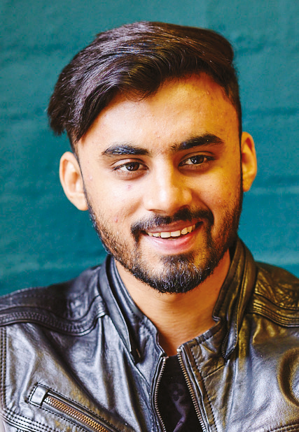

Planning your arrival
International Office

Slide 2
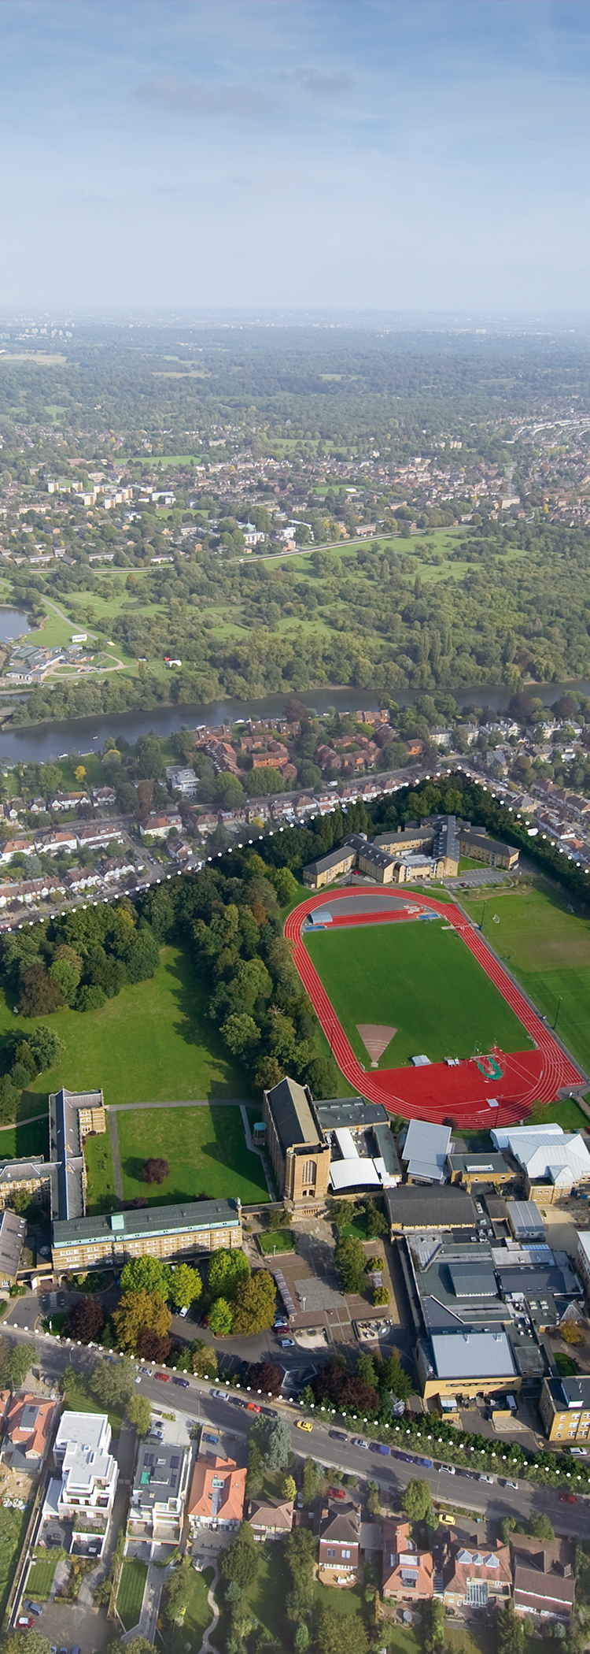

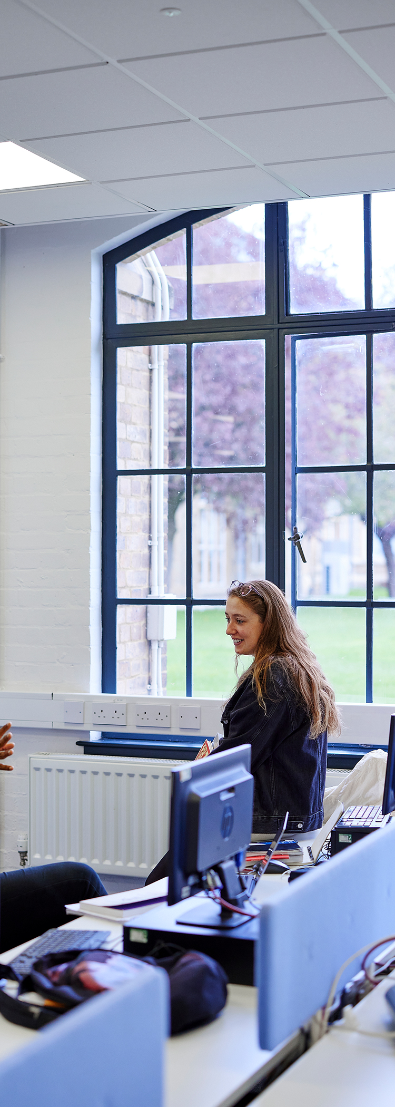
Steps to St. Mary's...
Travel and arrival.
Visas and Enrolment.
Getting Settled
Course Induction - welcome events and international orientation.
Key contacts
Any extra question you have
Notes:
Agenda – 3 photos

Slide 3
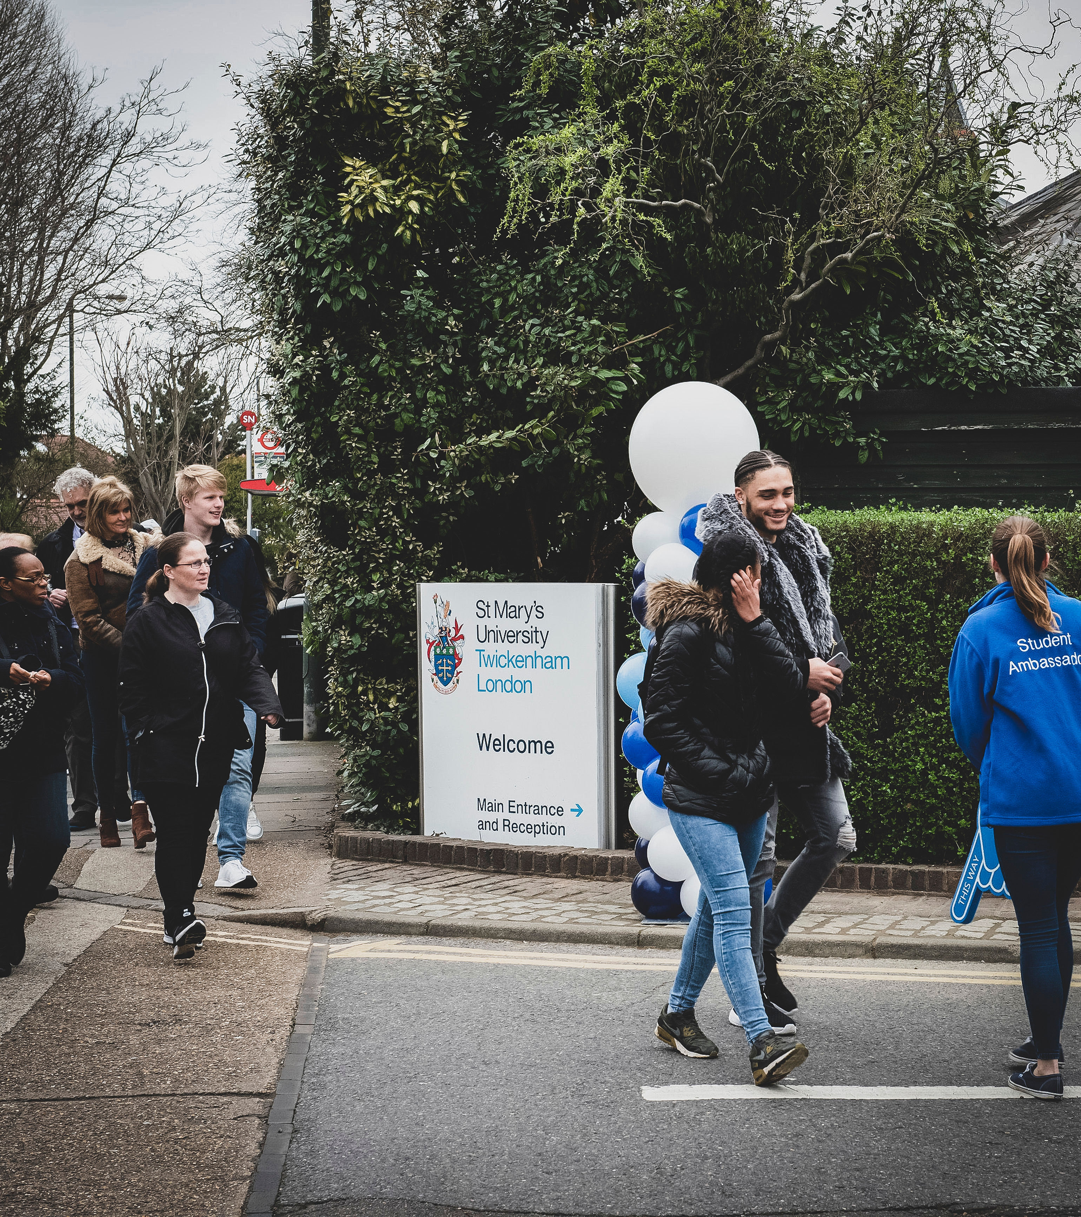
Travel and Arrival
Notes:
Delete and add your own video (insert > video > online film > enter URL link from YouTube)

Slide 4
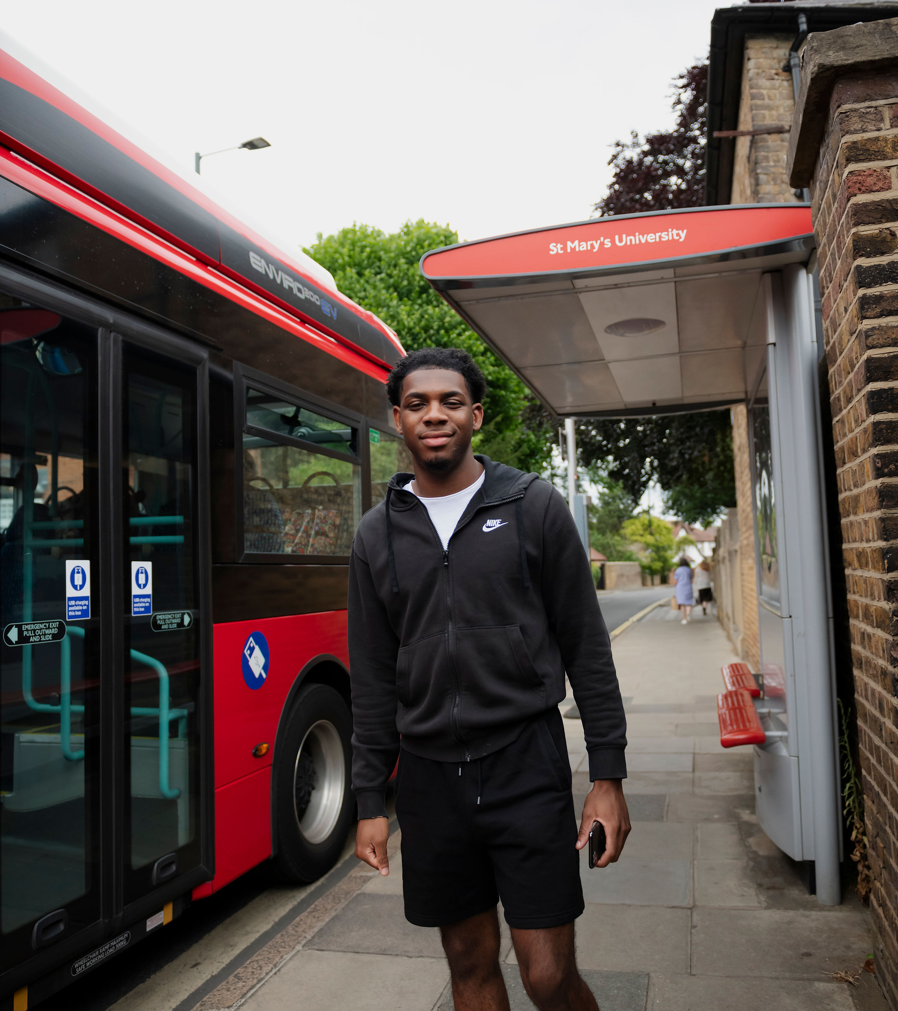
Booking travel
Before you buy a ticket:
Have your visa, if necessary. Make sure to arrive after your entry clearance starts.
Have a confirmed place to live
Latest arrival dates:
  Primary: 28 Aug 2026
  Secondary: 01 Sept 2026
Ideally arrive before 26 Aug – to attend PGCE Welcome Day
Notes:
Studying – programme photo on right

Slide 5
Essential Planning
In the weeks before you travel:
  Read our pre-departure advice at https://www.stmarys.ac.uk/international/prepare/get-ready.aspx
  Plan how to access money until you can open a bank account. Have a credit card and/or a prepaid debit card for emergencies (Visa or Mastercard).
  Fill any necessary prescriptions and take care of healthcare appointments
  Confirm your accommodation and plan how to get there when you arrive (contact accommodation@stmarys.ac.uk or international@stmarys.ac.uk if you need support)
Notes:
Pathway – programme photo on right

Slide 6
Entering the UK
  E-mail international@stmarys.ac.uk if you need advice about travel arrangements
  Carry paper copies of your St Mary’s offer letter, proof of finances and accommodation in your hand luggage
  See a Border Force Officer to check if you need a passport stamp and keep your boarding pass to show when you arrived
Your ID check: The St Mary’s University visa team must meet with you face-to-face during the enrolment period for your ID check. You must present yourself with your passport and your share code.
  Further guidance at ukcisa.org.uk/Information--Advice/Visas-and-Immigration/Immigration-on-arrival
  Directions to campus: www.stmarys.ac.uk/contact/directions.aspx

Slide 7
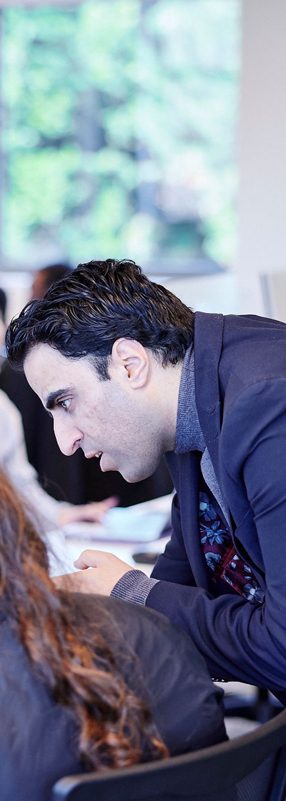
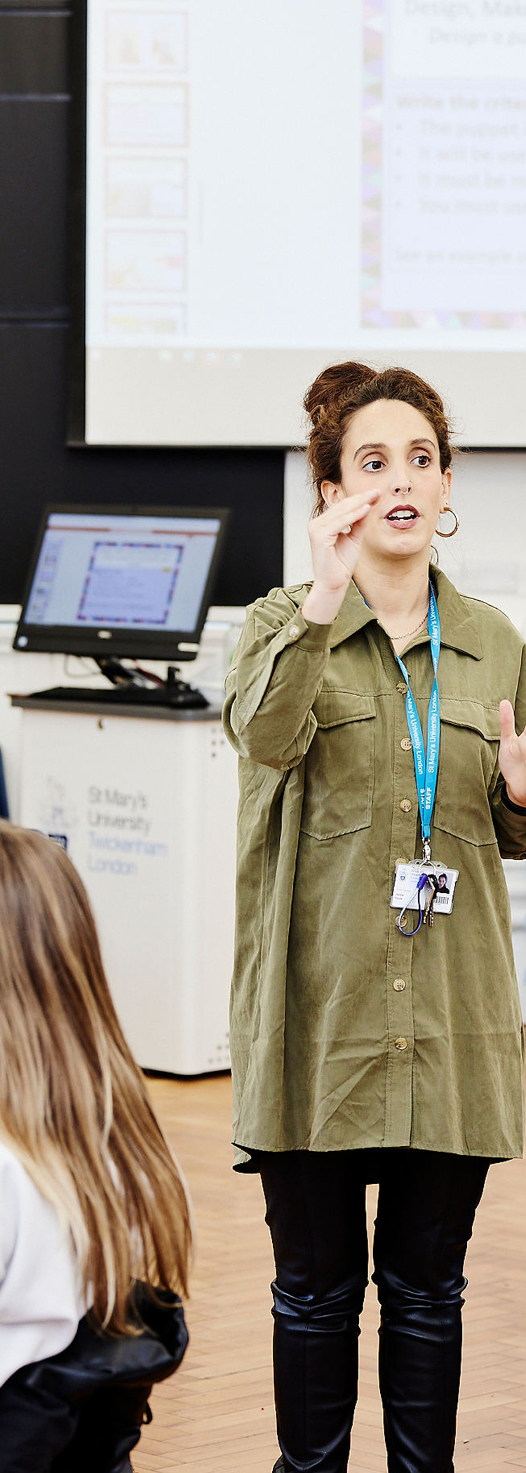
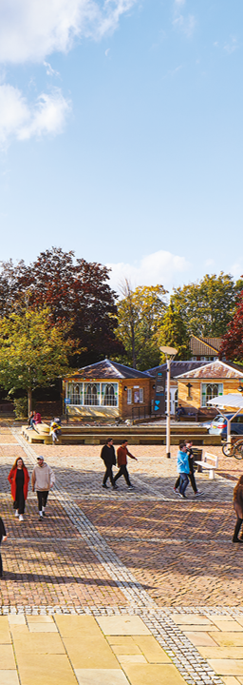
Getting
Settled
Notes:
Delete and add your own video (insert > video > online film > enter URL link from YouTube)

Slide 8
After you arrive
You can do some things only after you’re here:
Please download MySMU app: required for attendance, time-table and regular updates.
    Open a bank account: After you enrol online, you can request a banking letter through your e:Vision student portal. See https://www.stmarys.ac.uk/international/student-life/%E2%80%8Bopening-a-bank-account.aspx for details.
    Register with a GP (doctor): For details, see www.stmarys.ac.uk/international/student-life/%E2%80%8Baccessing-health-services.aspx
    Get a National Insurance Number (if you have permission to work): You need to apply for this before you start work. Full instructions here: https://www.gov.uk/apply-national-insurance-number
Notes:
Delete and add your own video (insert > video > online film > enter URL link from YouTube)

Slide 9
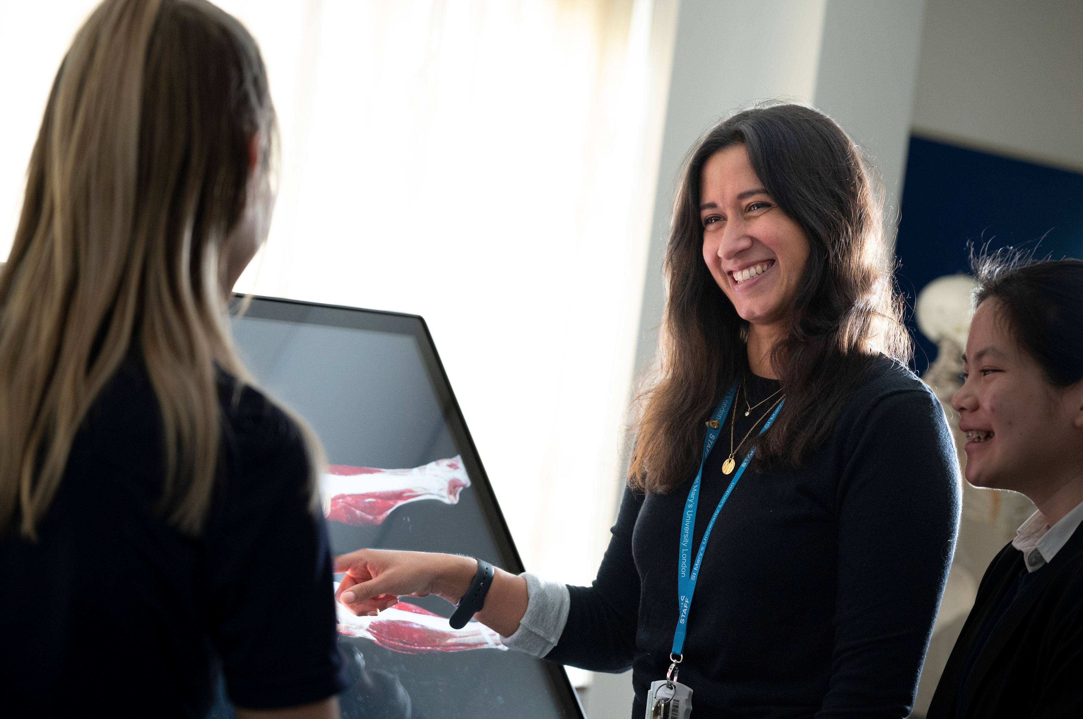
International PGCE Welcome Day
Starts at 9:45am on 26 August 2026
Meet at Lecture Hall N44 – located towards the back side of the student dining hall 'The Refectory'
Sessions on: Introduction to St Mary's, Wellbeing, Document checks, Arrival information and safeguarding/school preparation sessions.
Meet and greet with faculty and key St Mary's staff.
Continue to check emails over the next two weeks with further pre-departure and Welcome Day information
Notes:
Delete and add your own video (insert > video > online film > enter URL link from YouTube)

Slide 10
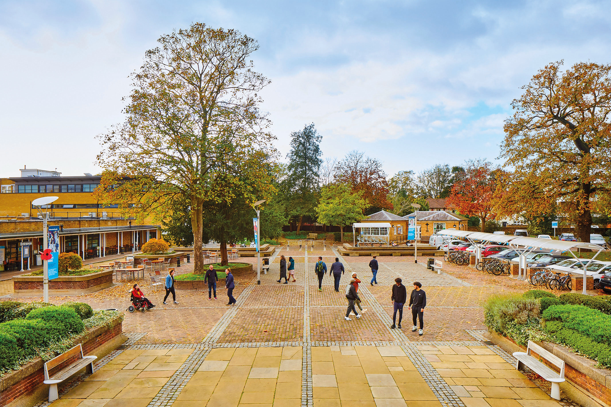
Starting on the Campus
Follow your teaching timetable
Get the MySMU app to check in for lectures
Collect your ID card from our Security team when you arrive
Personalised online campus tour at https://www.stmarys.ac.uk/virtual-tour/explore.aspx
Notes:
Careers

Slide 11
Succeeding at St. Mary's – our top tips
Join a sports club and/or student society: www.stmaryssu.co.uk/
    Register with a doctor (GP) right away: www.stmarys.ac.uk/international/student-life/%E2%80%8Baccessing-health-services.aspx
    Use study support early and often: www.stmarys.ac.uk/student-support/learning-development/study-support.aspx
    Protect yourself by knowing our academic integrity rules (plagiarism, etc.): stmarys.libguides.com/c.php?g=291307&p=1940644 and www.stmarys.ac.uk/policies/academic-regulations.aspx
    Explore London and the UK: www.visitlondon.com and www.visitbritain.com
Notes:
Careers

Slide 12
Key contacts
CAS and Admissions queries: internationaladmissions@stmarys.ac.uk
Arrival support: international@stmarys.ac.uk
Academic questions: Your Course Lead
Visa queries after you arrive, including BRP: studentvisas@stmarys.ac.uk
Queries about University and private housing: accommodation@stmarys.ac.uk
Problems logging into online resources: helpdesk@stmarys.ac.uk
Wellbeing or disability support: studentservices@stmarys.ac.uk
Tuition fee queries: feesoffice@stmarys.ac.uk
Registration queries: registryservices@stmarys.ac.uk
Notes:
Layout with 3 photos

Slide 13
Key contacts
International Admissions: internationaladmissions@stmarys.ac.uk
South Asia team: southasia@stmarys.ac.uk
Pakistan and Southeast Asia: undaleeb.qazi@stmarys.ac.uk
Africa and Middle East: gregory.barron@stmarys.ac.uk
The Americas: bill.richards@stmarys.ac.uk
Notes:
Layout with 3 photos

Slide 14
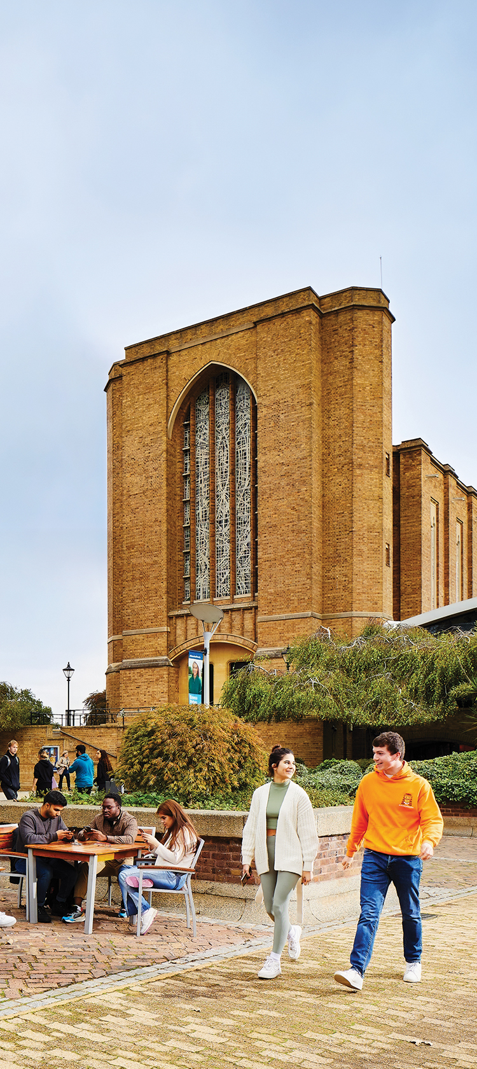
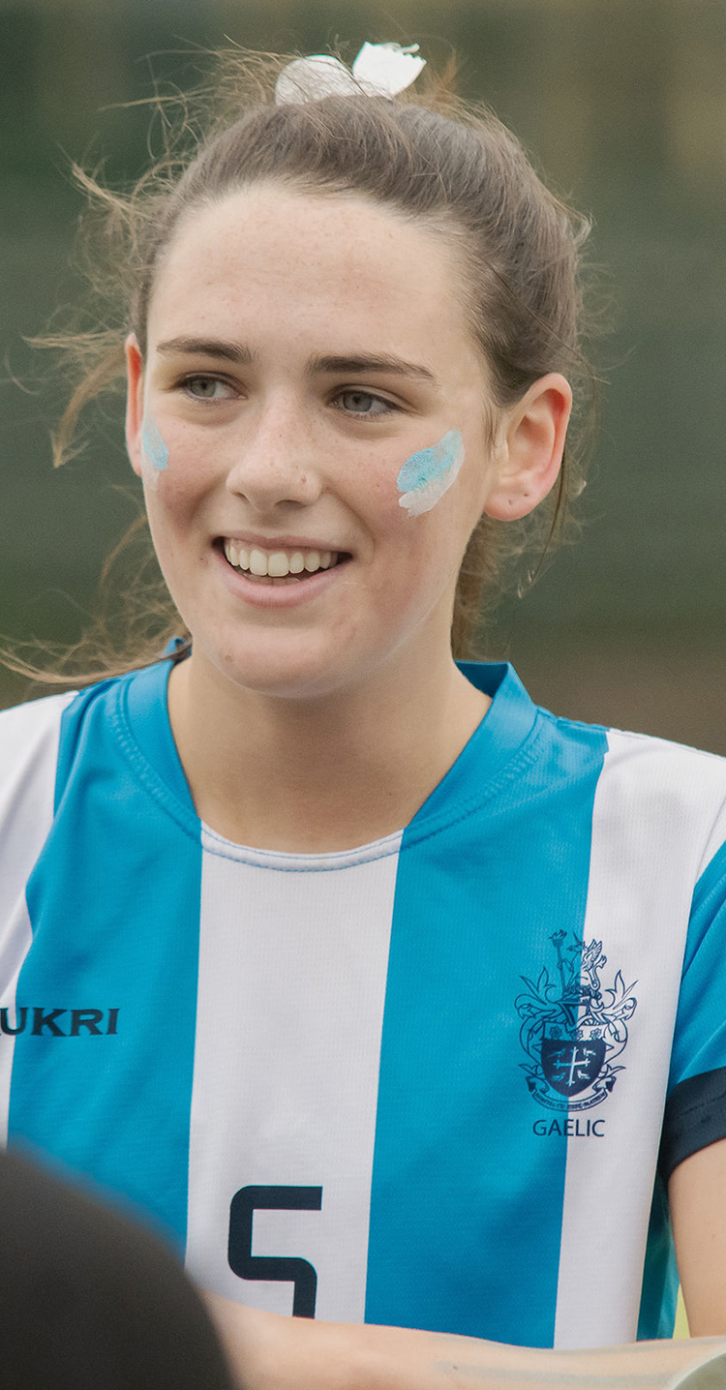
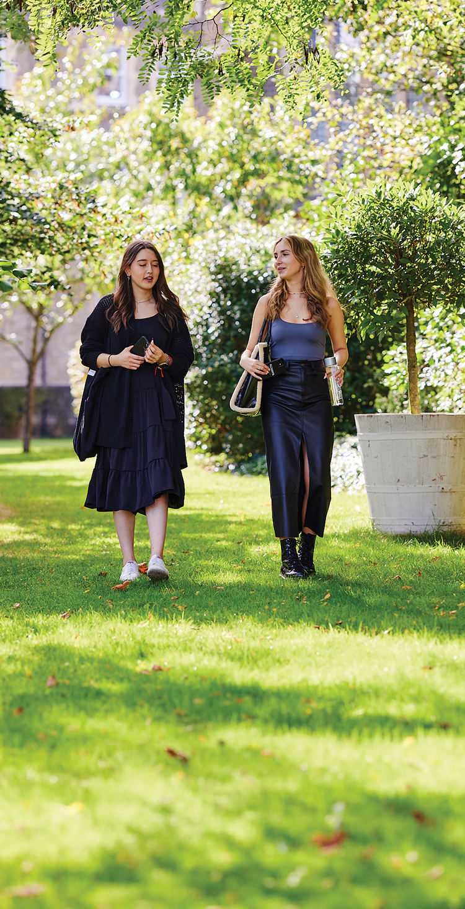
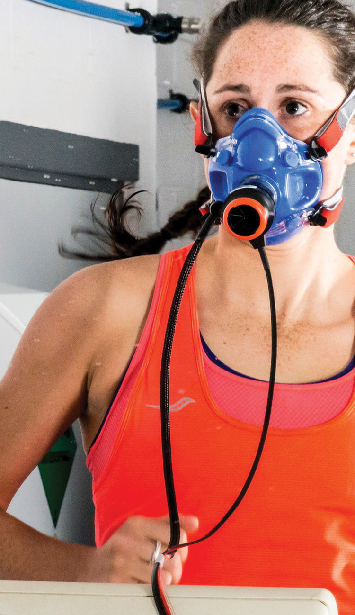
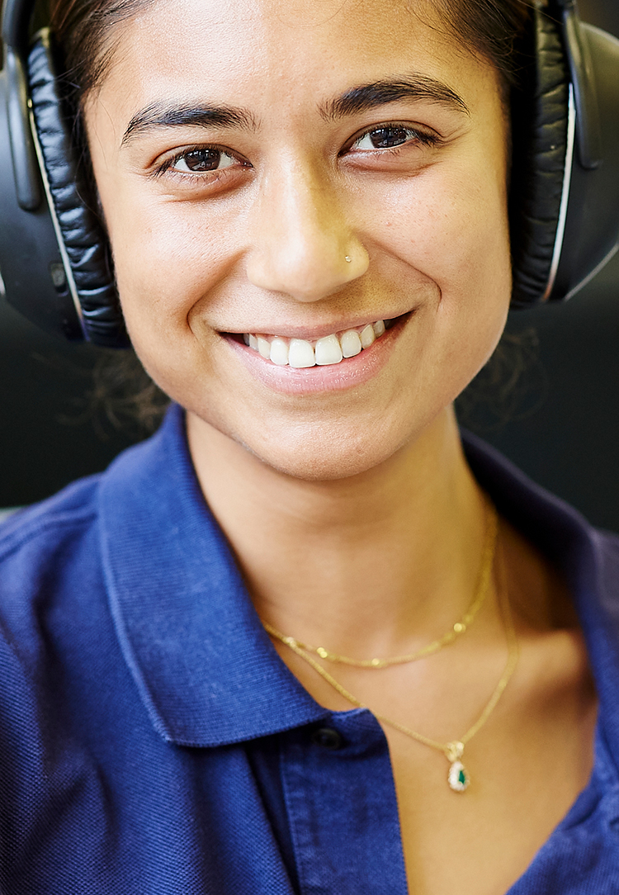
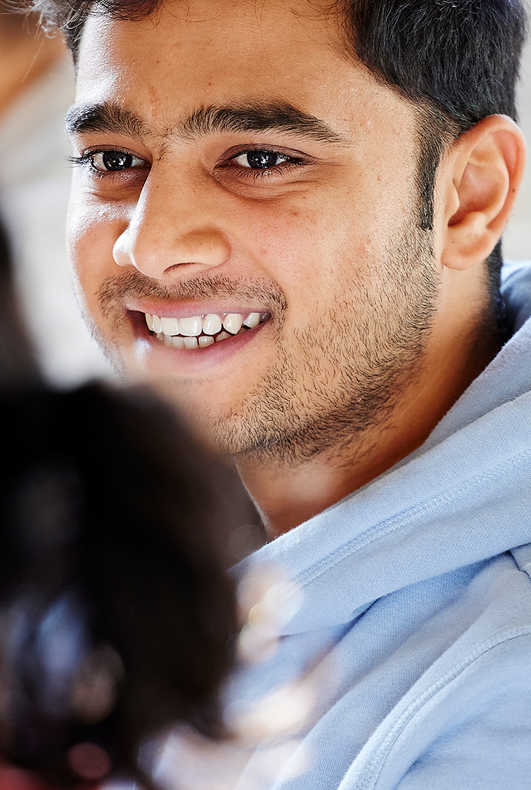
Q&A at end of session
Notes:
Please follow design close to the cover of the prospectus – perhaps with ‘welcome’ rather than 2025 across images? Please include St Mary’s branding here.
Note: this should featured a diverse mix of students – and can be the same for each school

