Slide 1

Chris Hebbs
UKVI Compliance and Immigration Manager
St Mary’s University

Slide 2
Online enrolment & face-face ID Check
For New Students
This guide explains what to do after receiving your Student Visa and subsequently your eVisa

Slide 3
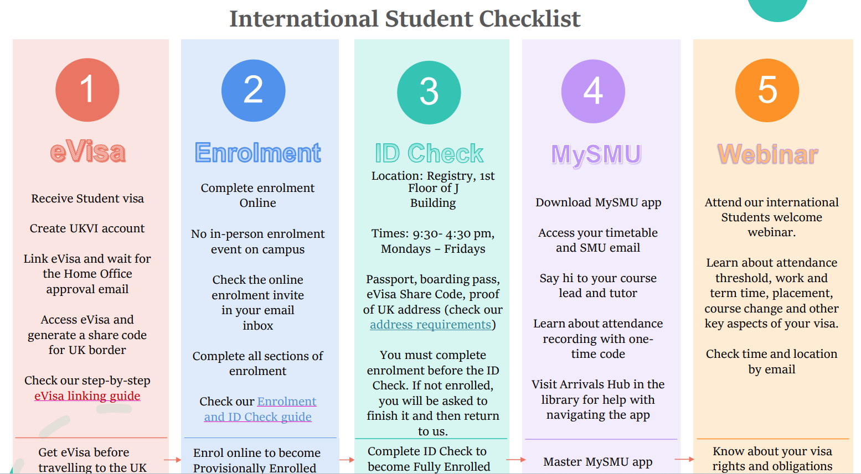

Slide 4
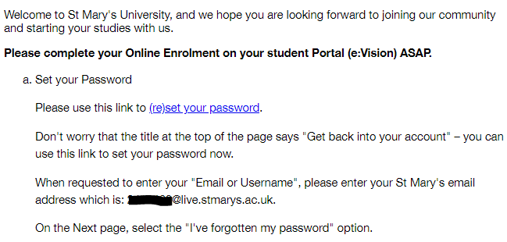
Complete your enrolment
You can begin your online enrolment when you receive an email from Registry about completing your online enrolment. The email is normally sent out in August and appears like the image below:

Slide 5
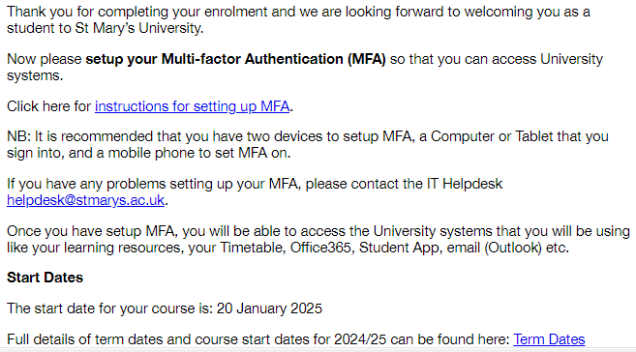
Email confirmation
Once you have completed the enrolment, you should receive an email confirming this.

Slide 6
You have received your visa
You should also have received a letter or email from the UKVI on your successful application. This document states the entire length of your visa and the conditions of the visa granted.
Check your spam folder if you cannot locate this email. Request this from your agent if they submitted the application on your behalf.
You will need to apply for an eVisa based on the link and instructions on your UKVI decision email/letter. Please refer to our eVisa application guide for details if you need help with this process. (Later in these slides)

Slide 7
Apply for your eVisa
You do NOT have a BRP. eVisa is the only proof of immigration permission.
UKVI Decision Letter/email contains instructions on applying for an eVisa.
Create UKVI account, verify your ID, apply for eVisa
eVisa approved, access ‘View and Prove’ to see eVisa and produce share code
Check our step-by-step guide:

Slide 8
Have your share code ready
Before you can fully complete the visa section of the enrolment, you will need to have gained access to your eVisa and generated a valid share code for it. The share code should begin with an ‘S’
You cannot complete online enrolment if you have not yet been granted a Student visa
You cannot complete enrolment if you have not begun the eVisa linking process
You cannot complete enrolment if you are still waiting for the eVisa to be approved by the Home Office

Slide 9
First day on campus
Collect your Student ID card at the Security Desk situated next to Reception at the entrance of the campus
Check if you have received emails from the student visa team about completing your ID check. For PGCE and study broad, we normally conduct the check on your arrival day.
Come to Registry Services with your passport, eVisa share code and boarding pass, proof of address, to speak to a member of the team

Slide 10
Complete ID Check with Visa Team
Where?
Registry Services, 1st Floor of J Building
When?
9am – 4.30pm, Monday – Fridays All week.
Documents to carry?
Passport, Boarding Pass, eVisa Share Code, Proof of address

Slide 11
We will explain your visa to you
After we verified your ID, collected your share code, and taken copies of your passport and vignette, your ID check is complete.
We will provide you with a copy of the Essential Guide which covers all the key points you need to know about your Student visa. The guide will cover attendance requirement, work conditions during and after studies, work placement, Graduate visa, Schengen Letter and others related topics.
You should use the MySMU app to record your attendance, check your outlook calendar for timetable, access your university email and information on our website. See the help desk in library if you need help with using the app.

Slide 12
If you do not complete the ID Check
If you have completed the online enrolment but have not done the ID check, your student status will be provisionally enrolled PE
Your student status will change to fully enrolled once you complete the ID check with the student visa team at Registry Services
We will remind you regularly about the ID Check if you have not completed this. If the time slots provided clash with your class or placement, please email us back with a proposed time that suits you.

Slide 13
Other services you should know
Fees team, 1st Floor of Student Centre.
Please ring the bell on the left of the counter to speak to the fees team if you have questions regarding your tuition fees or instalment plan.
Accommodation team, Wellbeing team, the 2nd floor of J Building.
Check with the accommodation team on availabilities of student halls on campus, or ask for help finding places nearby the campus within 1 hour 45 minutes via public transport. (As close as possible)
IT Helpdesk, Library
If you experience technical issues such as logging into your St Mary’s account, head to the library and speak to the Helpdesk staff.

Slide 14
UKVI Account + eVisa Linking Guide
For New Students
This guide will walk you through setting up your UKVI account and applying for your eVisa once you've received a successful Student visa decision.
You need to apply for an eVisa after you have successfully applied for a Student visa.
Your eVisa will be digitally linked to your passport.
No more physical BRP card will be issued.
You will be able to access and prove your immigration status online.

Slide 15
Check Your Email
  You will receive an official email or letter confirming the outcome of your visa application from the UKVI. This is your UKVI decision email/letter.
  This email/letter should confirm the application outcome, the length of your visa, the visa conditions, and instructions on creating a UKVI account and applying for a eVisa.
  If you cannot locate your UKVI decision email/letter because your agent or solicitor submitted the application on your behalf, please contact them to request it.

Slide 16
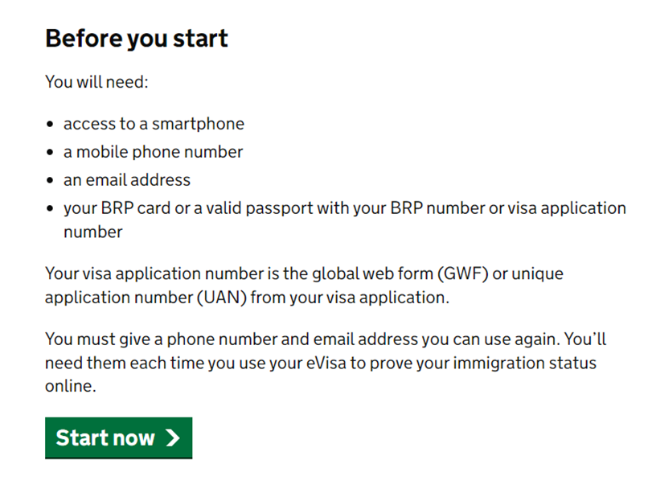
Set up UKVI Account
Go to the official UKVI website to create your UKVI account: https://www.gov.uk/get-access-evisa
Scroll down and click the green icon ‘Start now’

Slide 17
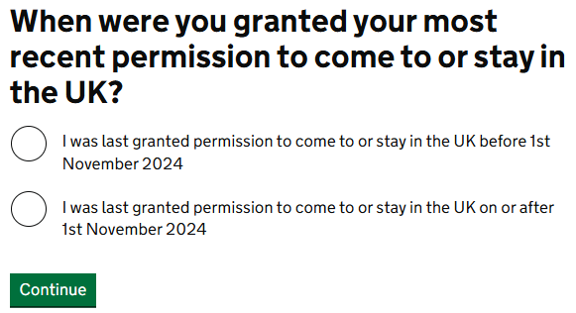
Check your UKVI decision email or letter – the visa grant date will be shown there. Select the correct option based on that date. New students from September 2025 onwards should select ‘after 1st November 2024’

Slide 18
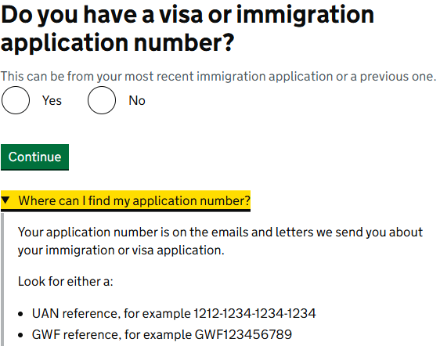
Your immigration application number (UAN reference) should be stated in your UKVI decision email/letter. If you cannot locate this information because your agent or solicitor submitted the application on your behalf, please contact them to request your application number.

Slide 19
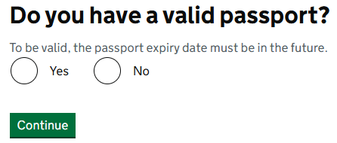
Select the answer ‘Yes’ if you have a passport with an expiry date in the future.

Slide 20
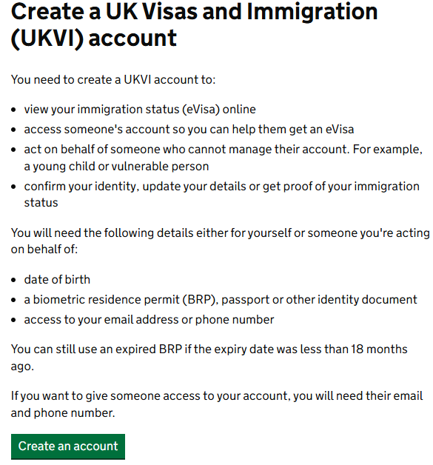
After answering these questions, you will be able to set up your UKVI account. Click ‘create an account’

Slide 21
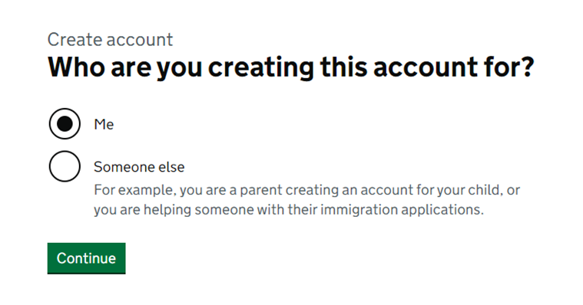
Select that you are creating the account for yourself.

Slide 22
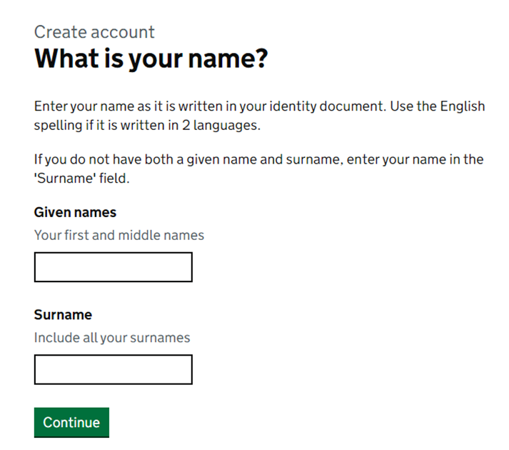
Provide your given names and surname as shown on your passport.

Slide 23
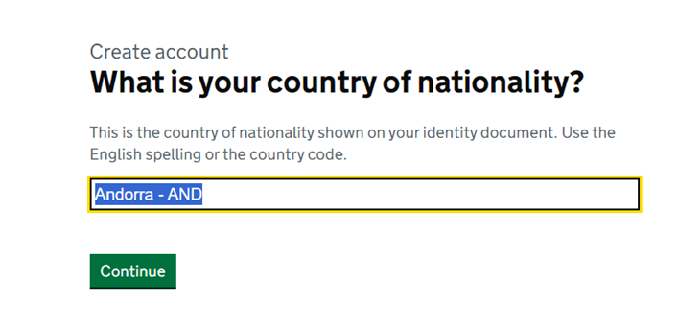
Type in or select your nationality from the drop-down list

Slide 24
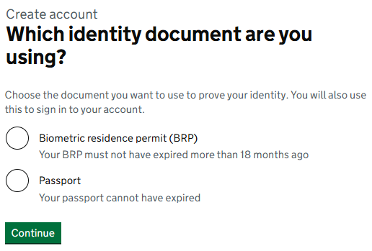
If you are granted a UK Student visa for the first time, you should select ‘passport’ as the ID document to set up your account with, as you will not be issued a BRP.
If you were granted other UK permission before your current one, you can use a previous BRP card to create the UKVI account. Make sure it has not expired more than 18 months ago.

Slide 25
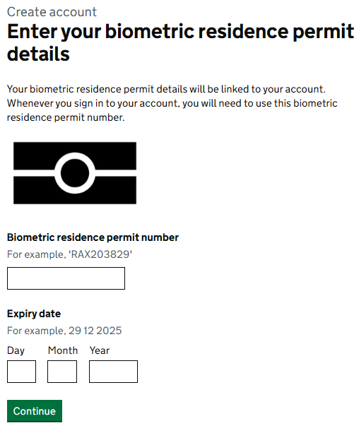
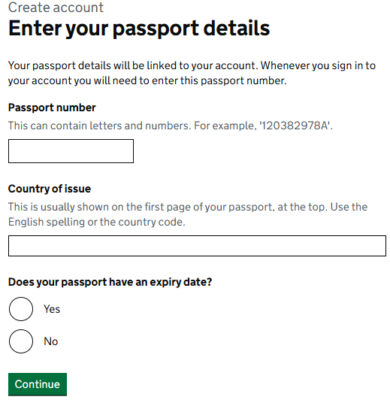
Based on your selection, you will be required to provide either your passport or BRP details

Slide 26
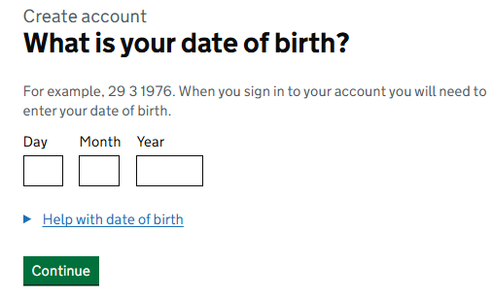
Enter your date of birth

Slide 27
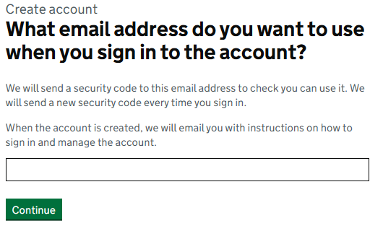
Use your personal email address to create the account, NOT your university email account as you will lose access of it after graduation. Click 'continue', then verify the email address by entering the 6-digit security code in the next page.

Slide 28
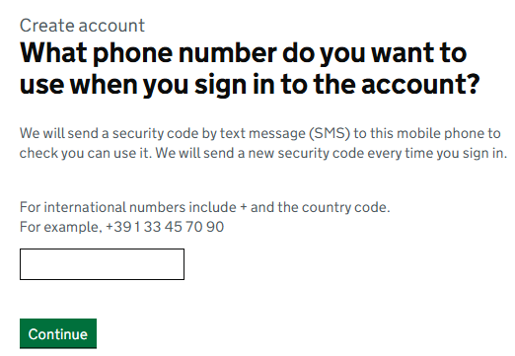
Use your UK phone number if you have one. If you only have an international number, add the correct country code at the beginning.
Click 'Continue', then verify the phone number by entering the 6-digit security code in the next page.

Slide 29
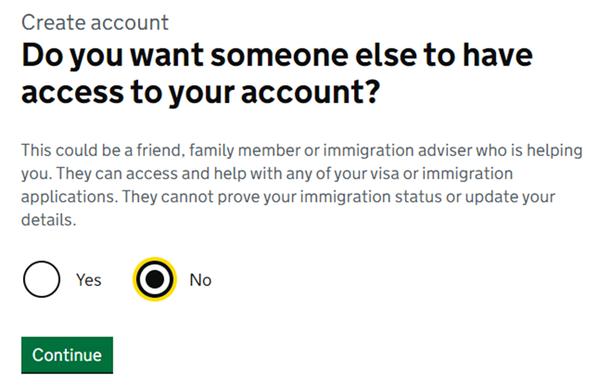
Select if you want others to access your UKVI account. You should select the option most suitable for your circumstances .

Slide 30
Check before you proceed
Review your answers in the next page before confirming the creation of your UKVI account. If you spot any error in your personal information, you will be able to click ‘change’ to edit the answer of that field.

Slide 31
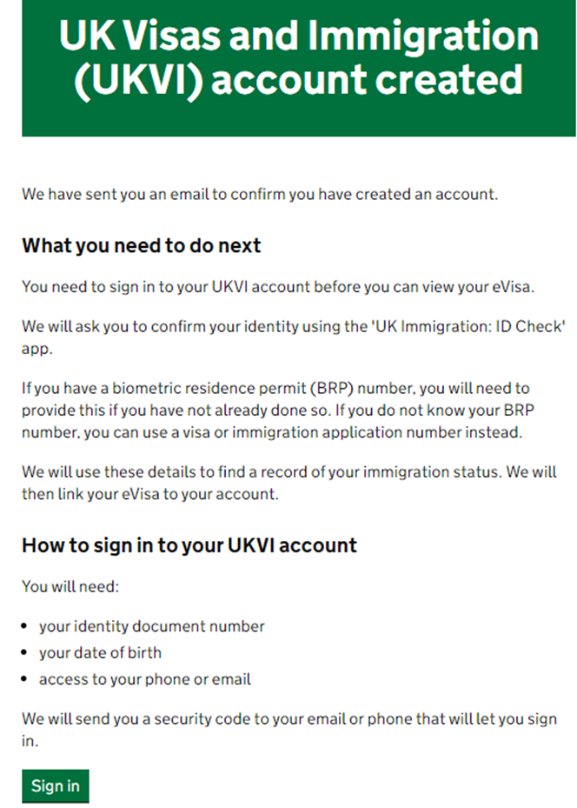
Account Created
You account is successfully created. Click ‘Sign in’. You will need to re-enter the ID document number (either BRP or Passport depending on which one you used to set up the account with), your date of birth and a security code sent to your phone or email.

Slide 32
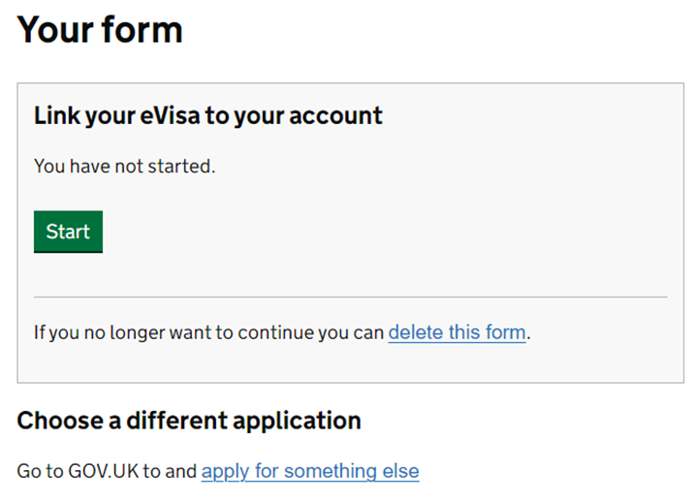
Start your eVisa Linking
After logging into your UKVI account, you can now link your eVisa to your account. Click on the green ‘Start’ button to see the process of the eVisa linking.

Slide 33
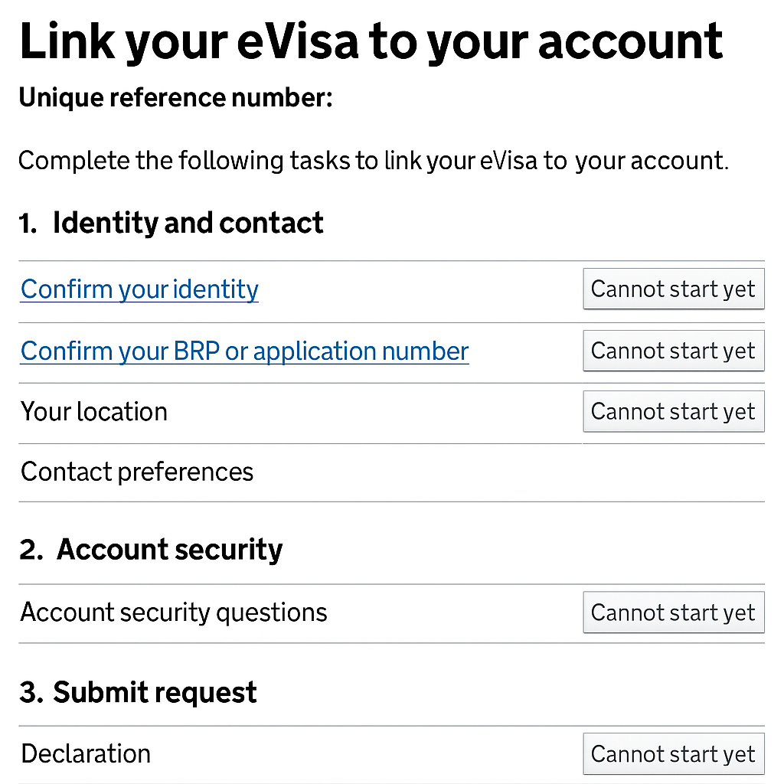
There are three sections containing six steps to the eVisa linking process. The six steps must be completed in order from top to bottom. After each step is completed, it cannot be edited again. So, make sure you action them correctly. Start by clicking ‘Confirm your identity’

Slide 34
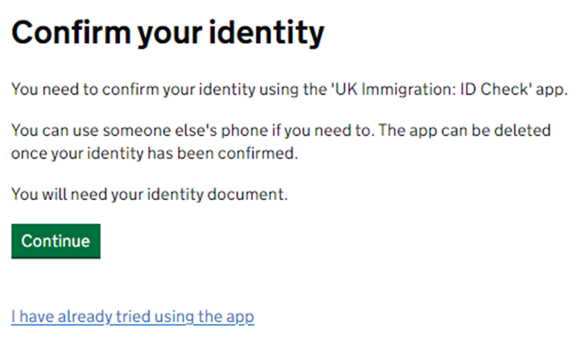
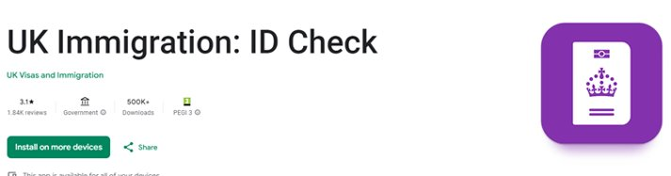
You will be asked to install an app called UK Immigration: ID Check on your phone.
Mark the name and icon shown on the right to make sure you've installed the correct one from the app store.

Slide 35
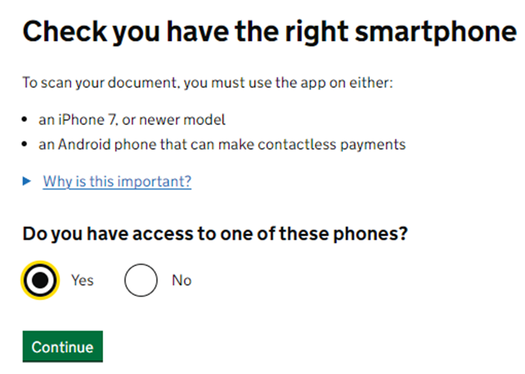
If you cannot find a suitable phone for running the app, please seek help from the visa team at Registry Services (1st Floor of J building) once you've arrived in the UK.
Your eVisa linking cannot proceed for the time being, but your UKVI account will remain active and the eVisa linking can be continued at a later date.
You are able to enter the UK using the vignette inside your passport.

Slide 36
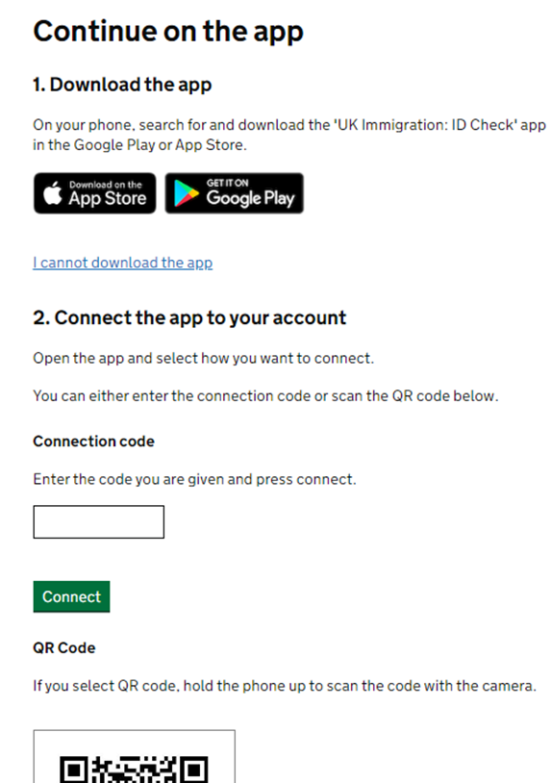
If you're ready to continue, open the app on your phone and begin the pairing process by either:​
Scanning the QR code displayed on the web page using your phone’s camera, or​
Entering the Connection Code shown in your phone app into the web page.

Slide 37
ID Check on the App
Once the pairing is complete, you can start the ID check via the app.
Confirm the documents you used when creating your account.
Take photos of your documents (back and front of the BRP, personal details page of the passport). Review and confirm the details captured by the app.
Scan your facial image by aligning your face within the oval shape on the screen. Hold still while the scan completes.
Take a photo of yourself against a plain background to be used as your eVisa avatar.
Check the Home Office’s tips on using the app: https://youtu.be/uDSnJ2-iG3E

Slide 38
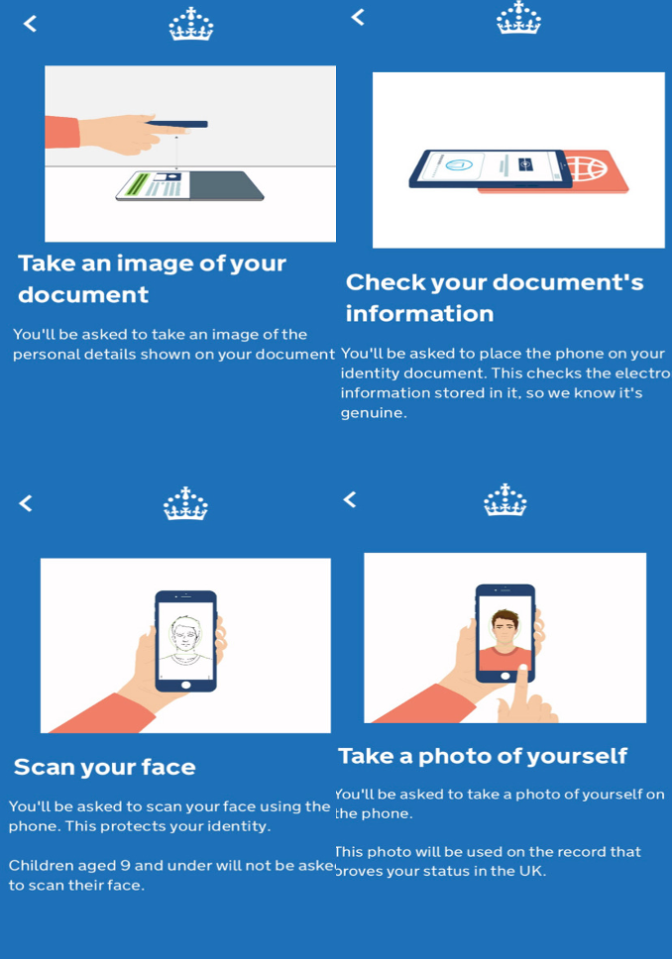

Slide 39
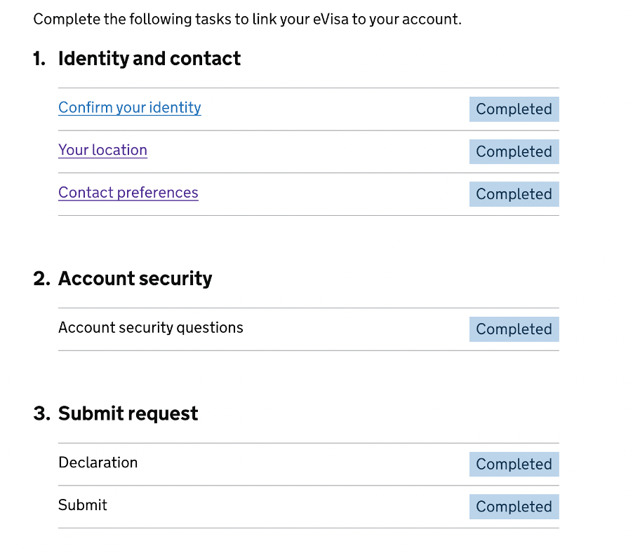
After completing the ID check in the app, return to your UKVI account using either:
Your phone’s browser, or
The original device you used to set up your account.
This will allow you to complete the remaining steps of the eVisa linking.
These questions are straightforward, so please answer them based on your circumstances.
In the 'Account security' section, you’ll be asked to select and answer three security questions. Choose questions for which you have clear and memorable answers to help keep your account secure.

Slide 40
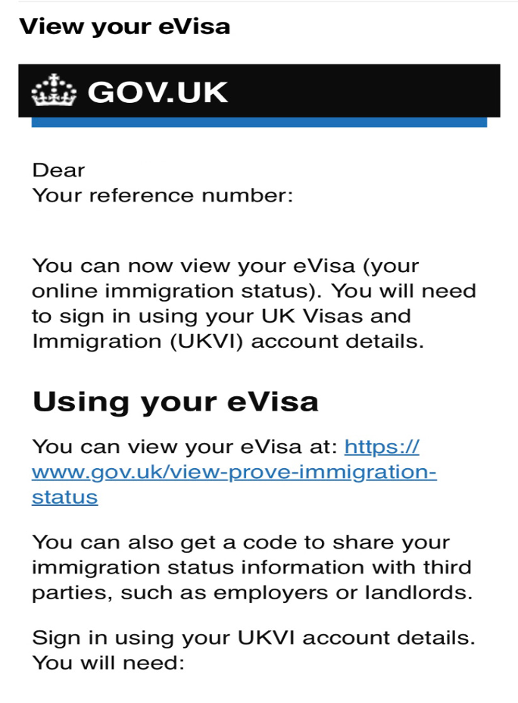
Once all the steps are shown as 'Completed', you can submit the application and will receive a confirmation of your submission by email.
The Home Office will send you another email titled ‘View your eVisa’ when they have approved your eVisa. We cannot advise the specific processing time as it varies with individual cases.
Not sure if your eVisa has been approved?
Check your email inbox and spam/junk folder for a message titled ‘View your eVisa’ from the Home Office.
Alternatively, visit the View and Prove page on GOV.UK.
If you can view your visa type, duration, conditions and the photo you took through the app, your eVisa has been approved and successfully linked to your UKVI account. You will be able to generate share codes for others to view your immigration permission. A valid share code will be required in the visa section of your online enrolment task.

