Slide 1

Thinking insightfully about climate change and science

Slide 2
Objectives
Identify questions that are amenable to science
List the different disciplines that inform an example big question
Explain the strength and limitations of science

Slide 3
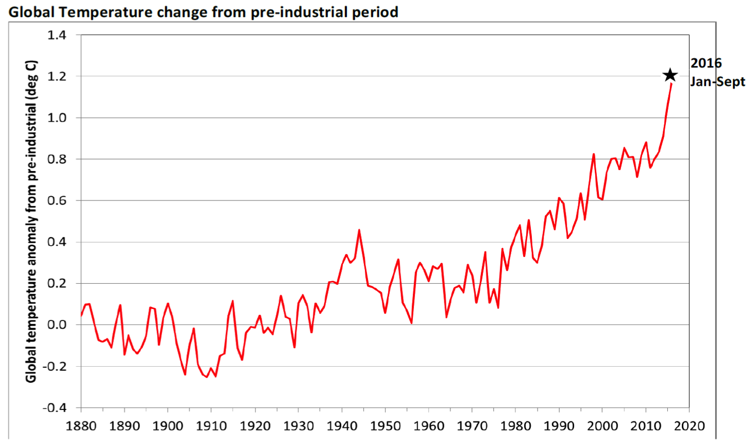
Starter
What information can you get from the graph?
Global temperature has continually increased since the late 1930s.
The biggest rate of increase is seen in the last 5-10 years.
Identify questions that are amenable to science

Slide 4
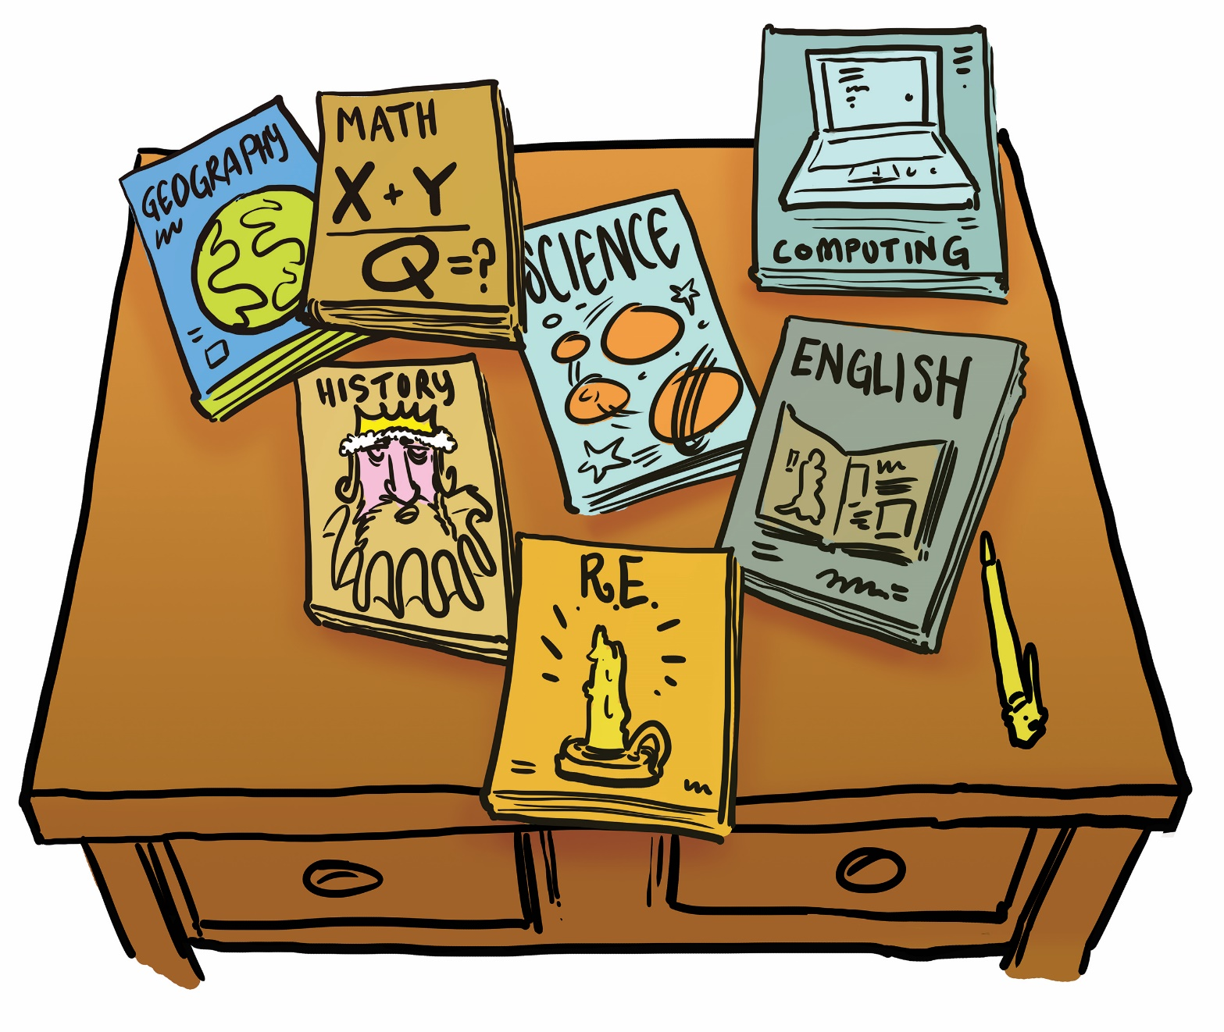
Lets think about science for a second
What makes a question ‘a science question’? What features does a science question have? 2 minutes to discuss in a group
Identify questions that are amenable to science
Notes:
Get students to list the features that make a question amenable to science. E.g investigative can do an expt see slide 7 for ideas.

Slide 5
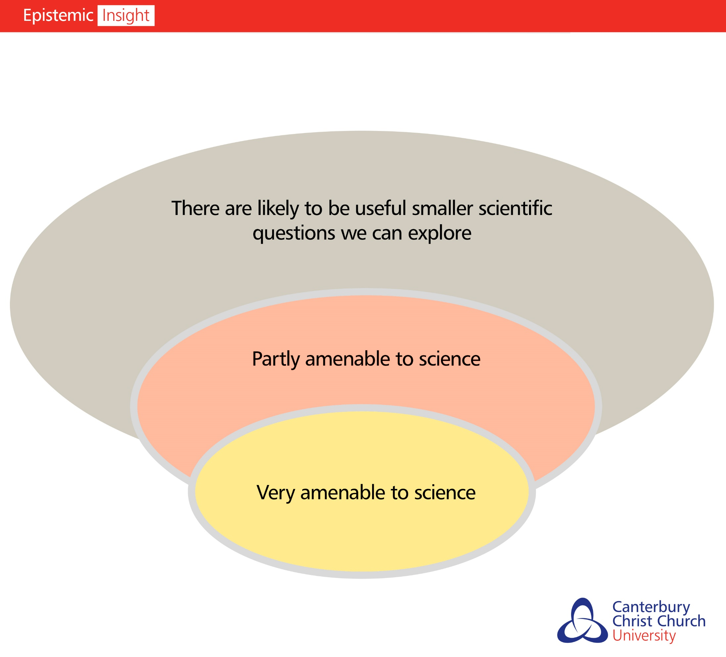
The Bubble Tool
Note:
Amenable=suited to
The bubble tool helps us group questions according to how well they can be answered using science alone
Identify questions that are amenable to science

Slide 6
How scientific are the following questions? Where would you place them in the bubble tool?
What causes global warming?
How do greenhouse gases cause global warming?
How do we respond to the climate crisis?
What are the products of combustion?
Partly
Ammenable
Big question
Ammenable
Identify questions that are amenable to science

Slide 7
How do greenhouse gases cause global warming?
What makes this question/problem amenable to science?
Properties and behaviour of natural objects – gases
Conducting experiments and making observations – testing chemical properties of gases in a laboratory
Proving effectiveness objectively and predicting how things will behave – creating a model for the impact on atmosphere
For these reasons, science is very amenable to questions about gases and their effects on the atmosphere
Identify questions that are amenable to science

Slide 8
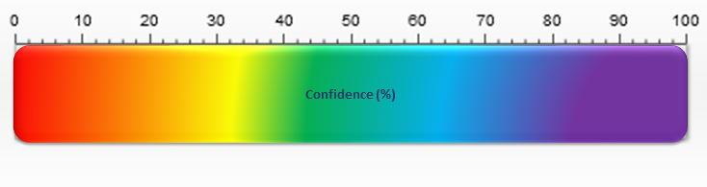
Introducing the confidence ruler. In the upcoming slides, you are going to be asked to rank how confident you are that the conclusions made are true. Higher numbers mean you are more confident
Introducing the confidence ruler.
Identify questions that are amenable to science

Slide 9
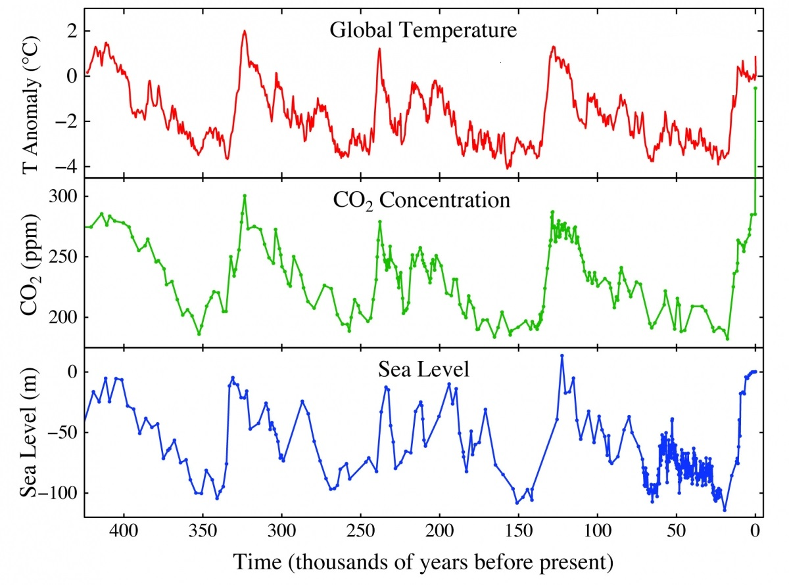
Rank your confidence on the confidence ruler.
Increasing levels of carbon dioxide is causing the temperature of the earth to increase.
Rising temperatures in the earth are causing sea levels to rise.
Identify questions that are amenable to science

Slide 10
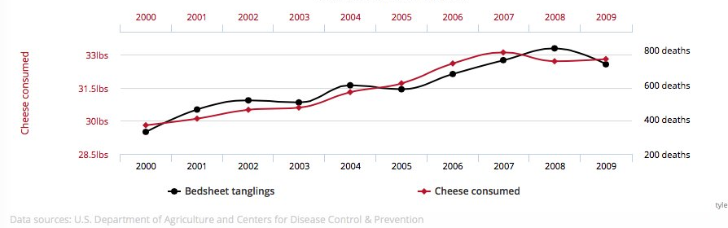
Rank your confidence on the confidence ruler.
The more cheese you eat, the more likely you are to die from being tangled in a bedsheet when you sleep.
Identify questions that are amenable to science

Slide 11
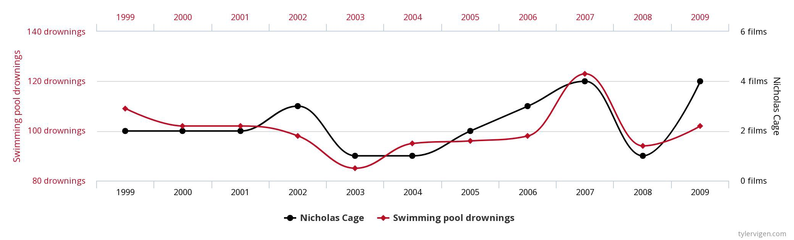
Rank your confidence on the confidence ruler.
The more films Nicoholas cage appears in each year, the more people drown in swimming pools.
Identify questions that are amenable to science

Slide 12
Did you give 100% confidence for any statement?
Why/ why not?
What would cause you to have greater confidence
Identify questions that are amenable to science
Notes:
Ideally they will not have given 100% confidence for any statement, but I would predict they are much higher for the temp/sea level statement prompt a discussion to get them to state why that is the case.
They may say that data has been peer reviewed. Lots of people have reached the same conclusion. The results have been repeatable.
As an extension task you could then get them to redefine what makes a question a scientific one.

Slide 13
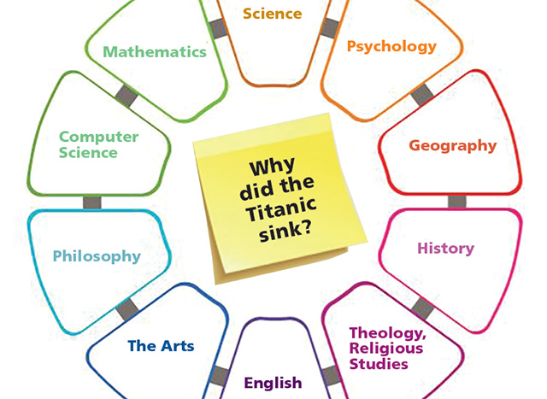
The discipline wheel
Big questions are questions that require more than one subject to give a complete answer.
The discipline wheel identifies the different subjects that contribute to a complete answer
Although science can tell you about the impact of the crash in the titanic, why the captain took the actions he did, the role of the media, trying to get a world record, all inform why the titanic sank.
List the different disciplines that inform an example big question

Slide 14
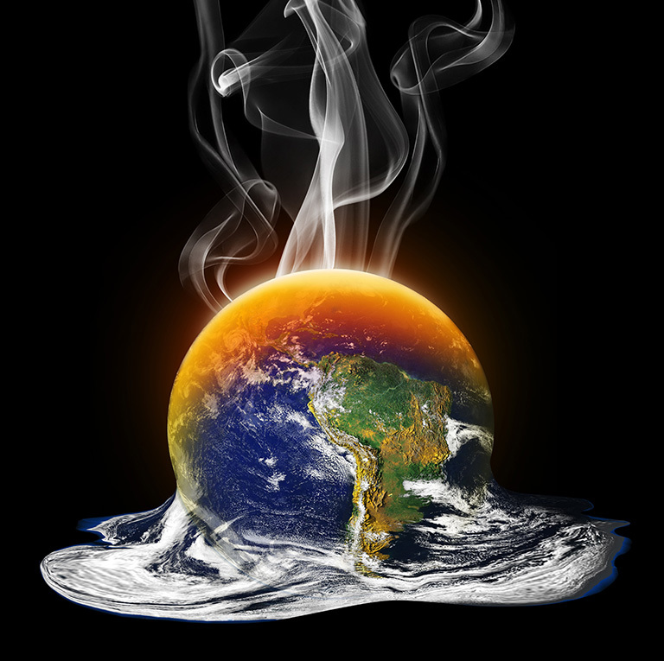
Climate change
A big question: How do we reduce emissions of climate change?
A very complex real-world problem A big question: How do we reduce emissions of climate change?
List the different disciplines that inform an example big question

Slide 15

A big question:How can we reduce emissions of greenhouse gases?
How can we reduce emissions of greenhouse gases?
You are going to imagine you are the chair of the Climate Change Committee, the group who advise the government on their climate policies
List the different disciplines that inform an example big question
Notes:
Setting he scene instrcutions

Slide 16
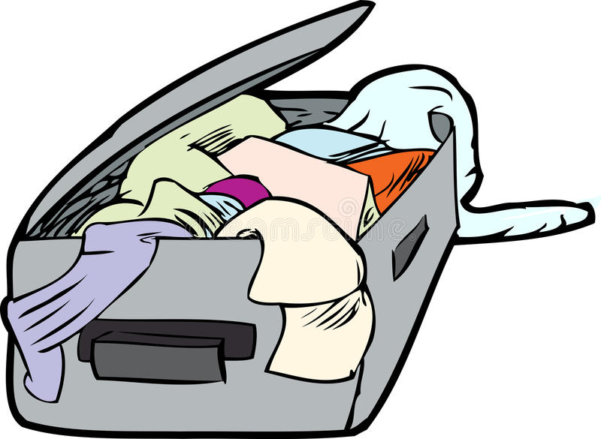
How can we reduce emissions of greenhouse gases?
‘Unpack’ the question!
Make a short list of some issues and questions that should go on the agenda for your meeting
List the different disciplines that inform an example big question
Notes:
Issues.
Global warming caused by fossil fuels, but also by issues such as intensive dairy farming/ population growth- production of methane.
Currently much of our fuel consumption is based on non renewables.
Numerous jobs are dependent on the fossil fuel industry.
Example questions.
Are alternative fuels readily available?
What causes global warming?
Is replacing fossil fuels economically viable?
Is forcing farmers to move away from dairy ethical

Slide 17
Which disciplines help answer my big question?
Suggested disciplines for wheel
Science
Economics
The arts
Ethics
Design and Technology
Geography
Psychology
Sociology
Religious studies
Business studies
Now, looking at your list consider:
Which discipline’s experts would you invite to your committee to address these questions and issues?
List the different disciplines that inform an example big question
Notes:
Give other views erceptions e.g.
E.g. business studies/economics, can we reduce emmsions without an impact on unemployment/ negative impact on the economy.
Is it ethical to insist we reduce global emissions.
Geographical view
By mapping the likely temperatures across the world - effects are uncertain and will vary across the globe in different places - so how can we manage this - and this will need to be done differently in different places - two approaches are:
(1) mitigation - again at different scales - these will include alternative energy sources - renewable ones - solar, carbon capture, planting trees as well as making international agreements - all being put under pressure by the growing world population
(2) adaption - by changing agricultural systems, managing the water supply - reducing demand or developing desalination plants.. and adopt strategies to protect areas liable to flooding - building defences, creating marsh land, moving groups of people (eg) new Indonesian capital, evacuation from remote low lying islands..

Slide 18
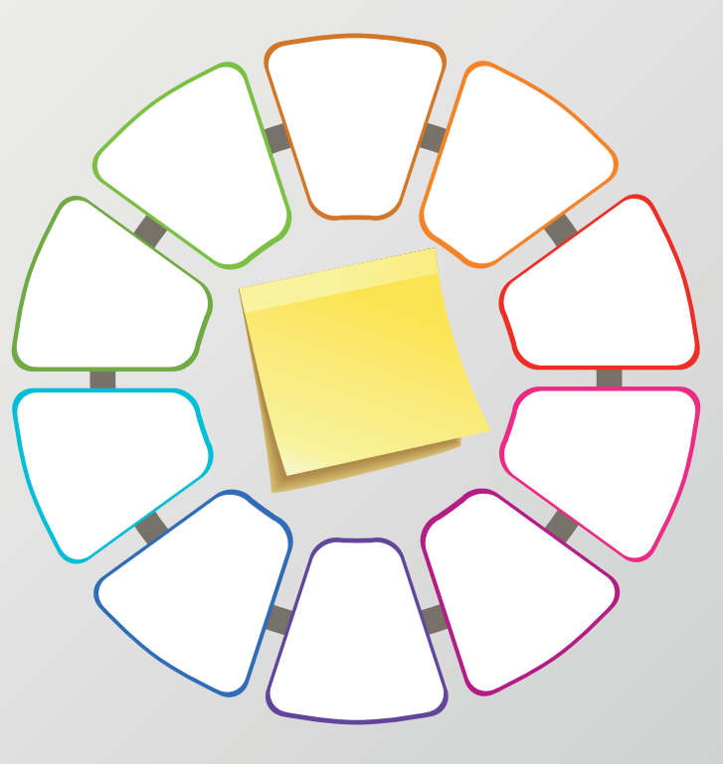
Construct your discipline wheel. Which subjects do you include and why?
Big question: How do we reduce emissions of greenhouse gasses.
Put this big question on the sticky note and list the disciplines you wish to include in the surrounding boxes.
List the different disciplines that inform an example big question
Notes:
List the subjects and how they are linked. The relative position of each subject is not hugely important.

Slide 19
Rank your disciplines by importance
Now, having considered all this, rank the disciplines in order of importance for answering the overall question.
How can we reduce emissions of greenhouse gases?
Did each group decide on the same ranking? Is there a correct answer?
Explain the strength and limitations of science

Slide 20
Pick your top 3 and explain why you put them in that order
Why did you place science where you did?
If it was top, why? If not, why not?
Explain the strength and limitations of science

Slide 21
Consider this quote:
‘I used to think that top environmental problems were biodiversity loss, ecosystem collapse and climate change … I was wrong. The top environmental problems are selfishness, greed and apathy, and to deal with these we need a cultural and spiritual transformation.’ (James Speth)
MENTI Do you agree? Why/why not?
Explain the strength and limitations of science

Slide 22
Exit ticket
What big question would you like to investigate
What are the sub questions that are amenable to science?

