Slide 1
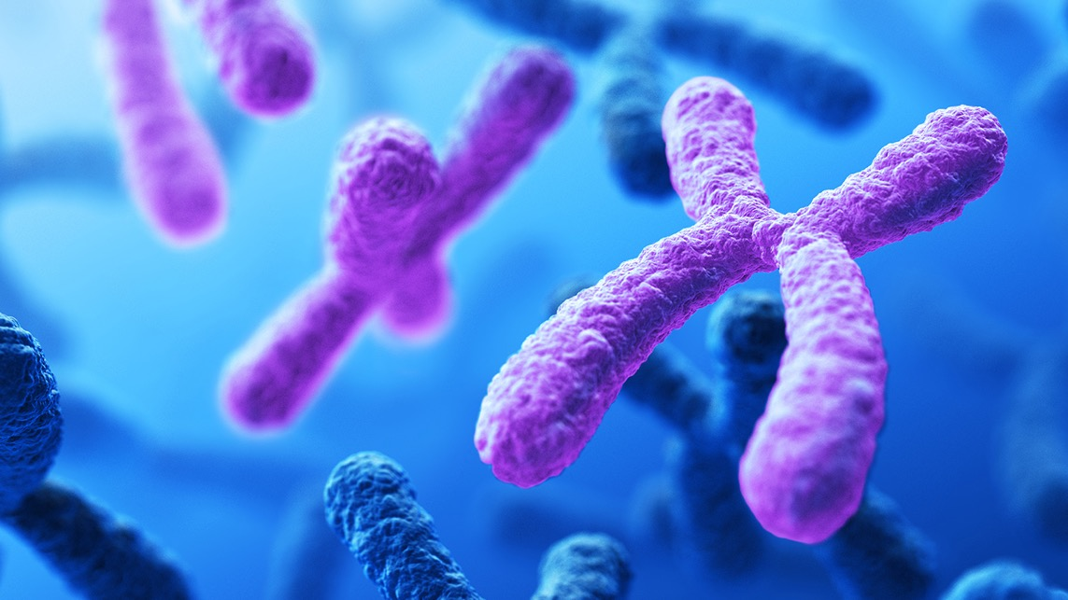
Starter Question:
What are genes? Why are they important?
Topic: Genetics and Inheritance
Genes Review

Slide 2
Kahoot
https://create.kahoot.it/details/7502f914-5968-4efd-844e-8706b65ebd78

Slide 3
Debate
We’re going to look at the issue of genetic engineering.
This is where genes can be altered by scientists to change an organisms characteristics.
Some people think that we should use this to change the genes of babies. Some disagree.

Slide 4
Step 1: Research
In a pair, write down some possible advantages of genetic engineering.
You can use the information sheet and your phones to help.
You have 5 minutes before I ask for an advantage from each group.

Slide 5
Step 1: Research
In a pair, write down some possible disadvantages of genetic engineering.
You can use the information sheet and your phones to help.
You have 5 minutes before I ask for a disadvantage from each group.

Slide 6
Step 2: Decision
Look at the advantages and disadvantages of genetic engineering on the board.
Decide whether you are completely for, mostly for, mostly against or completely against genetic engineering.
Write down your position and which types of genetic engineering you would make legal.

Slide 7
Step 3: Debate
Describe your position to your partner. Compare your positions, where do you agree and disagree.
Remember the school values of dignity and gentleness. Everyone is entitled to their opinion and comes from their own background.

Slide 8
Step 3: Debate
Be prepared to raise your hand to describe your position on genetic engineering.

Slide 9
Conclusion
You can see that even among well informed people, the range of different opinions is wide.
This is because the science is only part of the answer to the question of whether genetic engineering should be allowed.
What other subjects and topics are important here?

