Slide 1

RE elective, the place of RE and other subjects in the primary curriculum
Starter question:
How do people gain knowledge?

Slide 2

A model for today’s session
Initially we want you to view things as a primary school teacher. You will have to teach a portfolio of different subjects.
We will look at an exemplar question and outline the role science and RE play in answering that question
We want you to switch hats and think like an RE specialist. We will model what planning an RE lesson looks like and next steps for you.

Slide 3
Introducing big questions
Some questions are more difficult to answer than others. We call these questions big questions.
Examples include:
what does it mean to be alive?
Why does life on Earth exist?
What is human personhood?
Equally some questions can be answered by one discipline alone, we call these disciplinary questions, some can be answered by two disciplines, we call these bridging questions. Epistemic insight helps you articulate which questions are disciplinary and the role of each discipline in bridging and big questions
.

Slide 4
Which of these questions can be answered by only one discipline?
1. How do you know that plants photosynthesise?
2. How do I know you have a toothache?
3. How do you know that I am in love?
4. How do you know the sun will rise tomorrow?
5. Which members of society should get respirators?
6. How is the SARS-CoV-2 (Covid-19) virus transmitted?
7. Should wearing masks in public spaces be made mandetory?
9. How do we know global warming is causing climate change?
10. Is 2m the minimum safe distance to be away from someone?
One discipline alone- which one?
Bridging question?- which ones
Big question?
Relevant link Epistemic insight booklet lesson 1 ( hats activity)
Notes:
Add discussion points here. We spent a lot of time looking at question 9. There was discusion on whether this required a level of historical, mathematical and geographical knowledge. I.e. reading graphs refering back to previous fluctuations in global temperatures.
Some here are easier to group than others, but I think that is the point of the debate.
Important to say that answers to Q 7and 8 is not mere opinion. Depending on the lens you have you may have very different answers to these questions.
In terms of research articulate that in primary school teachers are skilled at blending a range of disciplines. However now with a science teacher lens we need to appreciate the types of questions which are investgiative by scientific enquiry. Our research is interested in unpacking the distinctiveness of scientific knowledge, and how it blends with other disciplines to construct a holistic curriculum. Further it aims to promote an understanding of comparing the merits of distinct disciplines in answering questions and how to relate science to big questions.

Slide 5
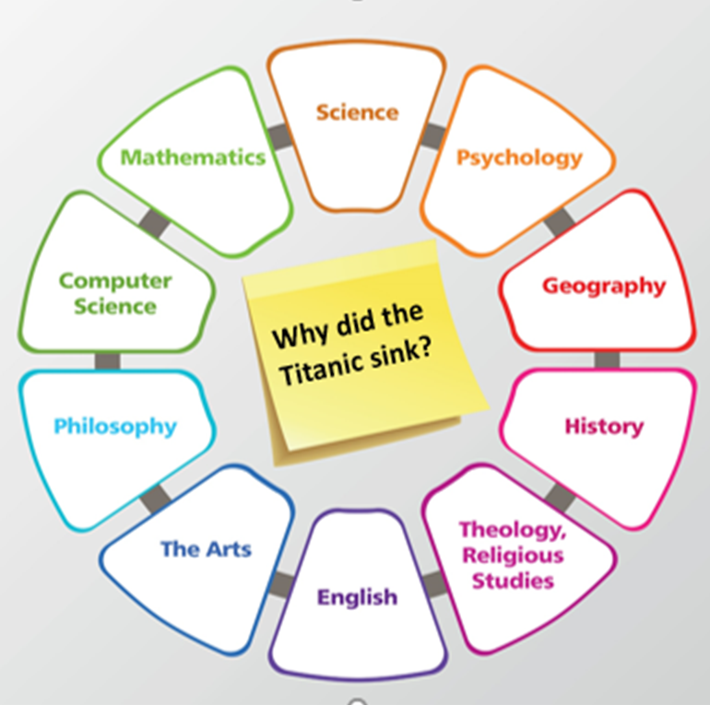
The discipline wheel
We Can use the discipline wheel to identify which subjects inform a complete answer to our big questions. This will not a;ways be static so once you and your students develop confidence with this, you can introduce a blank discipline wheel and get your students to work out which disciplines are relevant.
Big Question
Relevant link Epistemic insight booklet discipline wheel (page 9)
Notes:
The idea here is that there can be a multitude of disciplines that can inform big questions that look at real world problems. Our research is interested in how we support trainee teachers appraciate the types of questions that are purely scientific and how the distinct lens through which you view a question informs the answer that is given.
Take the example of why did the titanic sink useful clip hear if you have time. Epistemic insight watch from 1 minute stop at around 3 minutes Epistemic insight: engaging with life's Big Questions | Berry Billingsley | TEDxFolkestone - YouTube

Slide 6
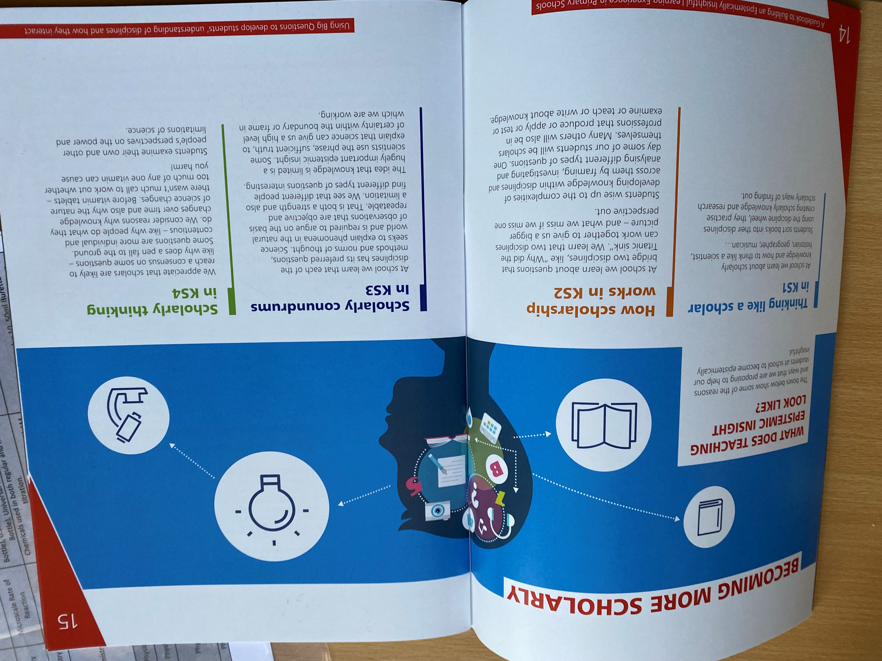
Becoming more scholarly
Below are some examples of what teaching epistemic insight might look like and reasons to help students become epistemically insightful.
Thinking like a scholar KS1 In school we begin by understanding how to think like a theologian or a scientist Introducing disciplinary questions is helpful
In KS2 we can introduce bridging questions. In lower KS2 students can identify which disciplines can inform an answer. By upper Key stage two we can encourage to construct their own investigations and identify the distinctive role each discipline plays
Relevant link Epistemic insight primary booklet page 14

Slide 7
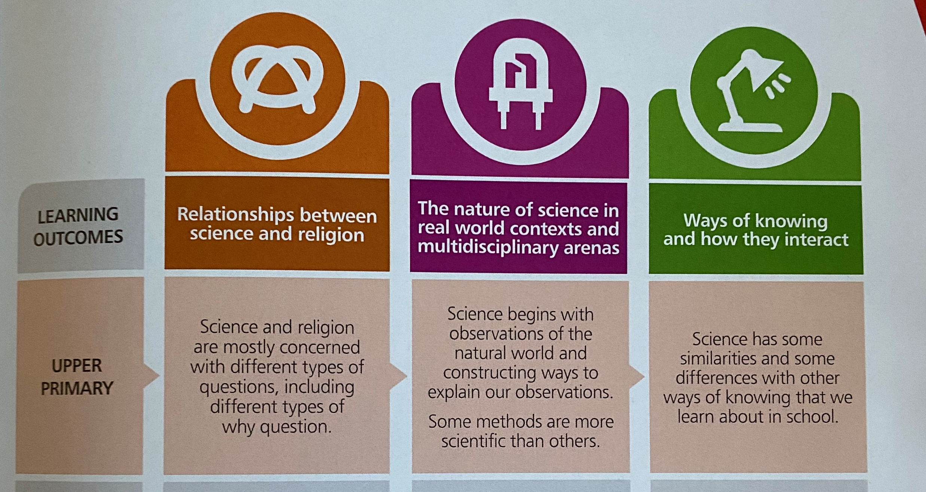
Introducing the Epistemic insight objectives
Relevant link Epistemic insight primary booklet page 7

Slide 8



With the theme of community Consider the following question ‘what gives value meaning and purpose to human life?’
RE
Science

Slide 9


The scientific perspective
In terms of community probably the biggest issue is climate change.

Slide 10
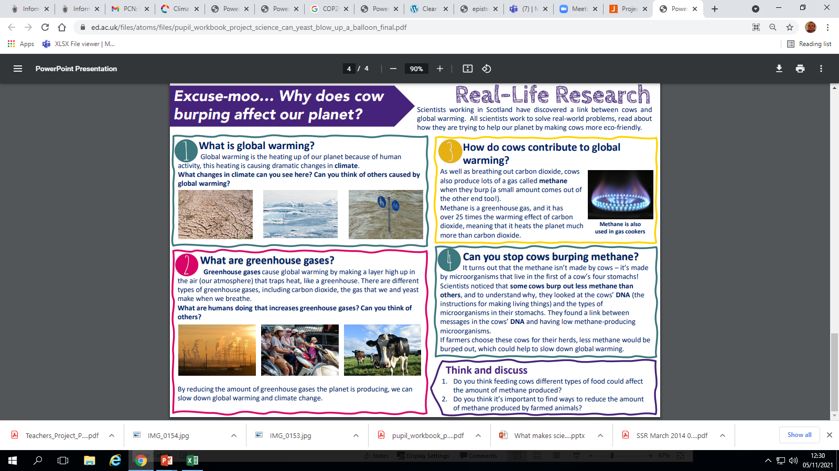
An example resource

Slide 11
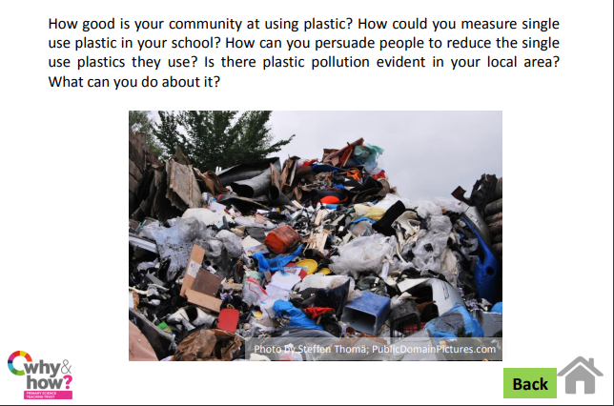
Scientific investigations you could do

Slide 12
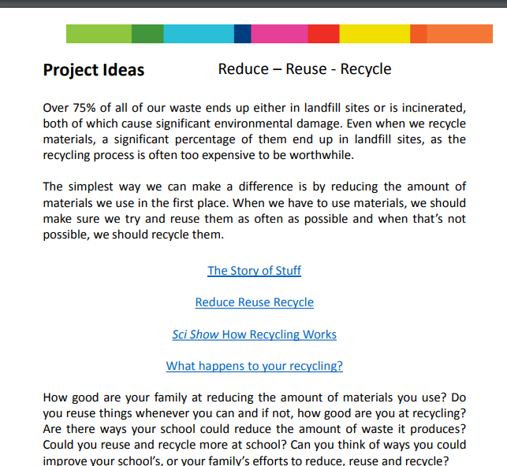
Reduce reuse recycle
Weblink for these resources
https://pstt.org.uk/resources/curriculum-materials/Climate-Science?gclid=Cj0KCQjwrJOMBhCZARIsAGEd4VEa9l43UEDU34fGCiokTcgm7iV_CEHt1uewE4aDLFC9AtSNzFbvcSMaAmgiEALw_wcB

Slide 13

The problem is not a purely scientific one
One example of the theological perspective a call to action from Pope Francis.
"Let us pray so that the cry of the Earth and the cry of the poor" is heard by summit participants.
"May this encounter yield efficient answers offering concrete hope to future generations.

Slide 14
With the theme of community Consider the following question ‘what gives value meaning and purpose to human life?’
What voice does RE have?
How would you respond to this activity with a theological lens? What activities would you be encouraging your students to explore/consider?

Slide 15
Concluding comments
A view that science and religion are in conflict is called scientism. It suggests that science is the only form of knowledge needed to answer real world problems such as those we have considered today.
The project attempts to exemplify the type of questions which are amenable to science ( and indeed other disciplines).
Science and theology aim to answer different questions.

Slide 16
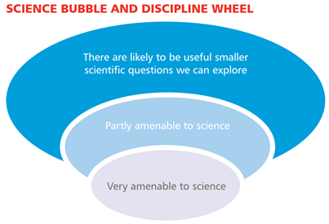
The bubble tool

Slide 17

Plenary activity
Write an example of a question science alone can answer.
Write an example of a question RE alone can answer.
Write an example of a bridging/ big question that is informed by sci and RE.

