Slide 1

What is Mastery?
23.06.15

Slide 2
The National Curriculum for Mathematics aims to ensure that all pupils:
become fluent in the fundamentals of mathematics, including through varied and frequent practice with increasingly complex problems over time, so that pupils have conceptual understanding and are able to recall and apply their knowledge rapidly and accurately to problems
reason mathematically by following a line of enquiry, conjecturing relationships and generalisations, and developing an argument, justification or proof using mathematical language
can solve problems by applying their mathematics to a variety of routine and non-routine problems with increasing sophistication, including breaking down problems into a series of simpler steps and persevering in seeking solutions.
These are the aims of a mastery curriculum!
Notes:
These three aims should not be lost in the detail of the programmes of study. The new draft seeks to strengthen these aims

Slide 3
Mathematics is an interconnected subject in which pupils need to be able to move fluently between representations of mathematical ideas. The programmes of study are, by necessity, organised into apparently distinct domains, but pupils should make rich connections across mathematical ideas to develop fluency, mathematical reasoning and competence in solving increasingly sophisticated problems. They should also apply their mathematical knowledge to science and other subjects.
The expectation is that the majority of pupils will move through the programmes of study at broadly the same pace. However, decisions about when to progress should always be based on the security of pupils’ understanding and their readiness to progress to the next stage. Pupils who grasp concepts rapidly should be challenged through being offered rich and sophisticated problems before any acceleration through new content. Those who are not sufficiently fluent with earlier material should consolidate their understanding, including through additional practice, before moving on.

Slide 4

What is mastery?
If you drive a car, imagine the process you went through…
The very first drive, lacking the knowledge of what to do to get moving
The practice, gaining confidence that you are able to drive
The driving test, fairly competent but maybe not fully confident
A few years on, it’s automatic, you don’t have to think about how to change gears or use the brake
Later still, you could teach someone else how to drive
However not all of us know exactly how the car actually works!
Learning to master driving takes time and a lot of practice!

Slide 5
What is mastery?
Mastery in mathematics is similar, but there is more.
It involves:
Deep and sustainable learning
Ability to build on something already mastered
Ability to reason about a concept and make connections to other concepts
Procedural and conceptual fluency (can’t solve problems without these)
The understanding of how and why it all works
Mastery is a continuum… mastery at a particular point of time that is sufficient mastery for that stage of learning and then built on at a later stage

Slide 6
Mastery curriculum
Some points to consider:
Expectation that all pupils are capable of achieving high standards:
  Whole class teaching
  Implications for class groupings?
  Implications for setting?
Differentiation is achieved by emphasising deep knowledge and through individual support and intervention - through enabling the children to access what is being taught.
Questioning and scaffolding vary, different problems to solve, higher attainers given complex problems which deepen their knowledge of the same content. Misconceptions dealt with immediately.
Fluency comes from deep knowledge and practice. Ability to recall facts and manipulate them to work out other facts is important.

Slide 7
Mastery curriculum
Practice: spending longer on key concepts
  Variation
  Practice within different contexts
  Extended practice which goes deeper… and deeper
Practice and consolidation within different contexts, e.g. time, money, length.
There is a focus on the development of deep structural knowledge and the ability to make connections.
Teaching precise vocabulary:
  Addend + addend = sum or total
  Minuend – subtrahend = difference
  Multiplicand x multiplier or factor x factor = product
  Dividend ÷ divisor = quotient

Slide 8
We often have preconceived ideas about which children have more or less potential. We need to think carefully about:
    How to support children who find a concept difficult
    How to challenge children who find it more accessible
    Observing and questioning the children during the lesson
    Making generalised assumptions about overall ability
Think about your own classroom. Do you promote the idea that every child can succeed or do you reinforce the idea that some are destined to excel while others will inevitably struggle? Consider:
      How children are grouped for mathematics?
      How mathematics tasks are assigned to children
      How extension groups are formed
      How intervention is given

Slide 9
Mastery curriculum
Practice: makes perfect - spending longer on key concepts
  Initial practice
  Intelligent practice, e.g., practice within different contexts, opportunities to develop fluency
  Extended practice which goes deeper… and deeper
  Practice to spot relationships and make connections
  Practice to deepen conceptual understanding
  Meeting the needs of all children – intelligent differentiation
Practice and consolidation within different contexts, e.g. time, money, length.
There is a focus on the development of deep structural knowledge and the ability to make connections.

Slide 10
Teaching for mastery
Dimensions of Depth
Factual knowledge
Procedural fluency
Conceptual Understanding
Language and communication
Thinking mathematically
Drury, 2014 (3,4,5)
Notes:
Use this instead of next slide? To connect back with day 1.

Slide 11
Designing purposeful learning for mathematics
Exploring
Clarifying
Practising
Applying
Drury, H. (2014) p56
zooming out
and
zooming in
Notes:
Zooming is LJ’s term for defining various stages in a lesson. Exploring might be about zooming out – drawing in a wide range of experiences – seeing the pig picture and then zooming in to a particular aspect of mathematical learning that you want the children to notice, then zooming out again with that skill/ process.

Slide 12
Designing purposeful learning for mathematics
Perserverance
Resilience
Questioning
Mathematising
Problem finding
Exploring
Revealing mew mathematics
Multiple representations, building / deconstructing mathematical models/ ideas, identifying misconceptions, making connections, emerging generalisations
e.g. explore making 3/8 with concrete and pictorial representations
Notes:
Mathematising - Freudenthal (RME)

Slide 13
Designing purposeful learning for mathematics
Clarifying
Confirming concepts from previous exploration/ learning. Addressing misconceptions, developing precise vocabulary, explaining in full sentences, hypothesising, generalising, pupil-pupil discussion, pupil-teacher discussion
e.g. understanding ‘same value different appearance’; using the term ‘equivalent fraction’, ‘numerator’, denominator’…
Notes:
Mathematising - Freudenthal (RME)

Slide 14
Designing purposeful learning for mathematics
Practising
“Perfect practice makes perfect” (Drury, H. 2014, p58)
  Practice that allows children to see patterns
  Intelligent practice, e.g., practice within different contexts, opportunities to develop fluency
  Extended practice which goes deeper… and deeper
  Practising an application of a generalisation
  Practice to deepen conceptual understanding
  Meeting the needs of all children – intelligent differentiation
e.g. multiplying and dividing numerator and denominator by the same number to find equivalent fractions
Notes:
Helen says that practice should be perfect – not practising misconceptions so immediate correction/ interention or return to exploring/ clarifying.

Slide 15
Designing purposeful learning for mathematics
Applying
Deepening and mastering through unfamiliar contexts, through non-routine problems, choosing the technique/concept to be used, connecting the unfamiliar with familiar.
e.g. writing fractions as unit fractions or the sum on unit fractions (Egyptian fractions)

Slide 16
Designing purposeful learning for mathematics
Intelligent Practice
All tasks are chosen and sequenced carefully with purpose, offering appropriate variation in order to reveal the underlying mathematical structure, concept or process to pupils.
Notes:
LJ to start from here

Slide 17
Designing purposeful learning for mathematics
Variation is an approach to teaching
Art of sequencing similar but increasingly complex problems to “generate disturbance of some sort for the learner”
Festinger (1957)
Notes:
Commonly used in the pacific rim countries and often mis-interpreted as ‘rote-learning’.
Festinger The Theory of Cognitive Dissonance

Slide 18
Designing purposeful learning for mathematics
Using variation of a problem to:
Generalise the characteristics or structure of an example/problem.
Observe variant and invariant properties between successive examples/ problems.
Ference Marton (2005), Watson, A. and Mason, J. (various c2007)
Notes:
Application of a more general theory of learning developed by Ference Marton (2005)

Slide 19
Designing purposeful learning for mathematics
Procedural Variation
  What’s stayed the same? What’s changed?
Conceptual variation
  What’s the same, what’s different?

Slide 20
Designing purposeful learning for mathematics
Procedural Variation
Varying the conditions, results, generalities:
  Same problem but varying the numbers.
  Same problem but varying the unknowns.
  Same structure and numbers but varying the context.
Varying the method to solve the problem
Varying the application of the method
Gu et al, 2004
Notes:
Gu Et al, 2004 Teaching Variation a Chinese Way of promoting effective mathematics learning

Slide 21
Designing purposeful learning for mathematics
Conceptual Variation
Same problem but varying the representation.
Gu et al, 2004
Notes:
Gu Et al, 2004 Teaching Variation a Chinese Way of promoting effective mathematics learning

Slide 22
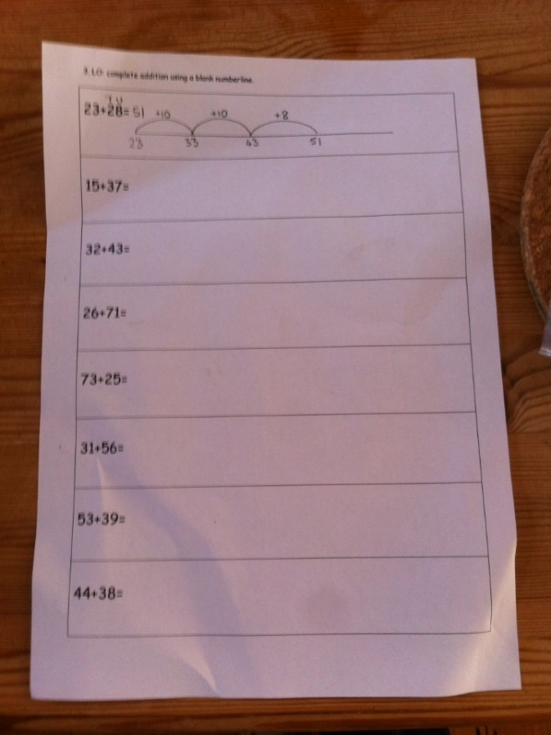
Designing purposeful learning for mathematics
28 + 10 = o
28 + o = 29
28 + 10 = o
28 + o = 27
34 + o = 44
34 + o = 43
34 + o = 42
23 + 28 =
15 + 43 =
26 + 71 =
73 + 25 =
31 + 56 =
53 + 39 =
44 + 38 =
Aspect of mathematical learning:
Procedural and conceptual
Add a number near to a multiple of 10.
Purpose
Explore and clarify
23 + 10 =
23 + 11 =
23 + 12 =
45 + 10 =
45 + 11 =
45 + 12 =
39 + 10 =
39 + 11 =
39 + 12 =
23 + 10 =
23 + 9 =
23 + 8 =
45 + 10 =
45 + 9 =
45 + 8 =
39 + 10 =
39 + 9 =
39 + 8 =
26 + 10 = o
26 + o = 27
26 + o = 28
47 + o = 57
47 + o = 58
47 + o = 59
Notes:
Exploring:
Use of diennes
Numberline / 100 square
What’s the same? What’s different?
What next?
Clarifying
Teacher – directed – questioning – what’s the same? What’s different between the representations of the same problem?
What’s changed? What’s stayed the same between each step? What do you notice?
Refer to the NCETM article included in the pack

Slide 23
Designing purposeful learning for mathematics
Consider teaching four units over the year, repeated with progression, within these themes:
Number sense
Additive reasoning
Multiplicative reasoning
Geometric reasoning
Teach these as fundamentals and add the real life applications of measures and statistics. This will enable practical activities in, for example, money, time, length, mass to be carried out within the four operations and everything else to do with number.

Slide 24
Designing purposeful learning for mathematics
Distinguish between a ‘purpose’ and a ‘learning objective’
An awareness of purpose is crucial when designing and facilitating opportunities for learning mathematics.
Do you set a learning objective for one lesson and share it with the children at the beginning?
Try sharing a long term vision in which learning objectives over a series of lessons can be shared.
Allocating short term learning objectives a lesson at a time can often lack coherence in the long or medium term plan. They also reduce the opportunity to discover!

Slide 25
A few quotes from Ofsted report 2011: Good Practice in Primary Mathematics
Practical, hands-on experiences of using, comparing and calculating with numbers and quantities
Understanding of place value, fluency in mental methods, and good recall of number facts
Subtraction is generally introduced alongside its inverse operation, addition, and division alongside its inverse, multiplication
High-quality teaching secures pupils’ understanding of structure and relationships in number
Calculation are strengthened through solving a wide range of problems.
Importance of moving towards more efficient methods
Importance of good subject knowledge and subject-specific teaching skills and seek to enhance these aspects of subject expertise.
Notes:
Ofsted supports what we are trying to do.
From the Ofsted report ‘Good practice in primary mathematics: evidence from 20 successful schools’:
http://www.ofsted.gov.uk/resources/good-practice-primary-mathematics-evidence-20-successful-schools
Report summary provided as handout.

Slide 26
Raising the Bar, ACME 2012
At present, England is significantly underachieving in terms of developing able mathematicians, and this situation is now critical. It is necessary to increase systematically the number of young mathematicians with a robust and deep grasp of the range of mathematical ways of thinking and working. Students should have an engaging and challenging experience of school mathematics that will encourage many more to pursue mathematically-intensive courses at university.
Potential heavy users of mathematics should experience a deep, rich, rigorous and challenging mathematics education, rather than being accelerated through the school curriculum.

Slide 27
It is not unusual for those groups or individuals identified as able mathematicians to be allowed or encouraged to progress through the curriculum at a faster pace. Such acceleration in mathematics is often counterproductive. Acceleration encourages only a shallow mastery of the subject, and so promotes procedural learning at the expense of deep understanding. This shallow acquaintance can also lead to learners feeling insecure and fails to adequately promote a commitment to the subject in students. This approach therefore often leads to apparent success without students developing the depth and tenacity that is needed for long-term progression. In addition, the use of acceleration is in stark contrast to the successful practice in many of the world’s mathematically most highly performing jurisdictions.

Slide 28
Ofsted inspections – clarification for schools
Pupils’ work
Ofsted does not expect to see a particular frequency or quantity of work in pupils’ books or folders. Ofsted recognises that the amount of work in books will often depend on the age and ability of the pupils.
Ofsted does not expect to see unnecessary or extensive written dialogue between teachers and pupils in exercise books and folders. Ofsted recognises the importance of different forms of feedback and inspectors will look at how these are used to promote learning.

