Slide 1


Epistemic Insight:
Examples of exploring questions
Rob Campbell
St Mary’s University Twickenham
With thanks to Mina Cullimore Research fellow at CCCU

Slide 2
Linked CCF statements
‘Learn that…’ 1. In order for pupils to think critically, they must have a secure understanding of knowledge within the subject area they are being asked to think critically about. 2. In all subject areas, pupils learn new ideas by linking those ideas to existing knowledge, organising this knowledge into increasingly complex mental models (or “schemata”); carefully sequencing teaching to facilitate this process is important. . | How this foundation knowledge supports key skills, i.e. ‘Learn how to…’: 1. And - following expert input - by taking opportunities to practise, receive feedback and improve at: Enabling critical thinking and problem solving by first teaching the necessary foundational content knowledge.
Key Content / Activities:

Slide 3

Developing Knowledge about Knowledge
How do we gain knowledge?
Does knowledge change over time?
Can different disciplines provide complementary (but different) types of knowledge about the same question?
Notes:
1. Do we gain knowledge in only one way or from a variety of different ways and settings. I would suggest that we gain knowledge from everything we do, Atlhough some knowledge will be more useful than others.
For example gaining knowledge from– reading books, experience, practicals, listening and observing others etc
2. Does knowledge change over time? The world was always round– therefore this has not changed but our understanding that the world is round and not flat – developed over time. Through discovery and innovation such as telescopes, maps, exploration into space
3. Can different disciplines provide complementary (but different) types of knowledge about the same question?
For example: What is a footprint? This could be interpreted in a number of ways or disciplinary approaches
If you undertook an internet search for the question. Apart from dictionary definitions How many disciplinary approaches would you find in the first 2-3 pages of results?
For example: A footprint is:
An impression/imprint in the ground – history/fossils or science/biology
Carbon or global footprint – use of resources (geography)
Digital footprint – consider things like safety, confidentiality – data protection
Footprints in the sand – biblical extract , so we could investigate through religion or even consider this through English and its written construction
Water, carbon, actual imprint, digital, tent, ecological, plastic, food,
Business, science, environmental

Slide 4

What is the distinction between cross-curricular teaching and the epistemic insight approach?
Geography
Science
Maths
RE
Theology
Philosophy
Social sciences
+
Cross-curricular teaching
intentionally applies multiple disciplines within a learning environment
Do you have experiences of cross-curricular teaching (when you were at school)?
How was this approached by teachers? by students?
Notes:
For presentations, consider using a slightly blue background as this will be easier for audience members who may have dyslexia or other visual impairments

Slide 5
Planning investigating Big Questions through Epistemic Insight
Epistemic Insight
develops students’ appreciation of the strengths and limitations of individual disciplines by exploring how these work in cross-disciplinary contexts
Notes:
EI encourages students to think about what kind of questions (through a discipline’s lens) could be investigated in relation to a Big Question, and if/when/how being investigated and informed by another discipline would be useful/valuable (and to know why they are selecting disciplines – what these can offer and contribute to acquiring knowledge and understanding about human personhood and the nature of reality).

Slide 6
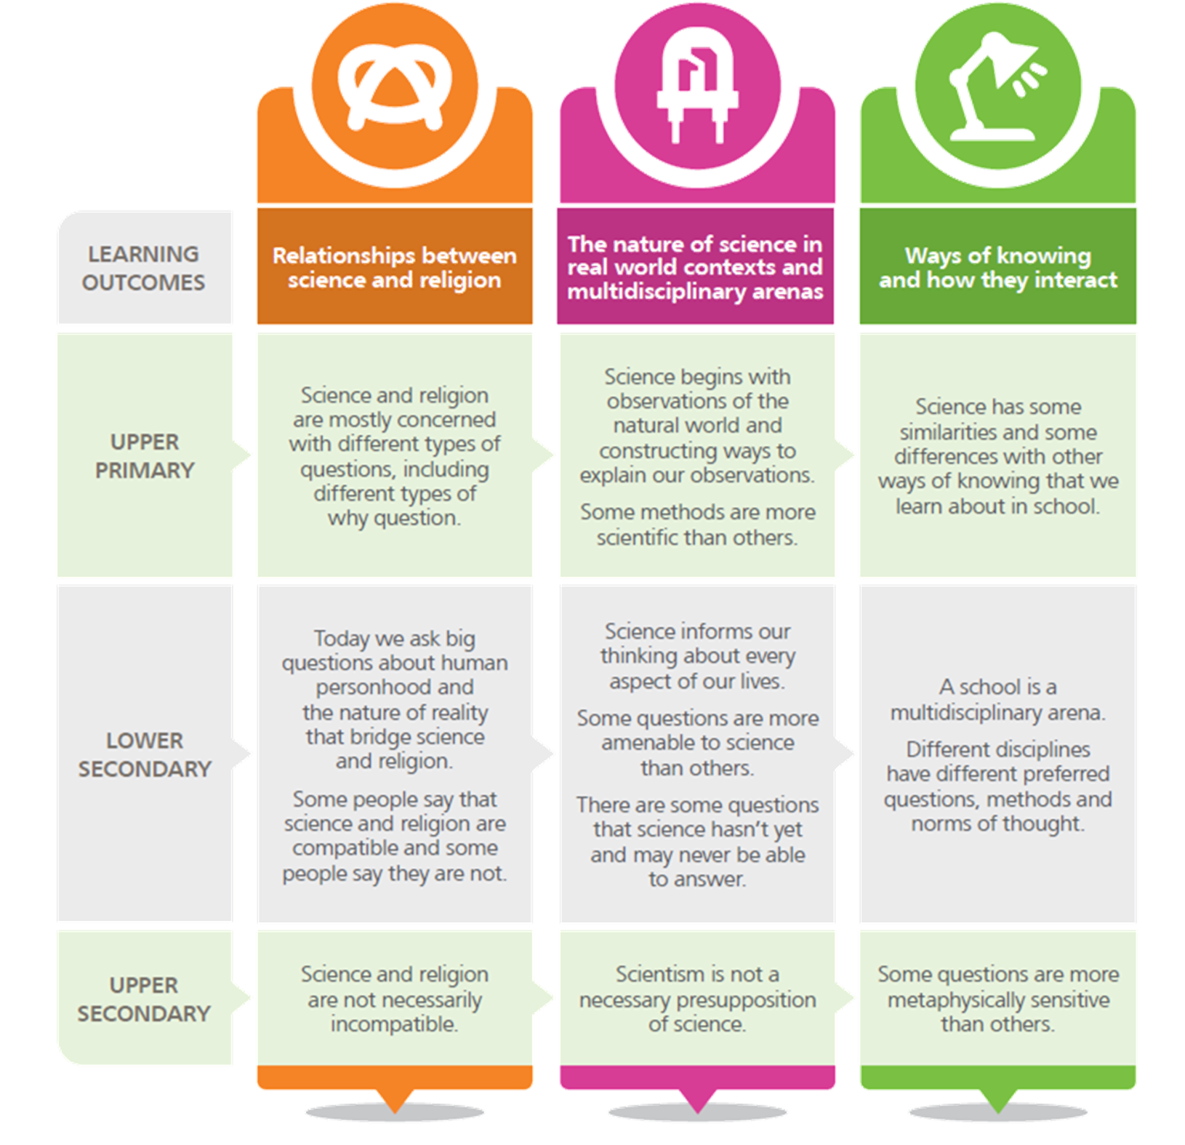

How does EI address this?
Notes:
For this research project, an understanding of our framework is important… so in my preparation session with teachers we discuss this

Slide 7
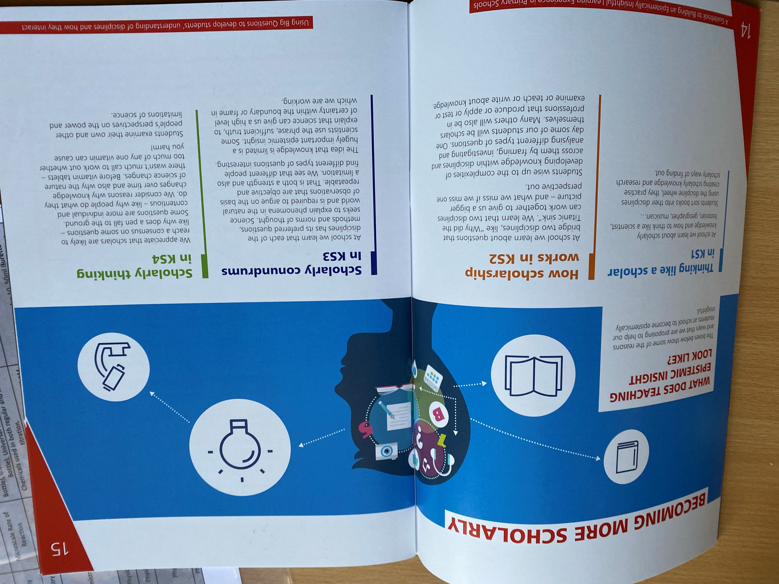
Becoming more scholarly
Below are some examples of what teaching epistemic insight might look like and reasons to help students become epistemically insightful.
Thinking like a scholar KS1 In school we begin by understanding how to think like a theologian or a scientist. Introducing disciplinary questions is helpful.
In KS2 we can introduce bridging questions. In lower KS2 students can identify which disciplines can inform an answer. By upper KS2 we can encourage children to construct their own investigations and identify the distinctive role each discipline plays

Slide 8
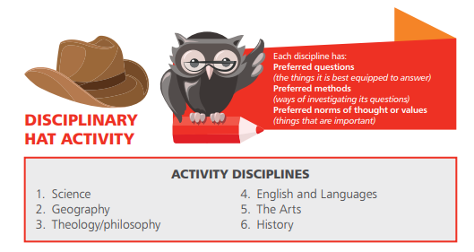
Understanding Disciplines
Notes:
Observe what is happening in your subject/lessons you sit in/lessons you plan/lessons you teach.
In your classroom/s – what kinds of questions are being asked and investigated? What ways/methods are used to investigate questions/topics?
Why is a particular question suited to the discipline (subject)?
Think about opportunities when a question/topic can be informed by the contributions of different disciplines!
When you were a student in school, you were given subjects on your timetable. When/if you prepared for selecting your degree, you were choosing disciplines that would be approached with the rigours of scholarship. The discipline of the natural sciences include physics, chemistry, biology (your school subjects)… but zoology (for example) appears in HE.

Slide 9
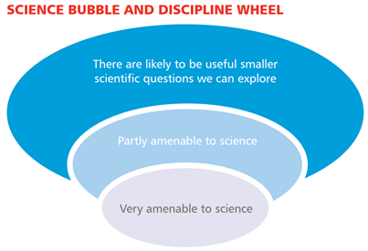
The bubble tool

Slide 10




Appreciating the distinctiveness of an individual discipline
Questions
Questions which investigate the nature of the world around us
Methods
Hypothesis
Observation
Data collection
Analysis
Proof/evidence
Ways of thinking
Objectivity
Replicability
Consensus

Slide 11


Using Epistemic
Insight Tools
We can ask a question that bridges two disciplines (a bridging question)
What does the story of Noah’s ark tell us – theologically and scientifically?
Will we one day live and work on Mars – according to biologists and planetary scientists?
What can science and art reveal about seeing a sunset?
Why did the Titanic sink – through the lenses of history and engineering
Notes:
This is an example of what I prepared for recent sessions, to show how the DW can be used
The discipline wheel is available to download at: EI.com to use in your classroom
What are the characteristics, strengths and limitations of a discipline or area of knowledge?
How do disciplines interact to inform our thinking about different types of questions?
Why does it matter how a question is framed?
What are a disciplines preferred questions, methods and norms of thought?
What is distinctive about science as a discipline?
Science answers questions which investigate the nature of the world around us.

Slide 12
Using Epistemic Insight Tools
We can use big and bridging questions with the Discipline Wheel
What makes a human?
What is the role and value of face coverings?
Can a robot/AI be a person?
Are you what you eat?
Why do we see colour?
Why do humans exist?
How did the universe begin?
Can a robot be a good friend?
Notes:
The discipline wheel is available to download at: EI.com to use in your classroom
What are the characteristics, strengths and limitations of a discipline or area of knowledge?
How do disciplines interact to inform our thinking about different types of questions?
Why does it matter how a question is framed?
What are a disciplines preferred questions, methods and norms of thought?
What is distinctive about science as a discipline?
Science answers questions which investigate the nature of the world around us.
This question ‘How is tea made? could be answered through physics, investigating evaporation/boiling points or chemistry – the compounds, caffeine and tannin levels https://www.sciencefocus.com/science/science-of-tea/
Science values an objective and repeatable answer (norms of thought). This question can be investigated through experiment, testing a hypothesis. How to make a strong cup of tea. A weak tea. A sweet tea etc
Science can answer smaller questions well, but it may not be so good at answering a big question such as Why do humans want to fly? Which may need to go to other disciplines.
Could we go to other disciplines to answer How is tea made?

Slide 13

Discipline Wheel
How would each discipline (you have chosen):
Interpret the question?
Investigate the question?
Know they had arrived at a “good” answer?
What is the significance of seeing a rainbow?
Notes:
It is important to ‘have a go’ first
On your table pick at least two disciplines – thinking about the preferred questions, methods and norms of thought (how we know something is correct” for example) for both disciplines answer the 3 questions – we’ll come to you for your answers so make sure you write it down.
[collect these in after the session]

Slide 14

Learning reviews, mini- and end-of-lesson plenaries
How would each discipline (you have chosen):
Interpret the question?
Investigate the question?
Know they had arrived at a “good” answer?
Use the you are what you eat card to help you.
Am I what I eat?
Notes:
For presentations, consider using a slightly blue background as this will be easier for audience members who may have dyslexia or other visual impairments

Slide 15
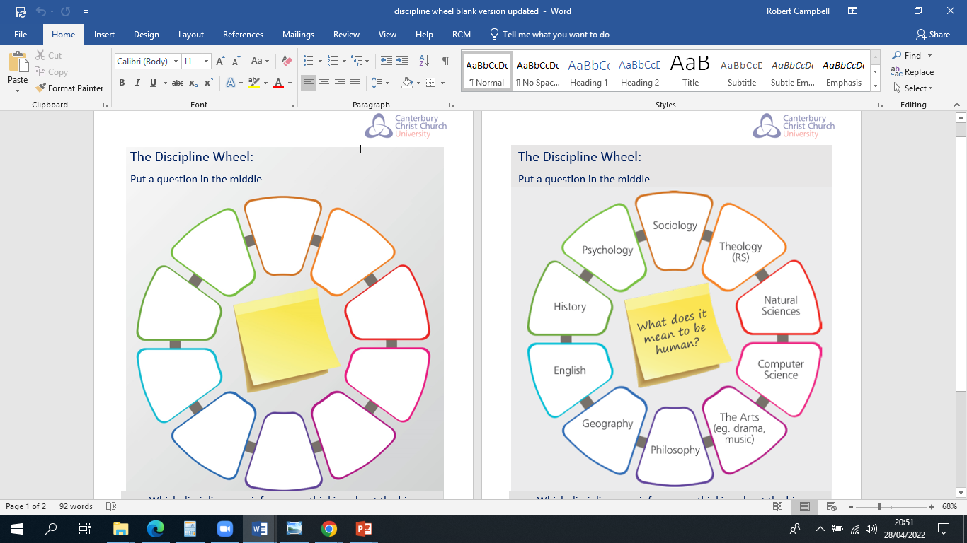
Activities
Which disciplines do you include?
How can you transform this into a lesson? Where can it fit in the curriculum e.g KS1/2 sci everyday materials
What investigations disciplinary questions can you ask?
Discuss with another group: what do you notice, did you come up with the same ideas?
How do I make the perfect cup of coffee?
Notes:
For presentations, consider using a slightly blue background as this will be easier for audience members who may have dyslexia or other visual impairments

Slide 16




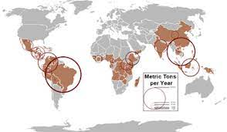
Additional prompts

Slide 17

A possible route to teach PSHE?
Do you need to add to your discipline wheel?
What are your reflections on how you now answer this question vs your initial thoughts?

Slide 18
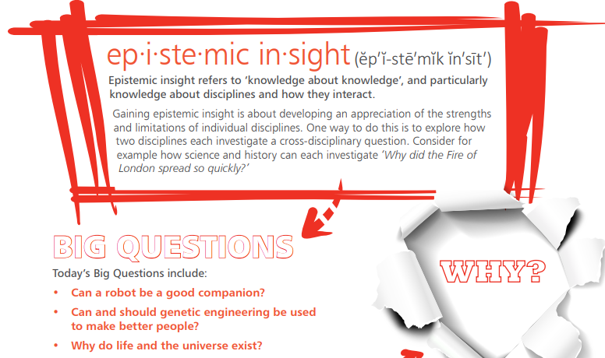

Epistemic Insight
Notes:
If short of time – keep this slide up as trainees finish the closing survey

Slide 19
The importance of REE
Finally, there is a basis to say that teacher education courses are also frequently compartmentalised at the expense of engaging teachers with the broader question of
how we can nurture young people’s developing intellectual curiosity,
teach scholarly attitudes, and
ensure learners have opportunities to develop single discipline and multidisciplinary approaches and expertise.
Berry Billingsley, ‘Teaching and learning about epistemic insight’, SSR June 2017, 98(365) pp59-64

Slide 20
Next steps
Could you:
Incorporate an epistemically insightful approach to big questions in your teaching?
Attend the Epistemic insight conference at St Mary’s University Twickenham 23rd-24th June. Book your FREEE place at https://www.stmarys.ac.uk/events/2022/06/epistemic-insight
Of particular interest Marianne Cutler ASE primary science 24th June
Submit a poster of your own epistemically insightful teaching. You could even do how do I make the perfect cup of coffee Submit your Abstract here https://www.epistemicinsight.com/conference-2022/ Deadline 8tH May 2022.

