Slide 1

Epistemic insight introduction
Starter question:
How do people gain knowledge?- where do we get our knowledge from? How does this change as we age?

Slide 2
Linked CCF statements
‘Learn that…’ 1. In order for pupils to think critically, they must have a secure understanding of knowledge within the subject area they are being asked to think critically about. 2. In all subject areas, pupils learn new ideas by linking those ideas to existing knowledge, organising this knowledge into increasingly complex mental models (or “schemata”); carefully sequencing teaching to facilitate this process is important. . | How this foundation knowledge supports key skills, i.e. ‘Learn how to…’: 1. And - following expert input - by taking opportunities to practise, receive feedback and improve at: Enabling critical thinking and problem solving by first teaching the necessary foundational content knowledge.
Key Content / Activities:

Slide 3


Aims of the session
Learn how different disciplines contribute to answering real-world problems
What makes a question a science question
How science and technology contributes to solving a problem
Notes:
Live broadcasts – reoccurring questions on socials then communicated to the broadcasting team.
Content packs from us building up to Results Day.

Slide 4
Introducing epistemic insight
Epistemic insight refers to knowledge about knowledge. It helps you articulate the similarities between subjects but also their distinctive features. Someone who is epistemically insightful can identify that not all questions re answerable by one subject in isolation and depending on the disciplinary lens you use you may come up with different answers to the same question.

Slide 5




Tools for EI
Many different forms of knowledge
We call these disciplines
Some of these disciplines correspond to the subjects you study in school

Slide 6
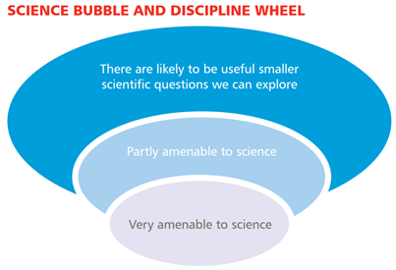
The bubble tool

Slide 7
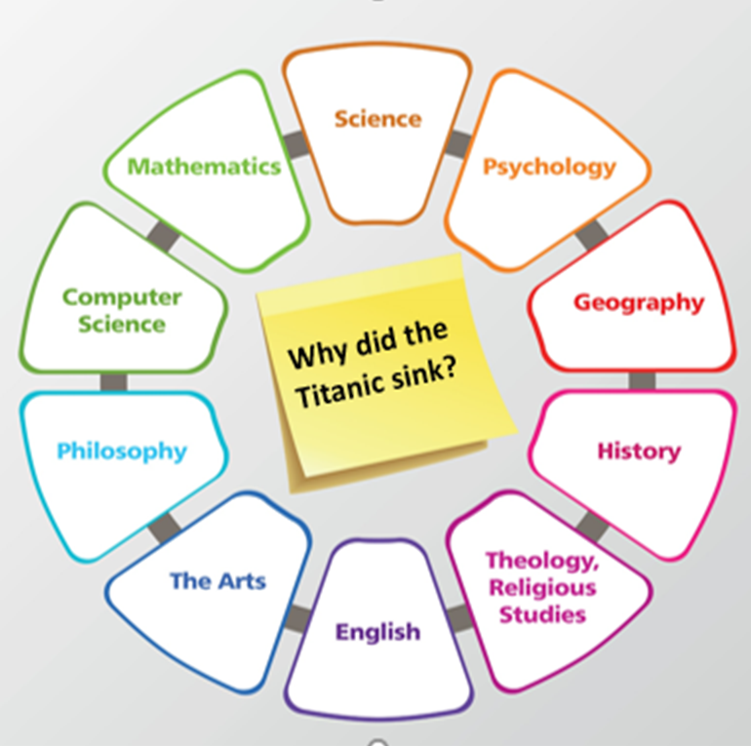
The discipline wheel
We Can use the discipline wheel to identify which subjects inform a complete answer to our big questions. This will not a;ways be static so once you and your students develop confidence with this, you can introduce a blank discipline wheel and get your students to work out which disciplines are relevant.
Big Question
Relevant link Epistemic insight booklet discipline wheel (page 9)
Notes:
The idea here is that there can be a multitude of disciplines that can inform big questions that look at real world problems. Our research is interested in how we support trainee teachers appraciate the types of questions that are purely scientific and how the distinct lens through which you view a question informs the answer that is given.
Take the example of why did the titanic sink useful clip hear if you have time. Epistemic insight watch from 1 minute stop at around 3 minutes Epistemic insight: engaging with life's Big Questions | Berry Billingsley | TEDxFolkestone - YouTube

Slide 8
Epistemic insight framework Link epistemic insight framework
Stage of school | Relationships between science and religion | The nature of science in real world contexts and multidisciplinary arenas | Ways of knowing and how they interact
Upper KS2 | Science and religion are mostly concerned with different types of questions, including different types of why question. | Science begins with observations of the natural world and constructing ways to explain our observation | Science has some similarities and some differences with other ways of knowing that we learn about in school.
ks3 | Some people say that science and religion are compatible and some people say they are not.. | Some questions are more amenable to science than others. | . Different disciplines have different preferred questions, methods and norms of thought
KS4 | Learning Outcomes Science and religion are not necessarily incompatible. | Scientism is not a necessary presupposition of science. | Some questions are more metaphysically sensitive than others.

Slide 9



Questions, methods and norms of thought
Questions
Questions which investigate the nature of the world around us
Methods
Hypothesis
Observation
Data collection
Analysis
Proof/evidence
Ways of thinking
Objectivity
Replicability
Consensus

Slide 10
Can science answer these questions?
1. How do you know that plants photosynthesise?
2. How do I know you have a toothache?
3. How do you know that I am in love?
4. How do you know the sun will rise tomorrow?
5. 6. How is the SARS-CoV-2 virus transmitted?
7.Should we ban cattle farming to reduce climate change?
8. Should Freedom day have happened on 19th July?
9. How do we know global warming is causing climate change?
1
Science Alone?
Informed by science?
Better answered by other disciplines?

