Slide 1


Big question what does it mean to be alive? – Come up with an answer within your subject disciplines
Epistemic insight 2

Slide 2
Linked CCF statements
Subject and Curriculum (Standard 3 – ‘Demonstrate good subject and curriculum knowledge’)
Learn how to…
Learn that…
Deliver a carefully sequenced and coherent curriculum, by:
Receiving clear, consistent and effective mentoring in how to identify essential concepts, knowledge, skills and principles of the subject.
Discussing and analysing with expert colleagues the rationale for curriculum choices, the process for arriving at current curriculum choices and how the school’s curriculum materials inform lesson preparation.
Explicitly teaching pupils the knowledge and skills they need to succeed within particular subject areas is beneficial.
In order for pupils to think critically, they must have a secure understanding of knowledge within the subject area they are beingasked to think critically about.
Pupils are likely to struggle to transfer what has been learnt in one discipline to a new or unfamiliar context.

Slide 3
Living
1.
2.
3.
4.
5.
Characteristics?
Non Living
1.
2.
3.
4.
5.
Notes:
Set up as a google jamboard. https://jamboard.google.com/d/1vsy3IK5bzQZzHyOF9NYwR5qwoZwyMlguoEqHD996y4I/edit?usp=sharing

Slide 4
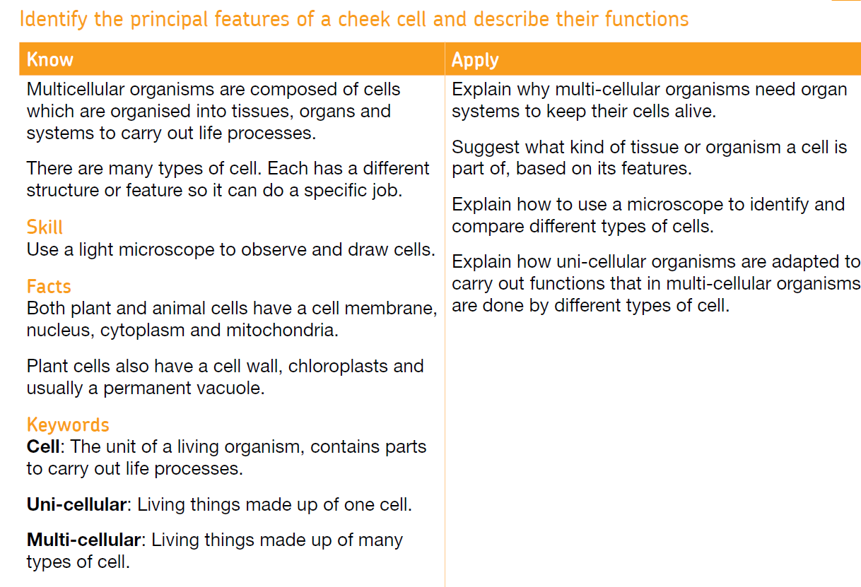
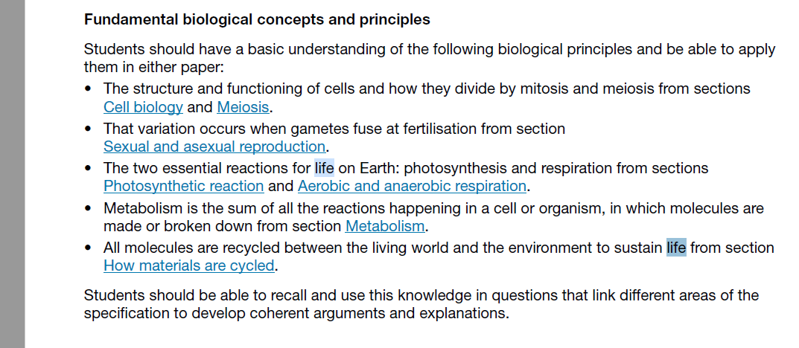
Links in the national curriculum

Slide 5
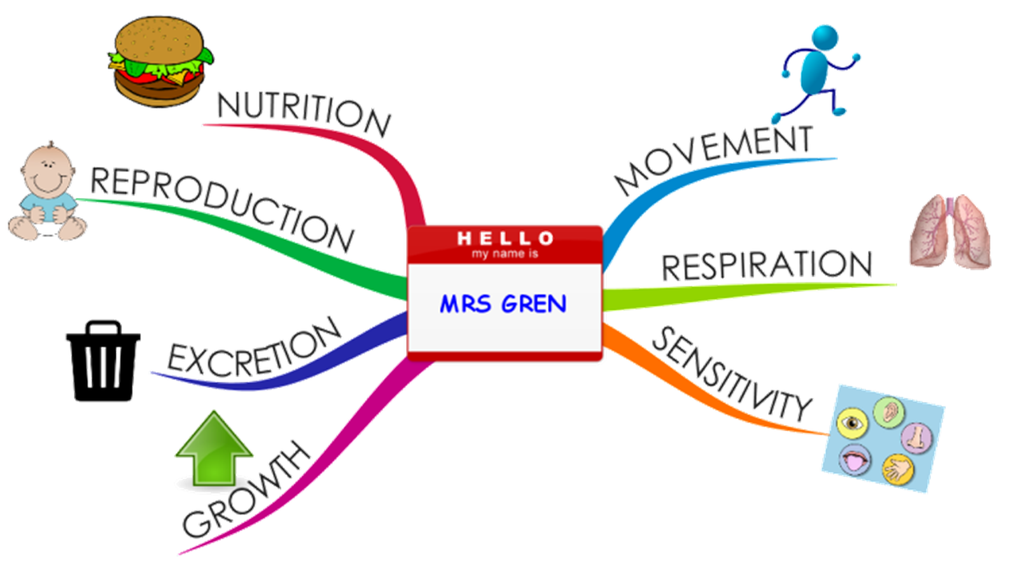
Characteristics of Life
Produce energy
Eliminate or expel waste
React to environment

Slide 6
RE GCSE Perspective
GCSE (AQA) - 3.2.1.2 Theme B: Religion and life
Students should study religious teachings, and religious, philosophical and ethical arguments, relating to the issues that follow, and their impact and influence in the modern world. They should be aware of contrasting perspectives in contemporary British society on all of these issues. They must be able to explain contrasting beliefs on the following three issues with reference to the main religious tradition in Britain (Christianity) and one or more other religious traditions: Abortion; Euthanasia; Animal experimentation.
The origins and value of human life
The origins of life, including: religious teachings about the origins of human life, and different interpretations of these; the relationship between scientific views, such as evolution, and religious views.
The concepts of sanctity of life and the quality of life.
Abortion, including situations when the mother's life is at risk.
Ethical arguments related to abortion, including those based on the sanctity of life and quality of life.
Euthanasia.
Beliefs about death and an afterlife, and their impact on beliefs about the value of human life.
p21-22 - https://filestore.aqa.org.uk/resources/rs/specifications/AQA-8062-SP-2016.PDF

Slide 7
Sensitivity warning
Sensitivity warning?

Slide 8
Some scenarios
Story 1: Dave is a friend of mine, at a young age he chose to have a vasectomy. He is therefore unlikely to be able to reproduce, (he did not store any sperm before his vasectomy). Is he any less alive than you or I. What about a woman who has gone through the menopause or people who are unable to have biological children?
Scenario 2 What about someone in a vegetative state
Scenario 3 What about someone in a coma?
In each of the scenarios How many of the characteristics of living things did each person have? What is your reflection?
Does your characteristic list need to change?
Notes:
On whiteboards in breakout rooms

Slide 9
Can a robot be alive?
What would it take to make robot alive?
Record your ideas on a discipline wheel. Which disciplines do you include? Why are they included/others excluded?
What disciplines did you refer to?

Slide 10
Introducing epistemic insight the epistemic insight framework
How do we meet these objectives in our teaching?
Stage of school | Relationships between science and religion | The nature of science in real world contexts and multidisciplinary arenas | Ways of knowing and how they interact
ks3 | Some people say that science and religion are compatible and some people say they are not.. | Some questions are more amenable to science than others. | Different disciplines have different preferred questions, methods and norms of thought
KS4 | Learning Outcomes Science and religion are not necessarily incompatible. | Scientism is not a necessary presupposition of science. | Some questions are more metaphysically sensitive than others.
Notes:
Big questions are ones that require more than one discipline to answer. Remember this is not additional to the science or RE curricula, but rather supports us teach all aspects of the curricium. E.g. science the limitations of science and the type of questions science can not answer.

Slide 11
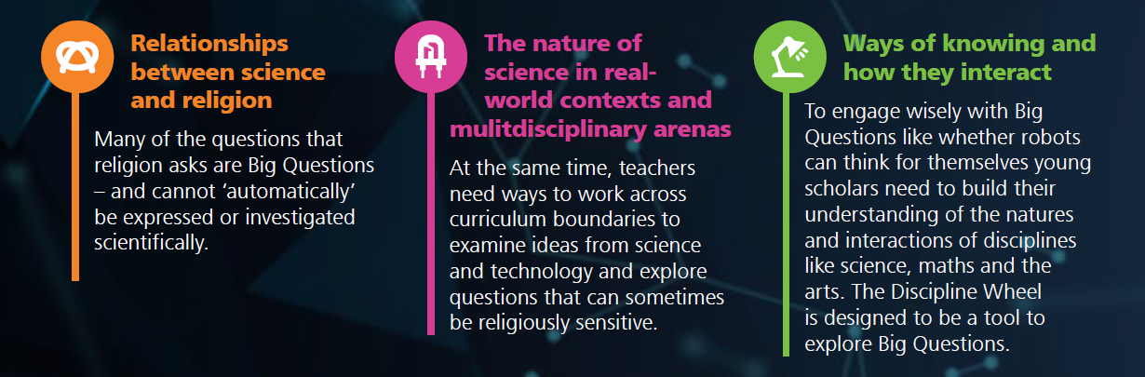
Specific to the question on robots

Slide 12
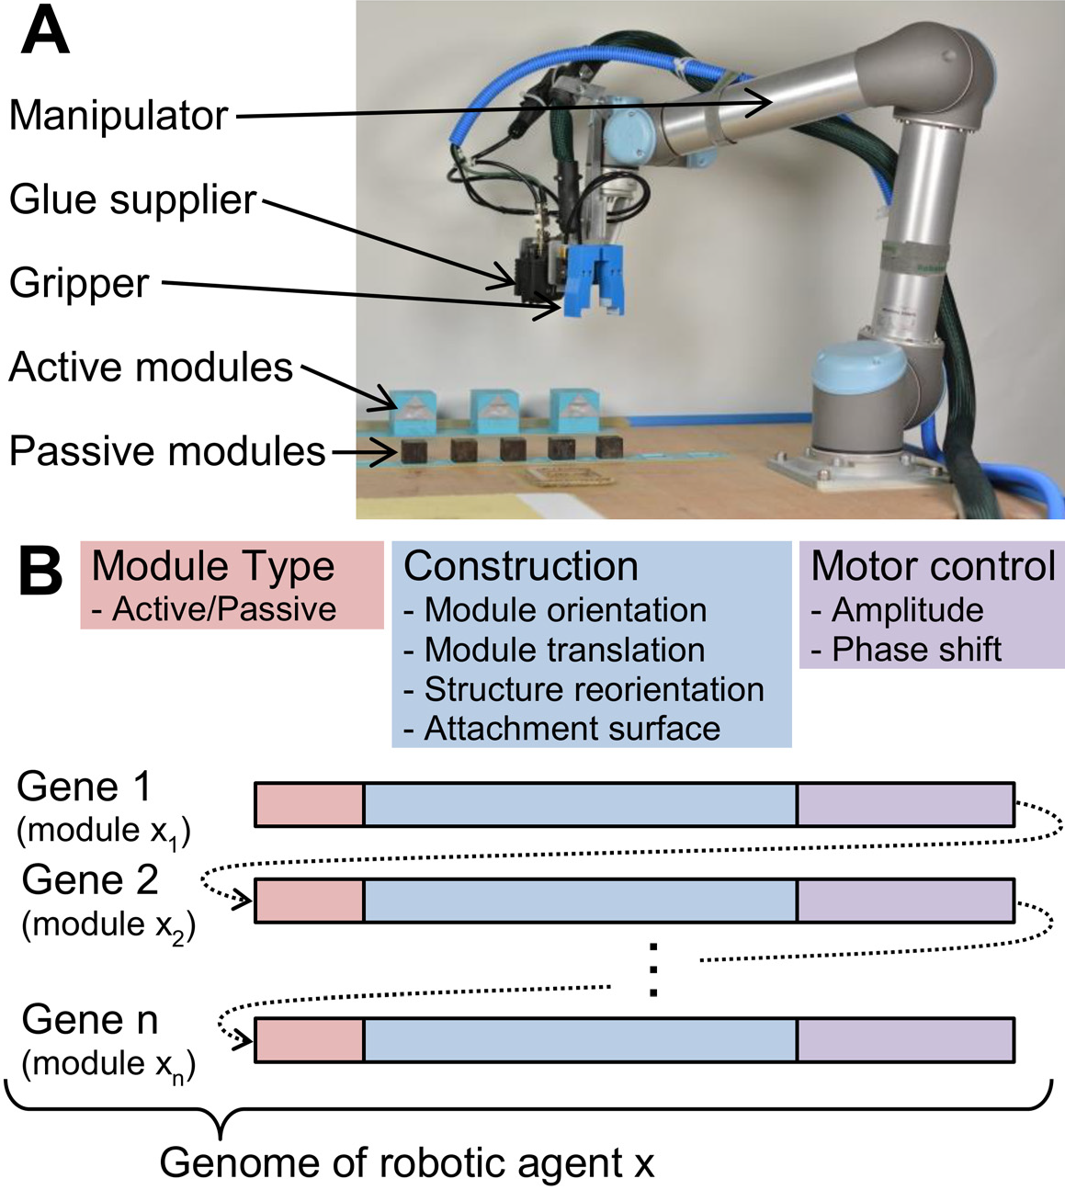
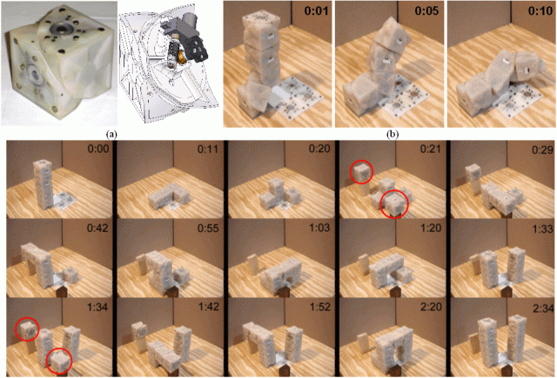
Can a robot reproduce?
Kykov et al., Nature 435 (2005)

Slide 13
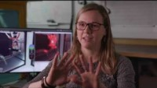
Can a robot ever be curious?

Slide 14

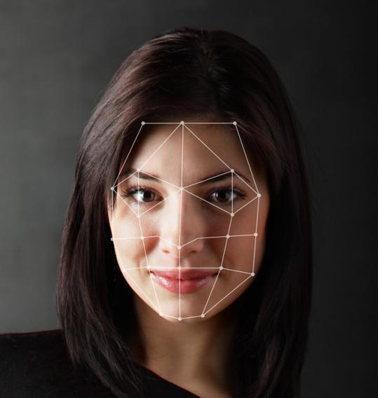
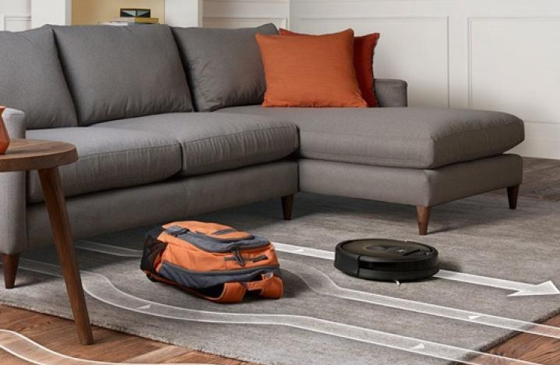
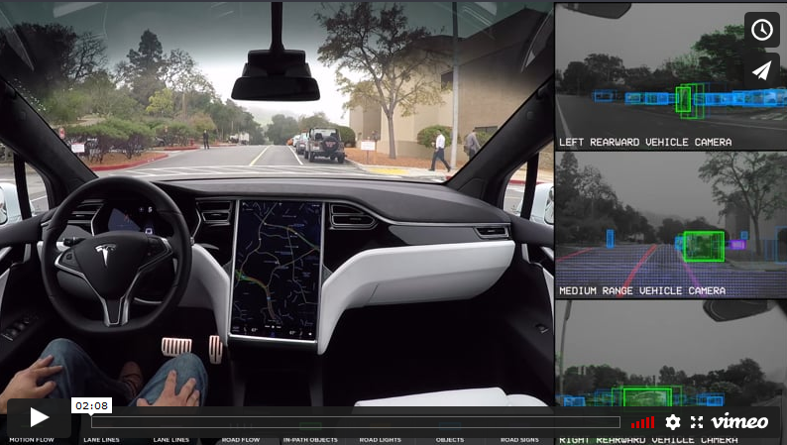
AI around us?
Smarter Home Robots
(Source: Builtin)
Smart Maps
(Source: Built-in)
Facial Recognition
(Source: Built-in)
Autopilot Tesla car (Source: Tesla)
Notes:
ARTIFICIAL INTELLIGENCE​
intelligence demonstrated by machines, in contrast to the natural intelligence (NI) displayed by humans and other animals.​

Slide 15
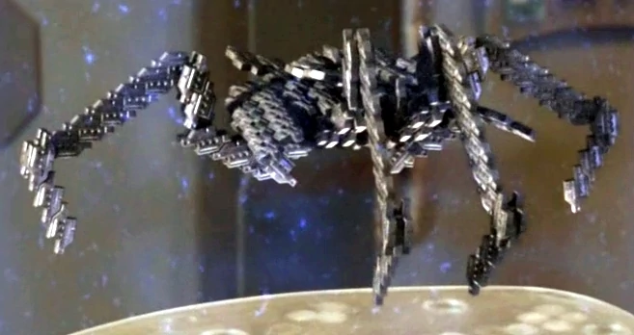
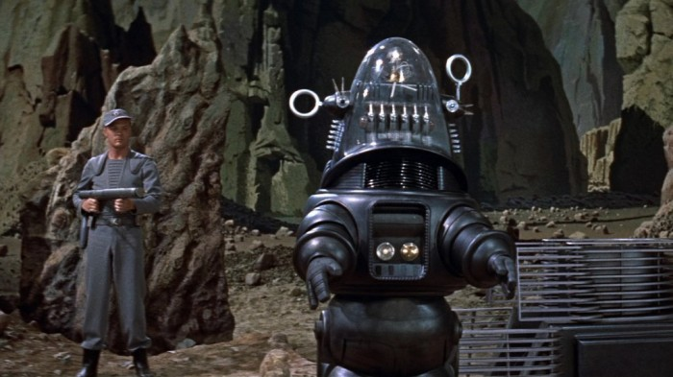



My cultural references.
Can you identify them?
Notes:
1.Robbie the Robot from Forbidden Planet and late Lost in Space
2. Front cover from I Robot Isaac Asimov
3. Stargate SG1 Replicators
4. Terminator films
5. Matrix trilogy

Slide 16
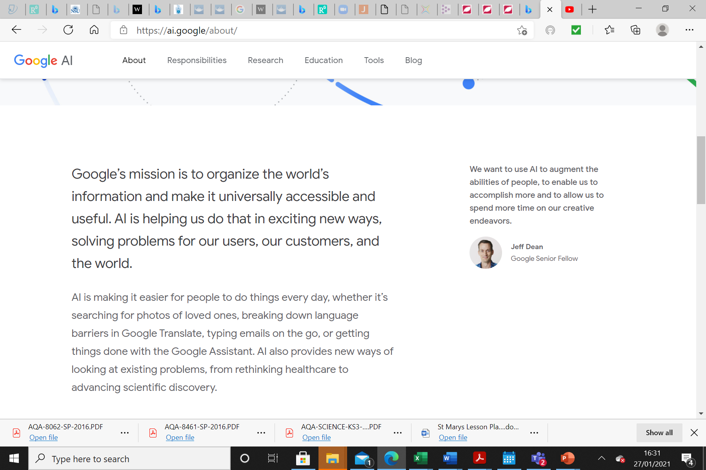
AI AROUND US
Hey Google! Thoughts?
Are there any ethical considerations to tale account of
Notes:
How do we think about that AI?
Do different generations see AI differently?

Slide 17
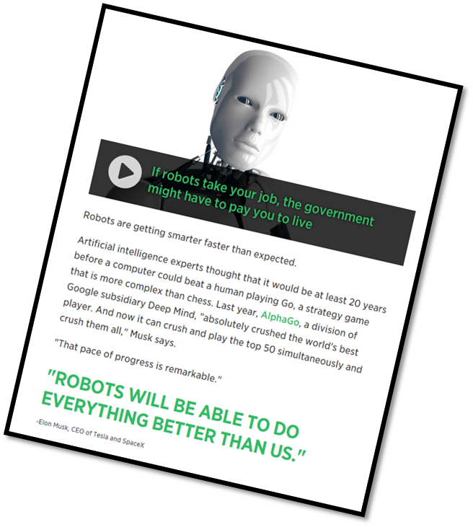
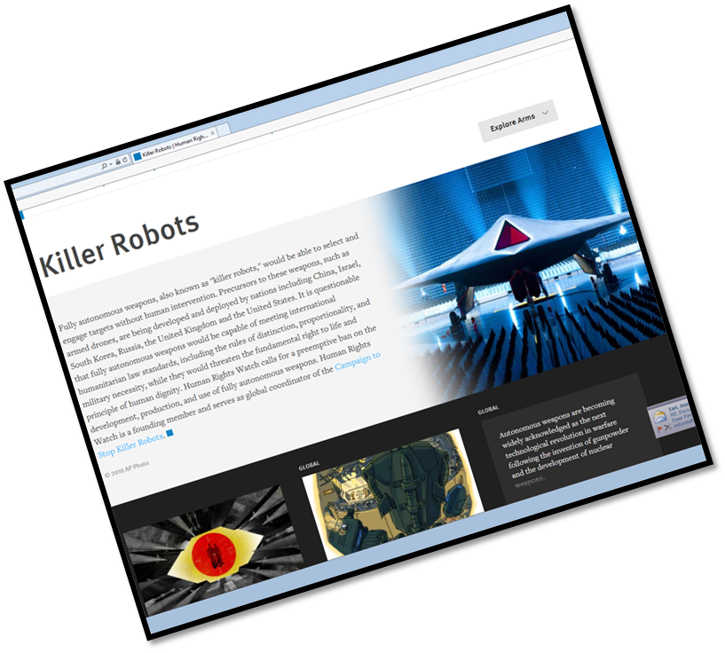
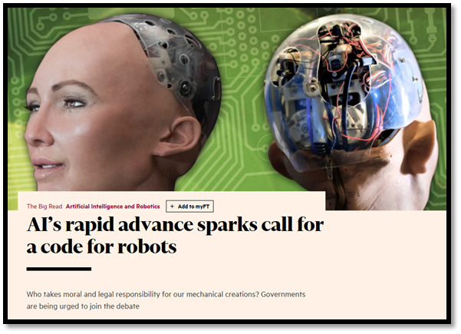
Challenges and Promises?
© https://www.hrw.org/topic/arms/killer-robots
© https://www.cnbc.com/2017/07/17/ elon-musk-robots-will-be-able-to-do-everything-better-than-us.html
© https://www.ft.com/content/1e0d2254-8c98-11e7-9084-d0c17942ba93
Notes:
All to input iis the ethical guidance on AI sufficient. What are the negative connotations of progrmmiing for robots to have curiosity?

Slide 18
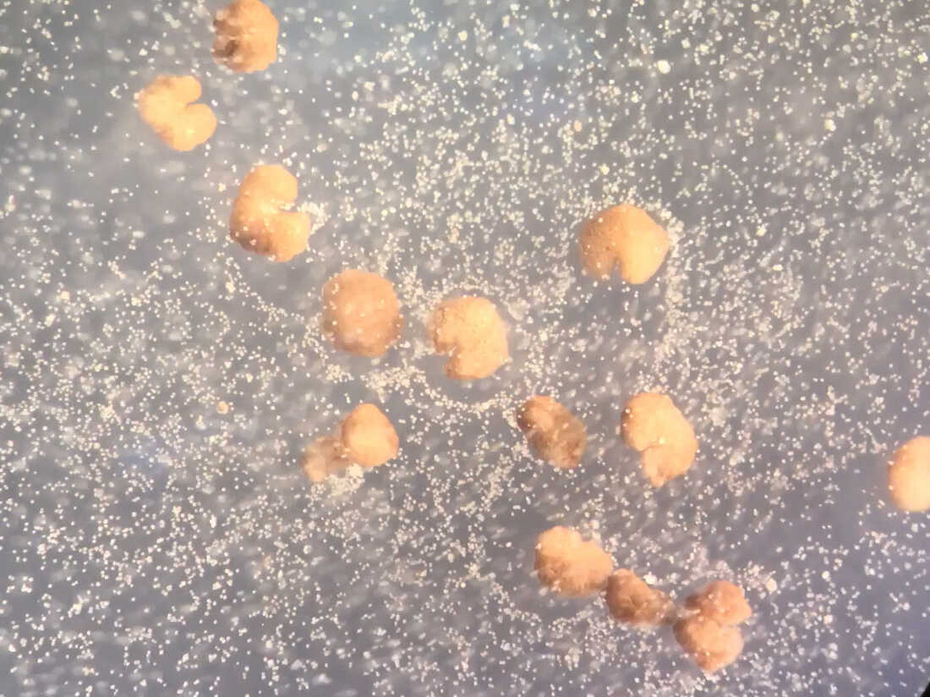
An update on reproducing Robots
Nov 2021 Science daily. Team builds first living robots that can reproduce
AI-designed Xenobots reveal entirely new form of biological self-replication—promising for regenerative medicine
What are the non scientific questions we need to ask?

Slide 19
What is the role of science within our society?
science
Theology/spirituality
science
Theology/spirituality
science
Theology/spirituality
Ethics

Slide 20
Plenaries
In your groups revisit the Likert scale statements from, the last session. Have any of your views changed? Why/Why not in what ways
Quantitative data is always more valuable than qualitative data
Trust in scientific data is a kind of faith.
Plenary 2
If somebody asked you what is science/ what is RE, how would you respond?

