Slide 1
Epistemic insight session 2
Session aims:
Describe the type of question your disciplinary lens will raise
Explore how to use the EI tools when answering big questions
Explain the limitations of your own discipline when seeking to solve real world problems..

Slide 2
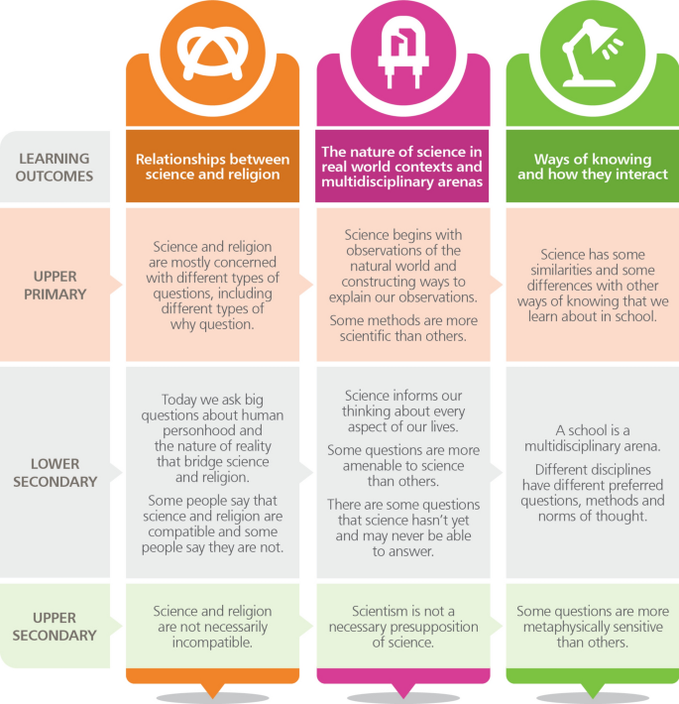
Epistemic insight framework Billingsley et. al (2018)

Slide 3




Appreciating the distinctiveness of an individual discipline.
Questions
Questions which investigate the nature of the world around us
Methods
Hypothesis
Observation
Data collection
Analysis
Proof/evidence
Ways of thinking
Objectivity
Replicability
Consensus

Slide 4
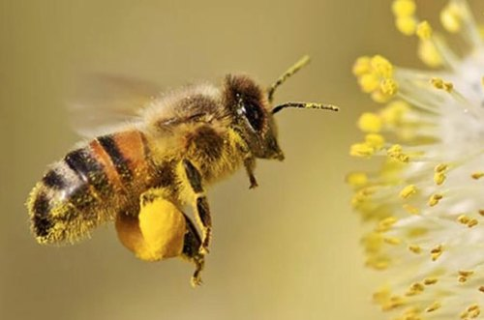
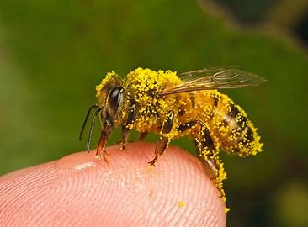
A new big question
Even if I don’t like honey, should I care if the honeybees die out?

Slide 5
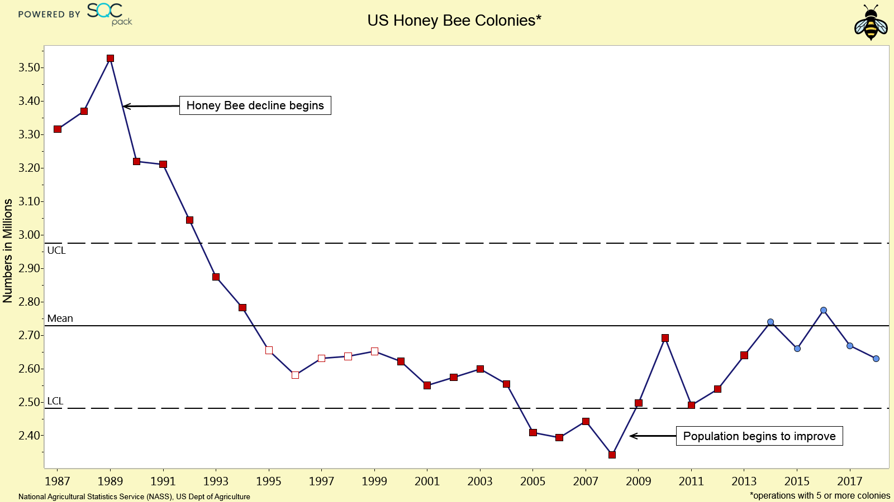
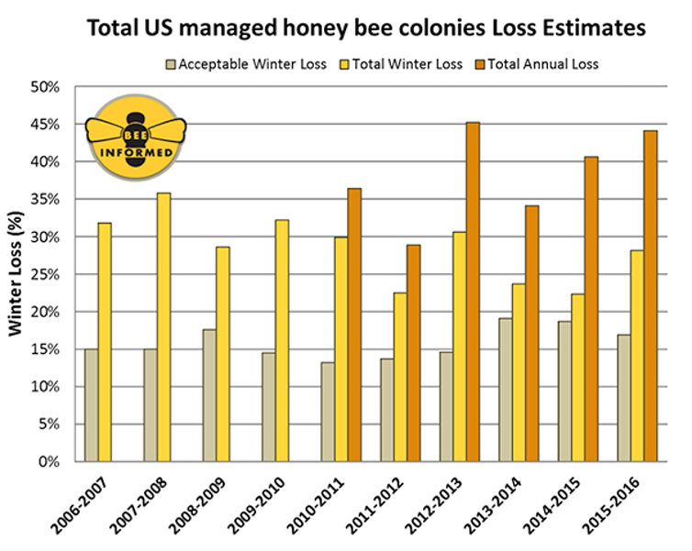
Graphs on honey bee population a mathematical lens?

Slide 6
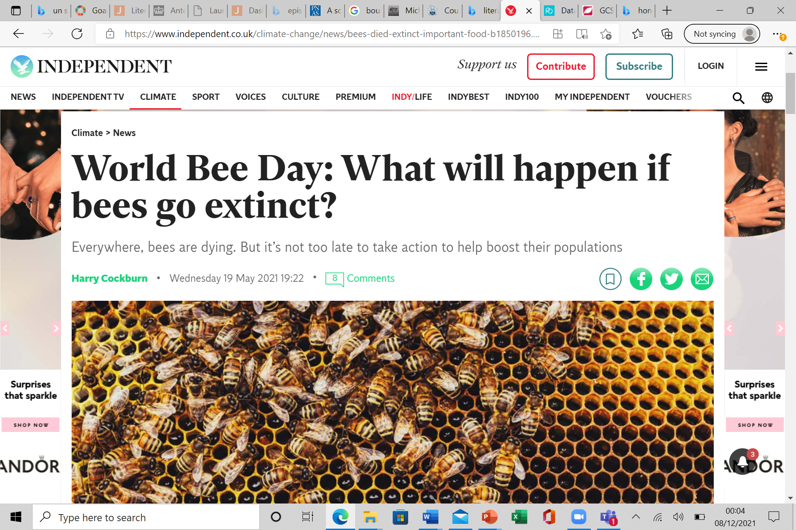
Bees in the news
Cockburn, (2021)

Slide 7



Big questions linked to real world problems: Sustainability. UN SDGs
UNESCO (no date)

Slide 8
Where does this fit into your Lectures on the PS module?
Curriculum Landscape Peter Ward – defining the term curriculum and articulating how the definition of the term has changed.
How pupils Learn Matthew Dell- Video from Prof Paul Howard Jones- working memory is limited- to ensure learning occurs the quality of communication is key.
Curriculum making: your role as a curriculum maker – Sophie Wilson- The role and purpose of a curriculum. Definitions of terms disciplinary knowledge and substantive knowledge.
Notes:
Quotations from Sophie’s lecture to emphasise Substantive knowledge different ways of learning different lenses to understand the world around them
Disciplinary knowledge provides objectivity through its different ways of thinking knowing.
Point to make
Articulating what is distinctive about your discipline is therefore valuable

Slide 9
Subject | Relevant curriculum statements (Wilson, 2021; Myatt 2021)
English | Through reading in particular, pupils have a chance to develop culturally, emotionally, intellectually, socially and spiritually. Understand and critically evaluate texts through: seeking evidence in the text to support a point of view, including justifying inferences with evidence
Geography | Apply geographical knowledge, understanding, skills and approaches appropriately and creatively to real world contexts, including fieldwork, and to contemporary situations and issues; and develop well-evidenced arguments drawing on their geographical knowledge and understanding (applying geography).
History | Enable pupils to think critically, weigh evidence, sift arguments, make informed decisions and develop perspective and judgement. This, in turn, will prepare them for a role as informed, thoughtful and active citizens. Understanding of how evidence is used rigorously to make historical claims, discerning how and why different interpretations of the past have been constructed
MFL | Develop awareness and understanding of the culture and identity of the countries and communities where the language is spoken. Students will be expected to understand different types of written language, including relevant personal communication, public information, factual and literary texts, appropriate to this level
Maths | Reason mathematically by following a line of enquiry, conjecturing relationships and generalisations, and developing an argument, justification or proof using mathematical language ▪ can solve problems by applying their mathematics to a variety of routine and nonroutine problems with increasing sophistication, including breaking down problems into a series of simpler steps and persevering in seeking solutions.
RE | The role of the Church in the local community, including food banks and street pastors. • The place of mission, evangelism and Church growth. • The importance of the worldwide Church including: • working for reconciliation
PE | Engagement patterns of different social groups in physical activity and sport
Science | explaining everyday and technological applications of science; evaluating associated personal, social, economic and environmental implications; and making decisions based on the evaluation of evidence and arguments.
Notes:
As Sophie explained to you, we have summarised the distinct purposes of each individual subject within the curriculum. It is valuable not only to see the distinctive purposes of each individual subject, but also how they interrelate within a holistic curriculum. I would argue that encouraging pupils to see how distinctive disciplines interlink is invaluable. When seeking to solve real world problems an understanding of the distinctive role of each discipline is essential to support students move beyond an approach that reverts to scientism.

Slide 10

Writing questions activity.
Write an example of a question another discipline alone can answer.
Write an examples of a question science alone can answer.
Write an example of a bridging/ big question that is partly amenable to science
What do you notice about each of these questions? How easy are they to investigate?

Slide 11
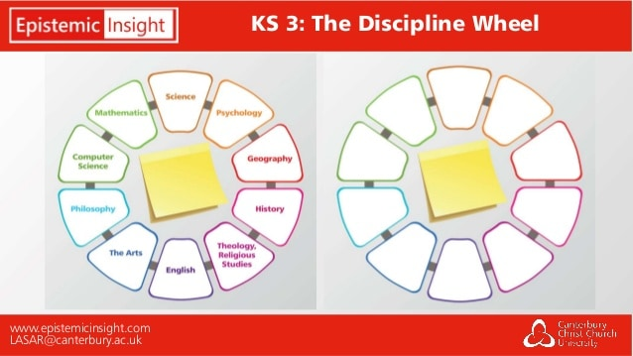
Introducing big questions using the discipline wheel
The discipline wheel can be used when posing big questions. It helps us articulate the role of a multitude of disciplines.
Big question:
Even if I don’t like honey, should I care if the honey bees die out?
Task explain the role of each of the following disciplines
Science
Mathematics
Geography
History
English/ The arts
RE
PE

Slide 12
A new big question
Choose one of the following goals
Conserve and sustainably use the oceans, seas and marine resources for sustainable development.
Protect, restore and promote sustainable use of terrestrial ecosystems, sustainably manage forests, combat desertification, and halt and reverse land degradation and halt biodiversity loss.
Ensure access to affordable, reliable, sustainable and modern energy for all.
Use the resources available on the UN’s sustainable development goal website to help you.

Slide 13

Final reflection
As you prepare for your next placement reflect on how/where your could include epistemic insight in your teaching.
How else could you teach the skills and objectives set out in your subject’s curriculum?
What should the balance between subject knowledge and developing disciplinary skills be?

Slide 14
References
Billingsley, B., Nasaji, M., Fraser, S. and Lawson, F. (2018) A framework for teaching epistemic insight in schools, Research in science education 48, pp. 1115-1131 DOI 10.1007/s11165-018-9788-6
Cockburn, H. (2021) “World bee day, what will happen if bees go extinct?” The Independent 19th May 2021. Available at https://www.independent.co.uk/climate-change/news/bees-died-extinct-important-food-b1850196.html date accessed 13th December 2021.
Dell, M (2021) How pupils learn 1 Cognition. Lecture for PGS6054 module available at https://mymodules.stmarys.ac.uk/mod/book/view.php?id=605996&chapterid=27429 date accessed 13th December 2021.
Howard Jones, P. (2020) Building new knowledge available at https://www.youtube.com/watch?v=XL5p6MBplgM date accessed 13th December 2021.
Myatt, M. (2020) Back on Track: Fewer things, greater depth, John Catt Educational Ltd, Woodbridge.
Unesco (no date) UNESCO and the sustainable development goals. Available at https://en.unesco.org/sustainabledevelopmentgoals date accessed 13th December 2021.
Ward, P (2021) Curriculum landscape. Lecture for PGS6054 module available at https://mymodules.stmarys.ac.uk/mod/book/view.php?id=605996&chapterid=27430 date accessed 13th December 2021.
Wilson, S (2021) Curriculum making: your role as a curriculum maker. Lecture for PGS6054 module available at https://mymodules.stmarys.ac.uk/mod/book/view.php?id=605996&chapterid=27454 date accessed 13th December 2021.

