Slide 1
Bridging session PE and Science- introducing epistemic insight
Linked CCF Statements
Learn that TS3
A school’s curriculum enables it to set out its vision for the knowledge, skills and values that its pupils will learn, encompassing the national curriculum within a coherent wider vision for successful learning.
TS4
Effective teaching can transform pupils’ knowledge, capabilities and beliefs about learning.
2. Effective teachers introduce new material in steps, explicitly linking new ideas to what has been previously studied and learned

Slide 2

Introducing epistemic insight
Epistemic insight refers to knowledge about knowledge. In particular, knowledge about disciplines and how they interact. This year you will be introduced to a range of lectures linked to epistemic insight.
Lectures in your discrete subject.
Purpose of PE and what is science
Bridging sessions
Science and PE
Microteach
Science and RE x 2
Science and History
Big questions – the entire curriculum
4 x PS sessions examples include
Is it true you are what you eat ?
Should driverless cars be legalised?

Slide 3
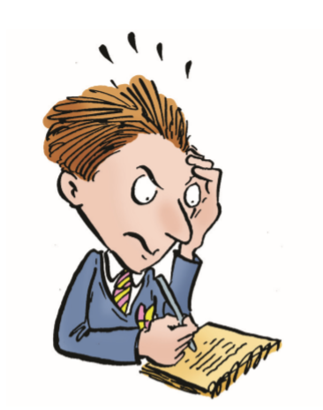
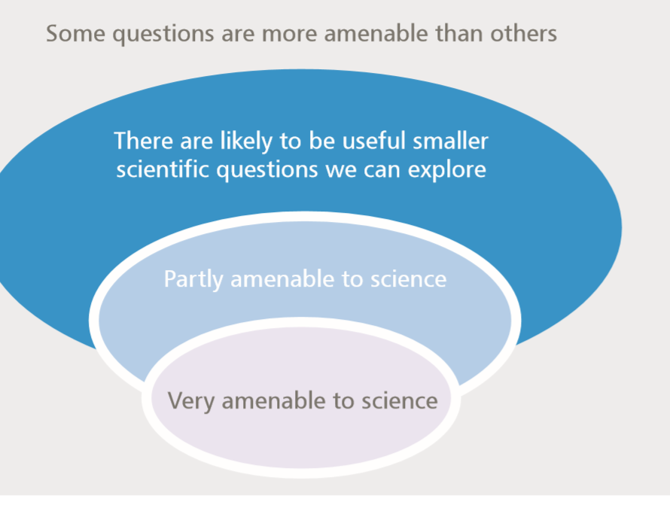
Why do we have sessions on epistemic insight?
Students experience a curriculum that is multidisciplinary, yet research suggests subjects often teach in silos. Epistemic insight encourages us to appreciate the type of questions that a singular discipline can answer and the limitation of each discipline.
The bubble tool groups questions according to how scientific they are.

Slide 4
Website links to the Men’s 4x100m relay in the Tokyo Olympics
Athletics: Team GB win men's 4x100m relay silver | Tokyo Olympics - YouTube
Men's 4x100m Relay Final | Tokyo Olympics 2020 - YouTube
TEAM GB: Silver and Bronze in Men's and Women's 4x100m Relay Finals | Olympic Games - Tokyo 2020 - YouTube

Slide 5

British Athlete suspended for doping
World Athletics Anti-Doping rules state that in instances where an athlete who has committed an ADRV competed as a member of a relay team, "the relay team shall be automatically disqualified from the event in question, with all resulting consequences for the relay team, including the forfeiture of all titles, awards, medals, points and prize and appearance money".

Slide 6
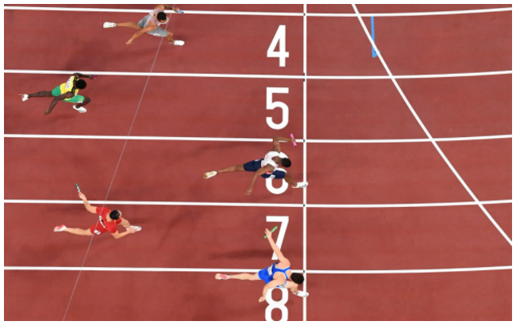

What next?
In your view, what consequences should there be for Team GB and CJ Ujah?
Should the GB Team be treated as one?
Should all 4 athletes have their medals removed?
Should the GB Team medal be downgraded to a bronze?
What is the effect of the steroid on the GB Team time...was the eventual outcome affected?

Slide 7

Todays 'BRIDGING QUESTION'…....
Should performance enhancing drugs be allowed at the Olympics?

Slide 8

Breakout room task no.2:
This time in your breakout rooms, we would like you to discuss our 'Bridging question', only this time, please try and answer from the alternative disciplinary perspective. I.e. scientists think from a PE perspective and vice versa.
Some prompts you may wish to consider:
Health and Well-being
The 'spirit of sport'
Social
Finance
Geography
Culture

Slide 9

"Create and deliver a cohesive curriculum that builds on prior learning and deepens knowledge".
Clear rationale for your school's curriculum. Teachers must understand importance of knowledge, progression and sequencing.
Achievement / outcomes - are students 'getting a good deal' out of the curriculum?
Staff and teachers must understand their role in delivering intent, as well as subject knowledge – includes a rationale for assessment.

Slide 10

Implementation
Identify key concepts within each subject...how do they connect to other subjects?
Opportunity to innovate change
How do we facilitate a multi-disciplinary approach to learning?
Leaders?
Subject Leaders?
Class teachers?
Intent vs. Reality
Providing opportunity for all pupils to learn and master essential concepts, knowledge, skills and principles of the subject
identify essential concepts, knowledge, skills and principles of the subject.
ensure pupils’ thinking is focused on key ideas within the subject and deconstructing this approach
Being aware of common misconceptions and discussing with expert colleagues how to help pupils master important concepts.

