Slide 1
Teaching RE and Science: conflicting epistemologies?
Tutors: Robert Campbell and Matthew Dell
Wednesday 11th November 2020.

Slide 2
Linked CCF Statements pedagogy
‘Learn that…’
1. In order for pupils to think critically, they must have a secure understanding of knowledge within the subject area they are being asked to think critically about.
‘Learn how to…’:
1. And - following expert input - by taking opportunities to practise, receive feedback and improve at: Enabling critical thinking and problem solving by first teaching the necessary foundational content knowledge.

Slide 3
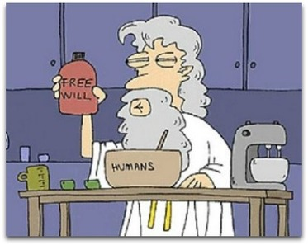
What do you think about this image?

Slide 4
Learning objectives
To know agreed definitions for key terms
To be able to appreciate the importance of epistemic insight.
To evaluate your own viewpoint on the nature of science/religion.

Slide 5
Group work
You need to be in a group of 4
Your group needs to have at least one RE PGCE trainee.
You group needs to be mixed, at least one member of the opposite sex.

Slide 6

Agree – Unsure - Disagree

Slide 7
There is such a thing as absolute truth?
Agree – Unsure - Disagree

Slide 8
Agree- Unsure-Disagree
Quantitative data is always more valuable than qualitative data

Slide 9
Development in science is about disproof not proof.
Agree – Unsure - Disagree

Slide 10
Trust In scientific data is a kind of faith.
Agree – Unsure - Disagree

Slide 11
A thought for the week:
I used to think that top environmental problems were biodiversity loss, ecosystem collapse and climate change.
I thought that thirty years of good science could address these problems.
I was wrong.
The top environmental problems are selfishness, greed and apathy, and to deal with these we need a cultural and spiritual transformation.
And we scientists don’t know how to do that.
Gus Speth, Environmental Scientist

Slide 12

Let's get you thinking!
What should a teacher do with questions about life after death?

Slide 13
Freeman J. Dyson, one of the world’s pre-eminent physicists whose futurist views consistently challenge humankind to reconcile technology and social justice. https://www.edge.org/conversation/freeman_dyson-progress-in-religion
Physicist – Freeman Dyson says....
‘Science and religion are two windows that people look through, trying to understand the big universe outside, trying to understand why we are here. The two windows give different views, but they look out at the same universe. Both views are one-sided, neither is complete. Both leave out essential features of the real world. And both are worthy of respect...

Slide 14
Freeman J. Dyson, one of the world’s pre-eminent physicists whose futurist views consistently challenge humankind to reconcile technology and social justice. https://www.edge.org/conversation/freeman_dyson-progress-in-religion
Physicist – Freeman Dyson says....
… Trouble arises when either science or religion claims universal jurisdiction, when either religious dogma or scientific dogma claims to be infallible. Religious creationists and scientific materialists are equally dogmatic and insensitive.
By their arrogance they bring both science and religion into disrepute. The media exaggerate their numbers and importance. The media rarely mention the fact that the great majority of religious people belong to moderate denominations that treat science with respect, or the fact that the great majority of scientists treat religion with respect so long as religion does not claim jurisdiction over scientific questions. ’

Slide 15
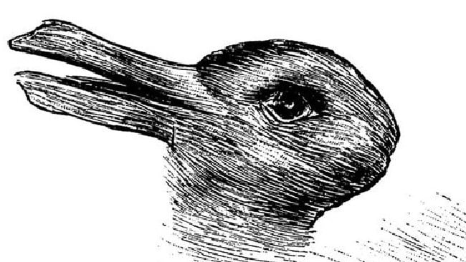
Two ways of seeing. What do you see in the picture?

Slide 16
Evolution vs Creationismn
Some students seem fascinated with what they see as the incompatibility of evolution and religious creation accounts.
Two ways of seeing – can lead to - what way is better?
Leads to are you with Dawkins or against him?

Slide 17
DCSF. 2007. Guidance on creationism and intelligent design. London: DCSF. Accessed 26 February 2018. http:// webarchive.nationalarchives.gov.uk/20071204131026/http://www.teachernet.gov.uk/docbank/index.cfm?id=11890
Creationism and intelligent design are not part of the science National Curriculum programmes of study and should not be taught as science. However, there is a real difference between teaching ‘x’ and teaching about ‘x’.

Slide 18
Royal Society statement regarding Professor Michael Reiss’ statement on teaching creationism
Some of Professor Michael Reiss's recent comments, on the issue of creationism in schools, while speaking as the Royal Society's Director of Education, were open to misinterpretation. While it was not his intention, this has led to damage to the Society's reputation. As a result, Professor Reiss and the Royal Society have agreed that, in the best interests of the Society, he will step down immediately as Director of Education a part time post he held on secondment. He is to return, full time, to his position as Professor of Science Education at the Institute of Education.
The Royal Society's position is that creationism has no scientific basis and should not be part of the science curriculum. However, if a young person raises creationism in a science class, teachers should be in a position to explain why evolution is a sound scientific theory and why creationism is not, in any way, scientific.
The Royal Society greatly appreciates Professor Reiss's efforts in furthering the Society's work in the important field of science education over the past two years. The Society wishes him well for the future.

Slide 19
Science Curriculum
A focus of the science curriculum is to highlight "the power and limitations of science". DFE (2014)
To do this we need a strong understanding of the nature of science.
Working scientifically.(Practical skill in science).
Asking questions
Performing tests
Your purpose of science education
Impact “ trust science over religion”.

Slide 20
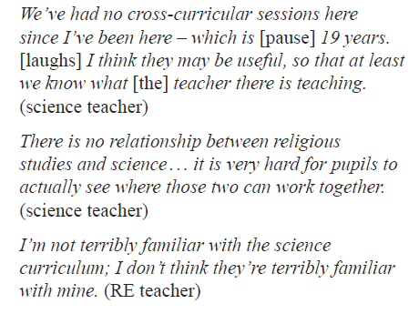
Research on cross curricular
Resources that can potentially help:
http://www.neverofftopic.com/
Billingsley (2017) p62

Slide 21
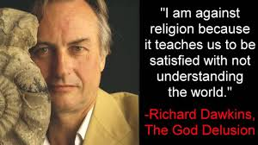
Contrasting views of science: Is someone being more scientific?
God delusion
https://www.youtube.com/watch?reload=9&v=VjnECJVwReo
David Attenbourough
https://www.youtube.com/watch?v=mI7f3xVgZdA

Slide 22
RE Curriculum
RE usually has an aspect of the curriculum that requires teaching about the relationship between science and religion – usually focused around the origins of the universe.
The National Curriculum for Science does not require such an exploration.

Slide 23
AQA Religious Studies GCSE specification
Christianity and science
The origins of life, including:
religious teachings about the origins of human life, and different interpretations of these
the relationship between scientific views, such as evolution, and religious views.
The origins of the universe, including:
religious teachings about the origins of the universe, and different interpretations of these
the relationship between scientific views, such as the Big Bang theory, and religious views.
https://filestore.aqa.org.uk/resources/rs/specifications/AQA-8062-SP-2016.PDF

Slide 24
AQA Religious Studies A level specification
Christianity and science
How and why science has influenced Christianity and how Christianity has responded, with particular reference to: emphasis on evidence and reason in science; specific scientific discoveries; science as a stimulus to Christian ethical thinking.
Developments in Christian thought:
How scientific explanation has challenged Christian belief with reference to the ‘God of the gaps’; 19th century Christian responses to Darwin’s theory of evolution and contemporary responses to the Big Bang theory, including reference to creationist views.
The belief that science is compatible with Christianity with reference to the views John Polkinghorne.
Different Christian responses to issues raised by science: genetic engineering.
https://filestore.aqa.org.uk/resources/rs/specifications/AQA-7062-SP-2016.PDF

Slide 25
GCSE A level
Explain two ways in which, for Catholics, science and religion can be seen to be in harmony.
‘The creation accounts in Genesis are an accurate scientific account of the beginnings of the universe’.
‘The fundamentalist approach is the only meaningful way to appreciate the Genesis creation stories.
‘Evolution was the end of religion.’ Evaluate this claim.
'Modern science creates problems for Christian ethics.'

Slide 26
Compartmentalisation
‘This raises the question of whether the compartmentalisation of curriculum subjects in England (an organisational structure not required by the 1988 Education Reform Act or any other legislation) leads to an inevitable compartmentalisation of knowledge and associated epistemological challenges.’
(Pearce et al, 2019, p4)

Slide 27

Saviour Siblings
Big Question for this workshop:
Should Science be used to create Saviour Siblings?
Notes:
Introduction – we will be thinking about the use of a medical intervention – it will sound quite futuristic but we will be talking about real people making real decisions today.
We’ll be thinking about the role of science in helping us to address a big question.
De we know what a saviour sibling is – what about sibling? Who has brothers and sisters - or knows someone who does – so we can see we’re dealing with some everyday decisions.
Explain saviour sibling – a child who saves an older unwell child by a donation of stem cells from the umbilical cord.

Slide 28
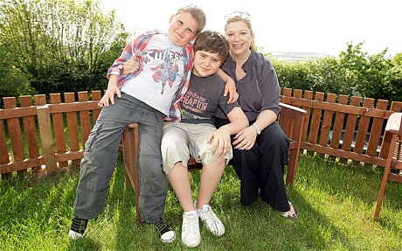
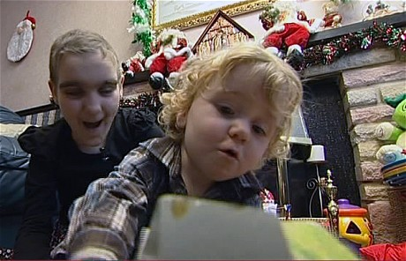

Should Science be used to create
Saviour Siblings?
What is a Saviour Sibling?
Megan has a rare blood disorder. Baby Max was born to be a tissue donor – and her saviour sibling. Max was the first to be born in the UK via this intervention.
Jamie Whittaker was very unwell with DBA a rare form of anaemia. His younger brother Charlie is a saviour sibling.
Human Fertilisation and Embryology Authority
Notes:
We’re going to look at the stories of Charlie and Jamie Whitaker and also Megan and Max Matthews.
This is Charlie and Jamie Whitaker with their mother. Jamie was conceived in order to help cure Charlie’s illness – DBA, a rare form of anaemia. Amazingly, Charlie is now cured and needs no further treatment. Charlie’s mother and father had to travel to the USA to have treatment to conceive their son Jamie as it was not lawful to have this procedure done in the UK at the time. Charlie was selected from several embryos because he would be a match for Jamie. At birth, cord blood is then taken from the baby and can be used to treat the unwell child.
The law said – it would only be ok to use IVF and genetic selection to choose an embryo if there is an advantage for both children. But in this case, the intervention was only going to help the older child. The family went to the US to get the intervention done.
Megan and Max Matthews. This case came later. Megan suffers from a rare blood disorder. Max is a tissue match, which means he can help to treat her disorder. By the time the Matthews family applied to the Human Fertilisation and Embryology Authority, asking to use genetic preselection, the law in England had changed. Now it was ok to create a child with the help of science only to help the older child and with no advantage to the child who is genetically selected.
Max is the first child to be conceived in the UK using fertility treatment to ensure that he would be a tissue match for his sibling.
What do you think about this law change – good, not good and why, what are the issues that you want to say make a difference. Once you’ve come up with some ideas – I’m talking to talk about them and draw them together.
Students say for example that Charlie might feel used and not special – an empty vessel and not a real wanted child. Facilitator – so much depends on the relationships and how the saviour sibling is made to feel. Science is not good at answering these kinds of questions. in the case of Charlie and Jamie, a third child – a sister –feels jealous because Charlie gets all the attention for saving a life – interview and feature in the Daily Mirror. Students may say – the family decide whether to tell the child, and then the child might discover … so lots of details that are ‘case by case’.
Playing God –and changing the natural order of things. When we think our knowledge is enough to make some big changes. But then we do all the time, we live in our own technology. Science isn’t able to answer questions about whether we should.
The uniqueness of the person – we are all different and so this makes it difficult to investigate scientifically – although science tries to generalise across a large group of people.
People can change their minds from moment to moment – it is very difficult to investigate something scientifically if it is changing.
So all of these characteristics make a question difficult to answer scientifically. Can your write them down while we have them in mind’’’

Slide 29
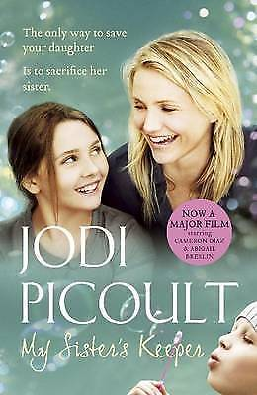
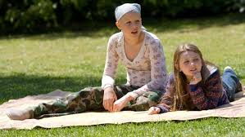
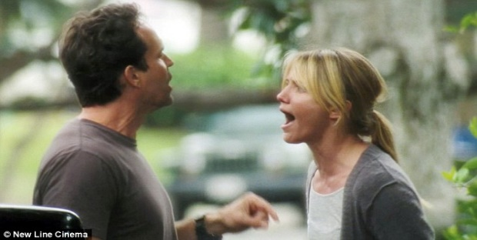
Should Science be used to create
Saviour Siblings?
Notes:
Ask pupils if they are familiar with the film ‘My Sister’s Keeper’. Explain that in the film, Anna is conceived by her parents as a tissue match to give help to Kate, her sister, who is suffering with leukaemia.
Explain that this is a work of fiction and not a true story. However, we are going to use this film as a basis for our discussion on whether science should be used to create Saviour Siblings.
In this case, it escalates – first stem cells, then a bone marrow transplant and then a kidney. Science informs our thinking here – maybe stem cells from umbilical cord are not enough and once a tisuue match will always be the source of help.
Another thing that some people say makes a difference is that we are using genetic preselection, so we create many embryos ‘in vitro’ and then test them and select one to put into the mother. What about those other potential lives – they may be ‘wasted’ – is that ok, does that inform your thinking?
Another question might be – ok so a tissue match in these cases for a fatal disease. But what if it’s a tissue match to give an older sibling sight or an improvement? Is that ok? Science informs our thinking about what kinds of treatment.
The older girl says she has had enough and she wants it to stop.

Slide 30
Prompt questions
Do you agree with the statements from last year’s group why?
What are the issues that you want to say make a difference?
How does this help you answer the question should science be used to create saviour siblings?
What types of knowledge did you refer to? RE, science, others?

Slide 31
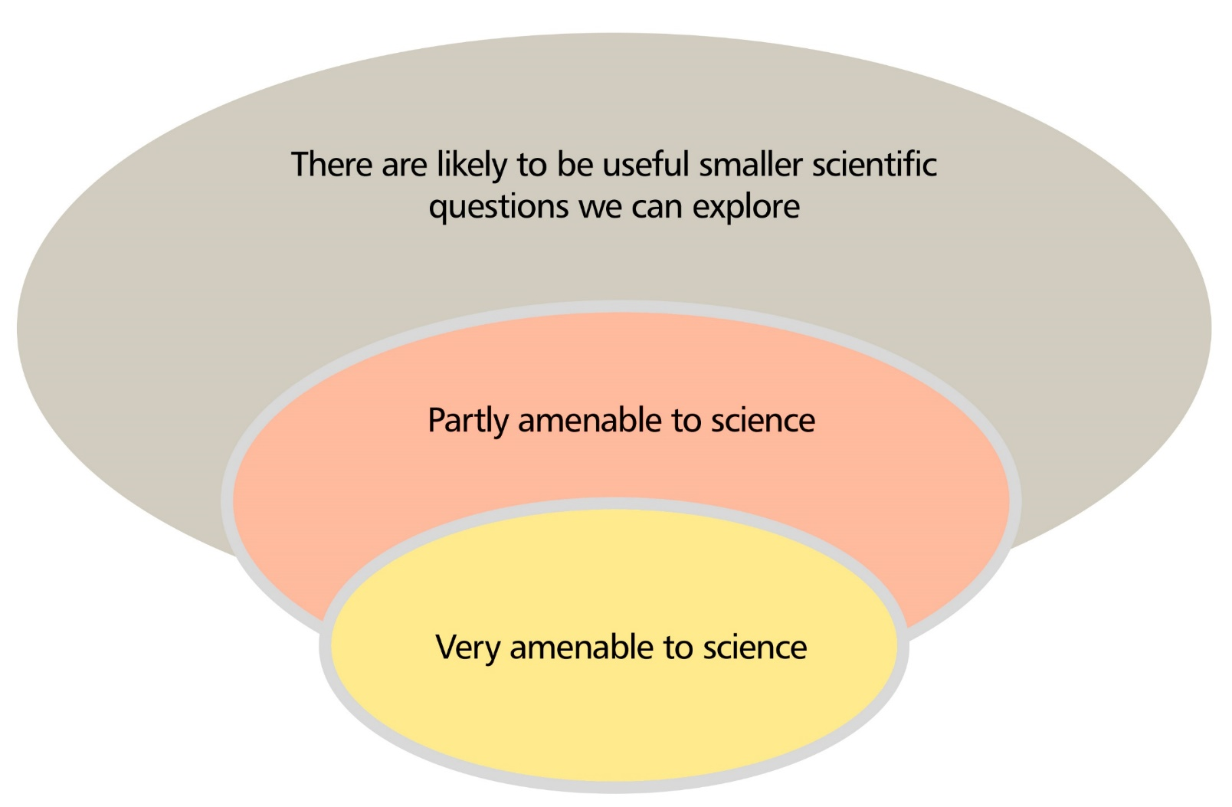
Science informs our thinking about a big question but it cannot fully answer it
Notes:
Summary – science informs our thinking about a big question but it doesn’t answer it –do you agree, write it down and discuss in your group if you agree. This is an example of an epistemic insight

Slide 32
Generating questions
On your table write a series of questions that you now want to ask. Place the questions in the relevant location on the board dependent on the type of subject knowledge that is needed to answer the question.
Question answered by RE | Interdisciplinary question | Question answered by science

Slide 33
Types of questions
Questions answered by RE | Interdisciplinary question | Question answered by science

Slide 34
Take away
What are the implications of this session for your practice?
Mind map: How are you developing links between the different sessions that you have had?
How do we help students develop epistemic insights?

Slide 35
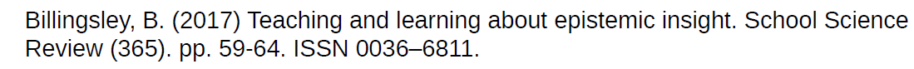
References
DCSF. 2007. Guidance on creationism and intelligent design. London: DCSF. Accessed 5/9/2019. http://webarchive.nationalarchives.gov.uk/20071204131026/http://www.teachernet.gov.uk/docbank/index.cfm?id=11890
DFE (2014) Science curriculum for Key stage 4 London available at https://assets.publishing.service.gov.uk/government/uploads/system/uploads/attachment_data/file/381380/Science_KS4_PoS_7_November_2014.pdf (Date accessed 6th September 2019).
LASER (2011) http://www.neverofftopic.com Date accessed 6th September
LASER (2011) http://www.neverofftopic.com/re-topics/science-year-7-9/what’s-in-the-box/ (Date accessed 6th September 2019).
Pearce, J. Alexis Stones, A. Reiss, M & Mujtaba, T (2019) ‘Science is purely about the truth so I don’t think you could compare it to non-truth versus the truth.’ Students’ perceptions of religion and science, and the relationship(s) between them: religious education and the need for epistemic literacy., British Journal of Religious Education, DOI: 10.1080/01416200.2019.1635434

