Slide 1
What makes science?
You will:
challenge your own understanding of what science is;
Explain the distinctive nature of scientific knowledge
consider how an understanding of what science is fits with the science curriculum and use this to support children to interpret data, draw conclusions and reflect on findings to ask new questions;
Relevant CCF statements TS3 subject knowledge
Learn that
A school’s curriculum enables it to set out its vision for the knowledge, skills and values that its pupils will learn, encompassing the national curriculum within a coherent wider vision for successful learning.
Explicitly teaching pupils the knowledge and skills they need to succeed within particular subject areas is beneficial

Slide 2
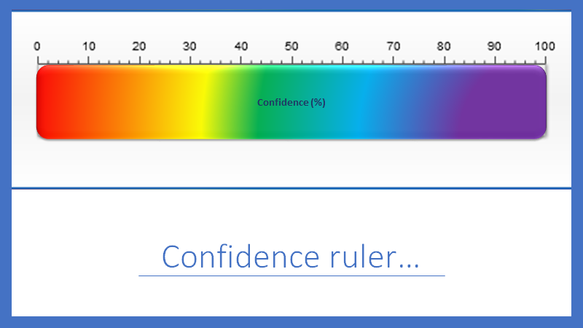
Confidence ruler

Slide 3
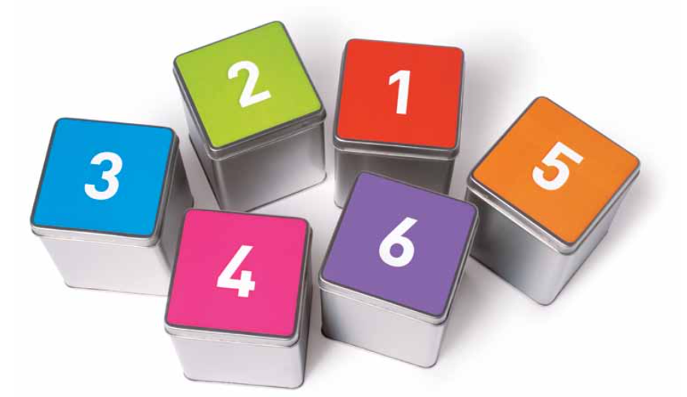
Confidence
What are in the tins?
How confident are you?

Slide 4
Share your thoughts on the confidence ruler

Slide 5
What was in the tins?
Paper clips
Tissue Paper
Air
Rice
Marbles

Slide 6
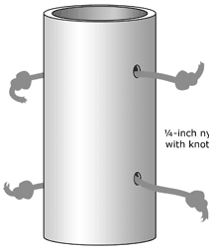
What can science tell us?
Pull on the different ends of the string.
Draw how you think the string is interconnected in the mystery tube.
Present your drawings to your table partner and to the wider group. Justify your thinking.
Underneath your original drawing redraw how you now think the pieces of string are interconnected.
https://undsci.berkeley.edu/lessons/mystery_tubes.html
https://www.ase.org.uk/resources/school-science-review/issue-367/mystery-tubes-teaching-pupils-about-hypothetical-modelling

Slide 7

What is your reflection on the last activity?
What did you notice in that last activity?
Was there a common theme in the drawings?
Did you adapt your original drawing? Why?
What does this tell you about science?

Slide 8

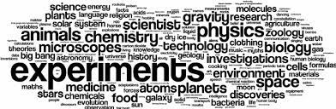
Word walls to describe science.
Do you agree with either of the word walls more? Are there any words which you think are missing? If somebody asked you what is science? What would you say?

Slide 9
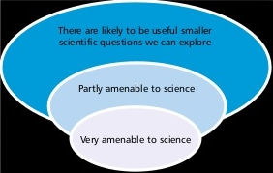
The bubble tool
There are some questions that can be answered by science alone.
Some questions require knowledge from other disciplines.
On the next slide are a list of questions, where would you place them on the bubble tool?
What do you notice about how the questions are constructed?

Slide 10
Can science answer these questions?
1. How do you know that plants photosynthesise?
2. How do I know you have a toothache?
3. How do you know that I am in love?
4. How do you know the sun will rise tomorrow?
5. 6. How is the SARS-CoV-2 virus transmitted?
7.Should we ban cattle farming to reduce climate change?
8. Should Freedom day have happened on 19th July?
9. How do we know global warming is causing climate change?
1
Science Alone?
Informed by science?
Better answered by other disciplines?

Slide 11
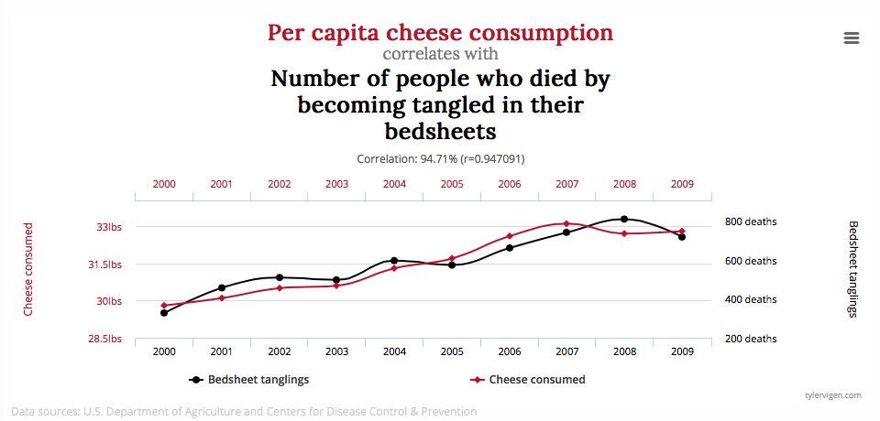
What can data show us?

Slide 12
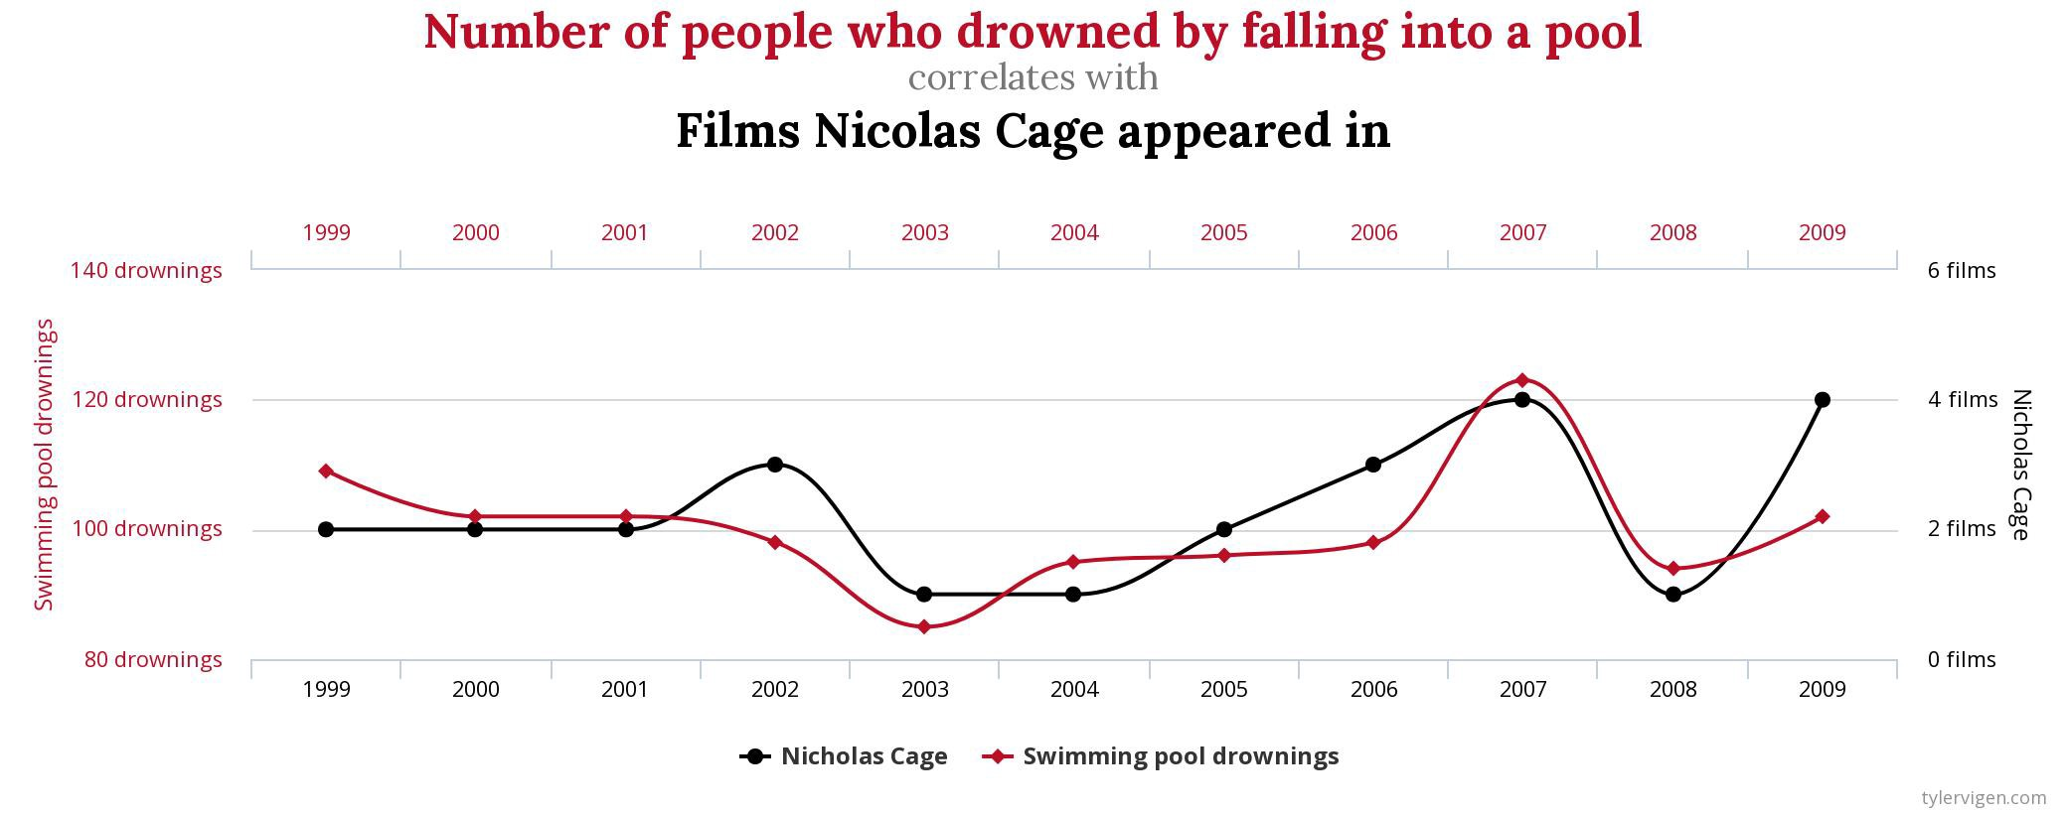
What can data show us?

Slide 13
Here are some typical enquiries in school
Cars down ramps of different surfaces – which surface causes the most friction? – carpet causes the most friction.
Height and show size –taller people have larger feet?
Growing a singular sunflower seed – what do you notice when you germinate and grow a sunflower seed?
Grouping invertebrates – A woodlouse is an example of a crustacean.
There a relationship between the mass of the mother of an animal and the gestation period? – The larger the mass the longer the gestation period.
Decide how trustworthy the conclusion is that is drawn from the data collected in each of these…
Where would you place it on the confidence ruler?

Slide 14
What is science?
Come back to the question we posed earlier.
If someone asked you what is science, what would you say?
Review and refine the answer you wrote earlier and share your answer with the group.

Slide 15
A nature of science
Understanding nature of science I a prerequisite of developing scientific literacy. Scientific literacy is the understanding of the role science can play in solving real world problems.
According to Lederman, Abd-el-Khalick, Bell and Schwartz (2002) there are five components of science that combine to make science distinctive. One in isolation is not distinctive, but also seen in other subjects.
Development of knowledge is based on empirical evidence taken from experiments.
Scientific knowledge is tentative
Development of scientific knowledge is creative.
Development of knowledge is theory laden.
Development of knowledge is linked to inquiry.

Slide 16
Where does this fit into the curriculum? – not in the specific subject content
Ks3 Curriculum (DfE, 2013:2)
develop understanding of the nature, processes and methods of science through different types of science enquiries that help them to answer scientific questions about the world around them
are equipped with the scientific knowledge required to understand the uses and implications of science, today and for the future.
KS4 curriculum (DfE 2014: 5)
The development of scientific thinking
• the ways in which scientific methods and theories develop over time
• using a variety of concepts and models to develop scientific explanations and understanding
• appreciating the power and limitations of science and considering ethical issues which may arise
• explaining everyday and technological applications of science; evaluating associated personal, social, economic and environmental implications; and making decisions based on the evaluation of evidence and arguments
• evaluating risks both in practical science and the wider societal context, including perception of risk
• recognising the importance of peer review of results and of communication of results to a range of audiences.

Slide 17
What is the purpose of science?
There are distinct arguments about the purpose of science education.
Economic development- producing the next generation of STEM employees
The democratic argument
The utility argument
The cultural argument
Read the Millar article and take a position you wish to justify

Slide 18
Where does this fit within your University lectures?
Your teaching approach will likely depend on your view on the purpose of science education.
For example do you run a practical to discover theory, or prove something you have already taught the children?
The following sessions build on this further
Science specific sessions
Purposeful practicals
Working scientifically
Questioning
Collaborative sessions between science and RE
Collaborative sessions between science and history
Collaborative sessions between science and PE
Potentially microteaching
Professional studies sessions on epistemic insight.

Slide 19
A final thought
I think it's much more interesting to live not knowing than to have answers which might be wrong. I have approximate answers and possible beliefs and different degrees of uncertainty about different things, but I am not absolutely sure of anything and there are many things I don't know anything about, such as whether it means anything to ask why we're here. I don't have to know an answer. I don't feel frightened not knowing things, by being lost in a mysterious universe without any purpose, which is the way it really is as far as I can tell.
(Richard Feynman, The pleasure of finding things out 1981)

Slide 20
References
DfE(2013) Science programme of study-key stage 3 National curriculum in England, London: Crown court. Available at https://assets.publishing.service.gov.uk/government/uploads/system/uploads/attachment_data/file/335174/SECONDARY_national_curriculum_-_Science_220714.pdf Accessed on 19th July 2021.
DfE (2014) Science programme of study-key stage 4 National curriculum in England, . London: Crown court. Available at https://assets.publishing.service.gov.uk/government/uploads/system/uploads/attachment_data/file/381380/Science_KS4_PoS_7_November_2014.pdf Accessed on 19th July 2021.
Lederman, N., Abd-el-Khalick, F., Bell, R.L., & Schwartz, R.S. (2002). Views of Nature of Science Questionnaire: Towards valid and meaningful assessment of learners’ conceptions of the nature of science. Journal of Research in Science Teaching, 39, pp.497–521.
Millar, R. (2014) Designing a science curriculum fit for purpose, school science review,95(352),pp 15-20.

