Slide 1
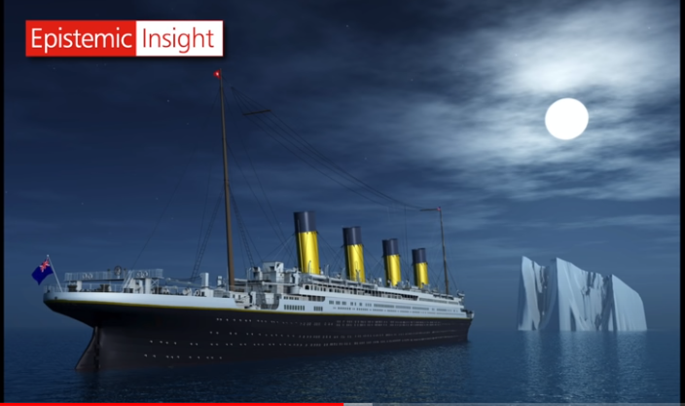
Why did the Titanic sink?
Answering the Big Question using Epistemic Insight:
A Workshop for Science and History Trainees.
Notes:
Who was to blame?

Slide 2
Session aims:
to understand the concept of epistemic insight
to observe how science and history contribute to solving a problem
to show how science and history can work together through modelling an activity
to develop a plan of how we can use EI in our discipline (reflection)
Notes:
The focus if the workshop is discussion and to learn from each other’s subject discipline.
to develop a plan of how we can use EI in our discipline in a lesson taught in the Development phase of teaching

Slide 3
A thirst for knowledge
‘students will need to be motivated and excited by their learning throughout their lives. So how can we, as teachers, instil this sense of curiosity and desire for knowledge?
I believe the key is epistemic insight. What is it?
Put simply, it’s knowledge about knowledge, and particularly,
knowledge about disciplines and how they interact.’
TES: 12th November 2021 Epistemic insight: are you utilising it in your school? Berry Billingsley
Notes:
Definition of Epistemic Insight from Berry Billingsley.
EI is the integration between subjects

Slide 4
Science and History ~
shared words are seen differently through the lenses of the different disciplines – a word’s meaning differs in both the science and history classroom.
eg: evidence
inquiry/ enquiry
investigation
revolution
Do they mean the same thing or are they different? Which classrooms – or, in other words, disciplines – discuss one or both?

Slide 5
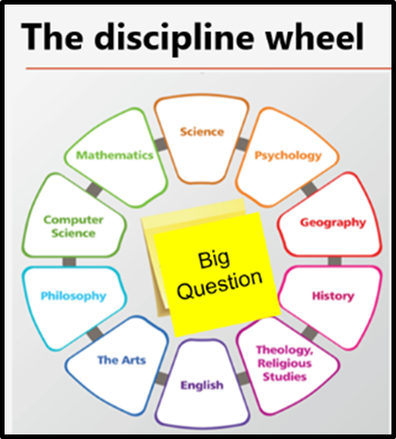
The Big Question!
____________________________________________________________
Why did the Titanic sink?
Who was to blame?
Notes:
Consider from the first activity how the distinct lens through which you view a question informs the answer that is given.

Slide 6
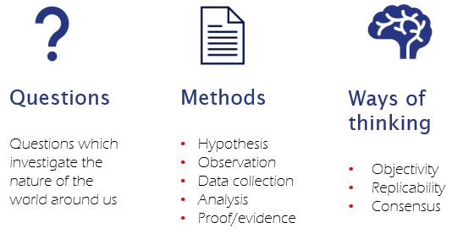
ACTIVITIES:
In small groups of same subject – using the unique lens of your subject/ discipline, discuss and explore:
the Questions, Methods and Ways of Thinking your discipline would use to answer the Big Question
b) In mixed groups of science and history trainees, answer the Big Question
Notes:
a)
VIDEO CLIP: Epistemic insight: engaging with life's Big Questions | Berry Billingsley | TEDxFolkestone – YouTube Epistemic insight watch from
b) the aim is to share your ideas and to get insight in to the knowledge of the other subject to answer the question: what questions, methods, ways of thinking are the same? eg: the different forms of enquiry

Slide 7
Plenary
Your plan ~ questions to consider/ reflect on:
What is distinctive about your own discipline?
What can you take from Science / History in this example?
What can you take from the EI project and implement in your own teaching?

Slide 8
Suggested further reading:
‘Why did the Titanic sink?’ – bridging two disciplines to teach epistemic insight with lower secondary school students Berry Billingsley, Sherralyn Simpson and Manzoorul Abedin

