Slide 1
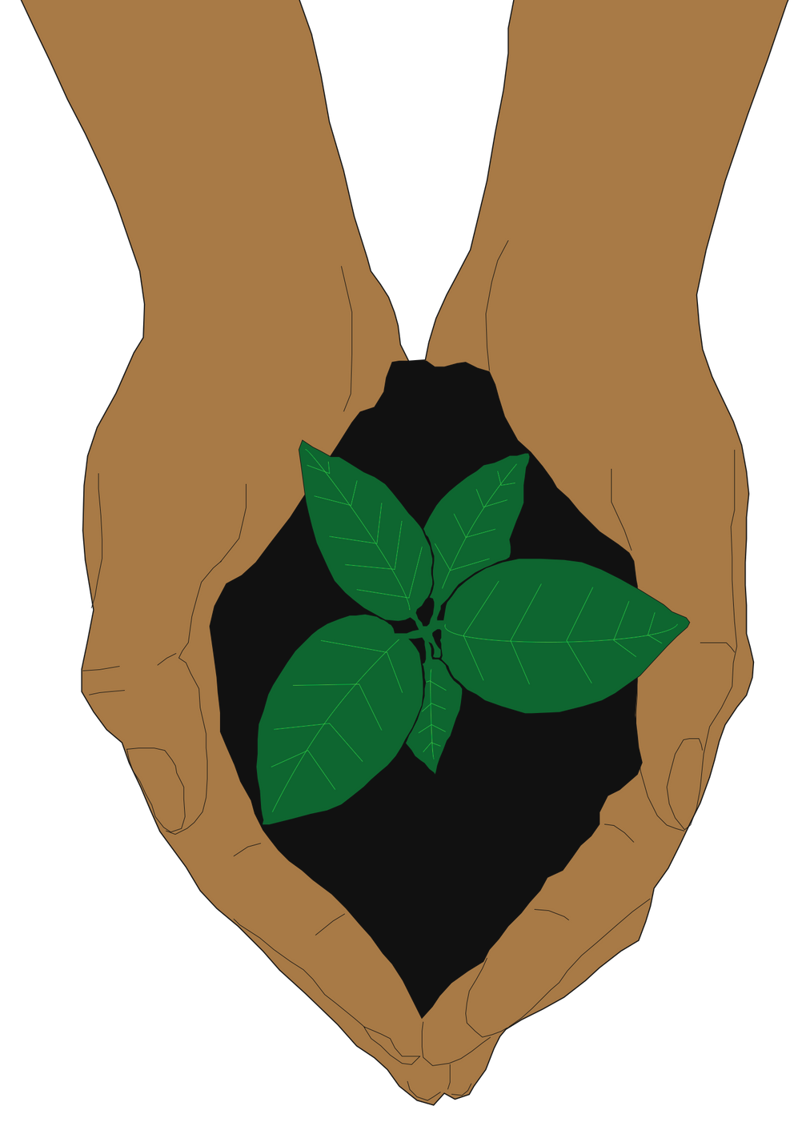
Session 1:
How do we see our relationship with the Earth?

Slide 2
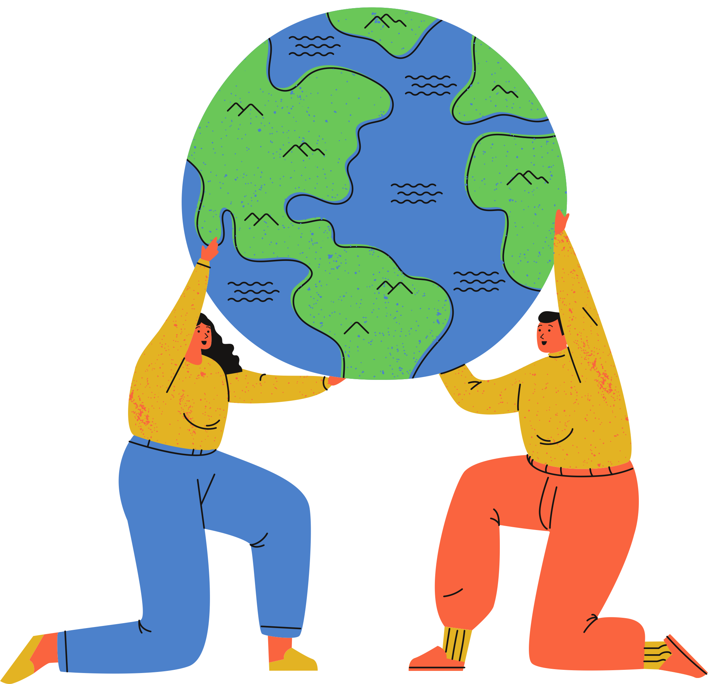
Today's prayer
Dear God,
Together, we pray for your guidance as we explore our relationship with your amazing creation, the Earth.
We pray that we may grow with you as stewards of your beautiful creation, caring for our common home together in our school and community.
Praise be to you!
Amen

Slide 3
What happened when we all stopped
Activity:
Watch "What happened when we all stopped" together
Write down your thoughts to the following questions:
What is the poem about?
Are there any images that stick out to you?
What is the mood of the poem? Does it stay the same throughout?
What makes the voice move from a ‘whisper’ into a ‘thunder’?
Discuss your answers with the people sat next to you
Notes:
Teacher's note: This animated poem by Tom and Bee Rivett-Carnac is a great way to get students thinking about the ecological crisis and the power of community actions. While the COVID-19 pandemic inspired this poem, allowing students to explore its themes invites creative and personal responses. Splitting the class in half and giving each group two questions to focus on can help encourage discussion.
[20 minutes max]

Slide 4
"What happened when we all stopped"
by Tom Rivett-Carnac and Bee Rivett-Carnac
Link not working? https://www.youtube.com/watch?v=gX0HOy8Pi54

Slide 5
Questions
What is the poem about?
Are there any images that stick out to you?
What is the mood of the poem? Does it stay the same throughout?
How does the poem move from a ‘whisper’ into a ‘thunder’?
for discussion

Slide 6
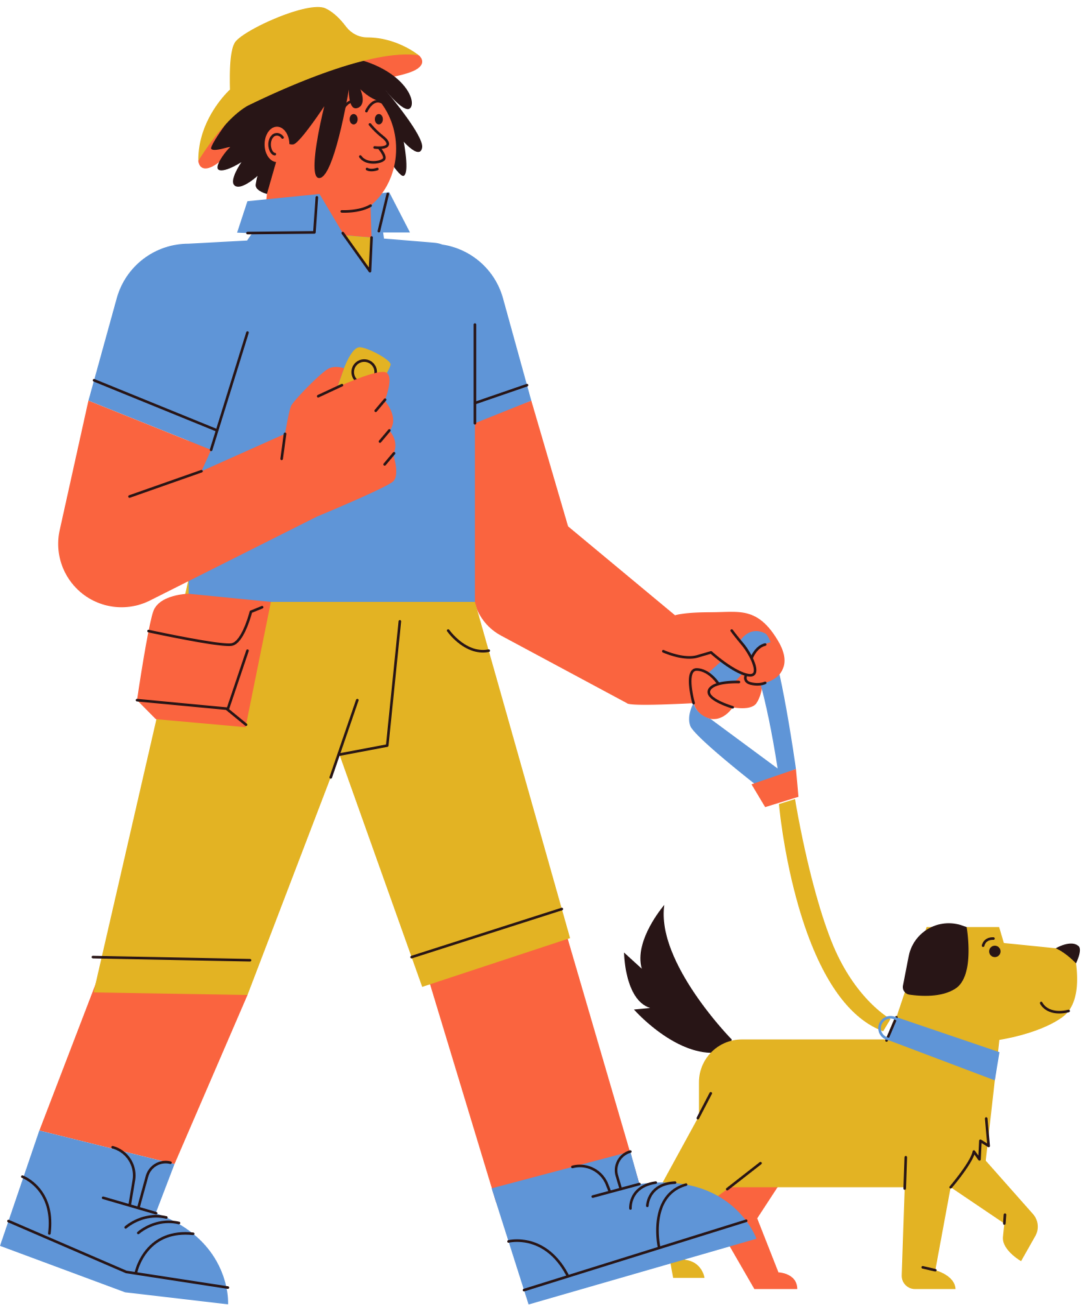
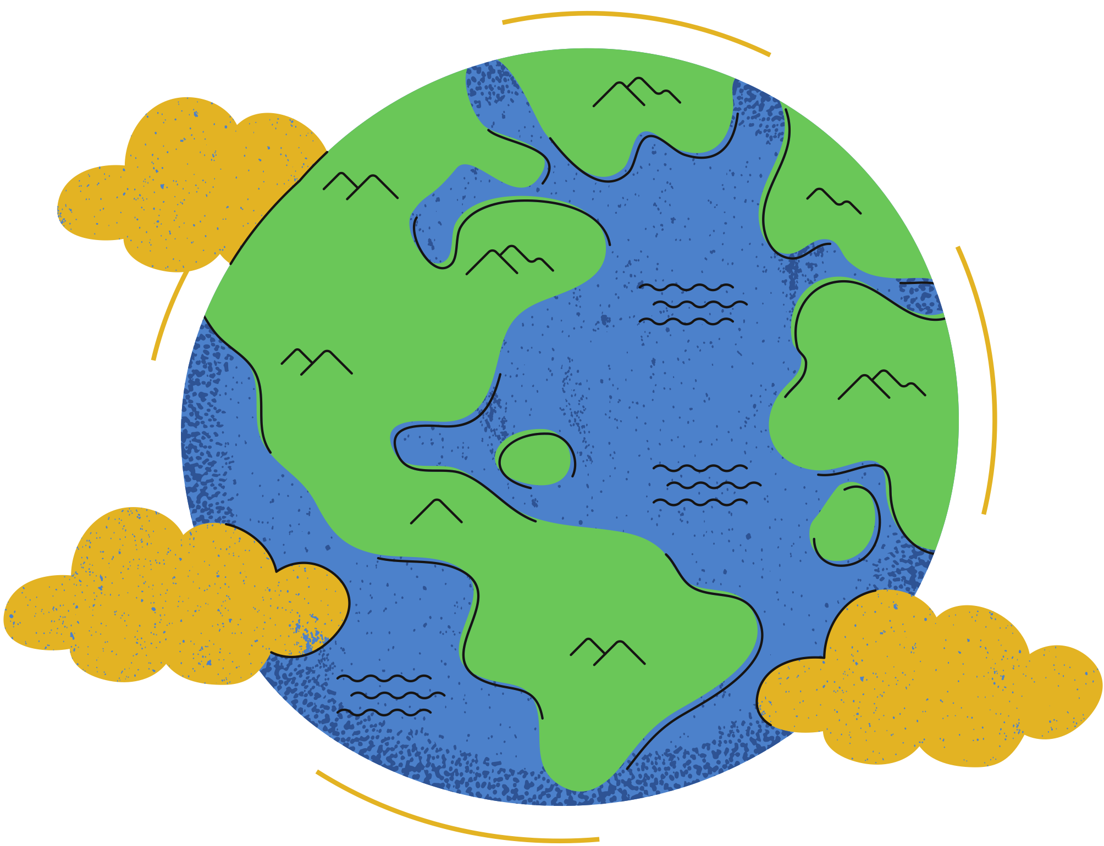
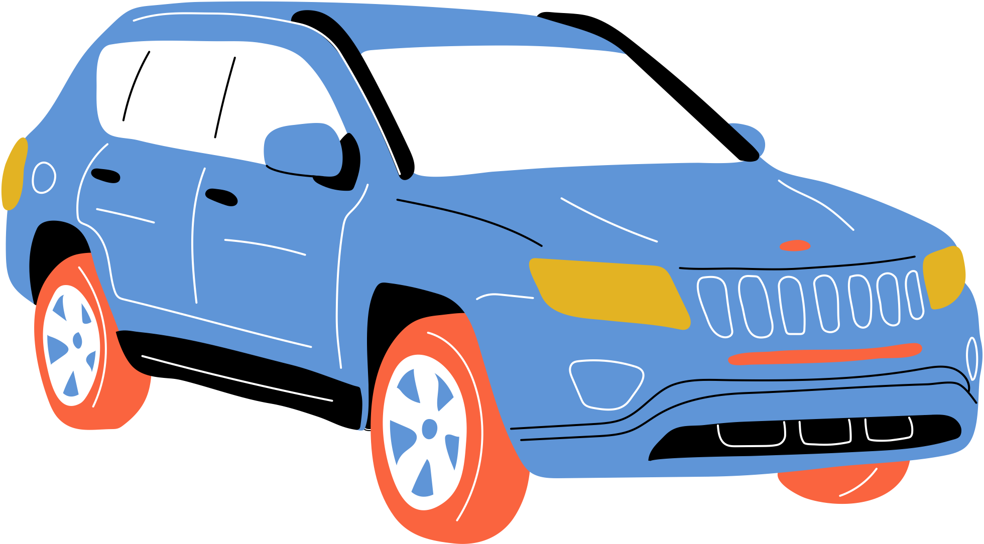
What happened when we stopped?
Let's explore what happened to our home during the COVID-19 lockdowns
36% of people in the UK were spending more time outdoors
Daily global emissions fell by 17% in April 2020
(ONS, 2021)
(Le Quéré et al., 2020)
Air pollution dropped by up to 48% in the UK due to the reduced road travel
Reports of nature returning to urban areas, from goats to dolphins, spread worldwide
(University of York, 2020)
Notes:
Teacher's note: For many students, the COVID-19 lockdowns are memorable events from recent years. As such, students can relate the effects of climate change to their personal experiences. They illustrate the potential of collective action to make substantive changes to our environment.
[10 minutes max]

Slide 7
Tipping Points
Increased flooding and rising sea levels
These are points of no return for our planet, where the damage done is permanent.
Climate scientists warn that if the Earth's temperature increases by 1.5°C, we might reach these tipping points, including...
More frequent and intense heatwaves
Increased extinction, especially of polar and marine wildlife
(IPCC Report, 2021)
Notes:
Teacher's note: In understanding the latest climate science, students can speak in informed ways about the ecological crisis and its predicted impacts. When introduced alongside the lockdown statistics, students receive a balanced, realistic understanding of climate change rather than a "doomsday" scenario. Allow time in class for questions and discussion if needed.

Slide 8
Laudato Si'
Introducing:
Letter published by Pope Francis in 2015
"On Care for our Common Home"
"I would like to enter into dialogue with all people about our common home." (LS, 3)
"Young people demand change."
(LS, 13)
Notes:
Teacher's note: This slide introduces Laudato Si' for young people. Encourage students to think of Laudato Si' as a dialogue. It's a letter we're all invited to respond towards with action.
Emphasise to students that their voice matters in this dialogue. Young people have a unique role to play in caring for our common home.
[10 minutes max]

Slide 9
What is happening to
Water scarcity
Poverty
our common home?
Greenhouse gas emissions
Pollution
"The earth, our home, is beginning to look more and more like an immense pile of filth." (LS, 21)
Loss of biodiversity and extinction
Our throwaway culture
Notes:
Teacher's note: Invite students to compare Pope Francis' letter to the latest climate science on the previous slides. Just like the scientists, Laudato Si' begins by identifying the problems caused by humans. Science and religion are not at odds here but share the same message.

Slide 10
Pope Francis:
"We are not God. The earth was here before us and it has been given to us [...] on the basis of the Genesis account which grants man “dominion” over the earth (cf. Gen 1:28), has encouraged the unbridled exploitation of nature
[...]
"We must forcefully reject the notion that our being created in God’s image and given dominion over the earth justifies absolute domination over other creatures."
"Our 'dominion' over the universe should be understood more properly in the sense of responsible stewardship."
(LS, 67; 117)
Dominion and Stewardship
Notes:
Teachers note: The following slides introduce the key terms 'stewardship' and 'dominion'. Some groups may best interact with the Laudato Si quote. The summary slide can support students in fostering this understanding. Meanwhile, the slide with the definitions can help students differentiate these two terms. Use whichever combination of these slides you feel best suits your class.

Slide 11
Dominion and Stewardship
Pope Francis:
What is Pope Francis saying here?
In the past, Christians understood the creation account in Genesis as meaning humans had control over the Earth. We call this view 'dominion'.
In Laudato Si', Pope Francis sees how this view of creation has led to climate change. Humans have used more than their fair share of the Earth's resources.
Instead, he argues, we need to view the Earth as a gift from God that we need to look after. We call this view 'stewardship'.

Slide 12
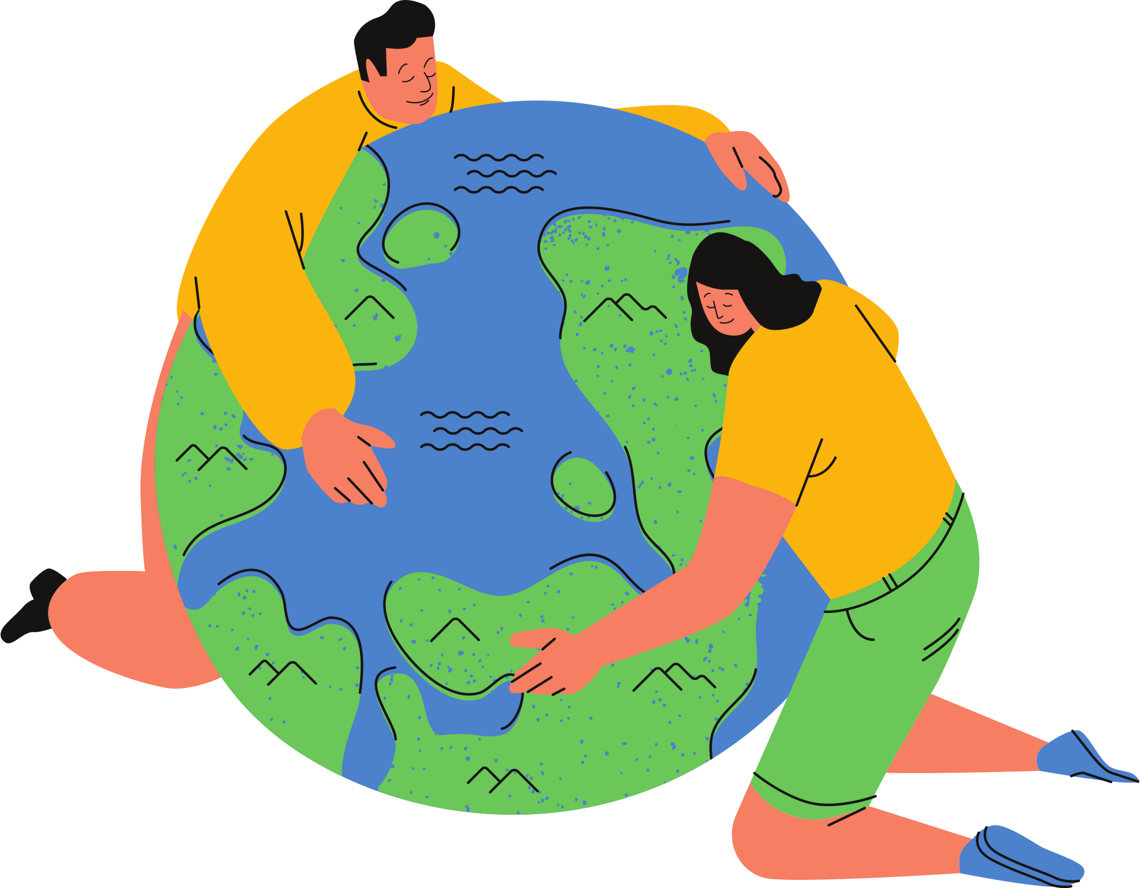
God said to them, “Be fruitful and multiply, and fill the earth and subdue it; and have dominion [...] over every living thing that moves upon the earth.” (Genesis 1:28)
Dominion
Stewardship
"to take sovereignty or control"
"the job of supervising or taking care of something"
from Latin 'dominium', meaning 'lord, master'.
from Old English 'stiward', meaning 'house guardian'

Slide 13
Dominion or Stewardship?
Activity:
Read the statements about different attitudes towards the Earth
Write whether you think this fits with dominion or stewardship
Think about the effect of those statements. Write the impact they would have on our planet. What would happen if everyone acted like that?
Notes:
Teacher's note: This exercise can help students understand the difference between stewardship and dominion. Some statements are harder to categorise than others. So, invite students to debate which view best fits that statement.
[20 minutes max]

Slide 14
Your last encounter with nature
Reflection:
Write a few sentences about your last encounter with nature
Reflect on how you responded to nature in this encounter
Did you act with stewardship or dominion?
How did your actions impact the Earth?
Would you act differently next time?
Notes:
Teacher's note: You can use this exercise as an optional homework activity.

