Slide 1
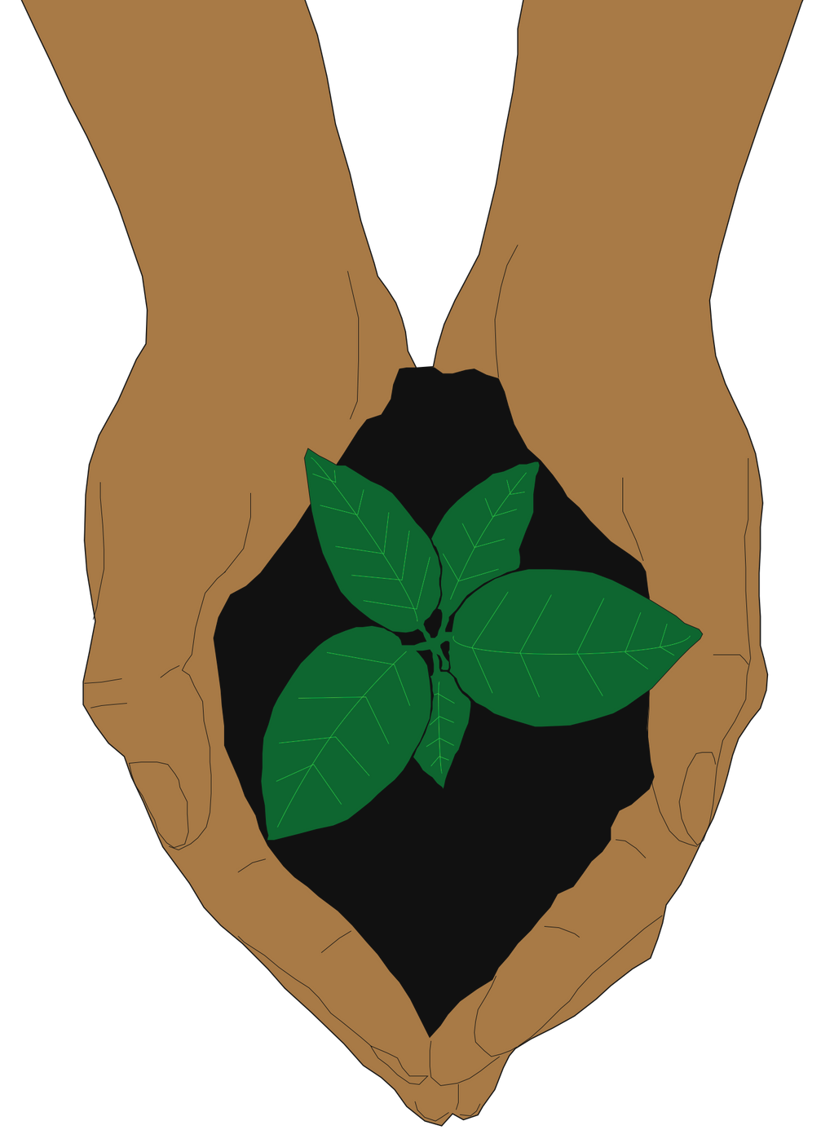
Session 2:
How do we impact the Earth and its people?

Slide 2
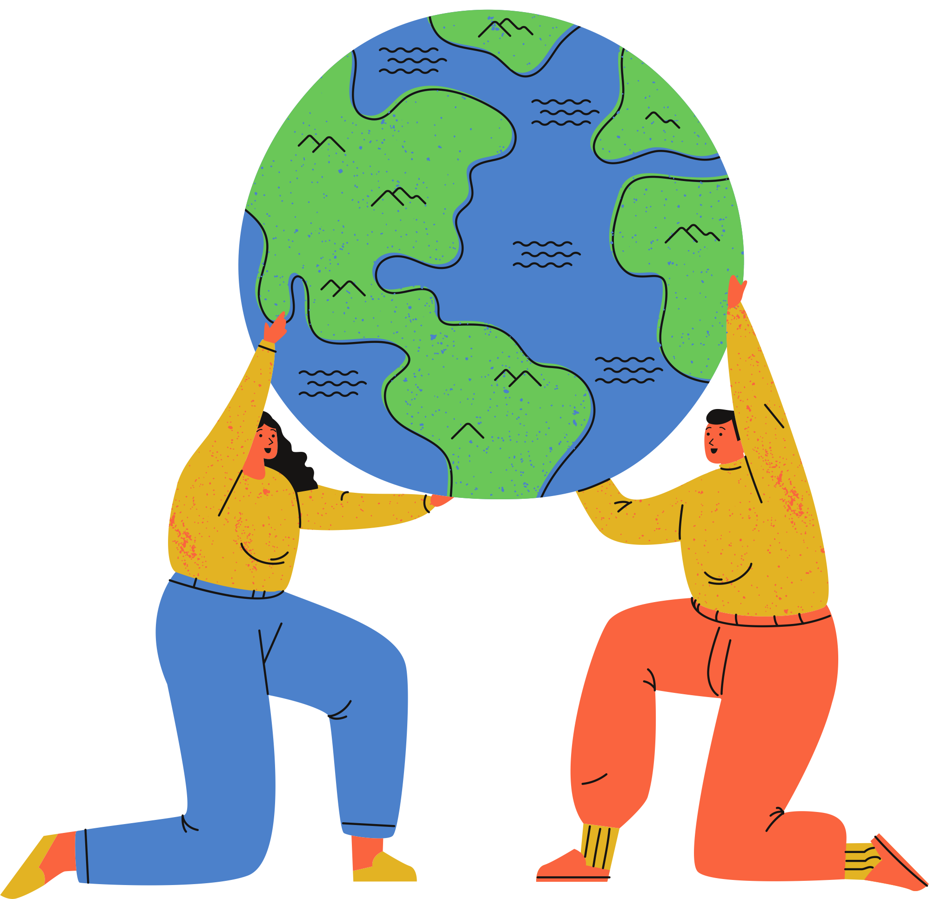
Today's prayer
Dear God,
We pray for your love and guiding spirit as we reflect on the impact of our actions on the Earth and its people.
As we respond to the cry of the earth and the cry of the poor, we ask that you help the poorest members of our global community and inspire us to care for your creation in every aspect of our lives.
Praise be to you!
Amen

Slide 3
So far,
What's happening to the Earth, our common home
The differences between stewardship and dominion
How Pope Francis calls all people to be stewards of God's creation
we've learned

Slide 4
Eco-choices
Activity:
1 minute writing down 3 activities you do every day
Example: Brushing your teeth
1 minute writing how those 3 activities impacts the environment
Example: Uses water (how much water? where is the water from?), toothpaste (in a plastic container? Ingredients like fluoride that pollute the water?), and toothbrush (made from plastic?)
2 minutes writing what you could do to reduce that environmental impact
Example: Turn off the tap when brushing your teeth, switch to a plastic-free toothpaste, use a toothbrush made from recycled or sustainable materials.
Notes:
Teacher's note: This quick-fire starter activity is a fun way to get young people thinking about their daily choices. Every action has some environmental impact. For instance, if a student writes 'sleeping', we could think about the plastic in their bedding materials or the electricity wasted when leaving phones plugged in overnight. Celebrate where students may already be making the 'eco-choice', such as walking to school instead of driving.
[15 minutes max]

Slide 5
A daily shower
A 10-minute shower uses 150 litres of water, on average (WaterWise, 2009)
That adds up to 54,750 litres of water on showers per person each year
62% of the UK's annual water footprint is imported from other countries (WWF, 2008)
40% of the world’s population experience water scarcity each year, and '55 million people globally are affected by droughts every year' (WHO, 2018)
Notes:
Teacher note: This example illustrates how small, individual actions add up to have enormous impacts. It also means that making small changes in our daily lives can have an astonishing effect. Bishop John Arnold's idea of "Think global, Act Local" is a helpful way to communicate these ideas. Encourage students to think about the global impact of their actions, but change their behaviours on a local level, because that’s where we see the positive impacts, in our communities and our schools.
(Much like a carbon footprint, a water footprint includes the water used to grow our food or make the products we buy.)
[10 minutes max]

Slide 6
How do our actions impact the environment?
Taking 3-minute showers can save the average household up to 230,000 litres of water each year (WaterWise, 2009).
If the UK's 27.8 million households made this change, that's 6.39 trillion litres of water saved annually. (ONS, 2021).
Other factors: Energy and water suppliers, the products we use in the shower
Think
Act
Global
Local
(Bishop John Arnold, 2019)

Slide 7
How do our actions impact the environment?
Since "today’s problems call for a vision capable of taking into account every aspect of the global crisis, I suggest that we now consider some elements of an integral ecology" (LS, 137)
Notes:
Teacher's note: This section introduces the key term 'integral ecology' from Laudato Si'. Pope Francis uses this term to encourage joined-up thinking. Instead of considering the care of creation and social justice separately, we should view them as two parts of the same issue. These slides begin by understanding ecology, before exploring what makes integral ecology different. Teachers may wish to use some or all of these slides to engage students in this key term.
[10 minutes max]

Slide 8
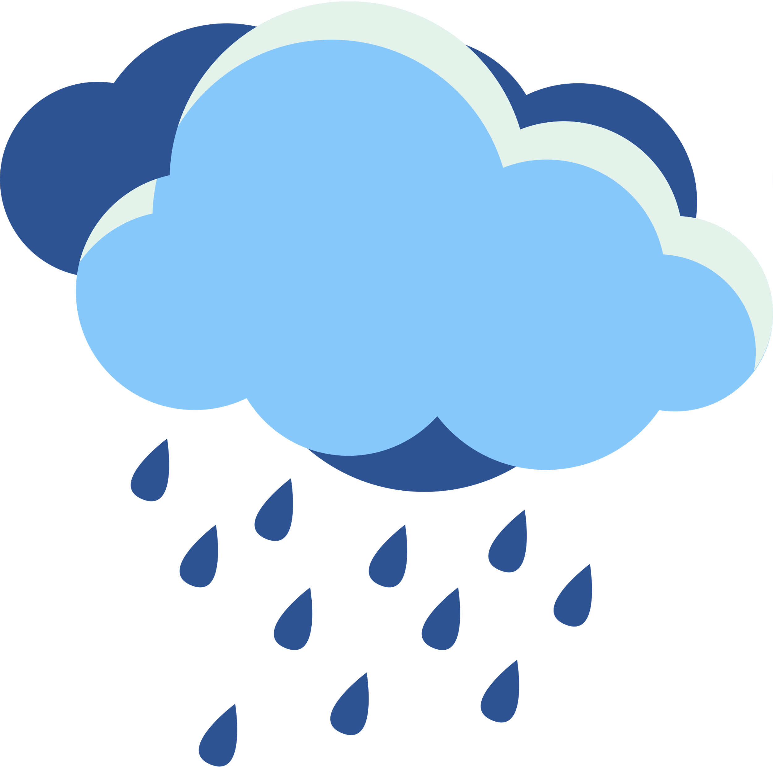
Ecology?
What is
The Water Cycle
Food chains
The connections between living things and their environments.
Ecosystems
Citizenship

Slide 9
Integral Ecology?
What is
“ A sense of deep communion with the rest of nature cannot be real if our hearts lack tenderness, compassion and concern for our fellow human beings. It is clearly inconsistent to combat trafficking in endangered species while remaining completely indifferent to human trafficking, unconcerned about the poor [...]
Everything is connected. Concern for the environment thus needs to be joined to a sincere love for our fellow human beings and an unwavering commitment to resolving the problems of society.”
An integral ecology is also made up of simple daily gestures which break with the logic of violence, exploitation and selfishness. " (LS: 91, 139, 230-231)

Slide 10
What is
Integral Ecology?
What is Pope Francis saying here?
Because everything is connected, we need to address environmental and social issues together.
For example, human trafficking and animal trafficking are parts of the same problem. They both come from a lack of respect and care for all parts of God's creation.
We can achieve this by changing our daily habits to show love and compassion for one another. We can also look for ways to connect with nature.

Slide 11
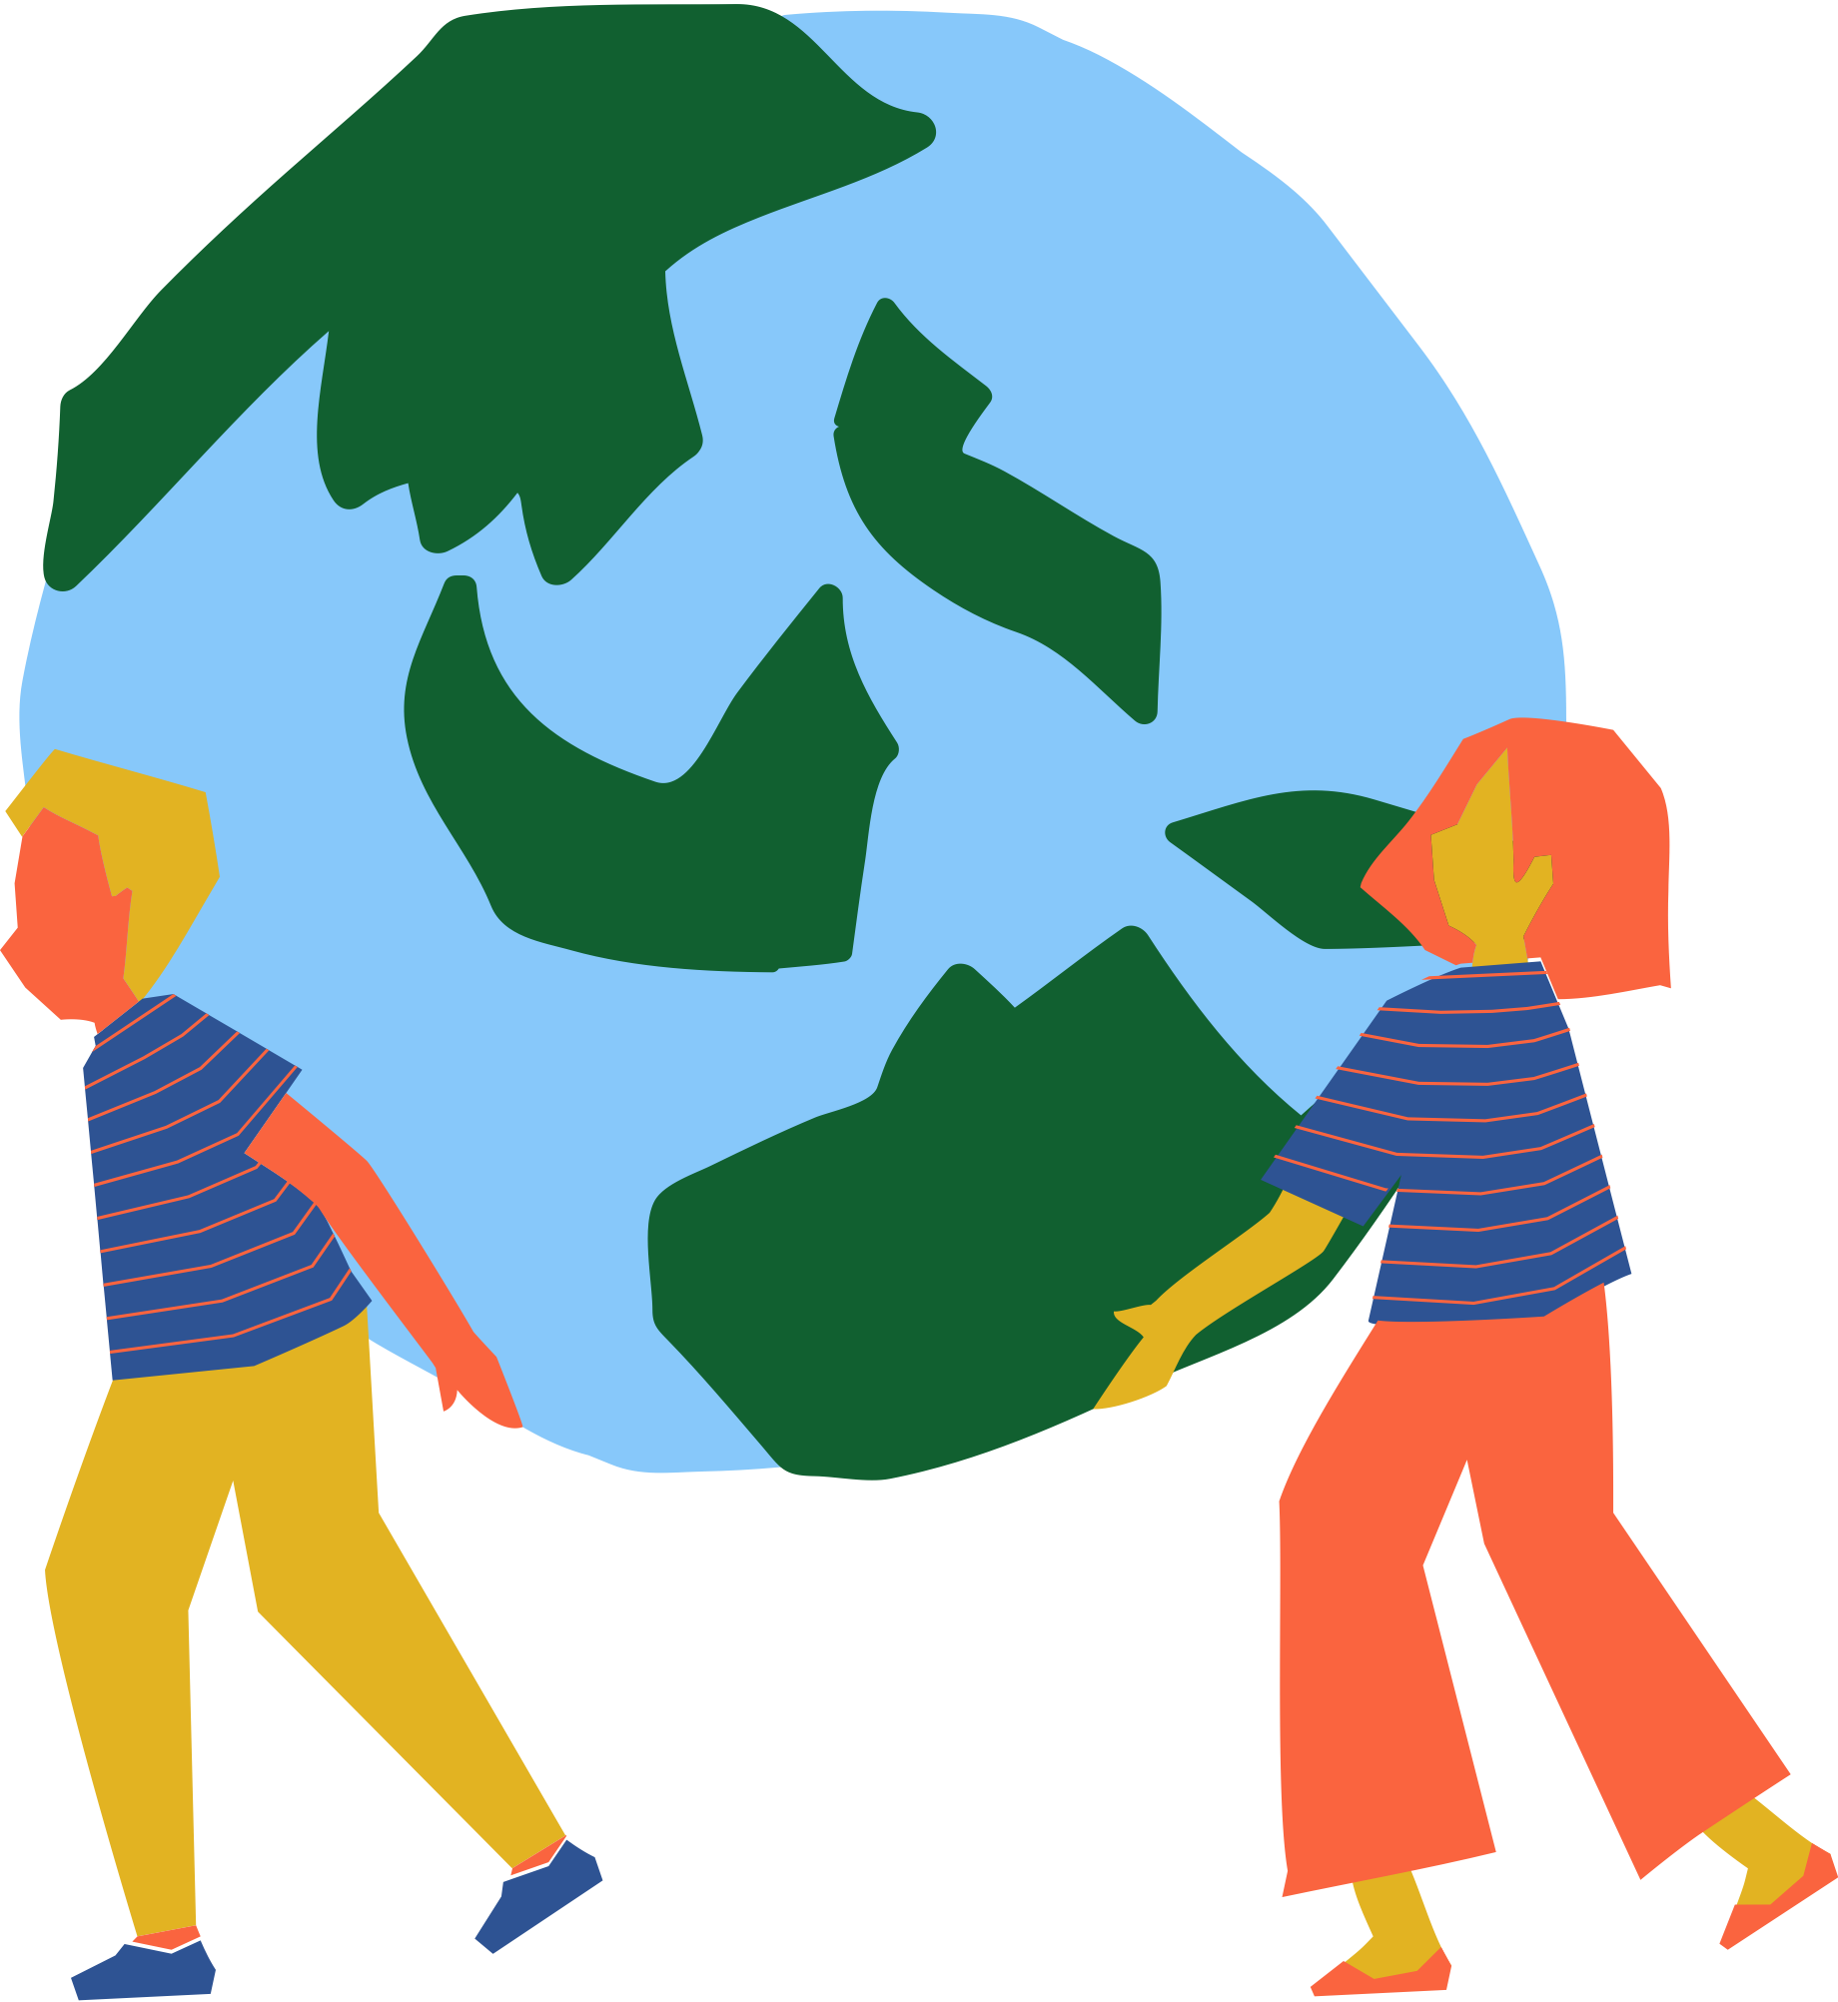
Integral Ecology
"We have to realize that a true ecological approach always becomes a social approach; it must integrate questions of justice in debates on the environment, so as to hear both the cry of the earth and the cry of the poor." (LS, 49)
The cry of the
Earth
The cry of the
Poor
Rising temperatures
Mass extinction
Habitat destruction
Rising sea levels
Extreme weather
Political injustice
Economic poverty
Social inequality
The most vulnerable in our society

Slide 12
Which choices?
Activity:
Look back at some of the eco-choices you identified earlier
Example: Taking the bus instead of the car
Are these choices accessible to everyone?
Example: Buses are often inaccessible for disabled people, mothers with pushchairs, and the elderly. They are often quite expensive, excluding low-income groups.
What changes need to happen to make them more accessible?
Example: Ask the council to redesign buses, making them more accessible and affordable.
Notes:
Teacher's note: This activity is an optional part of the lesson plan. It asks students to revisit their eco-choices and ask whether those choices are accessible to everyone. The aim of this activity is to build connections between the cry of the earth and the cry of the poor. Brainstorm ideas together for accessible alternatives to these choices.
[15 minutes max]

Slide 13
The cry of
Women and girls are 14 times more likely to die during a natural disaster. Yet, 67% of decision-making roles about the environment worldwide are held by men. (UN Women UK, 2021)
70% of the global poor rely on natural resources for their livelihoods, making them the most vulnerable to climate change’s adverse effects. (UN, 2015)
the poor
In the US, Black and Hispanic minorities were up to 63% more likely to suffer health damage due to air pollution than non-Hispanic white groups. (Tessum et al, 2019)
Notes:
Teacher's note: This optional part of the lesson plan looks at the cry of the poor in-depth. It invites students to consider how climate change does not impact everyone equally. Teachers may wish to offer a content warning to students in preparation for this content. Allow time for students to discuss their responses to these statistics and process their reactions.
[10 minutes max]

Slide 14
the poor
The cry of
Poorer healthcare
Primary caregivers
Limited access to education
Less secure housing
Women and girls are 14 times more likely to die during a natural disaster. Yet, 67% of decision-making roles about the environment worldwide are held by men. (UN Women UK, 2021)
Not included in decision making
Earn 30% less than men
Notes:
Teacher's note: This slide unpacks an example of climate justice. In this case, factors that influence higher mortality rates for women in natural disasters include:
- The gender pay gap could lead to economic instability. This might mean poorer-quality housing for women.
- As they are often the primary caregivers, women might have children or elderly relatives to look after. In the event of a natural disaster, they’re caring for numerous people.
- Women receive poorer healthcare than men on average, which could increase their risk of dying from injuries after a natural disaster.
- Yet, the people making the decisions about the environment and climate change are mostly men. So women’s needs aren’t accounted for in an organisation's planning.

Slide 15
Pause and Reflect
Spend a few speaking with the person next to you about what we've covered so far.
Now we understand integral ecology, how does it impact your perspectives on stewardship?
Had you heard of climate justice before? How do you feel about the statistics we covered?

Slide 16
What can we do?
Developing your hopeful mission
Notes:
Teacher's notes: The following slides offer guidance for students to develop personal mission statements. These missions can help students focus on the issues that matter to them and come up with a concrete action plan. Teachers may use some or all of these prompt slides to prepare students for this task.
Depending on the available time in class, teachers may wish to set this activity as homework. This setting may give students the time to write meaningful mission statements. If hosting this activity in class, allow 15-20 minutes.

Slide 17
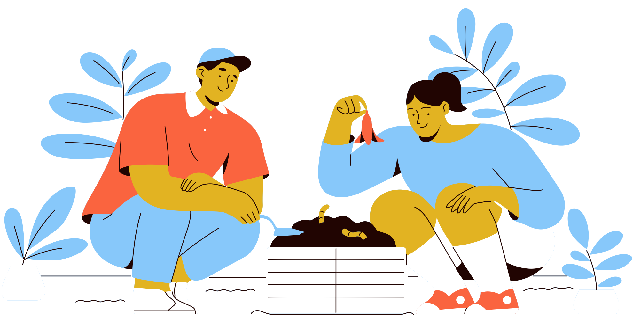
Staying hopeful
77% of students experience climate anxiety (Global Action Plan, 2020)
"Hope is the power by which we firmly and constantly long for what we were placed on earth to do: to praise God and to serve him; and for our true happiness, which is finding our fulfillment in God" (YouCat, 308)
When it comes to addressing climate change, finding hope that's rooted in our spirituality can allow us to:
Look towards a positive future where we care for our common home
Inspire trust in God, especially through tough times, that lead towards sustainable action

Slide 18
What is a mission statement?
Mission statements are like a guide, a blueprint, or a compass. Just as companies and schools have mission statements to guide their actions, your mission statement is there to help you keep your goals in mind and navigate your actions towards a sustainable future.
You can use your mission statement to:
Help recenter your actions if you feel lost or overwhelmed
Remind you why you're taking these this sustainable journey
Record your journey- update your mission statement as you go!
'Mission' comes from the Latin' mittere', meaning 'to send'. What will your mission statement send out into the world?

Slide 19
Example mission statements:
My Mission Statement
My mission is to help support biodiversity and wildlife in my local area.
I will do this because I love wildlife; it is beautiful and full of wonder. Preserving this beauty for future generations empowers me in this mission.
I will know that wildlife is thriving at home because I will hear the birds sing in the morning and see the birds and insects every day.
I commit to doing everything I can to raise awareness and support the wildlife around me, empowered by my family and faith in God.
I will...
Love my God and the Earth
Open myself to new ideas
Value myself, my beliefs and emotions
Educate others about climate change
&
Commit to living simply
Act to support the environment
Respect my neighbours and the Earth
Empower others to take action

Slide 20
Your direction of travel
“Would you tell me please which way I ought to walk from here?”
“That depends a good deal on where you want to get to,” said the Cat
“I don’t much care where-” said Alice,
“Then it doesn’t matter which way to walk,” said the Cat.
- Lewis Carrol, Alice's Adventures in Wonderland
When we're writing our mission statements, it's essential to think about our direction of travel.
If a sustainable future is our goal, how will we know when we've arrived? What steps do we need to take to reach our destination? Keep your end goals in mind as you map your journey.

Slide 21
Reflection:
Mission Possible
Imagine that reaching a sustainable future is a journey you need to take. To plan for that journey, you need to consider the following:
1. Motivation- Why do you want to take this journey? What’s your motivation for helping the environment? These motivations will help govern your actions.
2. Mission- What do you want to do to help the environment? What talents and skills do you have to offer? Write down three key goals to help direct your mission and guide your journey.
3. Materialise- What is it like when you reach your destination? How will you know you’ve achieved your mission?
4. Map- How do you plan to get there? What actions will you take? Write down three key steps you need to take to arrive to your destination.
Once you have imagined what your journey might look like, write it up as a mission statement. You can format this in any way you like, whether it’s a few simple sentences, a poem, an acronym, or something else entirely!

Slide 22
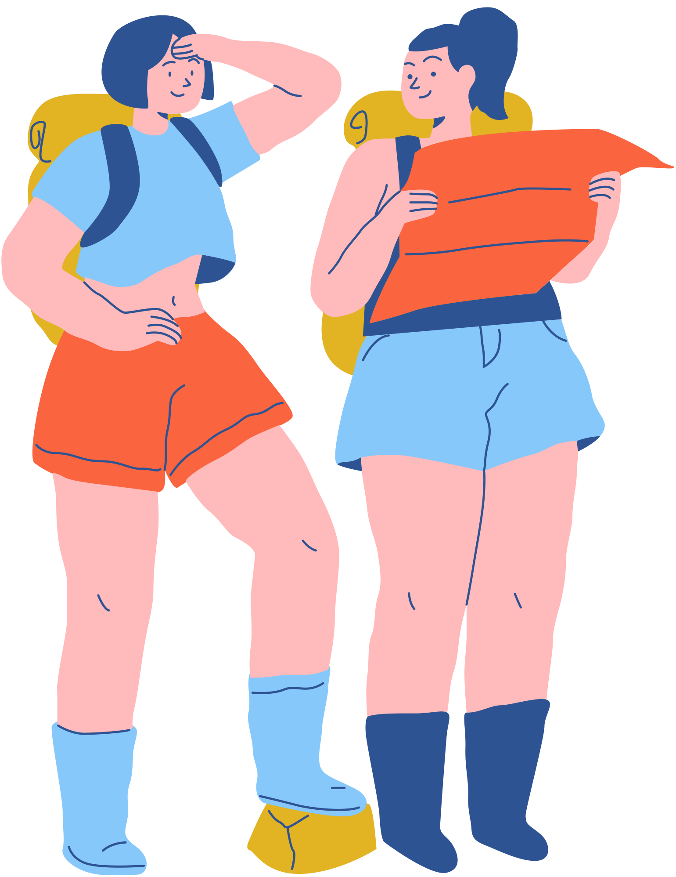
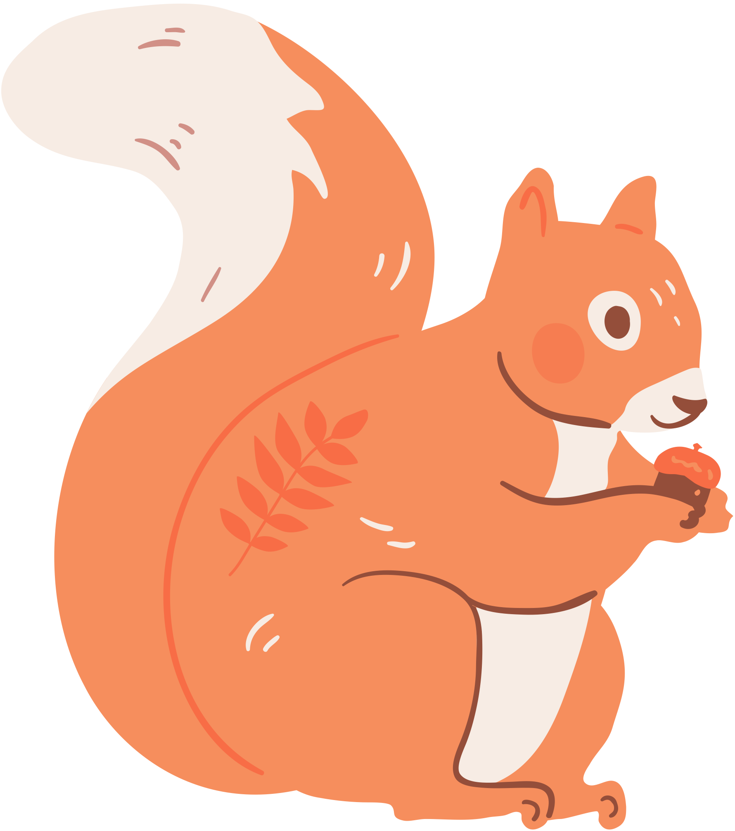
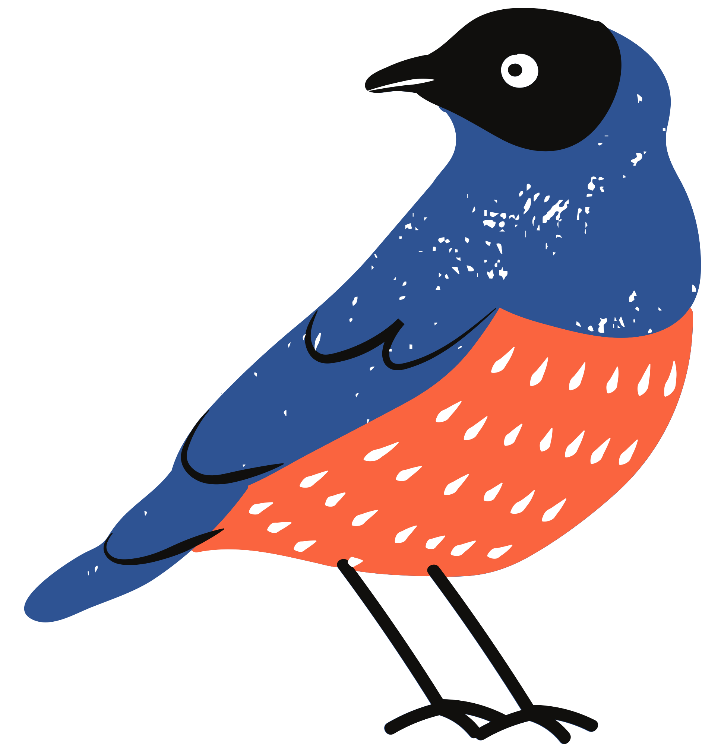
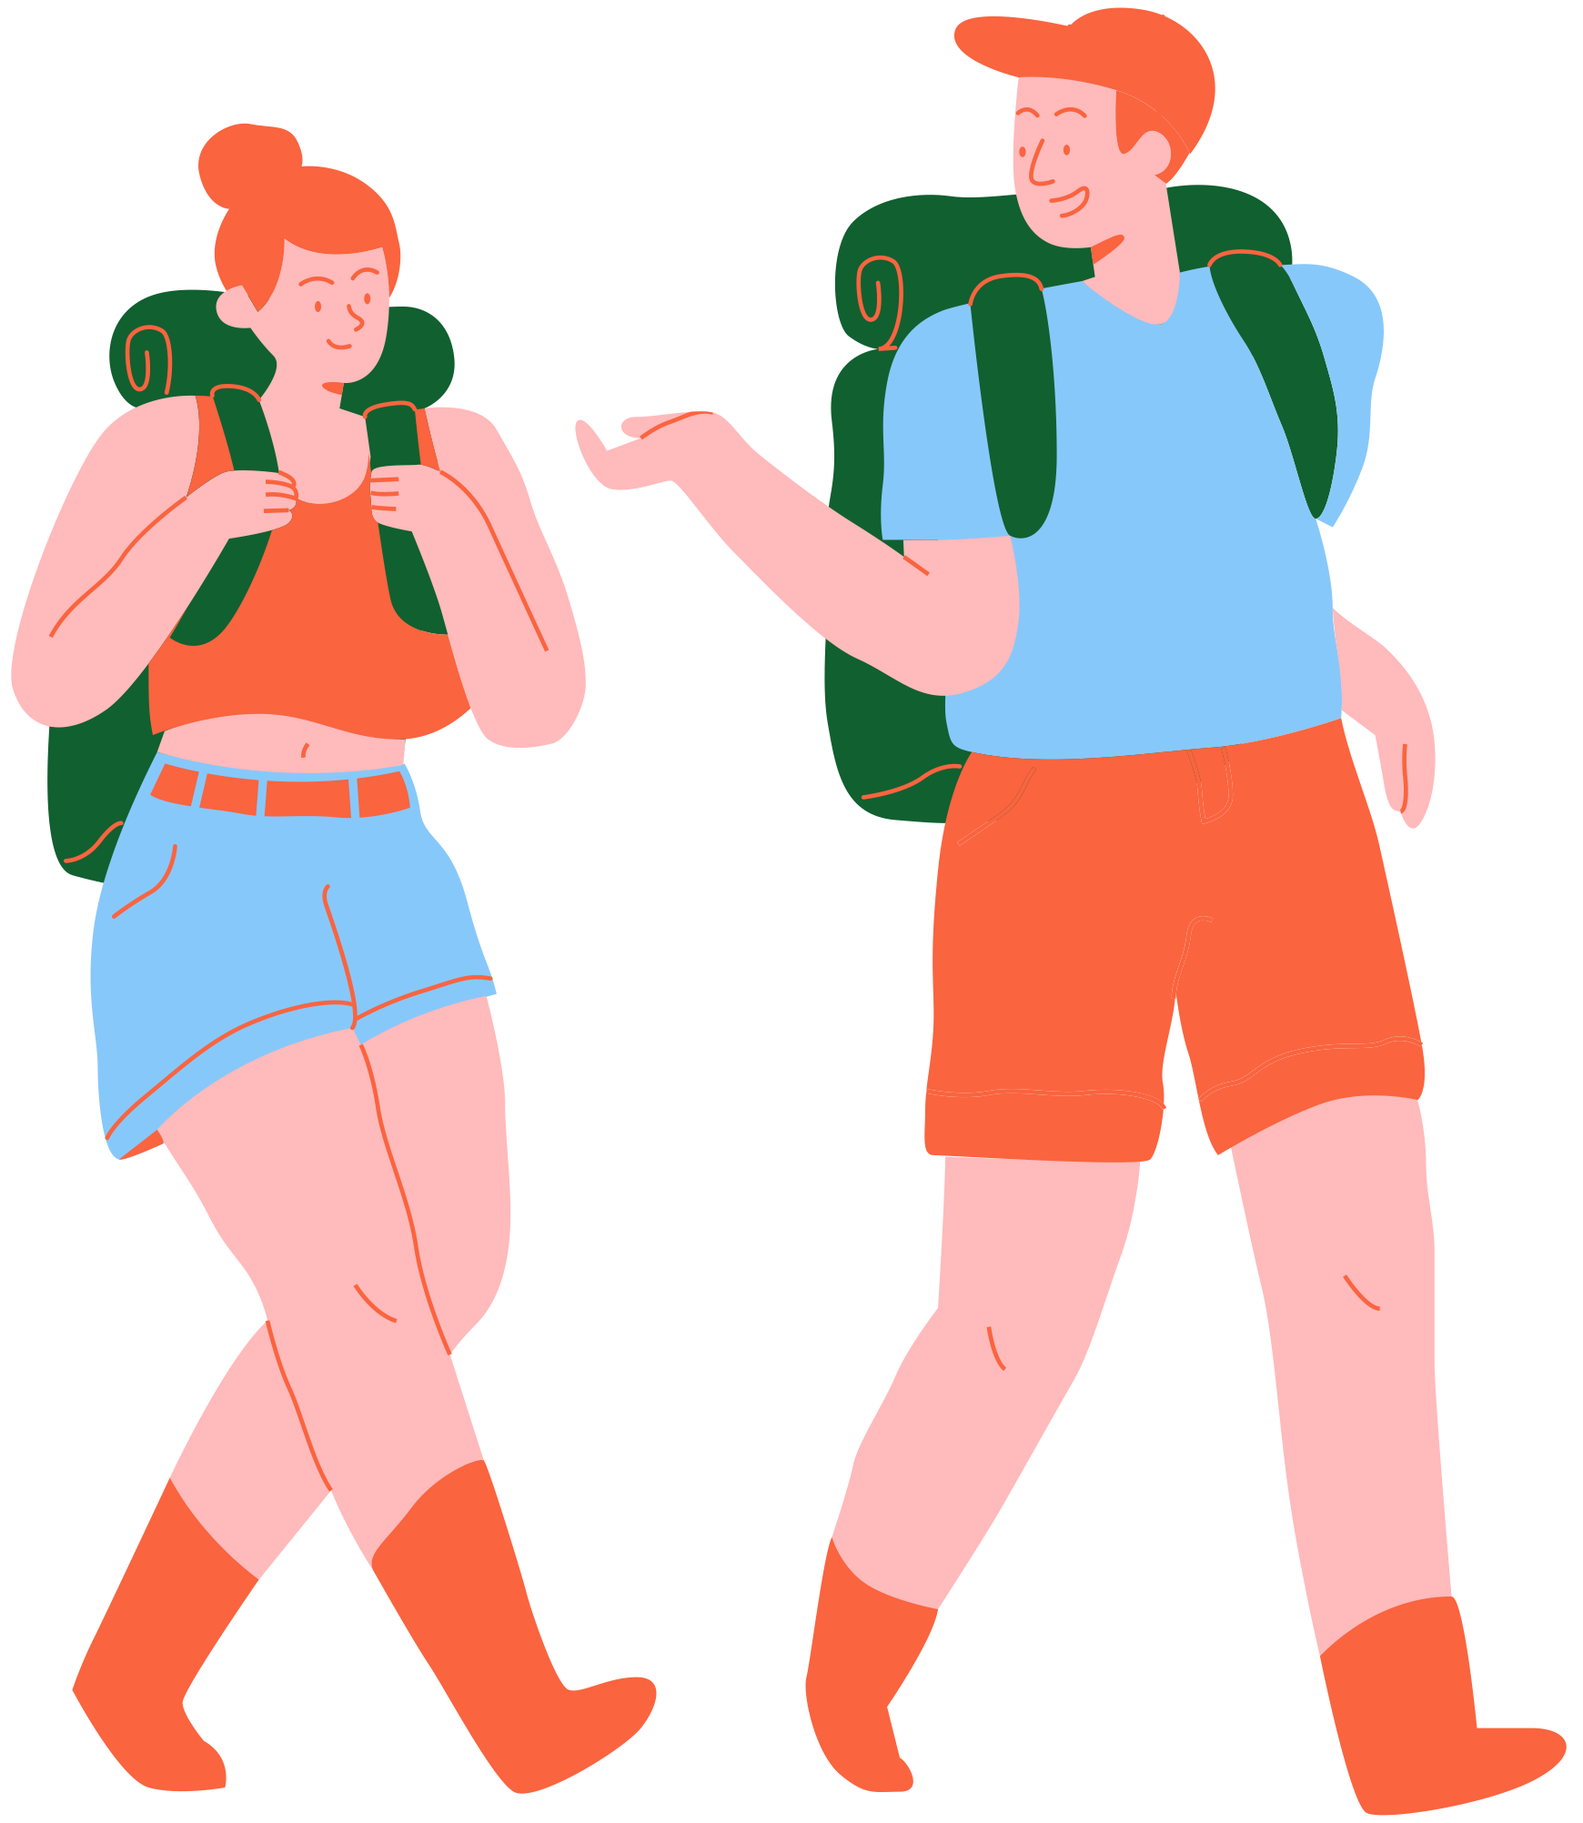
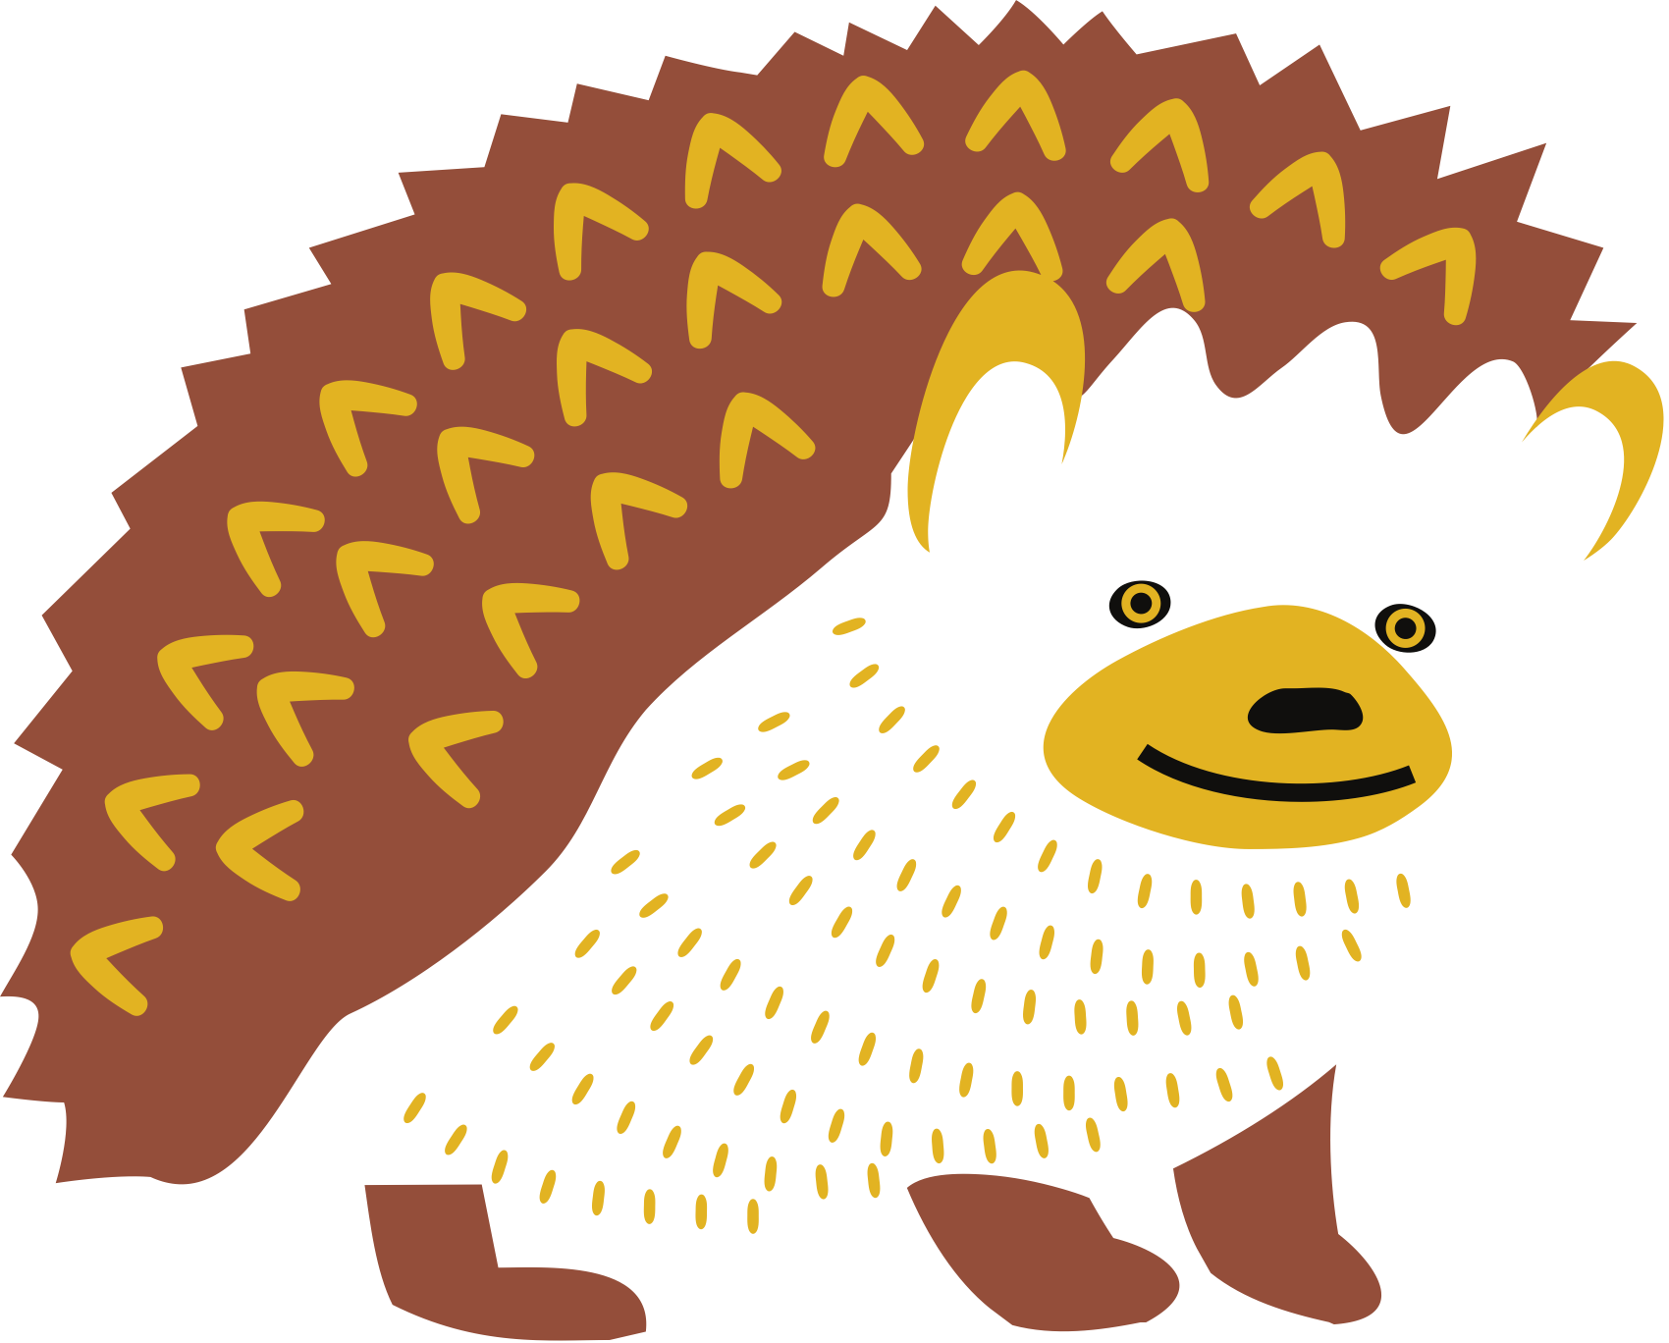
Mission Possible
1. Motivation
2. Mission
3. Materialise
4. Map

