Slide 1
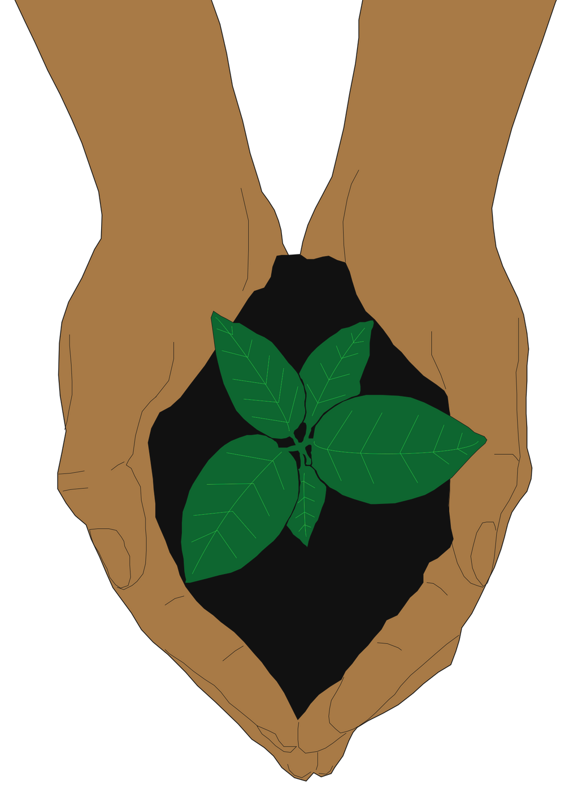
Session 3:
How can we act with love towards our common home?

Slide 2
Today's prayer
Dear God,
We give thanks and gratitude to you as we take this journey towards living more simply and sustainably.
We ask for your blessing as we begin to take action in our school, inspired by the beauty of your creation and guided by ecological virtues.
Praise be to you!
Amen

Slide 3
So far,
How Pope Francis calls all people to be stewards of God's creation in Laudato Si'
The importance of integral ecology as we answer the cries of the Earth and the Poor
What we can do to build a sustainable future in our mission statements.
we've learned

Slide 4
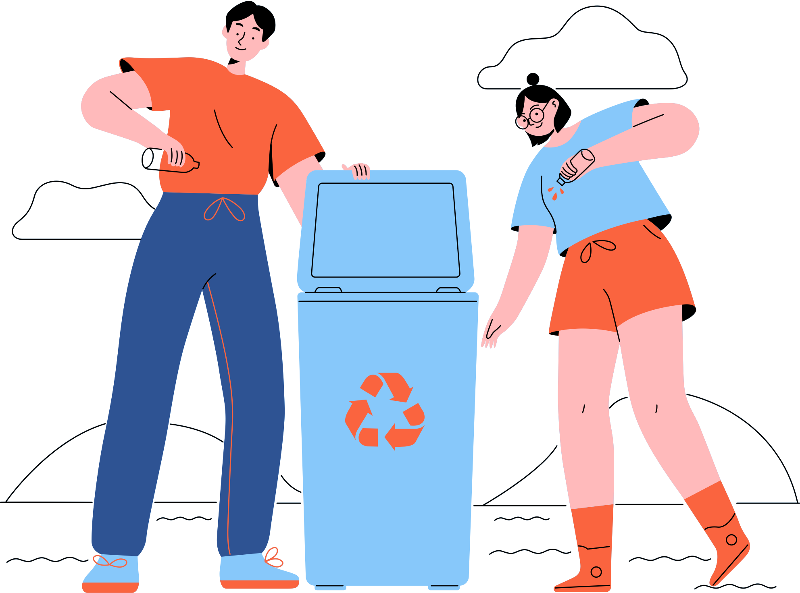
What is a virtue?
"Virtue is a habitual and firm disposition to do good" (CCC, 1833)
"Vices can be classified according to the virtues they oppose" (CCC, 1866)
Too little
(Vice)
Too much
(Vice)
Virtue
Cowardice
Courage
Recklessness
Notes:
Teacher's note: Before students plan their projects, these activities offer a deeper level to Laudato Si'. Virtues help us grow as individuals and in our faith. Encourage students to think about virtues as good habits. They need practice and hard work but ultimately help us do good in the world. This slide explains the difference between virtues and vices using the golden mean from Aristotle. Too much or too little of any quality leads to vice, so it's all about finding a balance.
[5 minutes max]

Slide 5
Virtues and vices
Activity:
Read through the list of words on your worksheet
Circle 3 words you think will help us live more sustainably
Which word is the most important to you?
Write a few sentences about why you think this word is the most important for you.
Underline 3 words you think will make sustainable living more difficult
Which word do you find challenging?
Write a few sentences about how this word impacts your daily life and hinders you from forming sustainable habits.
Notes:
Teacher's note:
This activity helps students understand the difference between virtues and vices in eco-action. Some habits or values allow us to live sustainably. Others make it more difficult. Ask students to consider why their chosen words matter to them. This activity might encourage discussion about why different people value these different qualities.
[15 minutes max]

Slide 6
Seven Catholic Virtues
Faith
Hope
Charity
Theological Virutes
Gifts from God
Belief in God
Trust in God
Love God and each other
Prudence
Justice
Fortitude
Temperance
Cardinal Virutes
Human habits to do good
Wisdom to know what's good
Respect the rights of every person
Courage to keep pursuing what's good
Balance our desires and appetites
Notes:
Teacher's note: For students who are ready to go further, teachers may wish to introduce the seven core Catholic virtues. In Laudato Si', Pope Francis urges us to cultivate ecological virtues. There is no set list of what these ecological virtues are. The theological and cardinal virtues offer a helpful starting point. The following slides view the seven virtues ecologically.
Depending on available time and capacity, this learning material is an optional part of the lesson plan.
[10 minutes max]

Slide 7
Pope Francis:
"Nature as a whole not only manifests God but is also a locus of his presence. The Spirit of life dwells in every living creature and calls us to enter into relationship with him. Discovering this presence leads us to cultivate the 'ecological virtues'. [...]
"Only by cultivating sound virtues will people be able to make a selfless ecological commitment." [...]
"Living our vocation to be protectors of God’s handiwork is essential to a life of virtue; it is not an optional or a secondary aspect of our Christian experience."
(LS, 88; 211; 217)
Cultivating ecological virtues

Slide 8
Cultivating ecological virtues
Pope Francis:
What is Pope Francis saying here?
We see God in nature. God's spirit is part of every living thing. We must practice good habits to strengthen our relationship with God through nature.
We call these good habits virtues. These virtues should help us act selflessly and lovingly towards nature.
For Christians, practising these virtues is not optional. They are important in acting as stewards of God's creation.

Slide 9
Ecological virtues?
Faith
Hope
Belief in God
Trust in God
Understand the beauty and holiness of God's creation and our responsibility as his stewards
Orientate our sustainable actions towards God in praise and gratitude
Charity
Love God and each other
Respect and love the Earth as God's creation

Slide 10
Ecological virtues?
Prudence
Wisdom to know what's good
Justice
Respect the rights of every person
Learn which actions are good for the Earth and its people
Answer the cries of the poor as we build an equal, sustainable future
Fortitude
Courage to keep pursuing what's good
Temperance
Balance our desires and appetites
Keep taking environmental action, even when things get tough
Encourage us to live simply and produce less waste

Slide 11
Your mission, your virtues
Reflection:
Read your mission statement from last session
Consider how your mission statement reflects the virtues
Does your mission statement reflect any of the cardinal or theological virtues?
Which virtues are at the core of your mission?
How do you feel about this reflection?
Reflect on whether you need to change your habits to achieve your mission statement. Why is this?
Notes:
Teacher's note: Teachers may wish to set this activity for homework, provided the class has covered the ecological virtues section. It invites a personal reflection on how the virtues feature in their mission statements from Session 2. Do they need to work on any virtue in particular to achieve their mission?

Slide 12
Planning
your project
Your task is to design a project that cares for our common home, inspired by what we've learnt from Laudato Si'. It must positively impact the environment in your school community. It needs a clear goal that's achievable within the time available.
You will work in a group of no more than 5. In our final session, you will show your project's outcomes to the class in a 5-minute presentation.
Notes:
Teacher's note: It's the moment the students have been waiting for: the projects! This moment is usually filled with excitement in the classroom as the students are ready to start. The following slides have some supportive frames to help focus this energy and structure the planning process in class.
This slide includes a project brief to outline expectations clearly. There is also a planning grid and some ideas to get them started.
[30 minutes max]

Slide 13
The C.A.R.E approach
Consider What will you do to care for our common home? Be as specific as possible and try phrasing your project as a question to offer it a clear focus. | Aim Why do you want to help our common home in this way? Why is it important to you, your group, and your school? Use your mission statements to help create your shared goal
Evaluate After the presentation, where will you take the project next? What are the long-term impacts of your project for you, your school, and your community? | Respond What will you need to achieve this project? How will you obtain this information/resources? How will you achieve it within the timeframe? How will you divide responsibilities between your group?
Notes:
Teacher's note: The C.A.R.E grid offers a planning tool that embeds student projects in Laudato Si'. In its simplest form, the C.A.R.E. model asks students to:
- Consider: What?
- Aim: Why?
- Respond: How?
- Evaluate: What next?
Students should think about how their idea cares for our common home throughout the projects. Each stage prompts students with questions to consider. Note that the grid is also a circular process, promoting a cycle of change rather than a one-off action.

Slide 14
Project ideas
Can we reduce the school's waste and rubbish?
How can we answer the cry of the poor?
How can we engage our peers in sustainability?
How can we bring nature into our school?
Do our school grounds support wildlife?
How do students travel to school?
How can we reduce our carbon footprints?
Where does the school get its food?
Where do we get our school's energy?
Are our school uniforms eco-friendly?
How could we repurpose our school's recycling?
How much water do we waste?
Here are some questions to get you started. Feel free to think of your own!

Slide 15
Example plan
Consider We will care for our common home by organising a wildlife survey on our school grounds, answering the questions "what wildlife do we support?" and "how can our school grounds support local wildlife?". | Aim Our group's mission statements all focus on wildlife because we care about animals and protecting their habitats. Encouraging more wildlife could benefit the whole school, increasing everyone's respect and appreciation for nature.
Evaluate We can repeat our survey in summer to see if we've increased the amount of wildlife on school grounds. We can encourage staff to make the survey a yearly activity to keep a record of our progress. | Respond We will: Complete surveys in the morning to see what wildlife we can see on school grounds Research and implement ways we can support our wildlife, like bird feeders and hedgehog tunnels.

Slide 16
Planning your project
Activity:
Spend a few minutes with your group talking about your mission statements
Which areas of sustainability to you share a common interest in helping?
Brainstorm some ideas for your project.
How can you help care for our common home?
Use the C.A.R.E grid to help your project take shape.
Plan a project timeline.
Which tasks need to happen first? Are any of them time sensitive?
Set a clear goal for what you will achieve by the next session. Divide the tasks equally between you.
Notes:
Teacher's note:
Students can then brainstorm and begin planning their projects with the worksheets provided. In this initial planning session, the aim is for each group to have a concrete idea of what their project will focus on.

