Slide 1
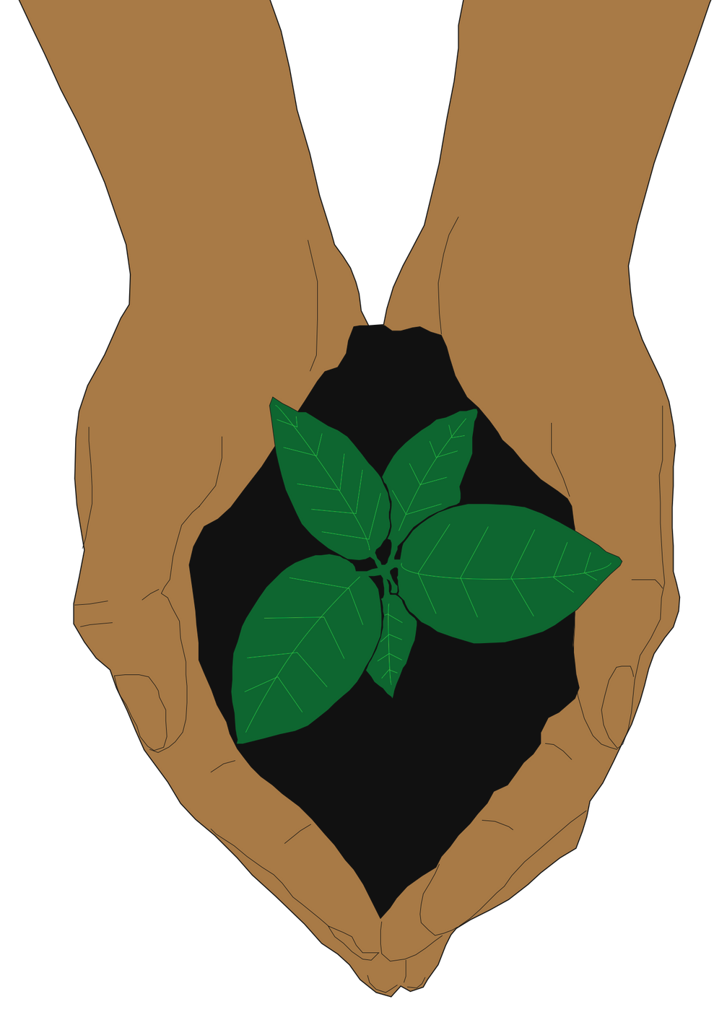
Session 4:
How can we make
a difference?

Slide 2
Today's prayer
Dear God,
Today, we continue to make a difference at our school as we care for our common home. You have guided us as the stewards of your creation, and we give thanks for our growing ecological knowledge as we live Laudato Si' together.
Guide our hearts to act with charity, faith and hope as we continue our mission.
Praise be to you!
Amen

Slide 3
So far,
Key terms from Laudato Si', including stewardship, internal ecology, the cry of the earth and the cry of the poor
Developed a mission statement and reflected on which ecological virtues we need to cultivate
Started to plan our projects to care for our common home
we've learned

Slide 4
Activity:
Recapping Laudato Si'
Watch the CAFOD Laudato Si' video to recap what we've learnt
Write down your thoughts and reflections about the video
Summarise the key ideas in Laudato Si'
Did you learn something new about Laudato Si' from the video?
What does Laudato Si' mean to you?
Discuss your answers with the person next to you
Notes:
Teacher's note:
This activity provides a helpful recap with lots of learning over the first three sessions. The animation from CAFOD gives a concise summary of Laudato Si's key ideas. Teachers may wish to give different groups in the class one question to focus on. This method can invite discussion after watching the video so that students can share their answers.
[15 minutes]

Slide 5
Recapping Laudato Si'
from CAFOD
Link not working? https://youtu.be/o3Lz7dmn1eM

Slide 6
Questions
for discussion
Summarise the key ideas in Laudato Si'
Did you learn something new about Laudato Si' from the video?
What does Laudato Si' mean to you?

Slide 7
The C.A.R.E approach
Consider What will you do to care for our common home? Be as specific as possible and try phrasing your project as a question to offer it a clear focus. | Aim Why do you want to help our common home in this way? Why is it important to you, your group, and your school? Use your mission statements to help create your shared goal
Evaluate After the presentation, where will you take the project next? What are the long-term impacts of your project for you, your school, and your community? | Respond What will you need to achieve this project? How will you obtain this information/resources? How will you achieve it within the timeframe? How will you divide responsibilities between your group?
Notes:
Teacher's note: As students prepare to continue their group work, remind them of the C.A.R.E approach. This prompt can help students to think about Laudato Si' as part of their project.

Slide 8
Project Progress
Activity:
Report back on your progress since the last session
Has everyone completed their allocated tasks?
Plan what you need to do next
What tasks still need to be done?
What are the next stages of your project timeline?
Summarise your goals to achieve by the next session
Who is responsible for each task?
Notes:
Teacher's note:
Students should spend the majority of this session working on their group project. As projects start to take shape, teachers may need to check in with each group to see if they need any support. For instance, if one group investigates how much waste their school produces, teachers might need to contact the school's caretaker.
Teachers may wish to structure this time to give each group clear goals within the class. For example, after 5-10 minutes, teachers can invite each group to report back on their progress to the rest of the class. This approach also helps ensure that each project has a distinct focus while encouraging discussion.

Slide 9
Giving Gratitude
Reflection:
Take a moment to pause and reflect on your project so far
Which aspects of Laudato Si' does your project reflect?
Thinking about your project, write three things that you feel grateful for
Write your thoughts as a prayer or poem, expressing gratitude to God for your blessings
Notes:
Teacher's note: This activity offers a reflective moment for students. It invites them to think about how their projects link to Laudato Si' and find areas they are thankful for in their work.
Teachers may wish to set this as a homework activity. Or, hosting this activity in class can offer a quite moment of reflection and prayer after a busy planning session.

