Slide 1
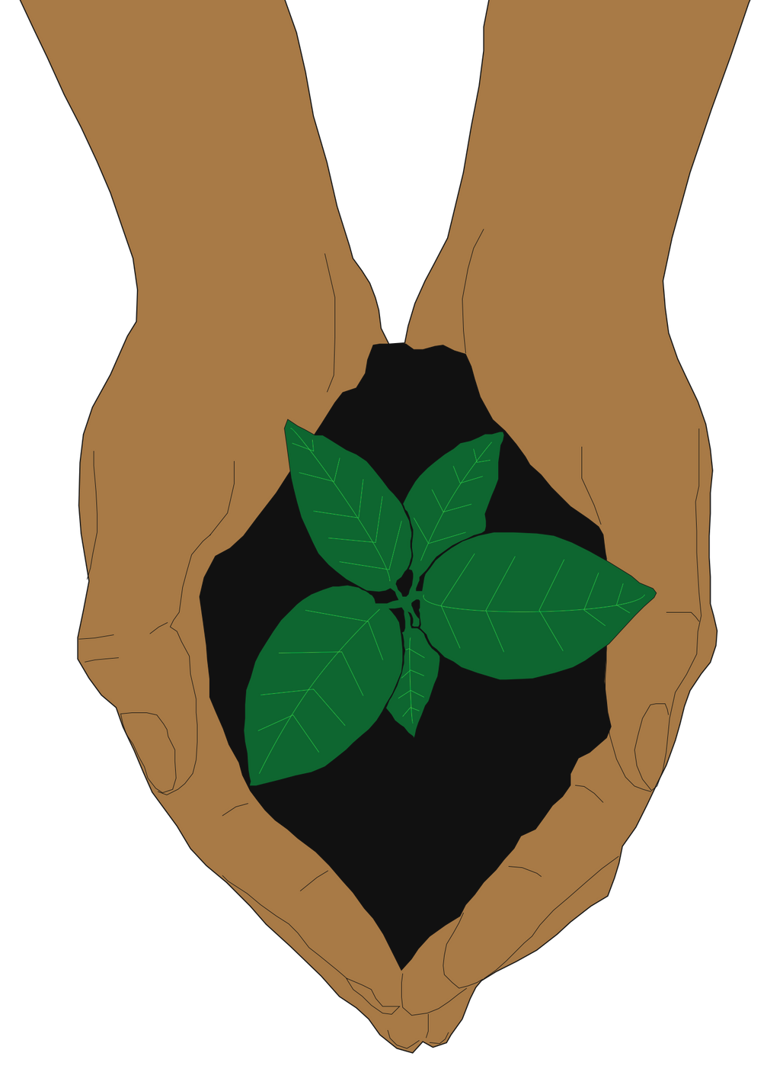
Session 5:
How can we keep making a difference?

Slide 2
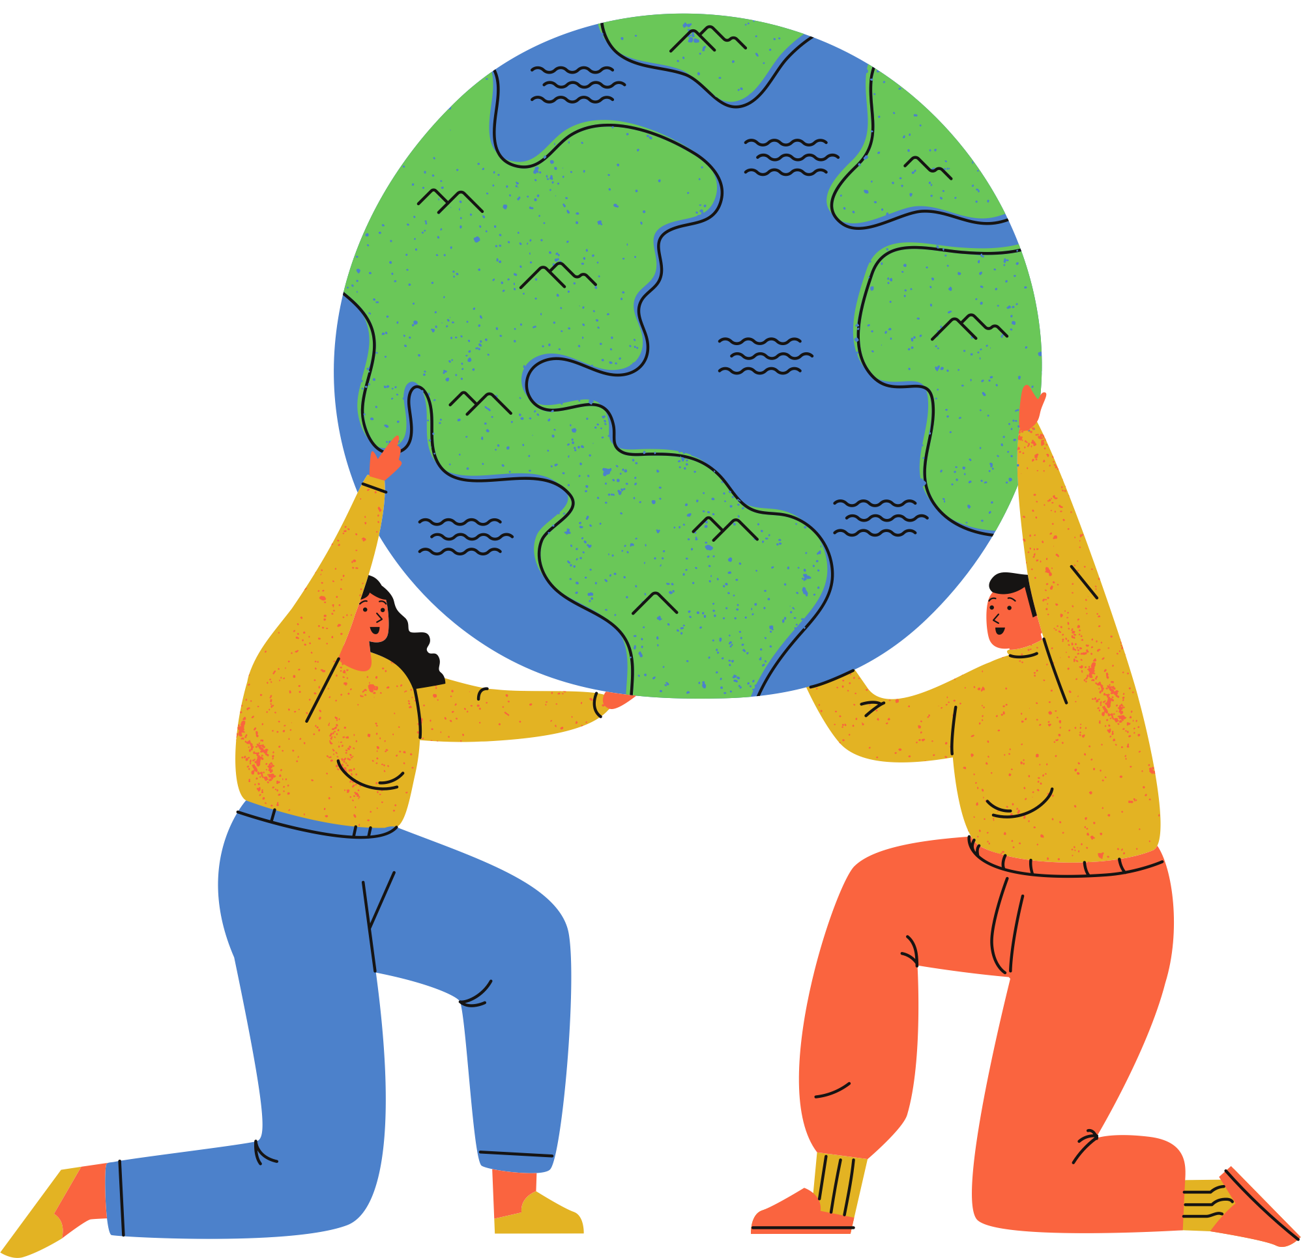
Today's prayer
Dear God,
All-powerful and ever-loving God, we thank you for the gift that is creation. We see your wonder and grace in everything from the smallest seed to the mightiest tree.
As we celebrate your beautiful creation, the Earth, fill us with hope and love as we cultivate a sustainable future through our work.
Praise be to you!
Amen

Slide 3
So far,
What Laudato Si' means and the key ideas Pope Francis gives us in his letter
Planned and started our projects to care for our common home
Reflected on what we're grateful for as we progress with our projects
we've learned

Slide 4
Activity:
Imagining an Eco-School
Imagine your school in 5 years winning an award for being the most environmentally friendly school in the country
What changes have taken place in this time for your school to reach this achievement?
Here are some areas to consider:
Energy
Food production
Education
Spirituality
Transport
School uniforms
Technology
Nature
Waste and recycling
Make a drawing of your eco-school- be as creative and colourful as you'd like!
Notes:
Teacher's note: This starter activity is a great way to get students to imagine what's possible in sustainability. There are endless possibilities here, so encourage some out-of-the-box thinking. Students might wish to get creative and draw their eco-school.
The following slide has some ideas they may wish to consider in planning this dream school. Teachers may ask students why these changes haven't happened yet to prompt further discussion.
[15 minutes max]

Slide 5
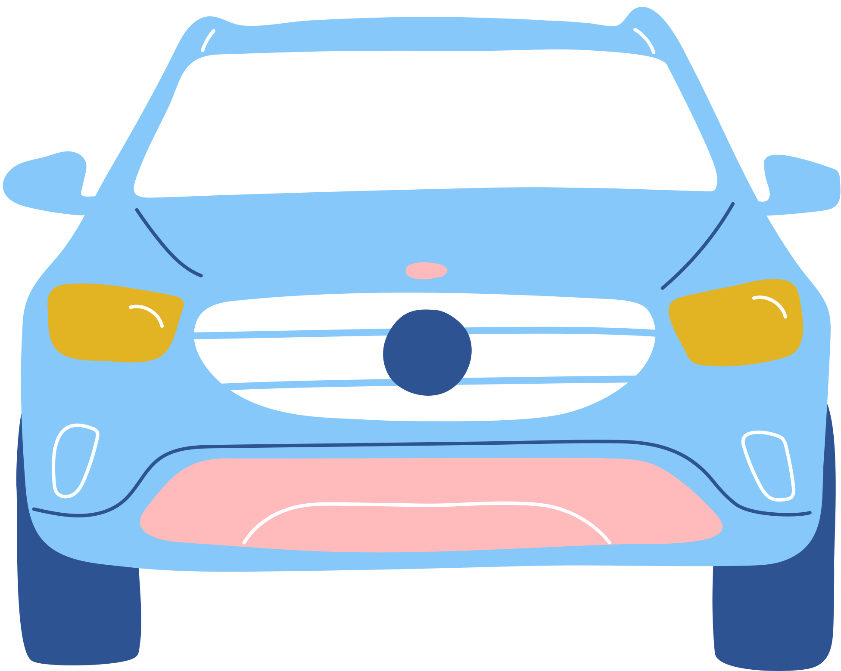
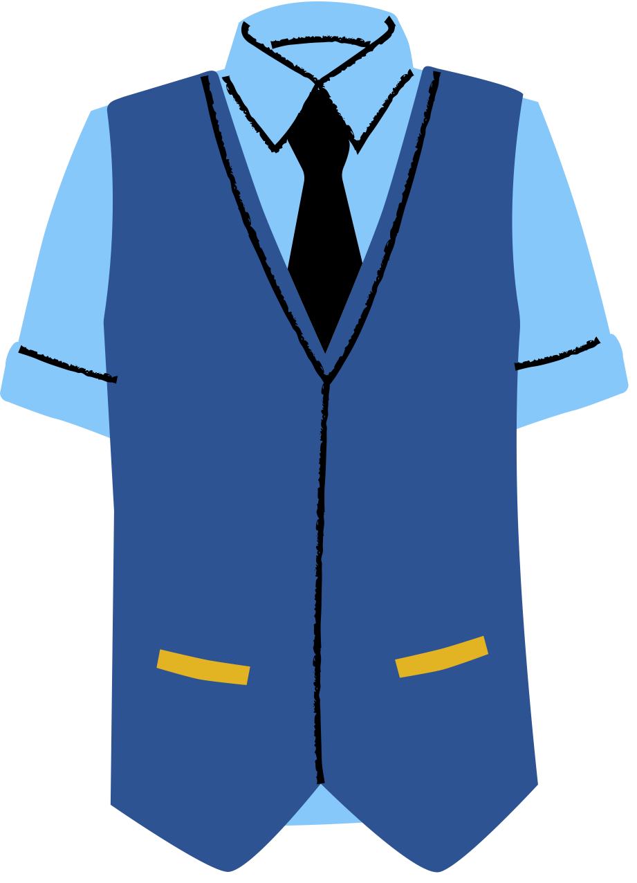
Imagining an eco-school
Renewable energy
Eco-curriculum
Bringing nature indoors
Outdoor worship
Compost toilets
Beekeeping
Garden to grow food
Plant-based menus
Carpooling groups
Zero-waste school
Sourcing food locally
Technology-free classroom
Second-hand uniforms
On-site recycling

Slide 6
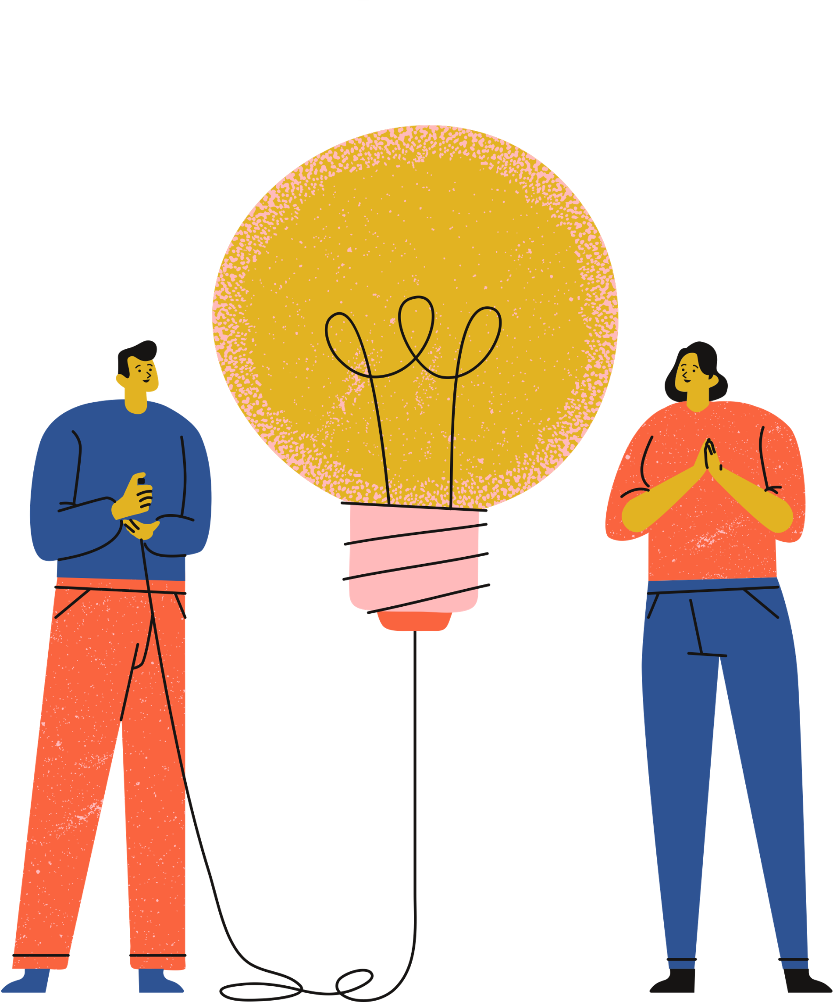
Planning
your presentation
Maximum of 5 minutes
Slides are optional
Everyone must contribute!
Notes:
Teacher's note:
In this session, the projects should begin moving towards their reflective presentations. This presentation planning utilises the same C.A.R.E framework from the previous session.
Encourage students to think creatively for their presentations. Poster presentations, slideshows, or videos work well in these settings.
Turning these presentations into committee meetings can foster collaboration between students. This format works well in smaller extracurricular eco-clubs.
[45 minutes max]

Slide 7
What should we include?
Consider- What did you do?
What did you do to care for our common home?
Aim- Why did you do it?
Link this to Laudato Si'
Why is this topic important in your school?
Respond- How did you do it?
What went well?
Did you face any barriers/problems?
Evaluate- What will you do next?
Think about the long-term impacts for your school

Slide 8
Planning your presentation
Activity:
Report back on your progress since the last session
Has everyone completed their allocated tasks?
Is there anything you still need to complete to finish your project?
Begin planning your presentation
Use the C.A.R.E. model to address the presentation's key questions
Summarise your goals to achieve by the next session
Equally divide the responsiblities between the members of your group
Notes:
Teacher's note: Much like session 3, this activity slide can help structure the time dedicated to student projects. The opening report supports the expectation for progress between sessions. The C.A.R.E. model offers a familiar planning structure for students as their projects move into the next phase.

Slide 9
Faith and the climate
Reflection:
Read the extract from Laudato Si' on your worksheet
What is Pope Francis saying here? Summarise his argument in your own words.
Reflect on the role of your beliefs in responding to climate change
Is religion important in addressing climate change? Why/why not?
Notes:
Teacher's note: This activity works well as a homework activity or an alternative starter activity. It helps build reading comprehension with students as they read an extract from Laudato Si'. In the process, they explore connections between climate change and religion. They may also reflect on their personal beliefs about faith and the climate.

