Slide 1
A Place for Older People –Finding Community
Sister Mary Considine and Thomas Gillespie

Slide 2
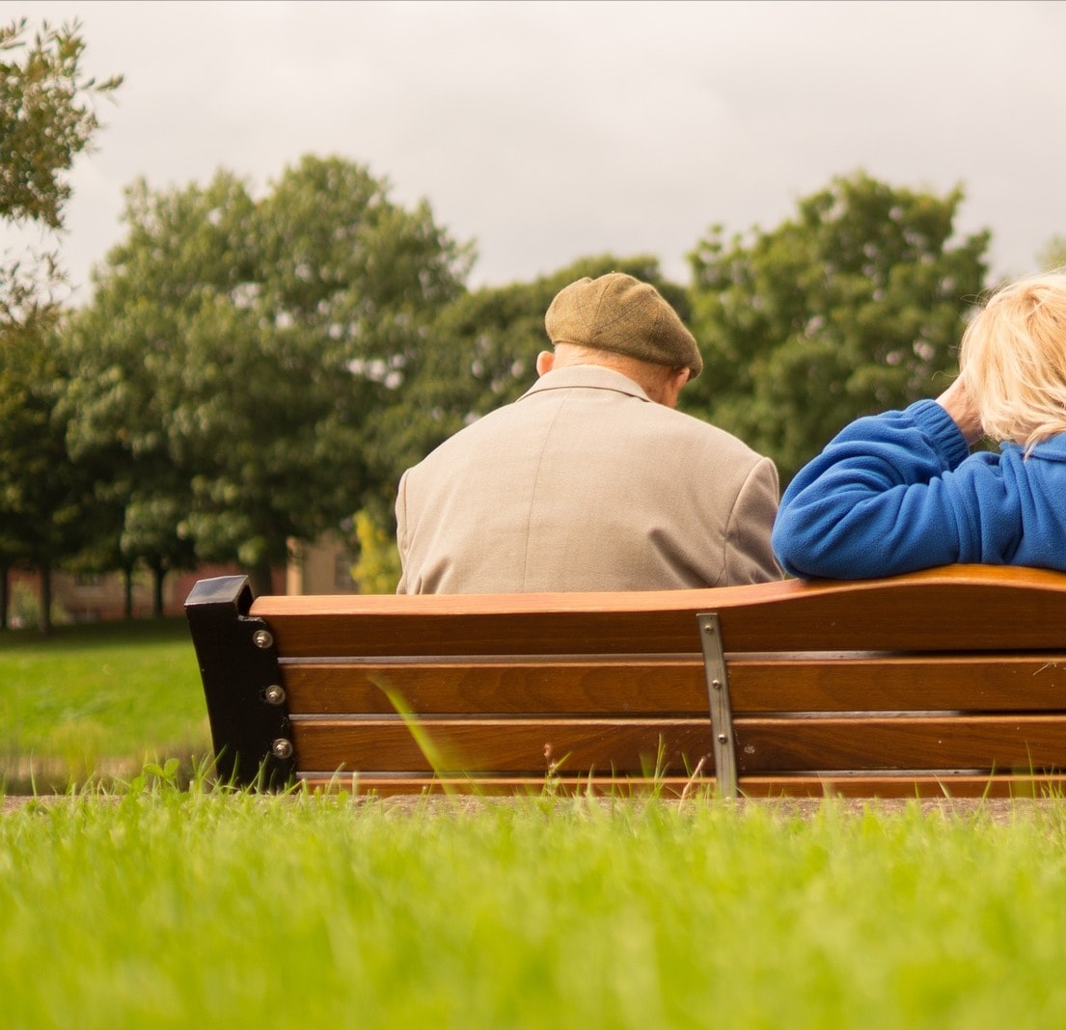
Objectives for the Session
Older people in the parishes of England and Wales
Key facts to consider – The Poverty of Loneliness
Vincentian social action
How is the Church responding
A spiritual and social awareness

Slide 3
Vincentian Informed Work
Our vision, which is inspired by Christ’s message to love our neighbour as ourselves and recognising the innate dignity of each person, is that we enable older people to have more of the social connections they would like.

Slide 4
The Poverty of Loneliness
The breakdown of community - individuals living alone – choice and circumstance
Social and economic pressure – including the challenge to pensions and payment for car
SVP are finding that younger people in the church do not have time to support. 85% of our current Conference membership reflects a 56+ age profile.
Campaign to end Loneliness - a challenge for the church

Slide 5
Older people growing lonely
A recent report by The Campaign to end Loneliness estimates that there are over 1.1m people aged over 65 in the UK who are chronically lonely. The Missing Million: In search of the loneliest in our communities: The Campaign to End Loneliness (2016)
According to the King’s Fund, by 2032 11.3 million people are expected to be living on their own, more than 40 per cent of all households, and the number of people over 85 living on their own is expected to grow from 573,000 to 1.4 million Time to Think differently: A programme of work by the King’s Fund (2012/13)
Older households are projected to increase more quickly than younger ones: those headed by persons aged 65 and over are projected to increase by 162,000 per year while ‘85 and over’ households’ are projected to increase by 57,000 per year.

Slide 6
Dementia
At least 850,000 people in the UK living with dementia, this will reach 1 million by 2025.
Estimated 46 million worldwide.
1 in 6 people over 80 have dementia.
40,000 people in the UK under 65 have dementia and this is increasing.
Dementia affects disability in older age ahead of cancer, stroke and heart disease yet as a county we spend much less on dementia than the other conditions.

Slide 7
How is the Church Responding
Pope Francis says "A people that does not have care for the elderly, that does not treat them well, has no future: such a people loses its memory and its roots."
Parishes see an aging population and ageing clergy with smaller and smaller support networks - Churches as a place of welcome and inclusion.
In 2015/16 SVP members undertook over 346,000 visits to older people, whether in their own homes or in residential care
In England and wales we have the new Embrace partnership led by CSAN, Caritas, SVP, Fr Hudson and Catholic care across 4 dioceses in England

Slide 8
Embrace Pilot
Embrace ‘s goal is to enable older people to make new friends and will value every individual
Build a community that offers hope and reduces isolation
Hosting holistic co-produced activities with parishes
A platform for the needs of older people to be recognised and resilience built
Run in partnership with volunteers and existing parish older people networks to provide a “Toolkit” that can be shared

Slide 9
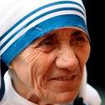
The life of the spirit
Importance of giving older people their place within the Church
.

Slide 10
Life of the Spirit
Gift of true joy.

Slide 11
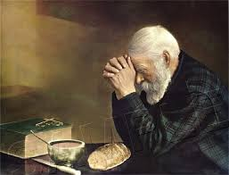
Stay Calm and wait on the Lord
The older person, an example of holiness.

Slide 12
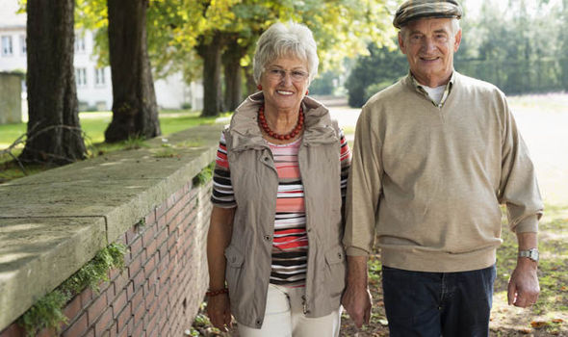
Ministers – Prayer Partners to the young
Giftedness of the Older Person.
Contemplating the Lord in our lives
Receivers of Mission.

Slide 13
The Wisdom of age
Older men and Women of the Scripture.
Sarah and Abraham - The leap of faith
Anna and Simeon in the gospel of Luke 2. 21 -38

Slide 14
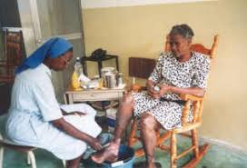
Caregivers because of their years of experience

Slide 15
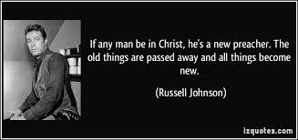
Preparing for the final journey.

Slide 16
Any Questions

